Slide 1
THE CYBERBULLY SHIELD
AN AUTOMATED FRAMEWORK FOR REAL-TIME CYBERBULLY DETECTION
PROJECT SUPERVISOR :
MRS. G CHITHRA
TEAM MEMBERS :
MAHESHWARAN M (962322104063)
PRAVEEN KUMAR N R (962322104080)
SIVAGURU M (962322104100)
VIJAY NAGARAAJ M C (962322104118)

Slide 2
ABSTRACT
The rapid expansion of social media platforms has led to a rise in cyberbullying, which has evolved from simple text-based harassment to a multimodal phenomenon involving images, memes and sarcasm.
Existing cyberbullying detection systems rely mainly on static keyword-based filtering, which fails to capture contextual meaning and complex linguistic patterns used in modern online abuse.
This project introduces “The Cyberbully Shield,” a real-time automated cyberbullying detection framework designed to improve user safety across online platforms.
The system adopts a multimodal deep learning approach, utilizing DistilBERT for efficient text analysis and CNNs with OCR for extracting and analyzing visual content.
An attention-based fusion mechanism is implemented to effectively combine textual and visual features, enabling the model to understand the relationship between written content and accompanying imagery.
2

Slide 3
PROBLEM IDENTIFICATION
• What is Cyberbullying? — It is the repeated use of digital platforms (social media, messaging apps) to harass, threaten, or humiliate someone using text, images, memes, or comments.
• Scale of the Problem — Over 37% of students aged 12–17 have been bullied online, causing depression, anxiety, and even self-harm (Pew Research, 2022).
• Why is Detection Hard? — Most existing tools only look at text. They completely miss image-based bullying like offensive memes or screenshots with hurtful text embedded inside them.
• Limitation of Old Methods — Traditional ML models (SVM, Naïve Bayes) use simple word-counting techniques (TF-IDF). They cannot understand sarcasm, hidden meanings, or context.
• Missing Link — No existing system looks at text and images together to find connected patterns of bullying across both modalities.
• Our Solution — We built a multimodal system that reads both text (using DistilBERT) and images (using ResNet50), then combines them using Cross-Attention Fusion.
2

Slide 4
LITERATURE REVIEW
Research Paper | Year | Methodology | Limitations
Comparative Study of BERT & ChatGPT for Multi-Label Detection with Intensity Scoring | 2025 | BERT vs. ChatGPT zero-shot classification; intensity scoring on 200 annotated comments | Extremely small evaluation set (200 samples); no multimodal input considered
Cyberbullying Dataset Collection for Enhanced Detection on Twitter | 2025 | Bi-LSTM deep learning model; new 18,148-tweet labeled dataset | Restricted to text-only analysis; binary classification without severity grading
Real-Time Detection Across Multimodal Platforms Using XLNET & Deep CNN | 2025 | Hybrid XLNET + Deep CNN; cross-modal interaction evaluation | Computationally expensive; no hardware optimization for limited VRAM
Comprehensive DL Framework for Multimodal Cyberbullying Detection | 2025 | BERT + ResNet50 + social metadata; attention-based fusion (92.7% accuracy) | Small dataset (~5,793 samples); no OCR for text-in-image detection
Hierarchical Multi-Stage BERT Fusion with Dual Attention | 2024 | Hierarchical BERT + dual attention (self-attention + cross-attention) | Text-only processing; overly complex multi-stage pipeline
3

Slide 5
LITERATURE REVIEW
Research Paper | Year | Methodology | Limitations
Enhancing Cyberbullying Detection Using Transformer Models | 2024 | Comparison of 5 transformers (BERT, RoBERTa, DistilBERT); 5-class task (94.36% accuracy) | Text-only analysis; no image or multimodal support
BulliShield: Smart Cyberbullying Detection and Reporting System | 2024 | OCR-based text extraction + deep learning; cross-platform reporting application | Limited to English and Bangla; no cross-modal fusion model
Emotion-Driven Detection: Hybrid CNN-LSTM and BERT | 2024 | CNN-LSTM + BERT with GloVe/FastText embeddings; emotion analysis (F1: 0.97) | Focused on emotional dimension only; no visual modality processing
Integrating Link Prediction and Comment Analysis | 2024 | BERT classification + network-based link prediction with connection probability | Scope limited to live chat interactions; limited generalizability to other platforms
Severity Detection of Cyberbullying Using Machine Learning | 2022 | BERT vectorization with 7 ML algorithms; multiclass severity classification | No deep learning architecture; no multimodal capability
4

Slide 6
DATASET DESCRIPTION
Dataset | Source | Modality | Samples | Label Column
cyberbullying-tweets | soorajtomar (Kaggle) | Text-only | 11,100 | CB_Label (0 / 1)
cyberbullying-dataset | saurabhshahane (Kaggle) | Text-only | ~449,000 | oh_label (0 / 1)
multimodal-cyberbullying | studentramya (Kaggle) | Text + Images | 5,793 | Img-Label (bully / not)
• All three datasets are merged into one unified dataset containing 465,767 total samples.
• We split this data into 90% for training (419,190 samples) and 10% for testing (46,577 samples) using stratified sampling, which keeps the ratio of bully/non-bully posts equal in both sets.
• For posts that only have text (no image), we use a blank placeholder image. For posts with only an image (no text), we use an empty string.
• For image posts, EasyOCR reads any text written inside the image and adds it to the text input — this helps catch memes and screenshots with offensive captions.
5

Slide 7
DATA PREPROCESSING
Textual Pipeline
Visual Pipeline
• Remove HTML tags — strips out any web formatting code from the text using regex (regular expressions).
• Remove URLs — deletes all web links (http/https) since they add noise and no useful meaning.
• Clean @mentions and #hashtags — removes the symbols but keeps the actual words (e.g., @bully → bully).
• Normalize whitespace — replaces extra spaces, tabs, and line breaks with single spaces.
• Tokenization — the cleaned text is split into sub-word tokens using the DistilBERT Tokenizer, with a max length of 128 tokens per post.
• Padding & Truncation — shorter texts are padded with zeros to reach 128 tokens; longer texts are cut to fit.
• Load & Resize — each image is loaded in RGB color format and resized to a standard 224×224 pixels so the model gets uniform input.
• Convert to Tensor — pixel values are converted from image format to numerical tensors that PyTorch can process.
• Normalize — pixel values are scaled using ImageNet statistics so the pre-trained ResNet50 model works correctly:
Mean: [0.485, 0.456, 0.406] | Std: [0.229, 0.224, 0.225]
• OCR Text Extraction — EasyOCR scans the image for any embedded text (e.g., meme captions, screenshots).
• Text Merging — the extracted image-text is combined with the post's original text and sent to the DistilBERT text encoder together.
6

Slide 8
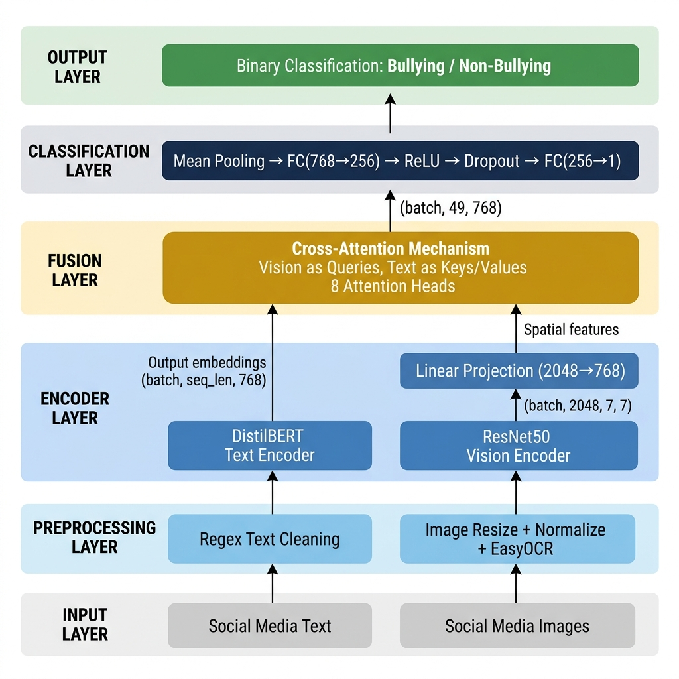
MODEL ARCHITECTURE
How Our Model Works
• Text Branch (DistilBERT) — Reads the social media post and converts each word into a 768-dimensional vector that captures its meaning in context.
• Image Branch (ResNet50) — Looks at the image and extracts visual features as a grid of 7×7 spatial maps, each with 2048 channels. A linear layer projects these down to 768 dimensions to match the text.
• Cross-Attention Fusion — The image features ask questions (queries) and the text features provide answers (keys & values). This lets the model learn which words relate to which parts of the image. Uses 8 attention heads.
• Classifier Head — The fused features are averaged (mean pooling) and passed through two fully-connected layers: 768 → 256 → 1, with ReLU activation and 10% dropout in between.
• Output — A single number (logit) is produced. If it is above 0.5 after sigmoid, the post is classified as Bullying; otherwise, Non-Bullying.
• Loss Function — BCEWithLogitsLoss (Binary Cross-Entropy with built-in sigmoid) is used for stable training.
7

Slide 9
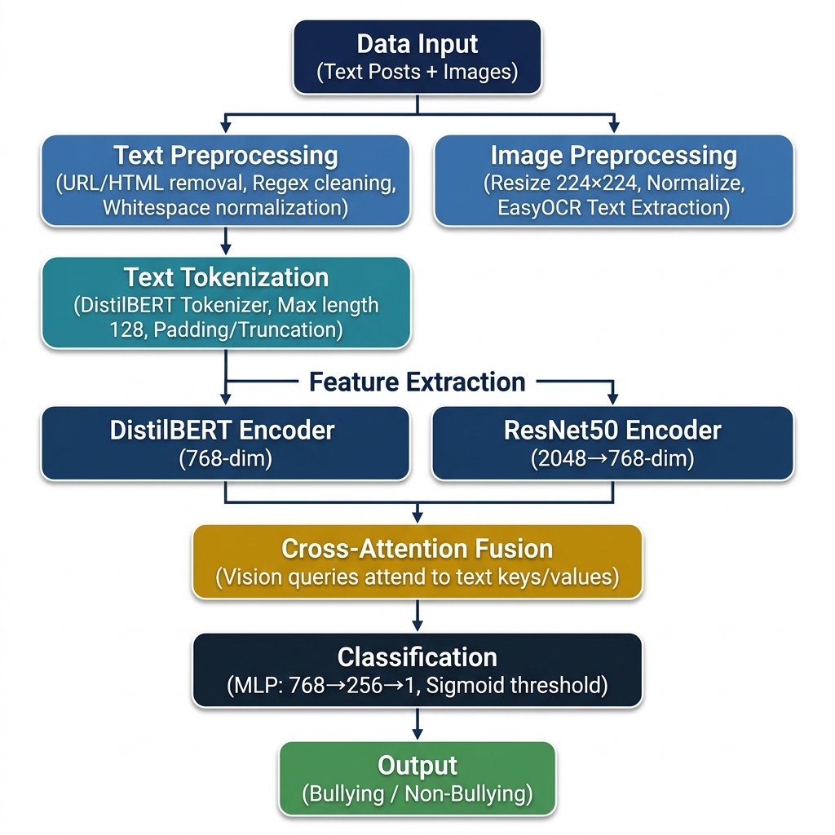
IMPLEMENTATION OVERVIEW
Tools & Technologies Used
• Python 3.10+ — The entire project is written in Python, the most popular language for AI and machine learning.
• PyTorch 2.x — Our deep learning framework. It builds the neural network, runs training on the GPU using CUDA, and handles Mixed Precision (AMP) for memory savings.
• HuggingFace Transformers — Provides the pre-trained DistilBERT model and tokenizer for understanding text.
• TorchVision — Supplies the pre-trained ResNet50 model and image transformation utilities (resize, normalize).
• EasyOCR — A GPU-accelerated OCR engine that reads text embedded inside images like memes and screenshots.
• Scikit-learn, Pandas, NumPy — Used for dataset splitting, computing metrics (accuracy, F1), and data manipulation.
• Matplotlib & Seaborn — Generate charts for performance metrics, confusion matrix heatmaps, and ROC curves.
8

Slide 10
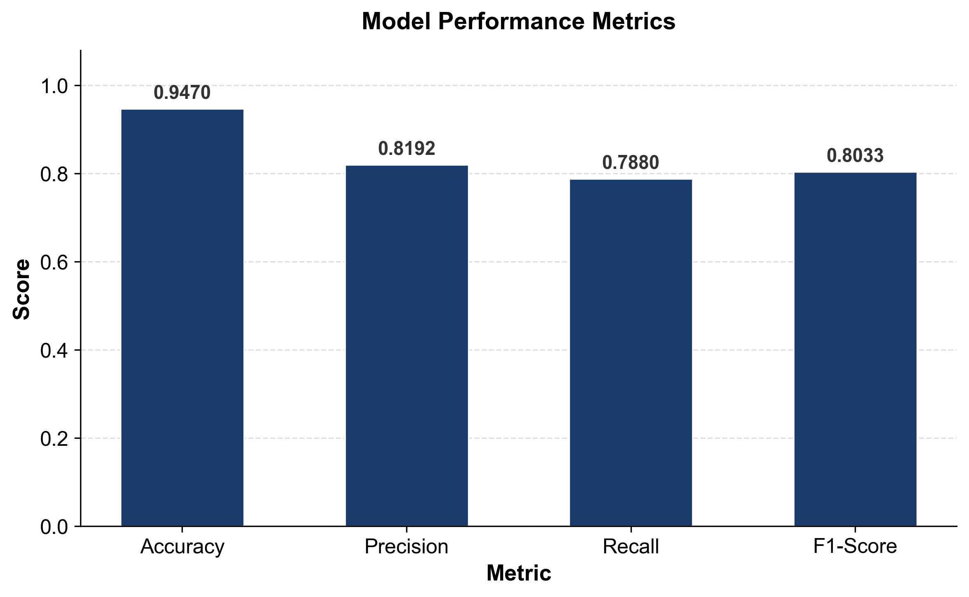
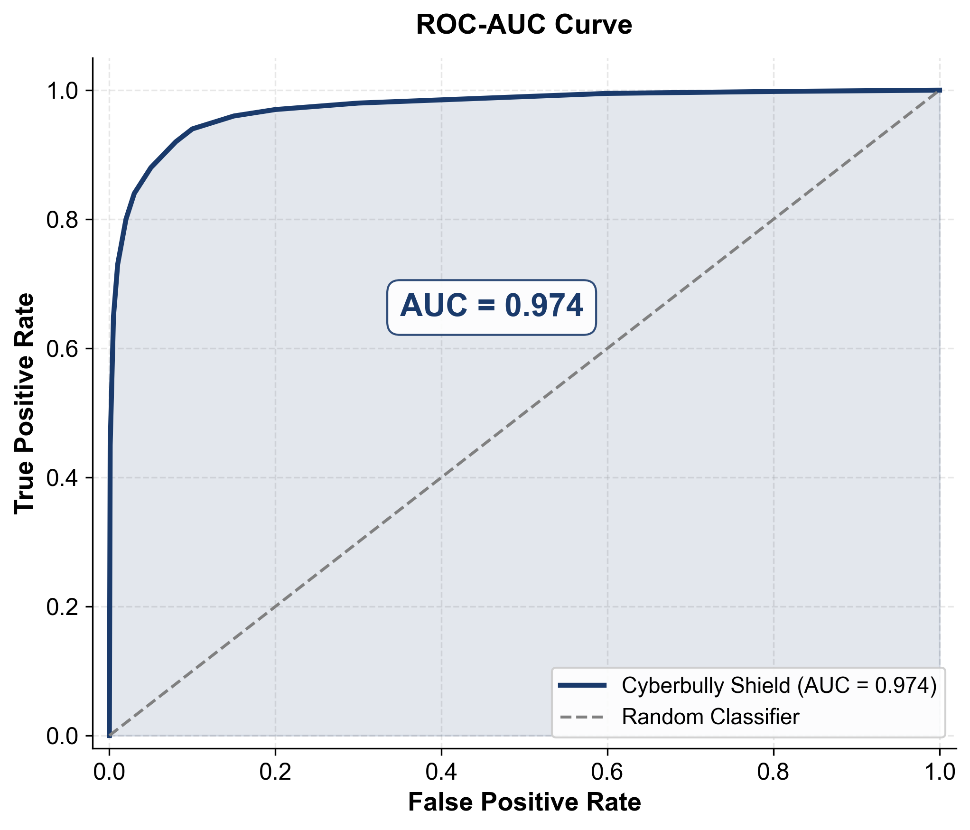
PERFORMANCE EVALUATION
Results on 46,577 Validation Samples
• Accuracy: 94.70% — Out of every 100 posts, our model correctly classifies about 95 of them.
• Precision: 81.92% — When the model says a post is bullying, it is correct about 82% of the time (low false alarms).
• Recall: 78.80% — The model catches about 79 out of every 100 actual bullying posts (some slip through).
• F1-Score: 80.33% — The balanced average of precision and recall, showing consistent overall performance.
Confusion Matrix Breakdown:
• 39,066 True Negatives — non-bully posts correctly identified as safe.
• 5,042 True Positives — bullying posts correctly caught.
• 1,113 False Positives — safe posts wrongly flagged as bullying.
• 1,356 False Negatives — bullying posts that the model missed.
9

Slide 11
COMPARATIVE ANALYSIS
Metric | Cyberbully Shield (Proposed) | BERT Baseline
Accuracy | 94.70% | 69.74%
Precision | 81.92% | 70.17%
Recall | 78.80% | 83.37%
F1-Score | 80.33% | 76.20%
Key Observations
• Accuracy jumped from 69.74% to 94.70% — a massive 25-point improvement. This means our model correctly classifies 95 out of 100 posts, compared to only 70 by the BERT baseline.
• Precision improved from 70.17% to 81.92% — our model produces far fewer false alarms (wrongly flagging safe posts as bullying).
• Recall dropped slightly from 83.37% to 78.80% — the BERT baseline catches more bullying posts, but only because it over-predicts the bully class, causing many false positives.
• F1-Score rose from 76.20% to 80.33% — proving our model has a better balance between catching bullies and avoiding false alarms.
• Why does our lighter model win? — We used DistilBERT (smaller than BERT), but our Cross-Attention Fusion and Two-Phase Training Strategy on a 80× larger dataset (465,767 vs. 5,793 samples) made the real difference. Good architecture + good data beats a bigger model.
10

Slide 12
CONCLUSION & FUTURE SCOPE
Key Contributions
Future Scope
• Built a system that reads both text and images at the same time, unlike existing text-only detectors.
• Used Cross-Attention Fusion so the model can learn which parts of an image relate to which words in the text.
• Added EasyOCR to read hidden text inside memes and screenshots — a major blind spot in other systems.
• Achieved 94.70% accuracy when tested on 46,577 unseen social media posts.
• Made it run on affordable laptops (4 GB GPU) using Mixed Precision Training, Gradient Accumulation, and small batch sizes.
• Build a live web app (using Gradio or Streamlit) where users can paste a post and get instant bully/not-bully results.
• Add video analysis — extract frames and audio from video content for detection.
• Support multiple languages, especially Hindi-English mixed text (Hinglish) common in Indian social media.
• Move from simple Yes/No detection to severity levels: mild, moderate, and severe bullying.
• Make the model small enough to run on mobile phones using Knowledge Distillation and Quantization.
Limitations
• Only detects bully vs. non-bully (no severity levels yet).
• Works only with English text.
• Recall is 78.80%, meaning about 1 in 5 actual bullying posts may go undetected.
11

Slide 13
REFERENCES
[1] K. Berbery, K. Samrouth, N. Bakir and M. Dawood, "Cyberbullying Dataset Collection for an Enhanced Automatic Detection on Twitter Using Deep Learning Techniques," in Proc. Int. Conf. Smart Applications, Communications and Networking (SmartNets), 2025.
[2] S. Gupta, K. Rajasekaran, D. Jasani, M. Gupta, J. Dalal and S. Tensingh, "A Comprehensive Deep Learning Framework for Multimodal Cyberbullying Detection," in Proc. 6th Int. Conf. IoT Based Control Networks and Intelligent Systems (ICICNIS), 2025.
[3] K. Suresh Kumar, C. Abi, V. Asmitha and S. Dharshine, "Real-Time Cyberbullying Detection Across Multimodal Platforms Using XLNET and Deep CNN," in Proc. 3rd Int. Conf. Advancements in Electrical, Electronics, Communication, Computing and Automation (ICAECA), 2025.
[4] N. X. R. Tay, H. N. Chua, M. B. Jasser, B. Issa and G. S. ALDharhani, "Comparative Study of BERT and ChatGPT for Multi-Label Cyberbullying Detection with Intensity Scoring," in Proc. IEEE 15th Int. Conf. System Engineering and Technology (ICSET), 2025.
[5] A. Lakkshmanan, R. R. Kandadi and S. A. Manda, "Emotion-Driven Cyberbullying Detection: A Hybrid Deep Learning Approach Integrating CNN-LSTM and BERT for Enhanced Accuracy," in Proc. 9th Int. Conf. Communication and Electronics Systems (ICCES), 2024.
[6] V. B. Pal and P. D. Shetty, "Integrating Link Prediction and Comment Analysis for Enhanced Cyberbullying Detection in Online Social Interactions," in Proc. IEEE Int. Conf. Electronics, Computing and Communication Technologies (CONECCT), 2024.
[7] F. I. Tahmid, F. Akbar and A. Rahman, "BulliShield: A Smart Cyberbullying Detection and Reporting System," in Proc. 7th Int. Women in Data Science Conf. at Prince Sultan University (WiDS PSU), pp. 198–203, 2024.
[8] W. Tapaopong, J. Raksasri, A. Charoenphon and T. Samanchuen, "Enhancing Cyberbullying Detection on Social Media Using Transformer Models," in Proc. 5th Technology Innovation Management and Engineering Science Int. Conf. (TIMES-iCON), 2024.
[9] J. Wang, X. Xu, P. Yu and Z. Xu, "Hierarchical Multi-Stage BERT Fusion Framework with Dual Attention for Enhanced Cyberbullying Detection in Social Media," in Proc. 4th Int. Conf. Artificial Intelligence, Robotics, and Communication (ICAIRC), 2024.
[10] M. V. Vyawahare and S. Govilkar, "Severity Detection of Cyberbullying in Online Social Networks Using Machine Learning," in Proc. 5th Int. Conf. Advances in Science and Technology (ICAST), pp. 148–153, 2022.
12

Slide 14
THANK YOU

