Slide 1
Applied Data Science Capstone
Final Capstone Project

Slide 2
Introduction:
The technology industry is growing on a faster pace than ever. I have tried to analyze growing cities of The United States of America on the terms of popular venues like food, restaurants, entertainment and cultural activities.
For this project I have chosen 4 fast growing cities of four different parts of the USA. Following are the cities and their respective populations-
City Population
Columbus, OH - 892,533
Boston, MA - 694,583
Charlotte, NC - 872,498
Austin, TX - 964,254
Data Source: https://en.wikipedia.org/wiki/List_of_United_States_cities_by_population

Slide 3
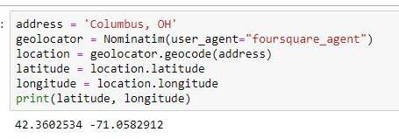
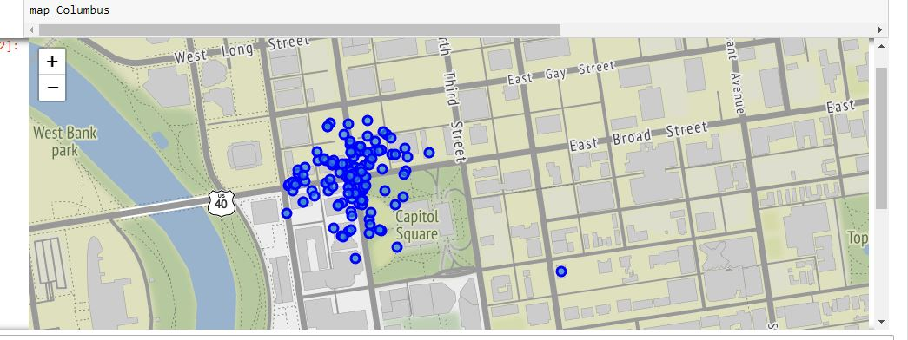
Data acquisition and cleaning:
I have used Foursquare API in order to get the popular venues of these four cities. The code snippets for the data collection and cleaning are the following:
Columbus, OH-

Slide 4
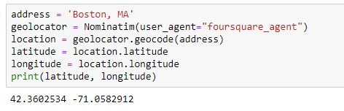
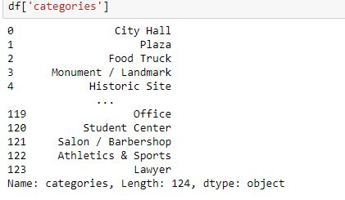
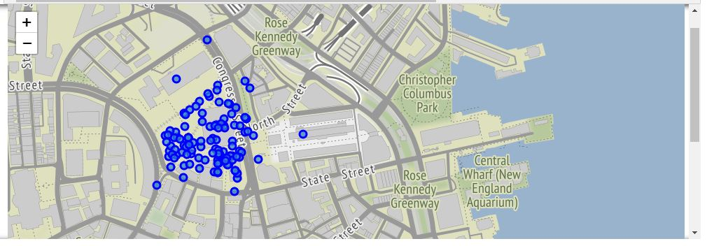
Boston, MA

Slide 5
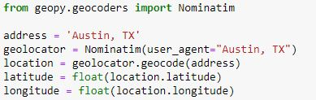
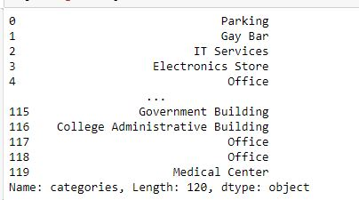
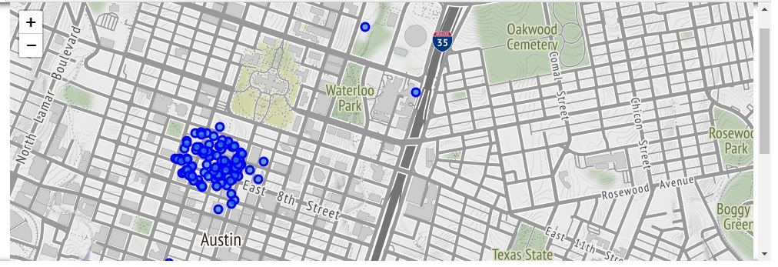
Austin, TX

Slide 6
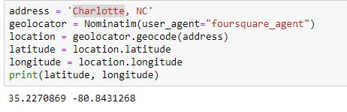
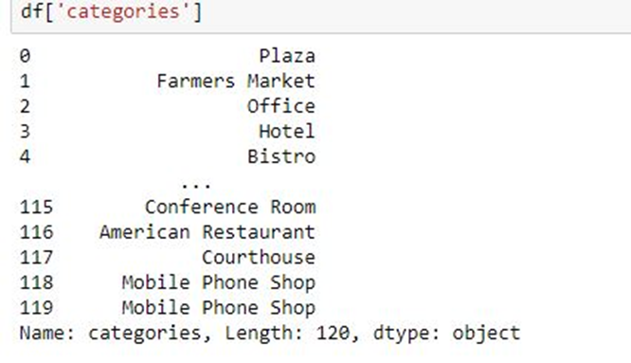
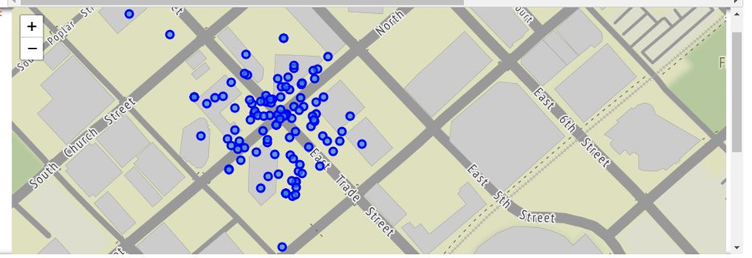
Charlotte, NC -

Slide 7
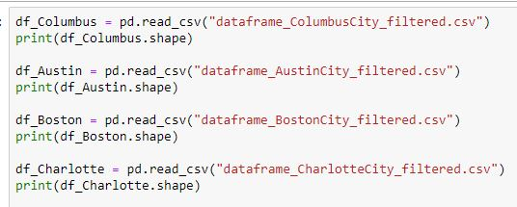
Methodology
Segmentation & Clustering- I combined all the four datasets in one for the purpose of clustering and segmentation-
I looked at the top venues in these four cities. I also see that there are two neighborhoods covered in some of these cities. After that I did one-hot encoding.

Slide 8
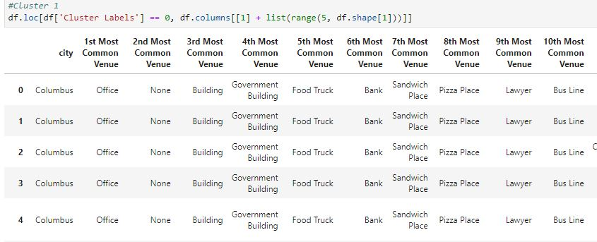
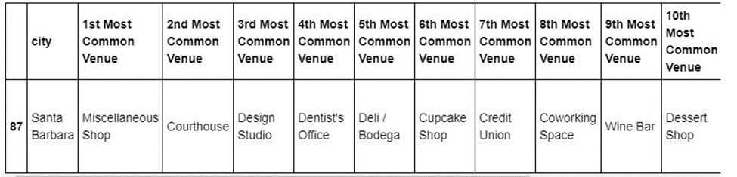
Result

Slide 9
Conclusion
After segmentation and clustering of all these four cities we have some interesting findings. There are 142 unique categories combining all four cities. There are plenty of restaurants, cafes, museums and bars etc are in all these four cities.
Austin’s top 5 venues contain nightclubs, movie theaters and not so surprisingly ‘Tech startups’.
Boston’s top venues are food trucks, offices, government buildings, monuments and movie theaters.
Columbus’s top venues are food trucks, offices and government buildings
Charlotte's top venues contains offices, co working spaces, music venues and night life
Boston is the capital of Massachusetts, so I am not surprised seeing government buildings in top venues. And the same is true with Columbus and Austin.
Cluster 3, 4, and 5 are pretty much the same in terms of the most common venues.

