Slide 1
PROJECT NAME:BOOKSWAGON.COM
RLL-GROUP-5
Group members: EmpID :
Alwar Vaidehi 2575887
K Siva Reddy 2576232
Pradyumn Patidar(Group Lead) 2576326
Prem Kumar R 2575654
R Hinduja 2576272
Tanya Yadav 2576362
Veerabhadra Gouda 2576304
V Vijay 2577184

Slide 2

URL FOR AUT: https://www.bookswagon.com/
Functionalities:
1.Login Page - V Vijay
2.Fiction Books – R Hinduja
3.Box Sets - Pradyumn Patidar
4.Search Box & Today’s Deal- Alwar Vaidehi
5.New Arrivals- K Siva Reddy
6.Request Book- Prem Kumar R
7.Award Winners- Veerabhadra Gouda
8.Best Seller-Tanya Yadav

Slide 3
AGENDA
Introduction
Selenium
Cucumber
TestNG
POM Framework
Listeners & IRetry Analyser
Extent Reports & Logs
Excel
Jira
Outputs

Slide 4
INTRODUCTION
In this project we are testing the functionalities of the website: Bookswagon.com
First we have started testing with writing the manual test cases.
The tools and Framework which we have worked with are: Selenium, TestNG, Cucumber.
We have created the extent reports and generated logs.
For the failed test cases we have used IRetry Analyser and screenshots for capturing the failed test cases.
We have Excel to read data.
In this project, we have used Jira for the test management lifecycle.

Slide 5

SELENIUM
Selenium is a functional automation tool for web application.
It supports many languages and webs, we are implemented this project by using Java and chrome.
Classes of selenium implemented in this project are:
1.Web driver:
It provides methods to interact with web elements, navigate through web pages, manage the browser
2.Browser Drivers-ChromeDriver:
Classes represent specific browser drivers that WebDriver uses to interact with the respective browsers
3.WebElement Interface:
Interact with various HTML elements on a webpage such as buttons, forms etc..
4.Actions Class:
This class is used to interactions such as mouse movements, keyboard events, double clicks etc…
5.Page Factory:
Used to support Page Object Design patterns

Slide 6
FUNCTIONS OF SELENIUM
get(String url)
sendKeys()
findElement(By by)
navigate()
getTitle()
click()
id(String id), name(String name), xpath(String xpathExpression)

Slide 7

CUCUMBER
Cucumber is a powerful open-source testing tool that facilitates Behavior-Driven Development (BDD) by allowing collaboration between developers, testers, and non-technical stakeholders. It is widely used for automating acceptance tests written in a natural language format, known as Gherkin, making it accessible to individuals with varying technical expertise.
Key Components:
Gherkin Language:
Gherkin serves as the domain-specific language for Cucumber. It provides a structured and human-readable way to define test scenarios and their expected outcomes.
Scenarios are written in a Given-When-Then format, fostering a common understanding among team members about the desired behavior of the software.
Feature Files:
Feature files are where Gherkin scenarios are documented. Each feature file corresponds to a particular feature or functionality of the application.
They act as living documentation, providing a clear and executable specification for the software.

Slide 8
Step Definitions
Step definitions are the glue code that translates Gherkin steps into executable code. These steps are written in programming languages such as Java, Ruby, Python, and JavaScript, depending on the Cucumber implementation used.
They link the plain-text Gherkin statements in feature files to the actual automation code.
Cucumber Implementations:
Integration with Selenium: Cucumber integrates seamlessly with Selenium, a widely-used web application testing framework. This integration allows teams to write high-level test scenarios in Gherkin and automate them using Selenium, providing an end-to-end testing solution.
Reporting and Documentation:
Cucumber offers various reporting tools, such as Cucumber Reports and ExtentReports, which provide detailed insights into test results. These reports enhance collaboration by offering a clear view of test execution, making it easier to identify and address issues.
Best Practices:
To ensure effective use of Cucumber, teams should follow best practices, including:
Writing clear and concise Gherkin scenarios.
Creating meaningful step definitions.
Regularly maintaining and updating test scripts.
Integrating Cucumber into continuous integration pipelines.

Slide 9

TestNG:
TestNG is an automation testing framework inspired from JUnit
Features:
Supports all categories of tests : Unit, Functional, end-to-end, parallel, integration etc.
Group Test Scripts and run them selectively make testing more powerful and easy.
Dependency tests are present in TestNG
Supports Parameterizing test cases and allows data driven testing
Detailed HTML Report
Annotations:
@Test,@AfterSuite,@BeforeClass,@AfterClass,@BeforeTest,@AfterTest,@DataProvider,@Listeners.

Slide 10
Assertions In TestNG
Hard Assertion :
It stops the program execution if the statement with hard assert fails.
Soft Assertion:
Next steps would be executed even if the statement with soft assertion fails
Data Provider Annotation:
In TestNG, the @DataProvider annotation is used to supply test data to a test method
Apache POI is an open source Java library for creating and manipulating various Microsoft Office-based file formats

Slide 11
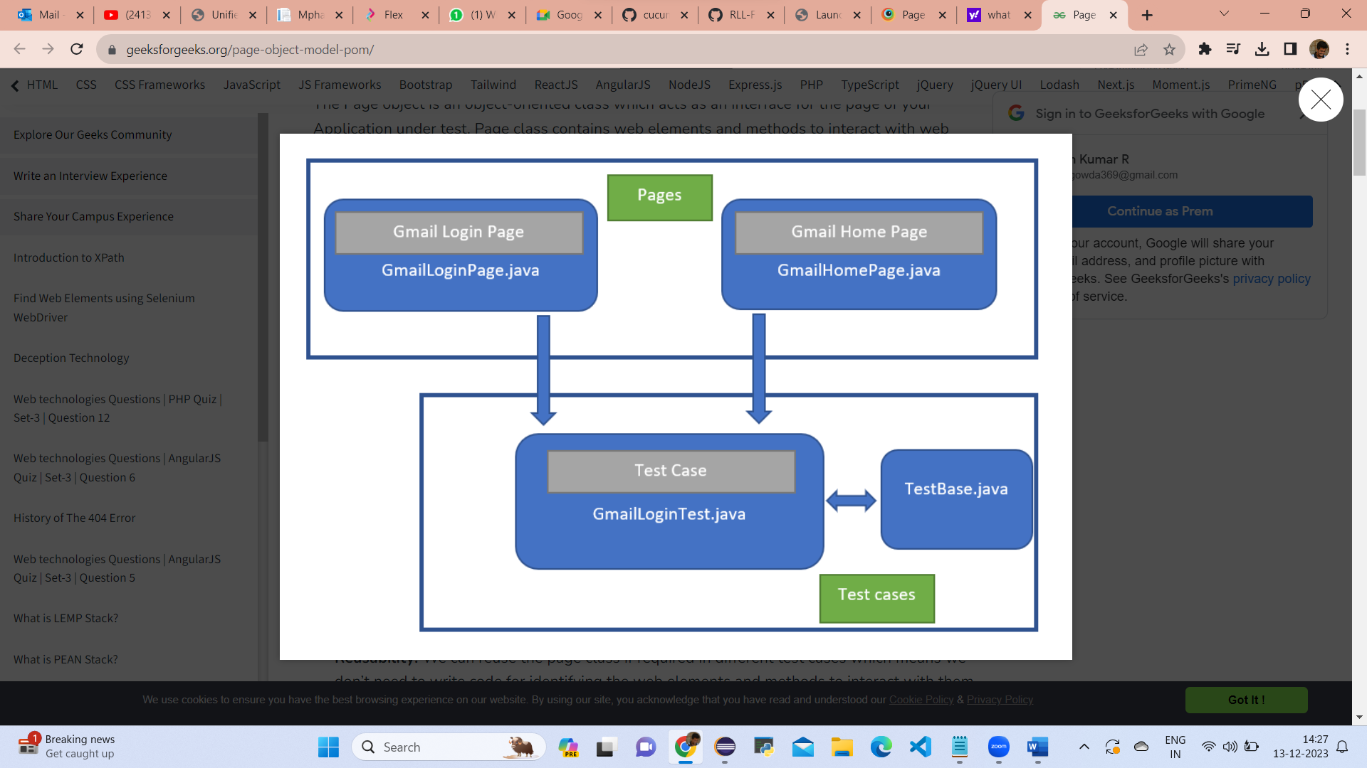
POM Framework:
POM also known as Page Object Mode
It is a design pattern in selenium that creates an object repository for storing all web elements
POM helps reduce code duplication and improves test case maintenance.
In Page Object Model, consider each web page of an application as a class file. Each class file will contain only corresponding web page elements.
Uses of the POM:
This Design Pattern is used in Selenium where web pages are represented by a corresponding class and web elements are represented by the variables of the class and all interactions are possible through the methods or say functions of the class.
Advantages of POM:
Reusability
Maintainability
Readability

Slide 12
LISTENERS & IRetry Analyser:
LISTENER
Used to listen any event that occurs while execute your TestNG classes in the Test console
Listener is not a class in TESTNG -> it is an Interface
If we have to record what TestNG is performing ,we will use listeners
Listeners are used to log events
TestNG provides several listeners that can be implemented to perform actions at various stages of the test lifecycle, such as before/after test suites, classes, methods.
Commonly Used TestNG listener include:
ITestListener--Used for general test event
The methods are in ITestLIstener are
Onstart(),onTestStart(),onTestSuccess(),onTestFailure(),onTestSkipped(),onTestFailedButWithinSuccessPercentage(),
onTestFailedwithTimeout(),OnFinish()

Slide 13
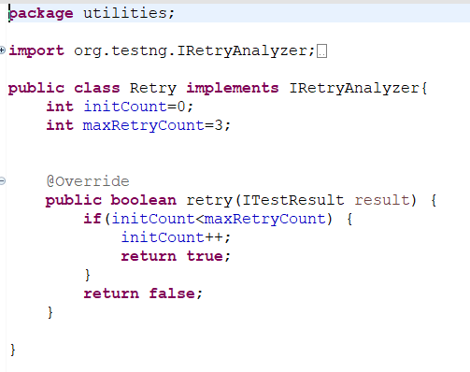

And this method are method over riding
We can execute listener in xml file
<listeners>
<listener class.name=" ">
</listerners>
Or by giving @listener(class name)
IsuiteListener-Manages test suite related events.
IRETRYANALYSER
IRetryAnalyser interface is given from org.TestNG, We implements the IRetryAnalyzer to the class ,
If any test case fail automatically we can give n number retry of attempts.
When testcase is failed before terminating from the test, if we mention retry attempt count, it will keep on retrying the test case automatic It is get pass, then it move automatically to the next case.
We can call IRetryAnalyser in @Test(retryAnalyzer=Retry.class)
In step definition Class:

Slide 14
EXTENT REPORTS AND SCREENSHOTS:
EXTENTREPORTS LIBRARY:
Extent Reports is an open-source reporting library useful for test automation. These reports are HTML documents that depict results as pie charts. They also allow the generation of custom logs, snapshots, and other customized details.
Once an automated test script runs successfully, testers need to generate a test execution report.
BENEFITS OF USING EXTENT REPORTS
They can be integrated with TestNG and JUnit
If required, screenshots can be captured and displayed for each step in a test
They allow testers to track multiple test case runs in a single test suite
They show the time needed for test execution
They can be customized to graphically represent each step in a test.
All methods on ExtentReports are multi-thread safe.

Slide 15
EXTENTREPORT CLASS
The ExtentTest class logs test steps onto the previously generated HTML report with status as PASS, FAIL, SKIP
The ExtentReports class generates HTML reports based on a path specified
CONFIGURATION:
ExtentSparkReporter supports a host of configuration via
• XML
• JSON
• JAVA
To load configuration via XML, use LoadXmlConfig() method
To load configuration via JSON, use LoadJSONConfig() method
We can directly use config() method in the JAVA code for any configurations.
SHORTCUTS:
We can use the following keyboard keys as shortcut keys.
VIEWS: t - Test-View, c - Category-View, d – Dashboard View, l – Change Theme
FILTER: p - show passed tests, e - show error tests, f - show failed tests, s - show skipped tests, esc - clear filters

Slide 16
ADDING SYSTEM/ENVIRONMENT INFORMATION:
It is possible to add system or environment info for your using using the setSystemInfo method. This automatically adds system information to all started reporters.
extentreports.setSystemInfo("OS", System.getProperty("os.name"));
ADDING SCREENSHOTS TO THE EXTENT REPORTS:
By capturing screenshots, testers can easily identify what went wrong during a test. Capture screenshots only when a test fails, since they consume a lot of memory.
Call getScreenshotAs method to create image file
OutputType defines the output type(Base 64, File) for the required screenshot
SCREENSHOT FOR TEST FAILURE:
Create a class. Implement TestNG ‘ITestListener‘.
Call the method ‘onTestFailure’.
In the extent test on fail call screenshot class and use them in: Test level (OR) Log level
Get Failed test a message and status and take a screenshot.

Slide 17
EXCEL
Excel we can entry the details of user in excel sheet
_We can used data driven method in testng. _ In data driven method it read excel file and enter details required locations _ we have used in data driven not required to enter send keys in your code it _access the required details in excel sheet.
Functions
FindBy
PageFactory
Fileoutputstream
Fout.flush

Slide 18
JIRA
What is jira:
Jira is a very powerful project management tool and some of the main part of jira is projects, issues and workflow.
We can defining goals and setting up team collaboration and add all your teammates in a single project.
Use of jira:
We use Jira's planning features for effective project management. We use dashboard for tracking and monitoring.
Integrations with Other Tools.
we integrate our jira with zephyr scale with the help of zephyr scale we import our all the
Manual test cases and assign everyone according to their scenarios. And after assigning everyone work on that zephyr scale.
Features:
We create daily sprint in jira, set daily goals and issues in our jira. In board you can check daily activity of any users whom you assign tasks like they did it complete or its in progress now. In list section you can have a list of all the activity where status of every activity show here.

Slide 19
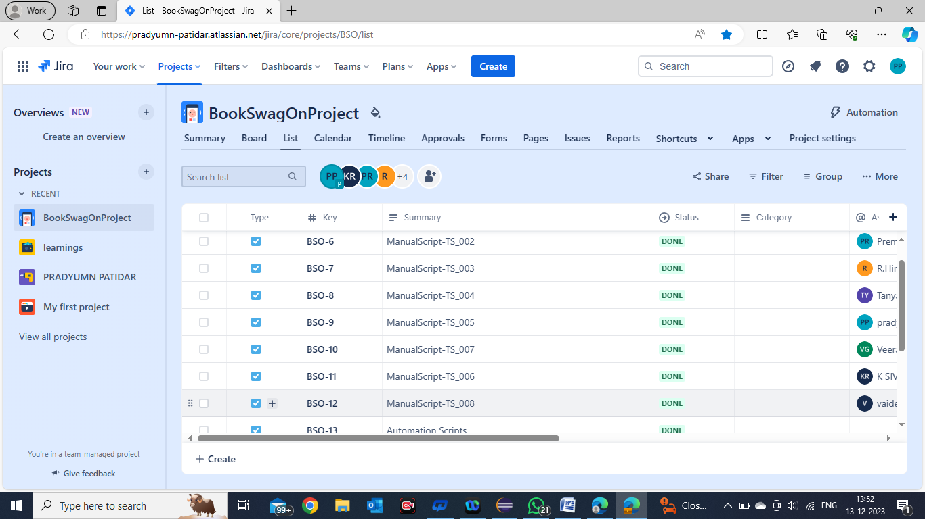
Why jira?
Main thing is why we use jira so jira provides us very good project management methodology for software development from planning you can fully customize your team management project. Jira gives you tools you need to estimate ,report and measure workflow and daily activities and a workflow design to fit your framework and it provide us planning and tracking tools so team can manage requirements from day one. Teams can easily use jira software for managing regular development task, bug tracking and product management. Jira is a very powerful tool for technical project managers.
How this tool looks like:

Slide 20
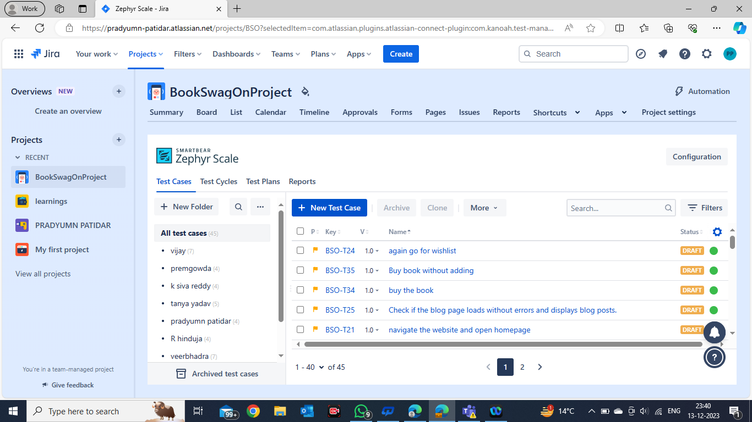
Zephyr scale

Slide 21
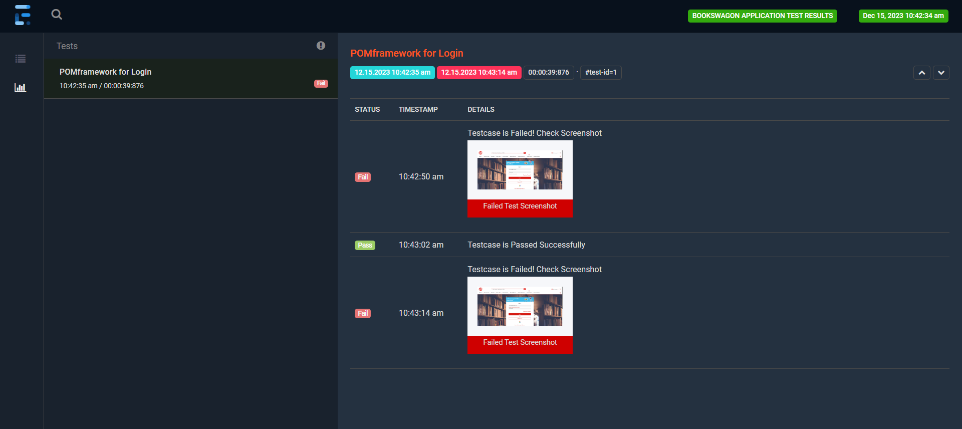
REPORTS:
EXTENT-REPORT WITH SCREENSHOT

Slide 22
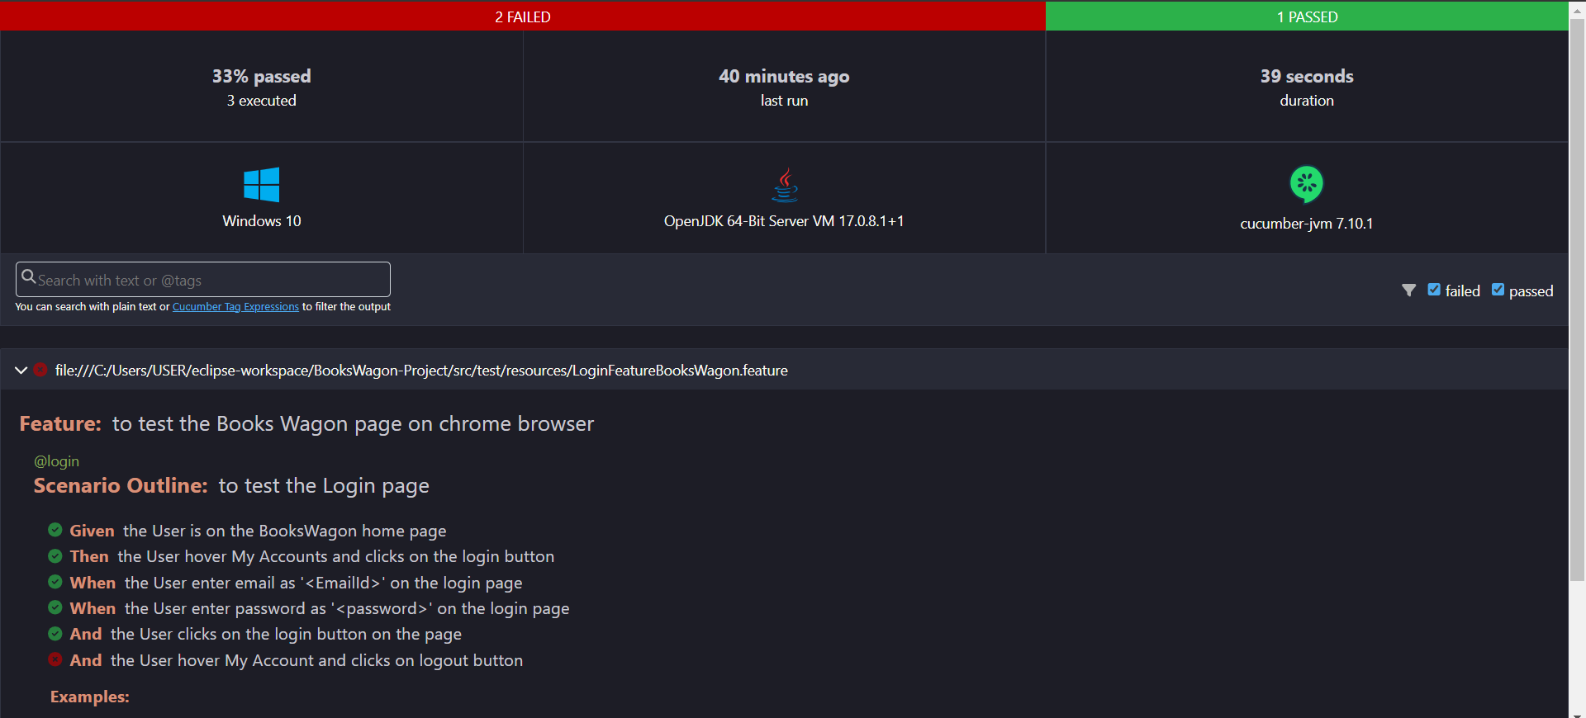
REPORTS:
CUCUMBER REPORT:

Slide 23
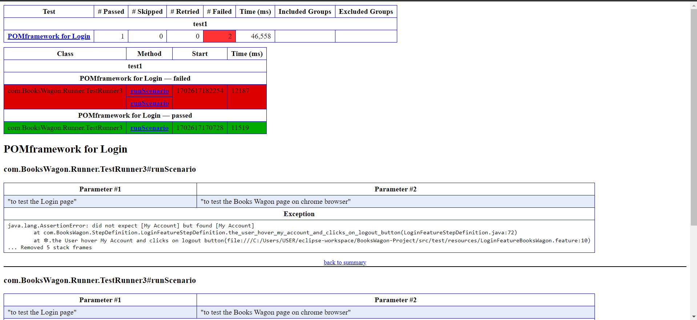
REPORTS:
TESTNG EMAILABLE REPORT:

