Slide 1

COMPUTER SCIENCE GRADUATE SOCIETY (CSGS) HACKATHON 2024 Predicting Medical Emergencies Using Machine Learning

Slide 2

Group members
VIJAY GUNTUKU
VINAY CHINTAKAYALA
MOIN AHMED ZAHIR

Slide 3

ABSTRACT
This project presents a machine learning-based solution to predict medical emergencies (like seizures or heart attacks) in real-time by analyzing patient data, aiming to provide timely alerts for doctors. Comparative analysis of six models—LSTM, CNN, CNN+LSTM, MLP, VGG-16, and MobileNet—indicated that VGG-16 yielded the best results for the selected dataset due to the high similarity between predicted and original graphs. This report outlines the methodology, model performance, and potential real-world applications of this system.

Slide 4
INTRODUCTION
With advances in healthcare technology, real-time monitoring of vital signs has become crucial in predicting critical medical events. Predicting emergencies like heart attacks and seizures can offer life-saving lead time for intervention. This project focuses on developing a predictive model using machine learning to analyze heart rate data, identify patterns, and trigger alerts before emergencies occur.
The objectives of this project are:
To compare and analyze different machine learning models for predicting medical emergencies.
To determine the best model for accurately predicting emergencies in real-time.
To implement a prototype that demonstrates the model's effectiveness in predicting emergencies based on heart rate data.

Slide 5
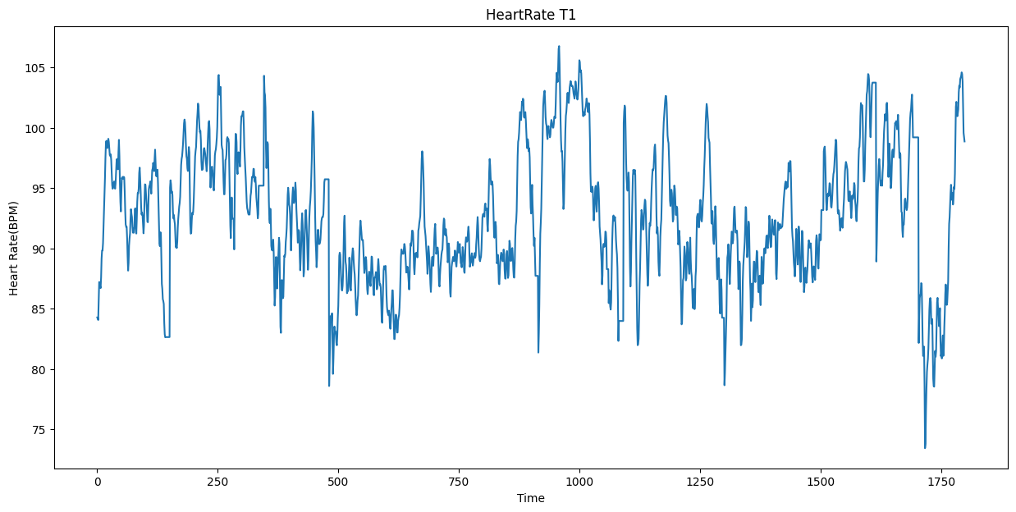
DATA COLLECTION AND PREPROCESSING
Dataset Summary
The dataset contains heart rate readings across four variables (T1, T2, T3, T4) and comprises 1800 rows of data. These readings capture variations in heart rate over time, serving as a basis for predictive modeling.
Preprocessing Steps
The preprocessing workflow included:
Standardization and Normalization: Scaling data to ensure uniformity across inputs.
Time-Series Transformation: Converting raw data into time-lagged sequences suitable for supervised learning. A custom `series_to_supervised` function was developed, generating inputs based on a sliding time window of 29 steps to improve temporal pattern recognition.
Data Splitting: Partitioning the data into training and testing sets with an 80-20 split, ensuring sufficient data for model validation.

Slide 6
MODEL SELECTION
Model Comparison
We evaluated six models, each chosen for its unique approach to handling sequential and high-dimensional data:
LSTM (Long Short-Term Memory): Known for capturing long-term dependencies in sequential data.
CNN (Convolutional Neural Network): Effective in identifying local patterns in time-series data.
CNN+LSTM: Combines CNN's feature extraction with LSTM's sequence processing.
MLP (Multi-Layer Perceptron): A simpler model serving as a baseline.
VGG-16 Inspired Model: A deep convolutional network adapted for time-series prediction, leveraging its pre-trained weights for improved pattern detection.
MobileNet Inspired Model: Known for its efficiency and effectiveness in handling real-time applications.
The hyperparameters for each model were tuned based on initial experimentation, with VGG-16 configured to optimize the real-time prediction task for high-dimensional, time-sequenced data.

Slide 7
MODEL SELECTION
Model Training
Each model was trained with an epoch count of 100, batch size of 256, and an Adam optimizer set with a learning rate of 0.0001. Training was conducted on the training subset of data, and model validation was performed using the testing subset.
Evaluation Metrics
To assess each model's performance, the following metrics were utilized:
Root Mean Squared Error (RMSE): To measure prediction error.
R² Score: To indicate the proportion of variance explained by the model.
Correlation Coefficient: To assess the similarity between predicted and actual values.
Mean Absolute Percentage Error (MAPE): For percentage-based error analysis.
These metrics were selected for their ability to provide insights into both error magnitude and predictive accuracy, crucial for real-time applications

Slide 8
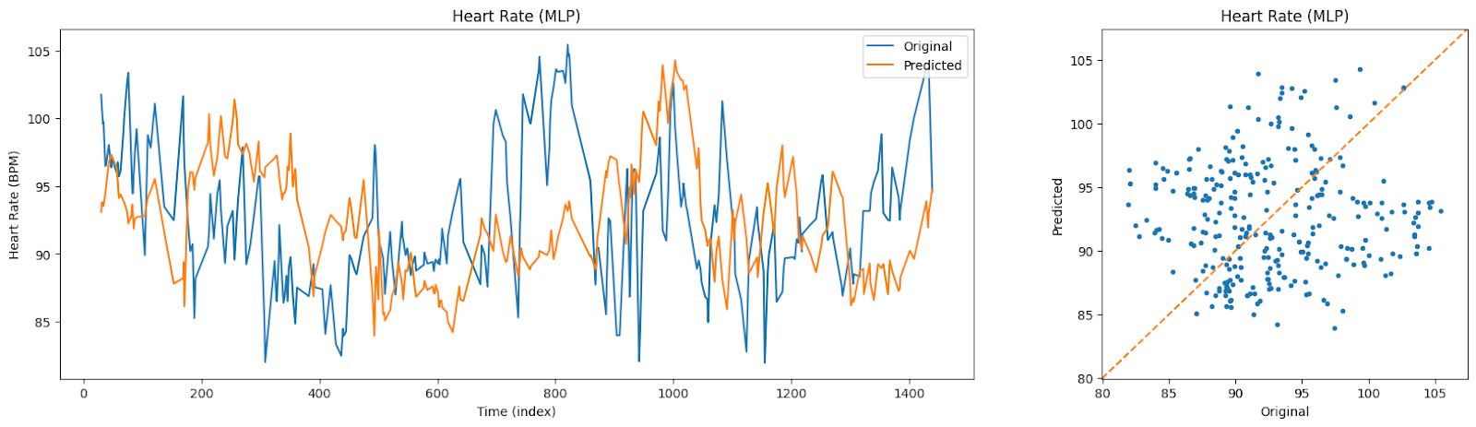

MLP RESULTS

Slide 9
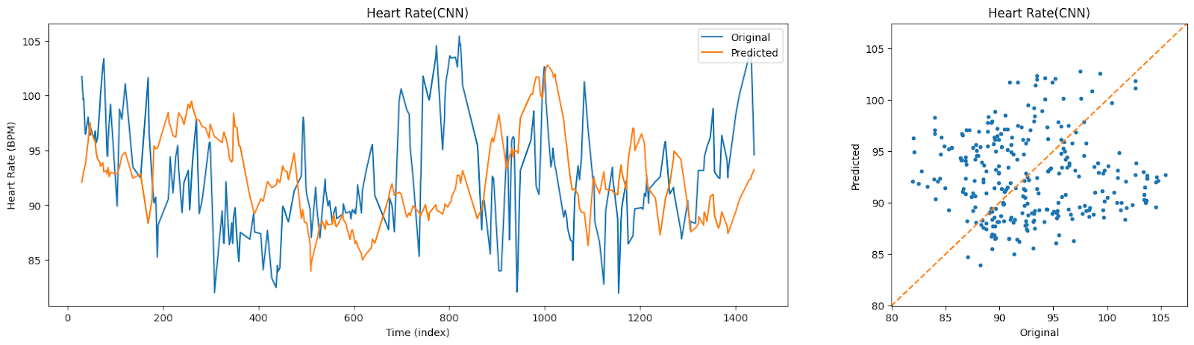

CNN RESULTS

Slide 10
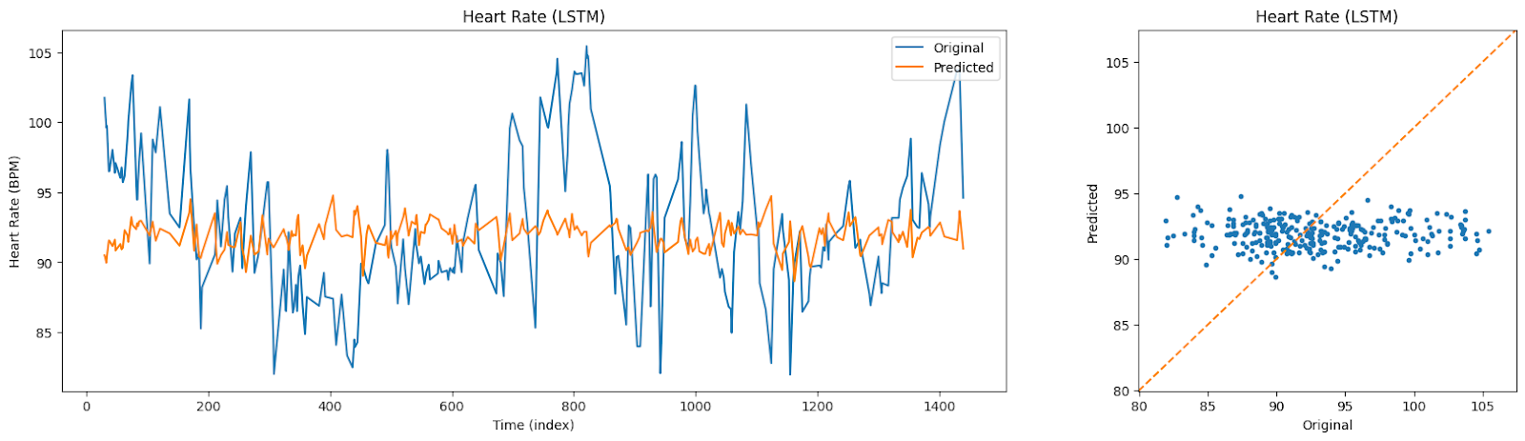

LSTM RESULTS

Slide 11
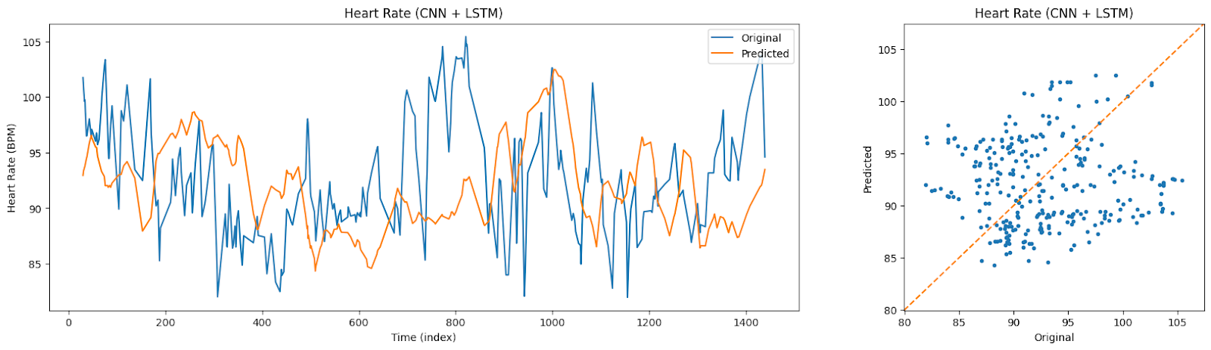

CNN+LSTM RESULTS

Slide 12
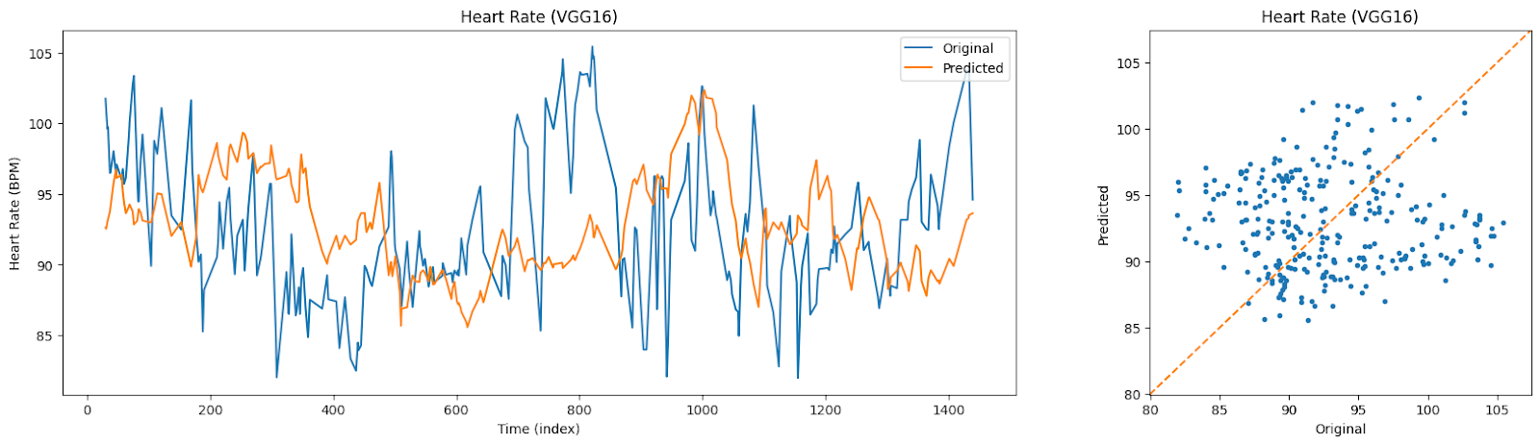

VGG16 Inspired RESULTS

Slide 13
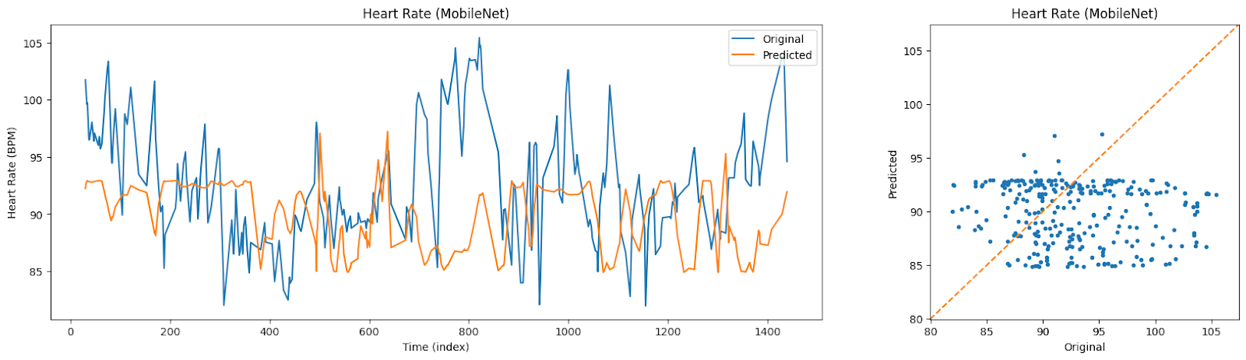

MOBILENET Inspired RESULTS

Slide 14
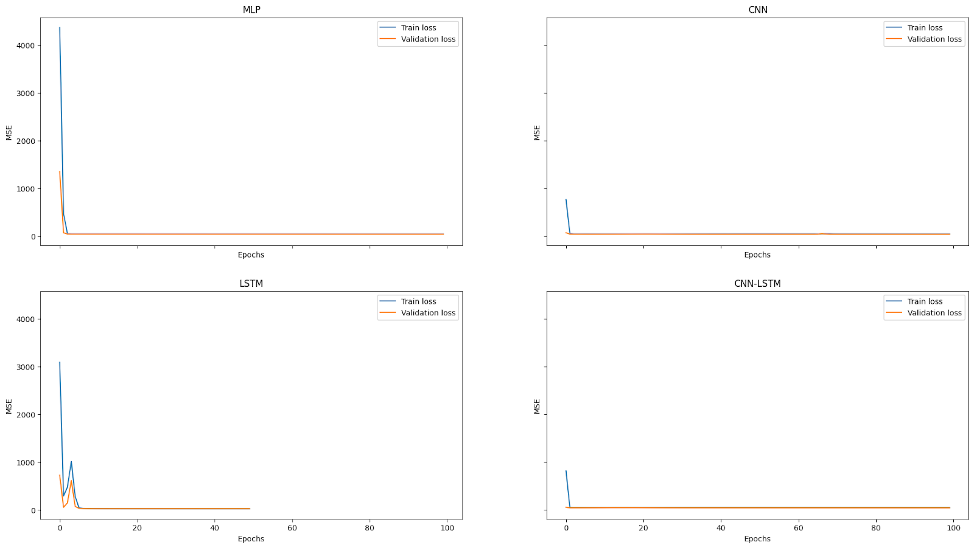
TRAIN LOSS AND VALIDATION LOSS

Slide 15
TRAIN LOSS AND VALIDATION LOSS

Slide 16
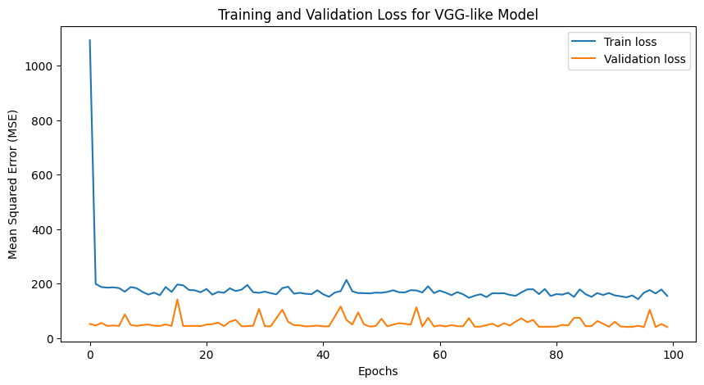
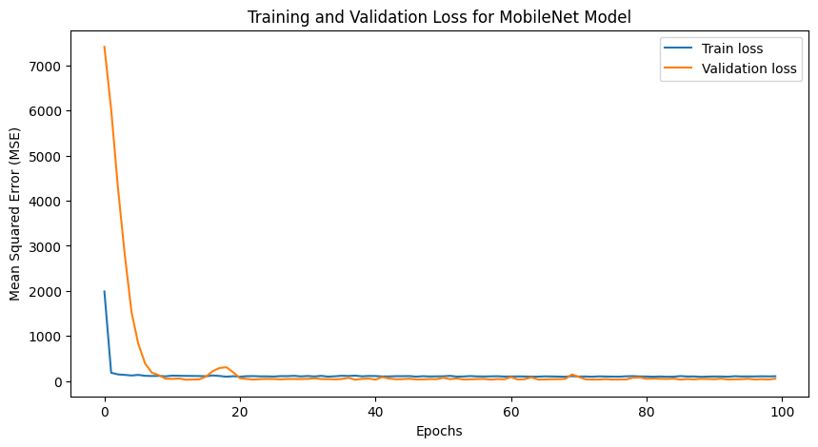
TRAIN LOSS AND VALIDATION LOSS

Slide 17
RESULTS
After comparative analysis, the VGG-16 Inspired model demonstrated superior performance, showing the highest alignment between predicted and original values. The table below summarizes the results, and the following graphs illustrate the similarity between predicted and actual graphs, validating this model as the optimal model for this dataset.
The primary finding is that VGG-16 Inspired model, with its deeper architecture, effectively captures complex temporal patterns, resulting in high predictive accuracy. The CNN+LSTM model also performed well but did not match this model’s precision in aligning with original data trends.

Slide 18
DISCUSSION
Model Insights
VGG-16 Inspired model’s performance can be attributed to its robust architecture, which captures intricate patterns in sequential heart rate data. The model’s pre-trained convolutional layers proved effective in extracting spatial and temporal features, making it well-suited to this type of predictive task.
Limitations and Challenges
Data Size: The dataset was relatively small, and a larger dataset could further improve model accuracy.
Real-Time Constraints: The models need to be optimized for real-time deployment, especially for resource-constrained environments.
Future Improvements
Integrating additional physiological features (like blood pressure and oxygen saturation) could further enhance prediction accuracy. Additionally, testing the model across more varied datasets would improve its generalizability.

Slide 19
CONCLUSION
This project demonstrated the feasibility of using machine learning to predict medical emergencies based on real-time heart rate data. Through comparative analysis, VGG-16 Inspired model emerged as the most effective model, with its predictions closely matching actual trends. This solution has significant potential for real-world application in healthcare settings, where timely alerts can be life-saving.

Slide 20
THANK YOU…

