Slide 1
Restaurant Location Recommender System
(A Clustering based approach)
VIJAYASHANKARAN R L

Slide 2
Why choosing the best location is necessary?
The classic real estate saying “location, location, location” applies to choosing a site for a new restaurant.
Location influences the success or failure of a restaurant in a host of ways, from attracting enough initial customer interest to being convenient to visit.
But the restaurant’s location is also interrelated to other factors, some of which are changeable, while others are not.

Slide 3
Data collection and acquisition
The data required would be
List of Boroughs and Neighbourhoods
Population
Population density
Area size of the neighbourhood
Other venues located nearby to determine the popularity of the neighbourhood
These data will be web scrapped from the below links:
https://en.wikipedia.org/wiki/Demographics_of_Toronto_neighbourhoods
https://en.wikipedia.org/wiki/List_of_postal_codes_of_Canada:_M
All the data about the venues, venues category, latitudes and longitudes of the venues are obtained from the Four-square API in the form of json data

Slide 4
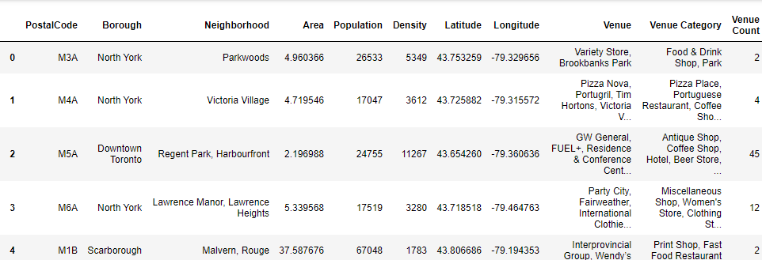
Cleaned Data

Slide 5
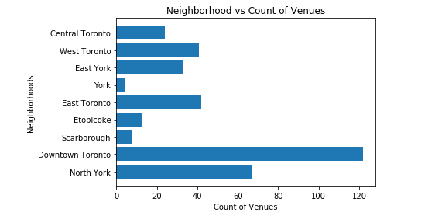
Neighbourhoods vs Venues

Slide 6
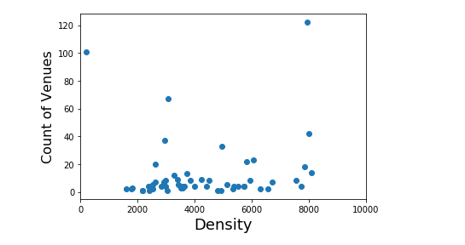
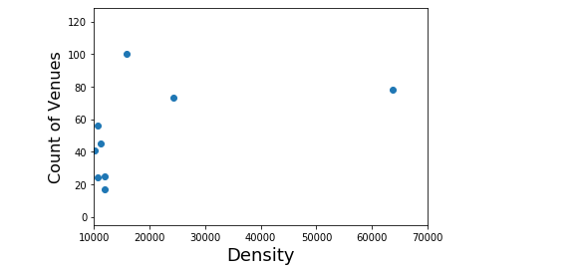
Visualizing featured data

Slide 7
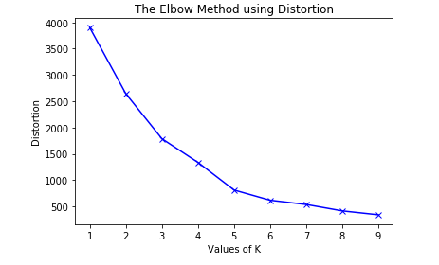
Clustering model (Determining k-value by elbow method)

Slide 8
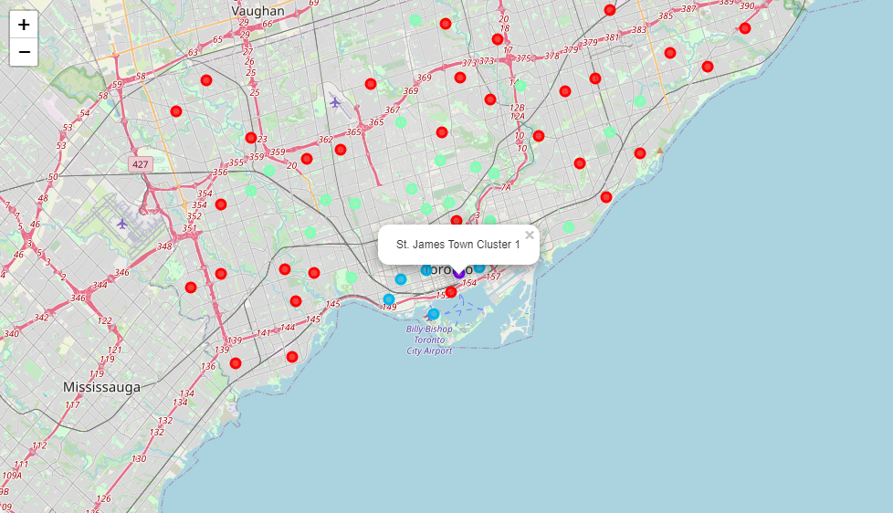
Plotting data on Map after clustering

Slide 9
Conclusion
It is found that the most preferred neighbourhood is “St. James Town” (Violet marker)
The next most preferred neighbourhood is “Church and Wellesley” (Yellow marker)
Followed by blue and green marked locations.
The Worst neighbourhoods are marked as red circles.
To increase the accuracy we need more features like Income of the people living in the neighbourhood, competition of restaurants in the neighbourhoods (which can be a double edged sword), preferred cuisines and much more.

