Slide 1
Database Management Systems Title : Customer order management

Slide 2
Context
City group Marketing is a business organization/company owned by few group of individuals, which sells cosmetics/electronic gadgets at a wholesale price. They used to maintain records of the customers and the order, payment details in notebooks, but due to the increase in their business they are planning to store the data into the database and the preferred backend data storage is RDBMS to store customer, products, invoice, orders details etc.

Slide 3
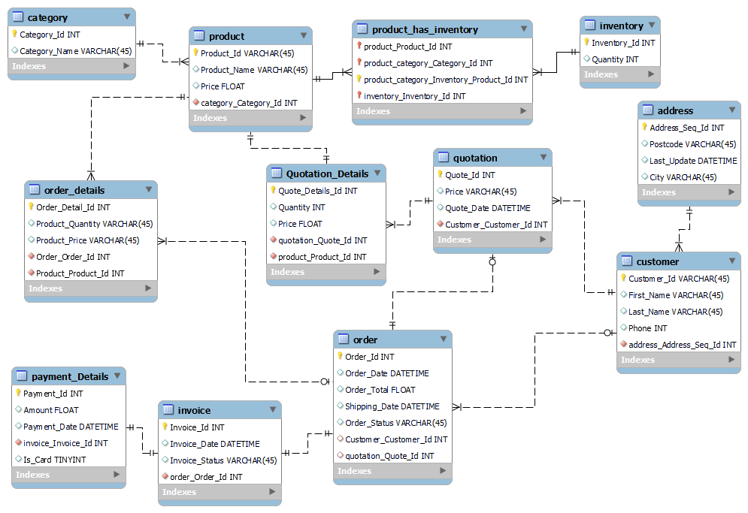
ENTITY RELATIONSHIP DIAGRAM:
The following illustrates the Customer Order Management

Slide 4
As you can see from the diagram, the Customer Order Management database has Eleven tables. Database Tables:
address
category
customer
inventory
invoice
order
order_details
payment
payment_details
product
quotation

Slide 5
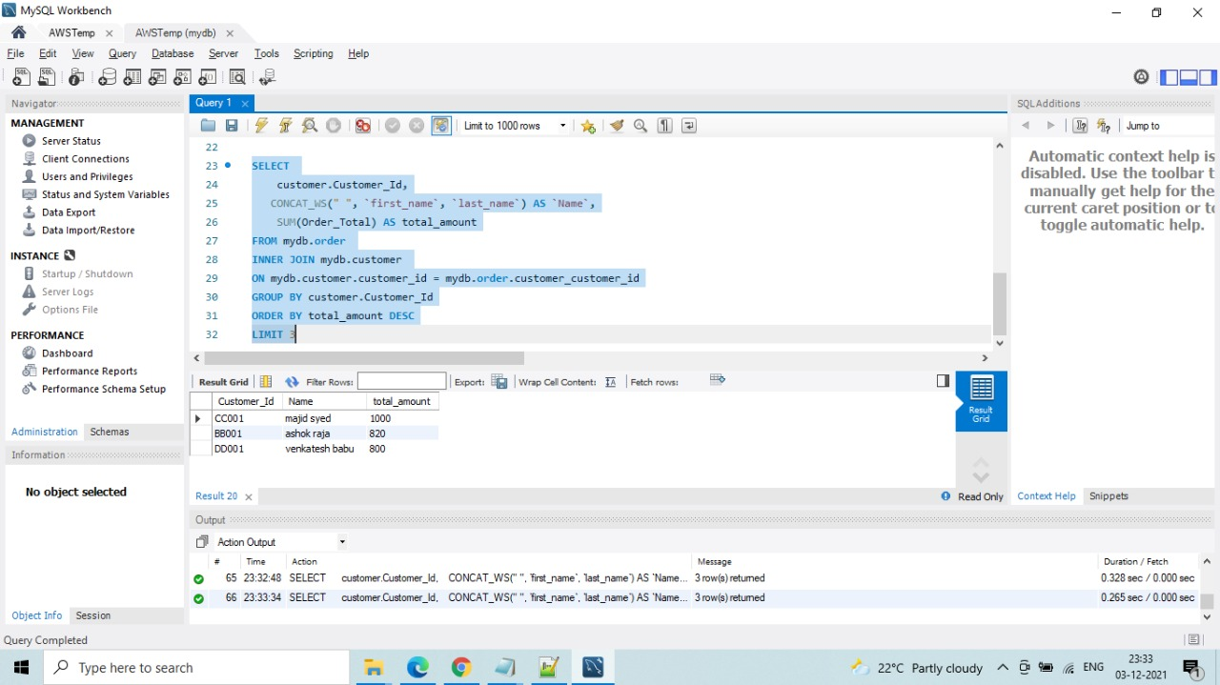
>>to fetch the data of Top 3 customers depends on total amount from order table. using Joins, Concat function, limit clause, group by
Query:
SELECT customer.Customer_Id, CONCAT_WS(" ", `first_name`, `last_name`) AS `Name`, SUM(Order_Total) AS total_amount FROM mydb.order INNER JOIN mydb.customer ON mydb.customer.customer_id = mydb.order.customer_customer_id GROUP BY customer.Customer_Id ORDER BY total_amount DESC LIMIT 3;

Slide 6
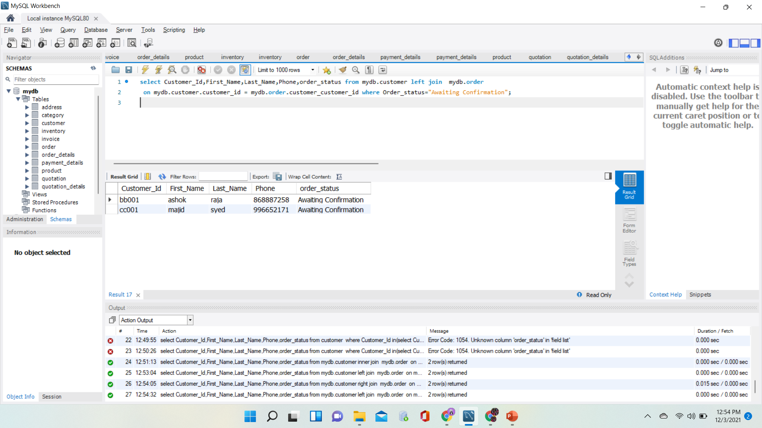
>>Orders which are waiting for awaiting customer information
Query :
select Customer_Id,First_Name,Last_Name,Phone,order_status
from
mydb.customer
left join
mydb.order
on mydb.customer.customer_id = mydb.order.customer_customer_id
where Order_status="Awaiting Confirmation";

Slide 7
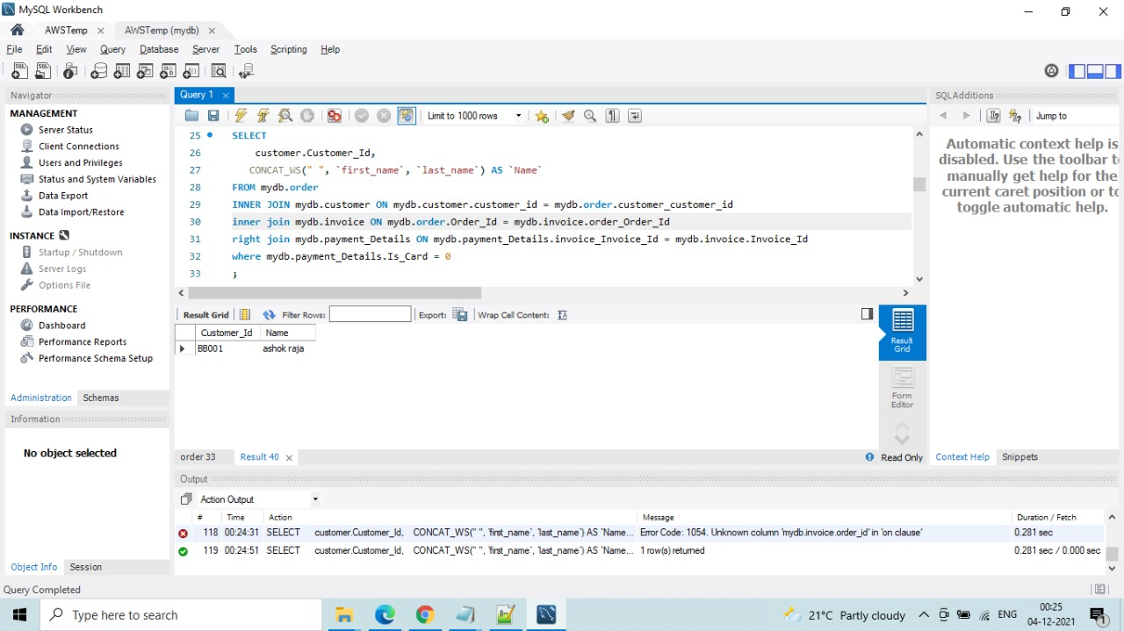
select customers who has made the cash payment using Multiple table joins, used inner, left join
Query:
SELECT customer.Customer_Id, CONCAT_WS(" ", `first_name`, `last_name`) AS `Name`FROM mydb.order INNER JOIN mydb.customer ON mydb.customer.customer_id = mydb.order.customer_customer_id inner join mydb.invoice ON mydb.order.Order_Id = mydb.invoice.order_Order_Id right join mydb.payment_Details ON mydb.payment_Details.invoice_Invoice_Id = mydb.invoice.Invoice_Id where mydb.payment_Details.Is_Card = 0;

Slide 8
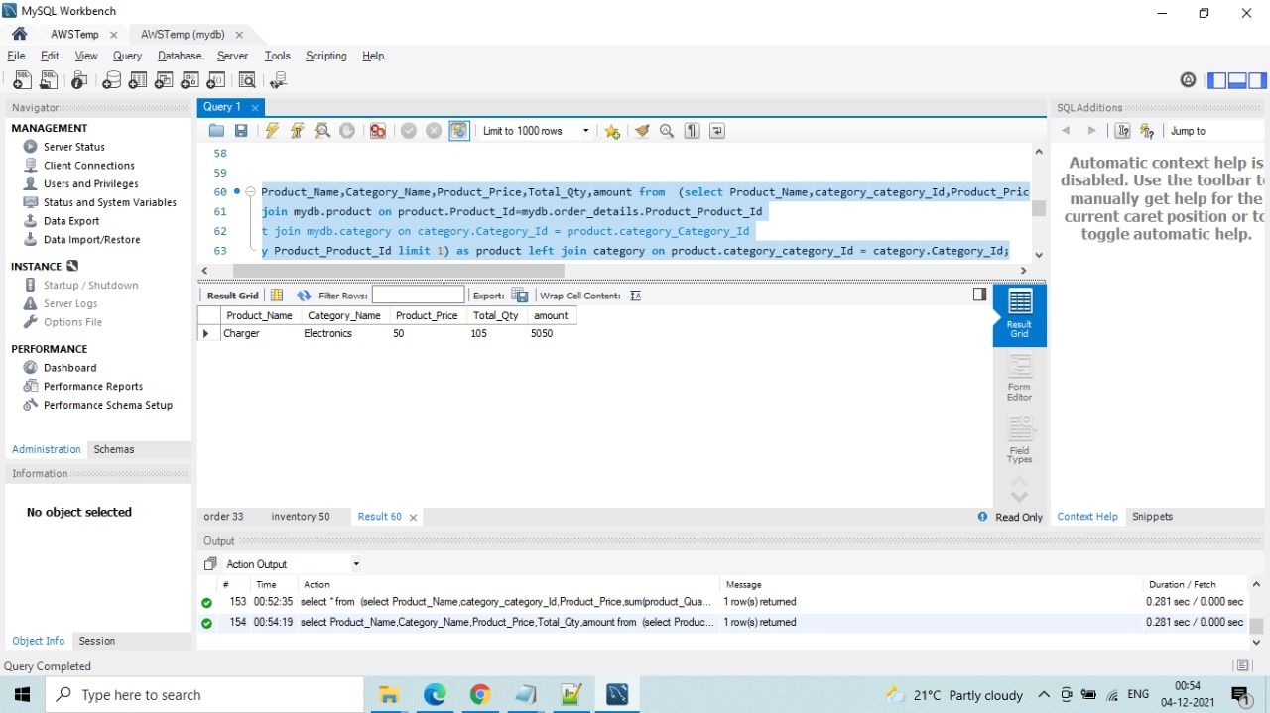
>>Product which customers mostly bought, used subquery in from clause, joins, limit
select Product_Name,Category_Name,Product_Price,Total_Qty,amount from (select Product_Name,category_category_Id,Product_Price,sum(product_Quantity) AS Total_Qty,sum(product_Quantity*Product_Price) amount from mydb.order_details right join mydb.product on product.Product_Id=mydb.order_details.Product_Product_Id group by Product_Product_Id limit 1) as product left join category on product.category_category_Id = category.Category_Id;

Slide 9
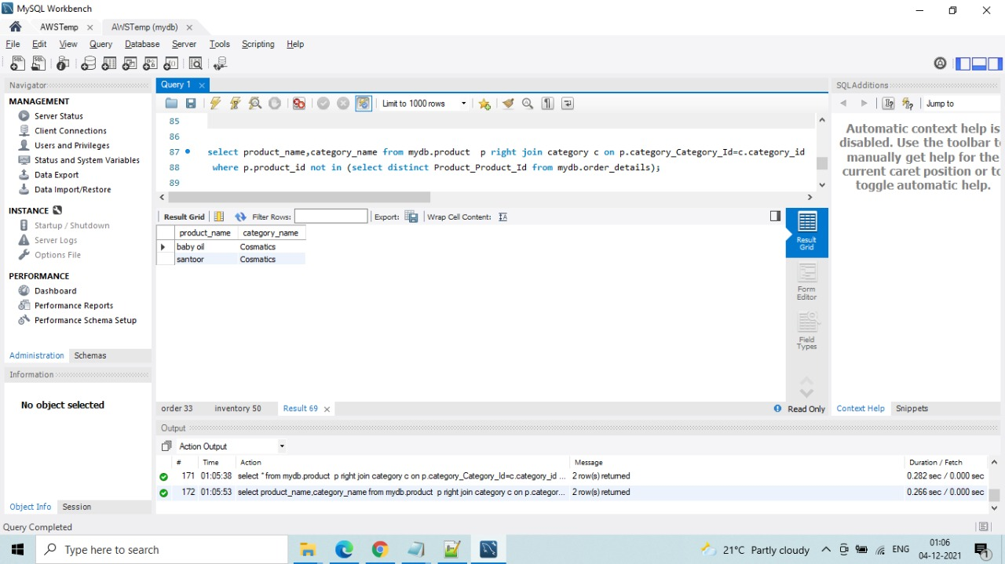
>>Products for which there is not even a single order
select product_name,category_name from mydb.product p right join category c on p.category_Category_Id=c.category_id where p.product_id not in (select distinct Product_Product_Id from mydb.order_details);

Slide 10
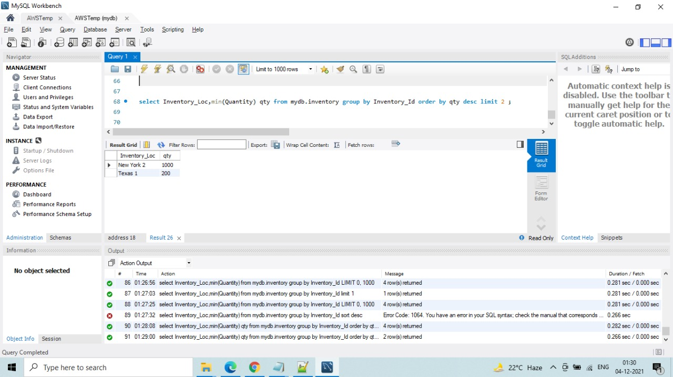
>>Show Inventories with less stock
select Inventory_Loc,min(Quantity) qty from mydb.inventory group by Inventory_Id order by qty desc limit 2 ;

Slide 11
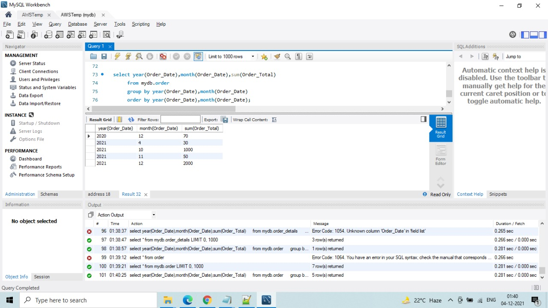
>>Show monthly sales report.
select year(Order_Date),month(Order_Date),sum(Order_Total) from mydb.order group by year(Order_Date),month(Order_Date) order by year(Order_Date),month(Order_Date);

Slide 12
Summary
Our project supports all the stages in any company’s sales process, from order creation through customer delivery, it makes quick work of the logistics challenges.
It supports including health care, transportation, food service, automotive and pharmaceuticals etc.
Traditionally, the Customer order management process involved Errors, manual tasks, especially in order entry and inventory management.
To come up with above error handling and manual entries in notebooks We come up with database to store the data and for the quick process.

