Slide 1
GCT CASE STUDY
PROCESS AND DATA ANALYTICS
CO₂ Plant Data Pipeline
Vijay Singh
Date: 14-07-2024

Slide 2


Agenda
Objective & Constraints
Sensor Simulation Design
S3 Storage Strategy
Processing Architecture
Data Format & Sample JSONs
Alert Logic & Thresholds
Glue + Athena + QuickSight
Challenges & Learnings
Improvements & Ideas
Screenshots
Final Thoughts

Slide 3
Objective & Constraints
🎯 Objective
Design and implement a real-time data pipeline that simulates sensor data from a CO₂ capture plant — using only AWS native tools under the Free Tier.
The goal was not just to collect data, but to:
- Ingest it in real time
- Structure and process it automatically
- Generate alerts for anomalies
- Enable insightful dashboards for analysis
⚠️ Constraints & Guidelines
🏷️ Budget: Free Tier usage only — no external services
🕐 Time: Fast-paced execution with minimal manual steps
🔗 Integration: Use AWS-native services (S3, Lambda, Glue, Athena, QuickSight)
📈 Scalability: Structure must support long-term extensibility
⚡ Real-time: New sensor data every 10s, processed within 1 minute

Slide 4
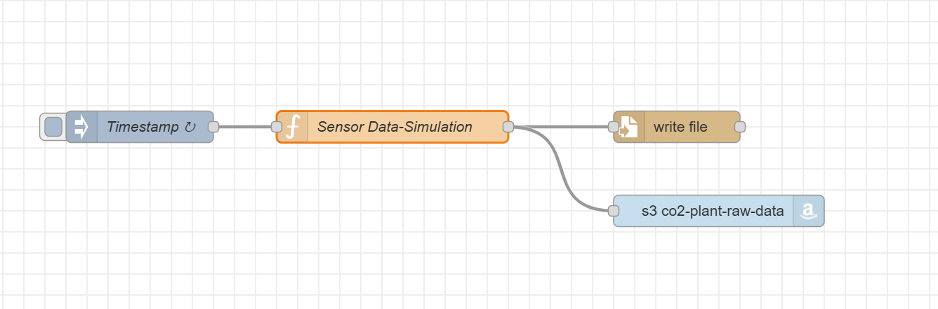
Sensor Simulation Design
🔧 Setup Tool: Node-RED (Local Flow)
Used Node-RED to simulate real-time sensor data generation and file delivery.
Sensor Logic
8 Sensors: pH, conductivity, pressure, temperature, fillLevel, flow, humidity, co2
Frequency: → Every 10 seconds, one reading per sensor → Every 1 minute, 6 readings are saved as one .json file
Node-Red Simulation Design

Slide 5
Sensor Simulation Design
💾 Dual Output Strategy(for additional data protection)
1. 🖥️ Local Disk: Structured folder hierarchy by Year/Month/Day/Hour
2. ☁️ AWS S3: JSON files also uploaded directly to co2-plant-raw-data bucket

Slide 6

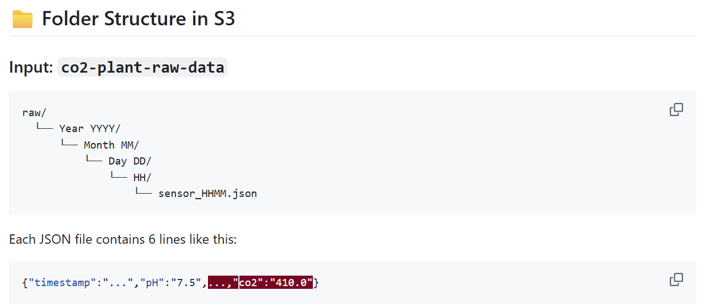
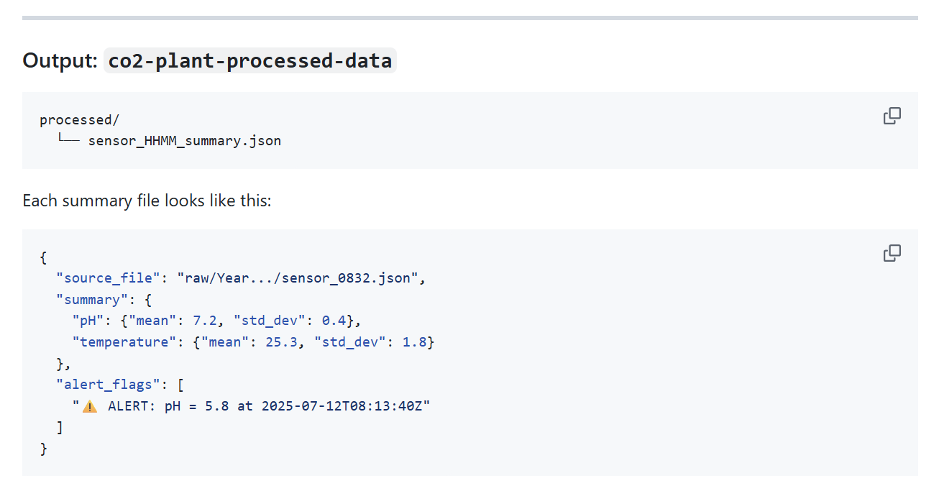
S3 Structure & Strategy
🗃️ Bucket Design
Raw Data Bucket → co2-plant-raw-data
Processed Data Bucket → co2-plant-processed-data

Slide 7


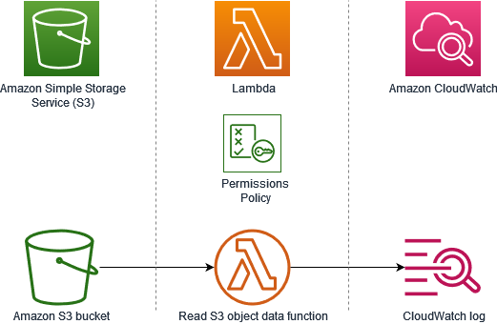
S3 Structure & Strategy
🎯 Strategy Highlights
🔁 Organized by time for easy querying
📈 Facilitates partitioned data access in Glue/Athena
🔒 Uses S3 event notifications to trigger Lambda instantly

Slide 8



Processing Architecture (AWS Lambda)
Feature | AWS Lambda (Free Tier) | Google Cloud Functions | Databricks Community Edition
Trigger on S3 Upload | ✅ Native event-based | ❌ Needs workaround | ❌ Not event-driven
Free Tier Execution | ✅ 1M reqs + 400K GB-sec/month | ✅ 2M invocations/month | 🚫 Limited compute, no auto-trigger
Auto-Scalability | ✅ Fully automatic | ✅ Fully automatic | 🚫 Manual/limited
Ease of JSON Processing | ✅ Python-native, quick deploy | ✅ Similar capabilities | ✅ But heavier setup
Cold Start Speed | ⚡ Very fast | ⚡ Comparable | 🐢 Slow, notebook start time
Best Fit for Sensor Pipeline? | 🥇 Yes – event + cost + speed | 🥈 Good backup | 🥉 Not suitable for real-time
🚀 Why Lambda?
Serverless & scalable
Auto-triggers on S3 upload
No manual intervention needed
Ideal for real-time lightweight processing
​

Slide 9
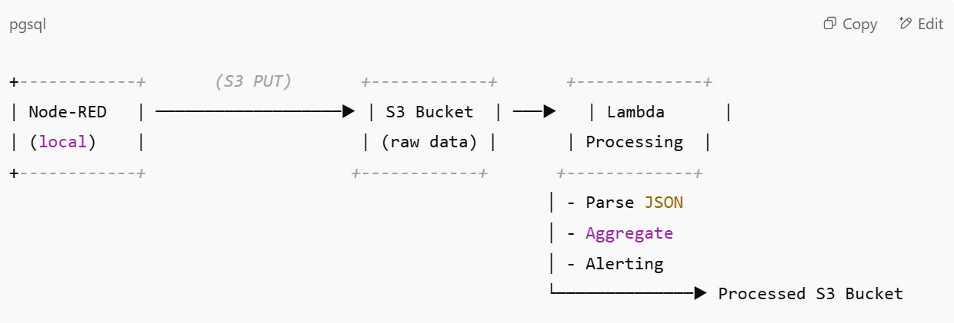
Processing Architecture (AWS Lambda)
🔄 Flow Overview
1. Trigger: New file lands in co2-plant-raw-data/raw/
2. Lambda Execution:
Reads NDJSON file line by line
Parses readings from 8 sensors
Calculates:
📊 Mean
📈 Standard Deviation
Detects ⚠️ Alert Conditions (pH, temp, CO₂, pressure)
Saves a processed summary file to co2-plant-processed-data/
​

Slide 10
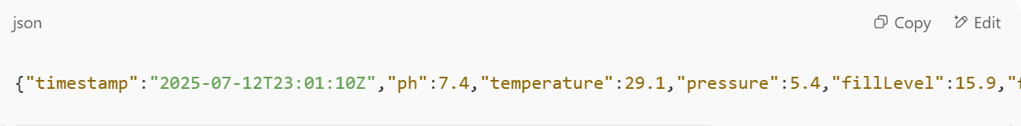
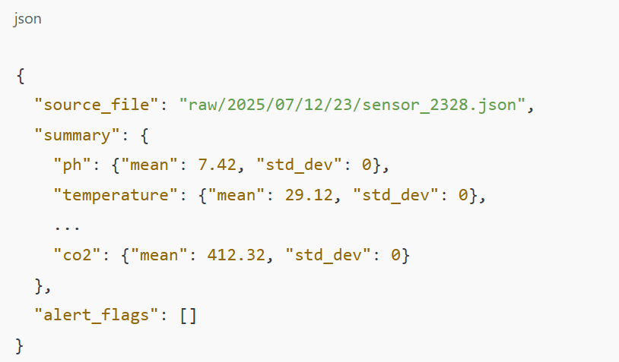
Sample JSONs – Raw vs Processed
🔹 Raw Sensor File (NDJSON Format)
Each line = one timestamped reading from all sensors (6 lines per file, written every minute)​
🔹 Processed Summary File
Created by Lambda after reading all 6 lines
Aggregated + statistically enriched + alert-ready

Slide 11
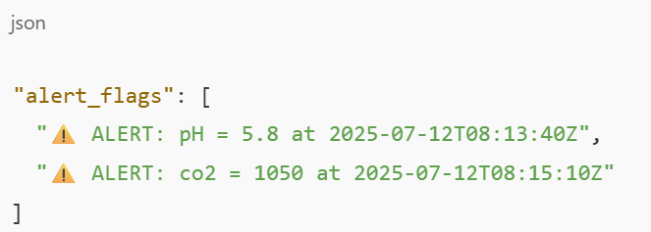
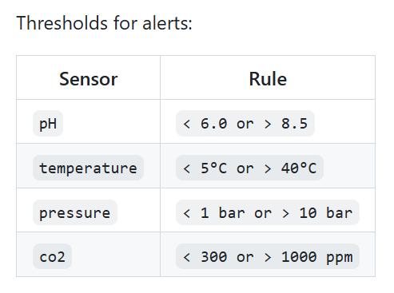
Alert Logic & Thresholds
🔍 Why Alerts?
To detect anomalies and ensure the plant is operating safely and efficiently. Out-of-range values could signal:
Sensor malfunction
Unsafe conditions
Process inefficiencies
✅ Flexible Design Rules can be easily extended or modified via config files or database in the future.
​

Slide 12

Glue + Athena + QuickSight
🧱 AWS Glue – Data Catalog Setup
Created a Crawler targeting co2-plant-processed-data/processed/
Automatically infers schema from _summary.json files
Stores metadata in a Glue database (e.g., co2_summary_catalog)
Runs on schedule or on-demand to reflect new files
​

Slide 13
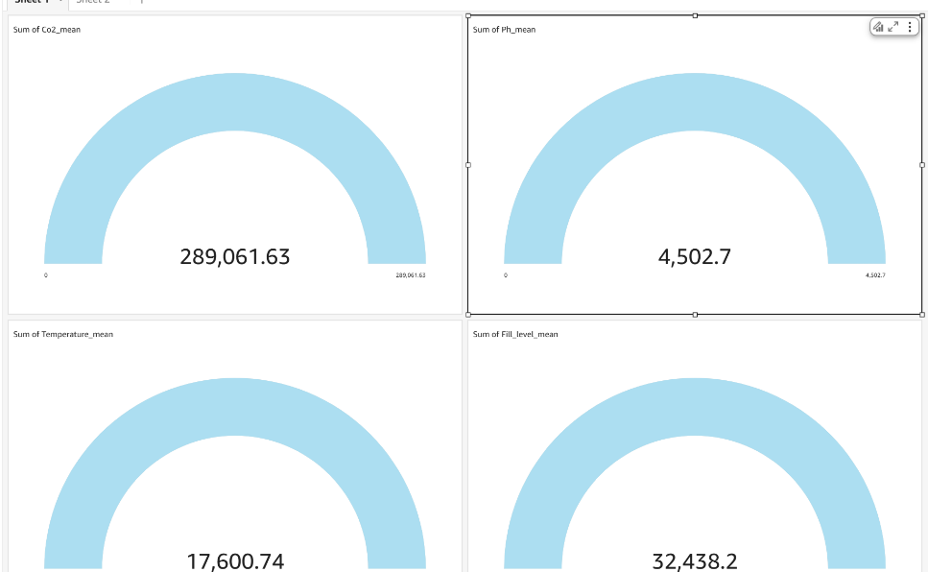
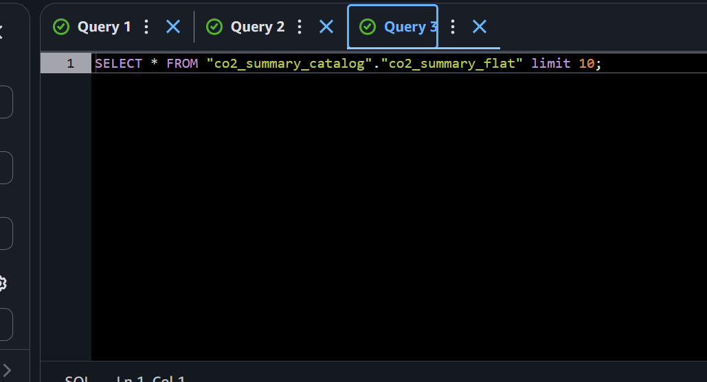
Glue + Athena + QuickSight
🔍 AWS Athena – SQL on JSON
Connected Athena to the Glue catalog
Wrote SQL queries to extract sensor stats like:
📈 AWS QuickSight – Dashboard View
- Connected QuickSight to Athena via S3 data source
Visualized metrics like:
Average temperature and pH trends
Number of alerts per hour/day
Comparison charts across sensors
​

Slide 14
Glue + Athena + QuickSight
​
📌 Benefits of This Stack:
🔗 Serverless + Scalable + On-Demand
🧠 Powerful analytics without ETL complexity
🎯 Real-time decision-making from processed data

Slide 15
Challenges & Learnings
Category | Challenge
File Timing | Lambda sometimes triggered before S3 file was fully uploaded
Data Format | NDJSON (newline-delimited JSON) caused parsing issues in early versions
IAM Permissions | Needed fine-grained S3 GetObject, PutObject, CloudWatch access
CloudWatch Logs | Lambda invoked, but logs not generated due to missing permissions
Glue Parsing | Nested JSON required schema flattening for Athena/QuickSight
​Major Learnings:
1. How to structure cloud storage for scalability (date/time folders)
2. Importance of error handling in serverless architecture
3. Setting up fine-tuned IAM roles for event-driven triggers
4. Power of Glue + Athena to query nested, semi-structured JSON
5. Using Node-RED for custom IoT pipelines — no external brokers needed

Slide 16
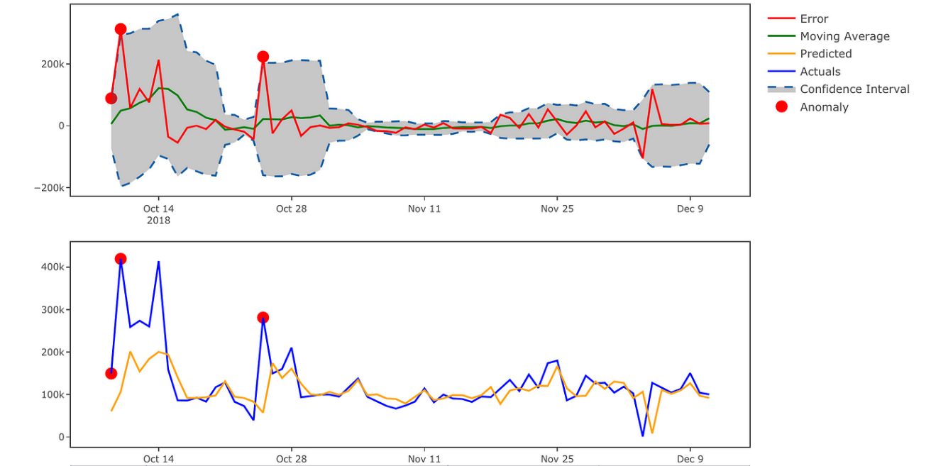
Future Ideas
🧠 Advanced Analytics Ideas:
Anomaly Detection using statistical models on std_dev
Forecasting Trends via AWS Forecast or Amazon SageMaker
Drift Detection if sensors start consistently varying from historical means
Visual Alert Timeline in QuickSight or Grafana
​

Slide 17

Oslo Manual, Chapter 6
Thank You!

