Slide 1
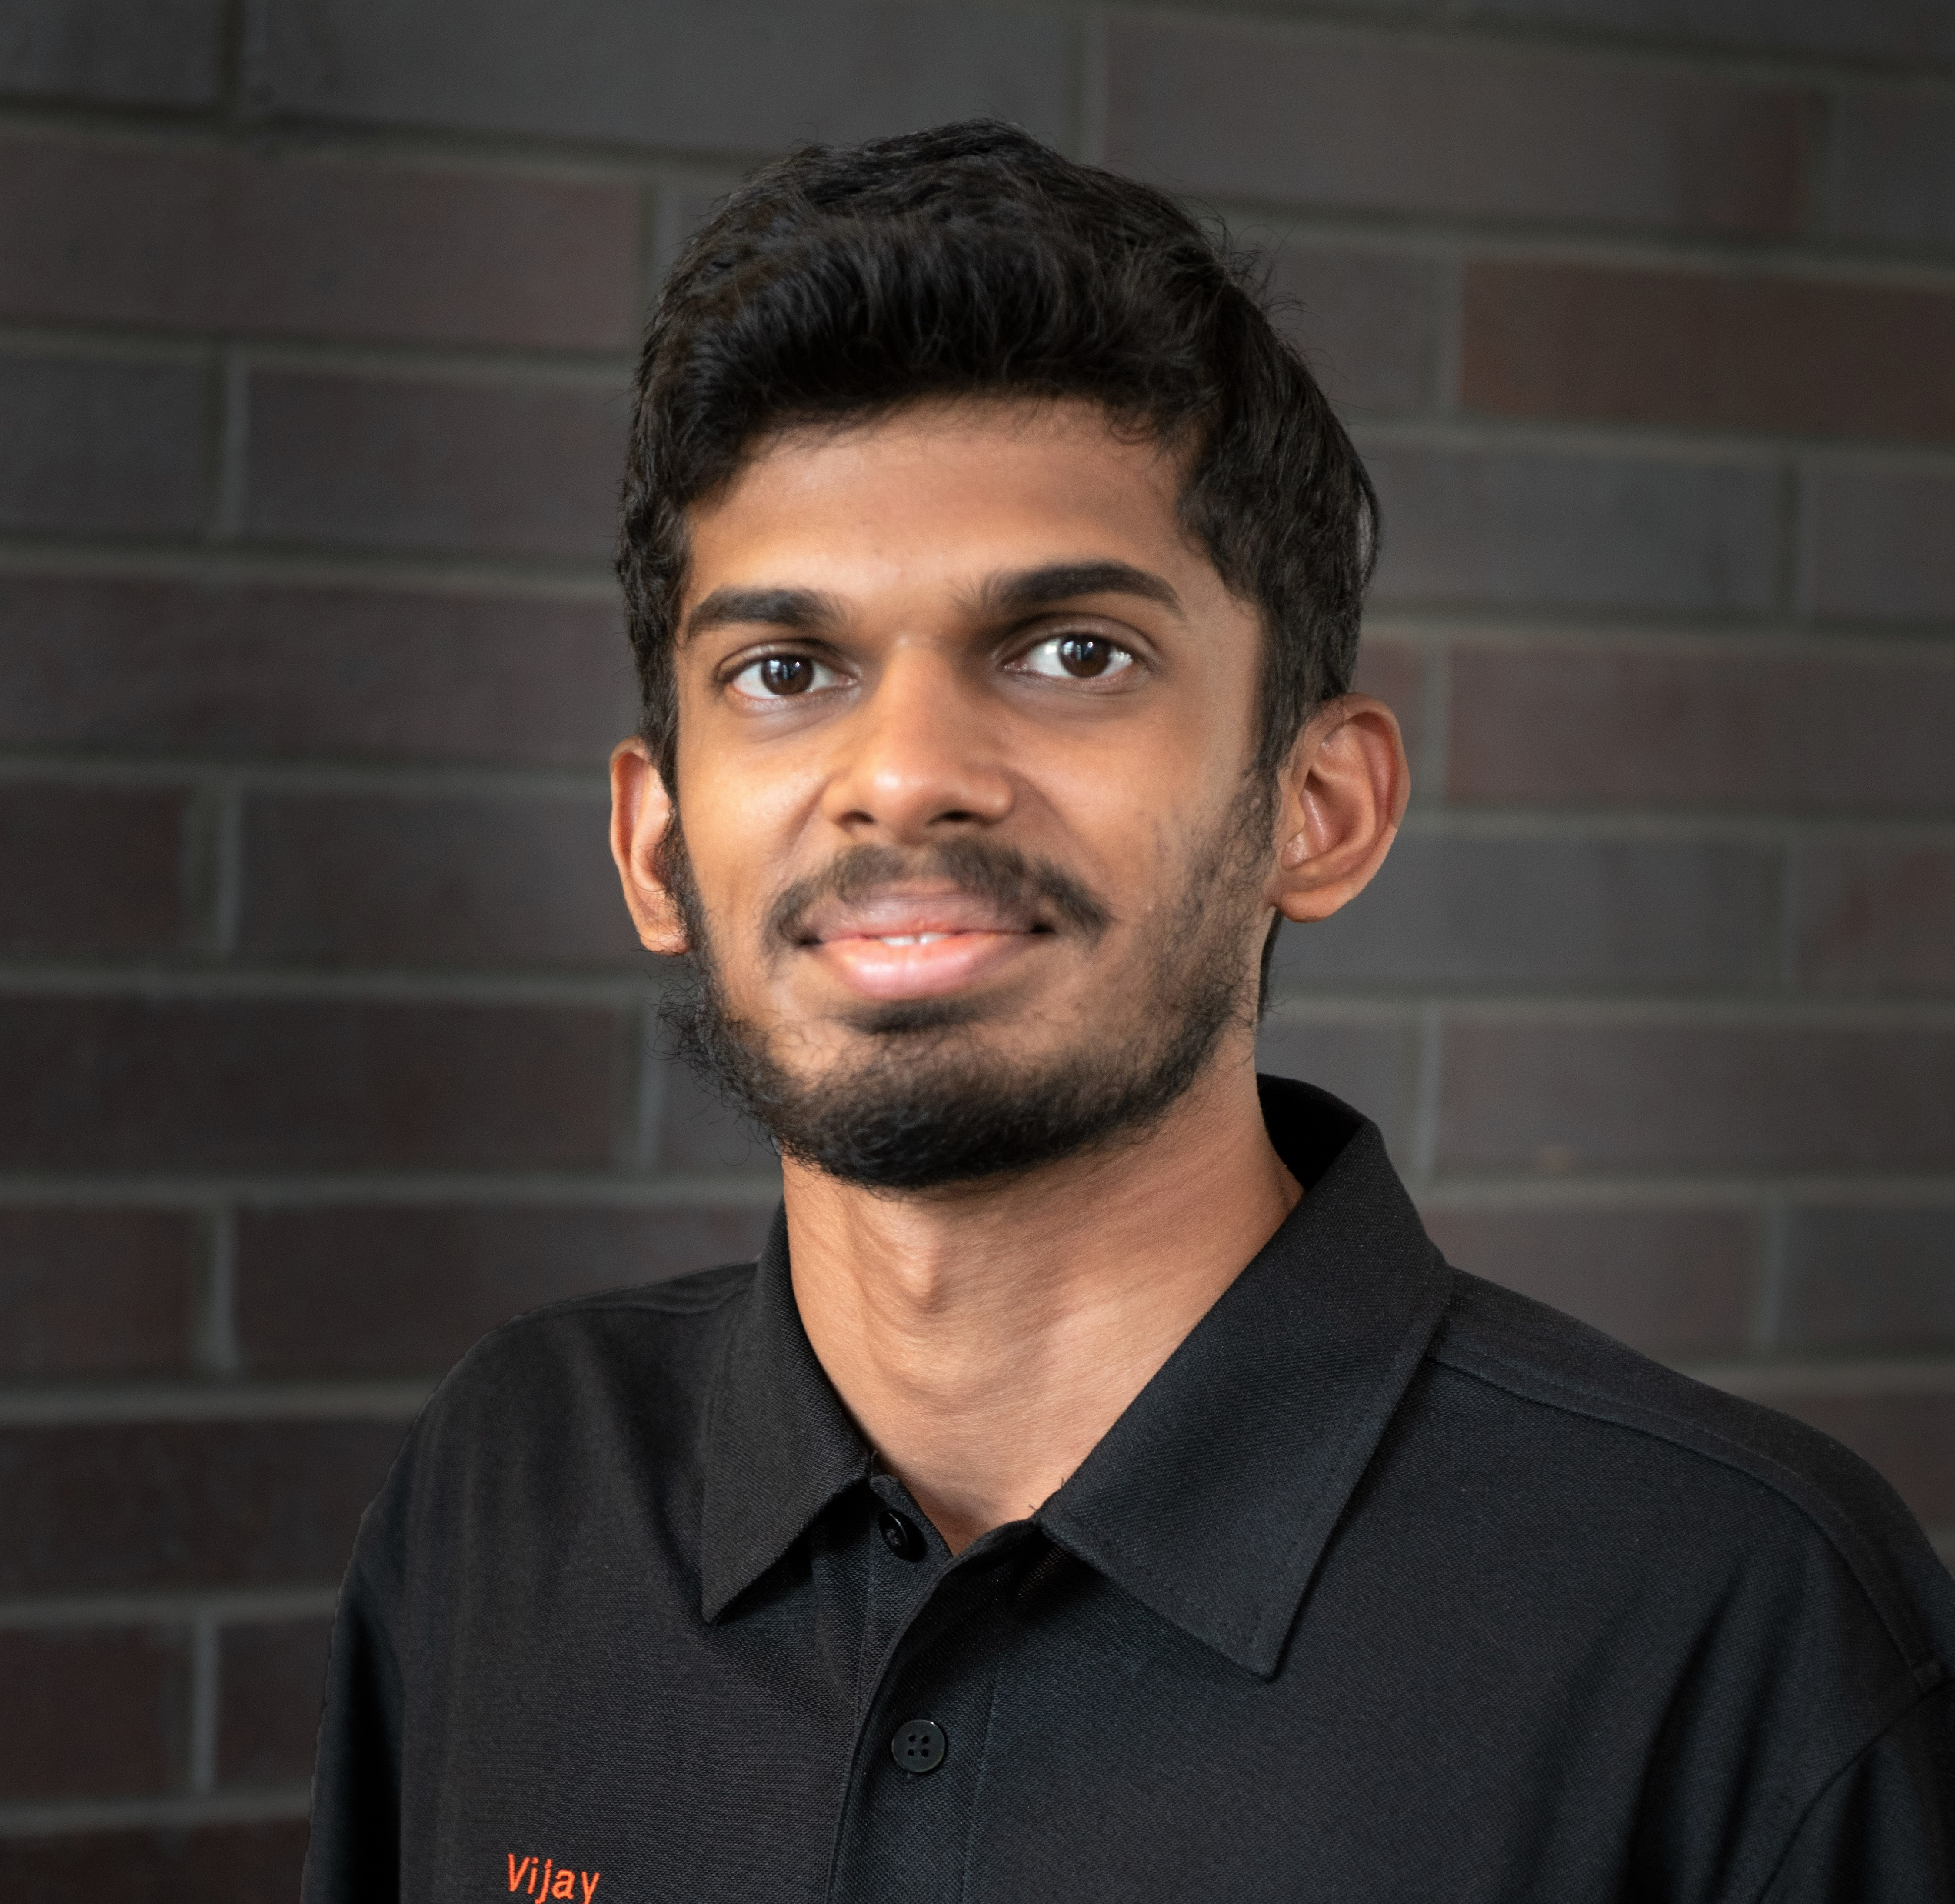
Portfolio
Vijay Lakshmanan Radhakrishnan (Vijay)
Test Engineer,
John Deere
E-mail ID: vjlatchu@gmail.com
GitHub: GitHub Repo
City: Ankeny, IA
Experience:
Test Engineer, John Deere (Sep 23 – Current)
ADAS Simulation Engineer,
Ford Motor Company (Sep 22 – Jun 23)
Areas worked on:
ADAS Simulations
Vehicle Dynamics Modeling
Brake Design, Controls and Testing
Vehicle Testing & Test Automation
Systems Engineering
Skills and Tools:
C/C++, Python, Bash
Matlab, Simulink and Stateflow
CAN protocols, Vector CAN tools
Git, Jira, Confluence, Microsoft Office Suite
Hobbies:
Badminton
Driving/ Go Karting
Languages: English, Tamil, German (Beginner)

