Slide 1
DATA SCIENCE
ADVANCED
CAB FARE PREDICTION
USING PYTHON
VIJAY BONDI
Y20AIT411
INFORMATION TECHNOLOGY
IT-A

Slide 2
Contents….
Abstract
Existing System
Proposed System
Flow Charts
Code
ScreenShots
References

Slide 3
ABSTRACT
Problem Statement
Data preprocessing
Modelling
Model Selection

Slide 4
Problem Statement
You are a cab rental start-up company. You have successfully run the pilot project and now want to launch your cab service across the country. You have collected the historical data from your pilot project and now have a requirement to apply analytics for fare prediction. You need to design a system that predicts the fare amount for a cab ride in the city

Slide 5
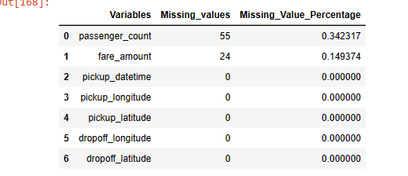
Data Preprocessing
Missing Value Analysis
→ The availability of incomplete observations.
→Incomplete submission ,wronginput,manual errors.
→It affects the Accuracy of the data model

Slide 6
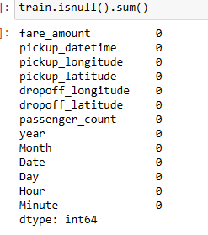
Data Preprocessing(contd)
Outlier Analysis
→The observations that deviates away from the remaining observations.
→Causes error in predicting target variables.
→check for outliers and remove them

Slide 7
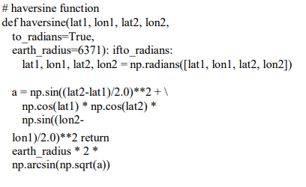
Data Preprocessing(contd)
Feature Selection
→Reducing the variables
→ Haversine function

Slide 8
Modelling
Linear Regression
Decision Tree
Random Forest
Gradient Boosting
Hyper Parameter Tuning
→Random Search CV
→Grid Search CV

Slide 9

Model Selection
Model Evaluation.
→Root Mean square Error:
Difference between values predicted and actual values.
→R Squared(R^2):
It a statistical measure of how close the data are to the fitted regression line

Slide 10
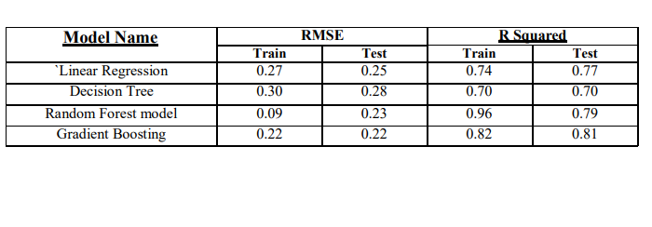
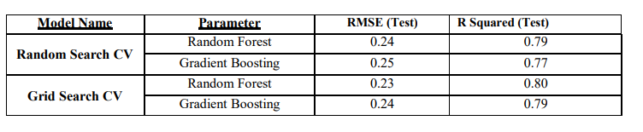
Model Selection(contd)
→A good model should have least RMSE and max R Squared value

Slide 11
Existing System
Static Pricing Models:
  Fixed pricing models and their shortcomings.
  Lack of adaptability to real-time variables.
Data Insufficiency:
  Issue of insufficient or outdated data used
  Lack of dynamic data sources for accurate predictions.
Dependency on Rule-Based Systems:
  Highlight reliance on rigid rule-based systems
  Inability to capture nuanced factors .

Slide 12
Proposed System
Flexibility in adjusting fares based on factors like demand, traffic, and weather conditions.
Improved accuracy
Enhanced user experience
Optimized operational efficiency.
Positive implications for both users and service providers.

Slide 13
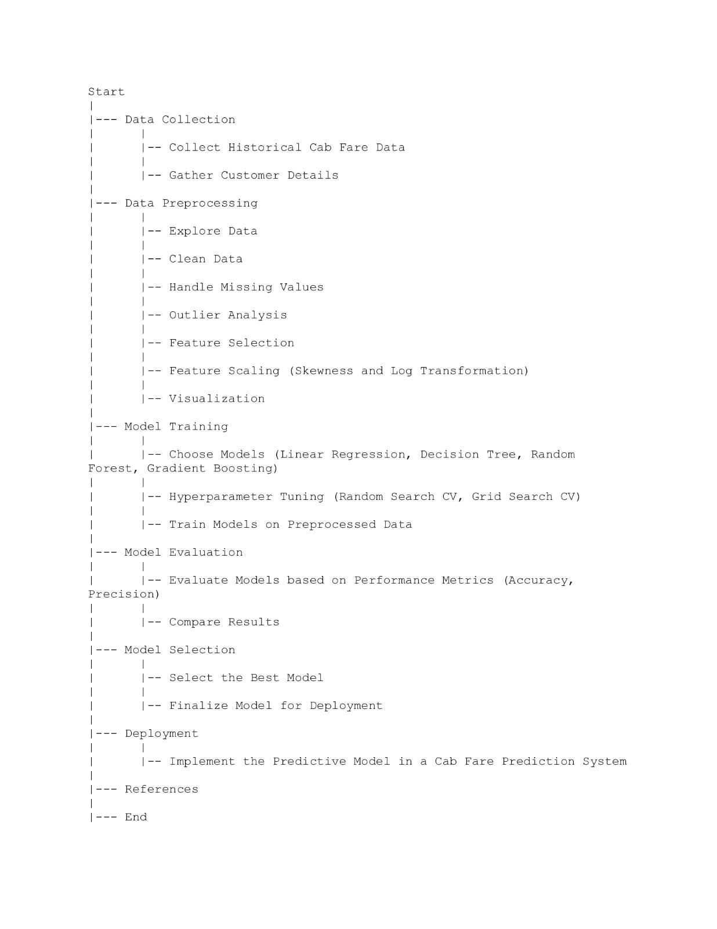
Flow Chart

Slide 14
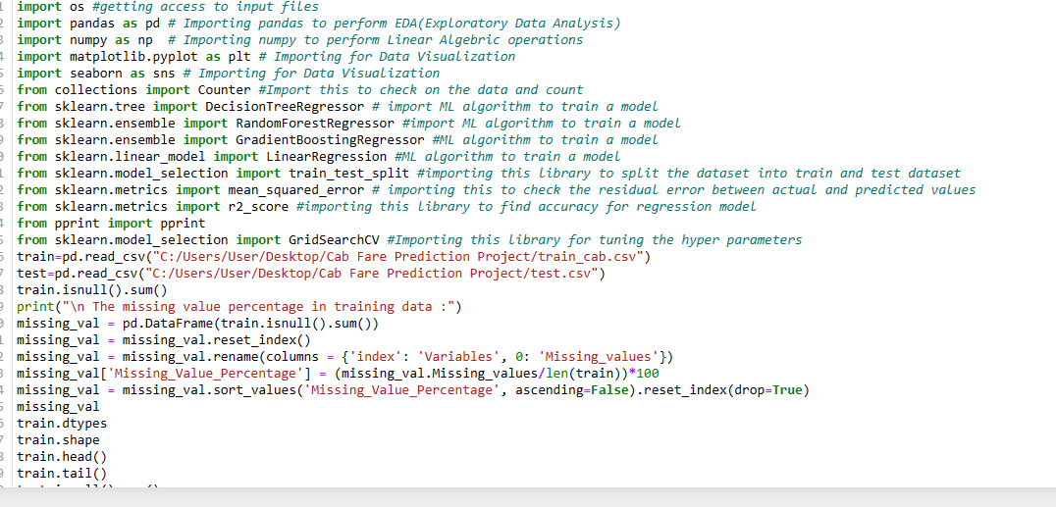
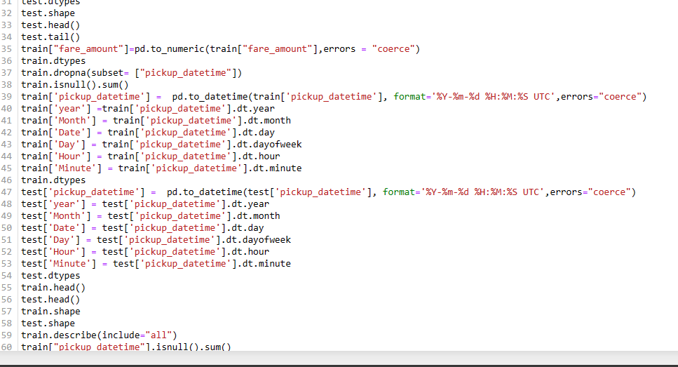
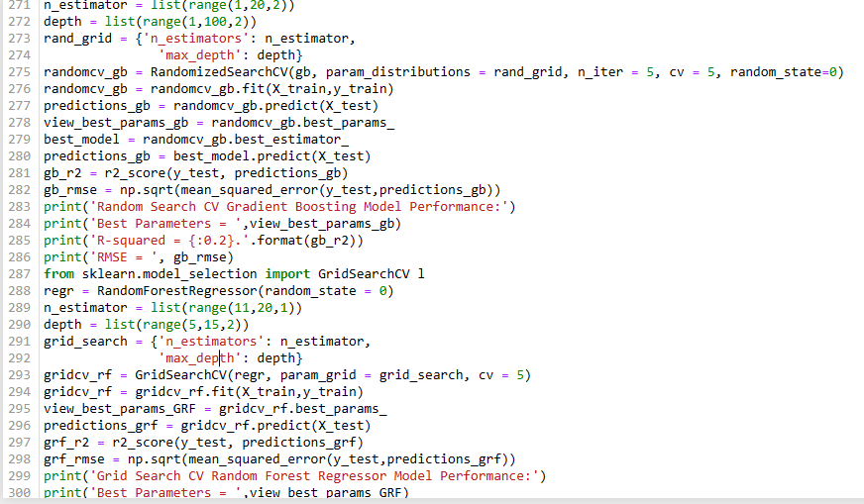
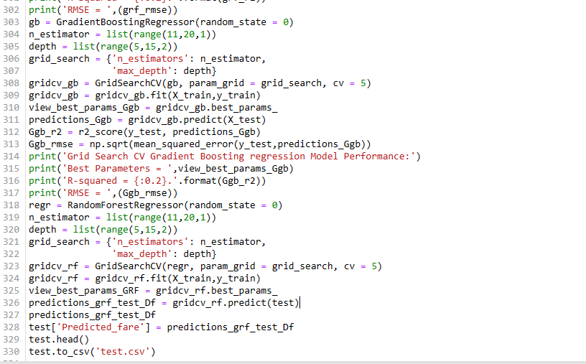

Slide 15
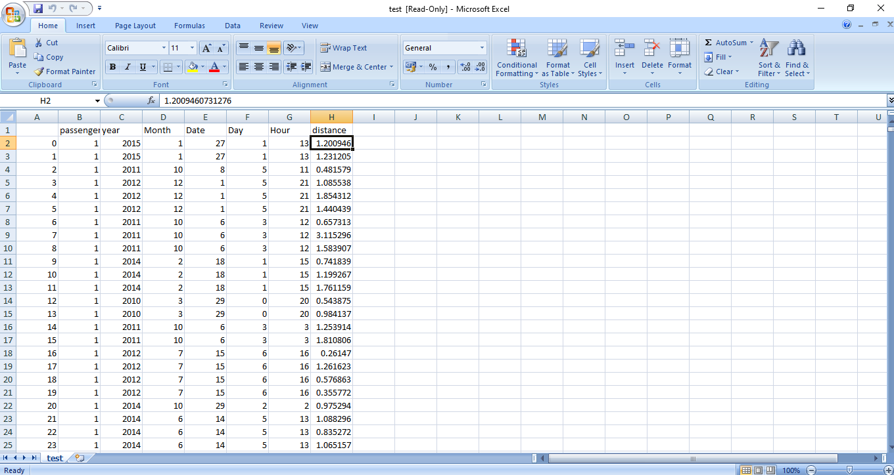
ScreenShot

Slide 16
References
For Data Cleaning and Model Development - https://edwisor.com/career-data-scientist
2. For other code related queries - https://www.analyticsvidhya.com/blog/2016/03/practical-guide-principalcomponent-analysispython/
3. For Visualization –
https://www.udemy.com/python-for-data-science-and-machinelearningbootcamp/
4.https://towardsdatascience.com/
5. https://stackoverflow.com/

