Slide 1

Seasonal Agriculture Performance Analysis
VIJAY CHANDRA
Uttarakhand Technical University, Dehradun
AICTE STU ID : STU6a65c636e2d6a1785054774

Slide 2

PROBLEM STATEMENT
Agricultural activities are influenced by seasonal variations in environmental conditions, farming practices, resource availability and market conditions. As a result, agricultural performance may differ from one season to another.
However, raw agricultural data does not clearly explain how agricultural performance changes across seasons or what patterns can be observed in different seasonal conditions.
The problem is to analyze the given agricultural dataset and investigate seasonal differences in agricultural performance by identifying meaningful patterns, trends, relationships and variations within the available data.

Slide 3
Project Description This project performs exploratory data analysis on a seasonal agriculture performance dataset containing 4,000 records across 28 attributes, covering environmental conditions, resource usage, crop production, and economic outcomes across three seasons — Kharif, Rabi, and Zaid. Key steps performed: - Data cleaning (handled missing values) - Statistical analysis (descriptive stats, IQR, seasonal summaries) - Univariate analysis (season, crop, and rainfall distributions) - Outlier analysis (IQR-based detection across all numeric variables) - Bivariate analysis (season vs yield, rainfall vs yield, farm area vs production, irrigation method vs yield) - Seasonal comparison of resource usage and economic outcomes - Cross-analysis of yield consistency across states and seasons - Correlation analysis across all numeric variables

Slide 4

WHO ARE THE END USERS?
Farmers – to plan crop choice, irrigation, and resource use by season
Agricultural policymakers – to design season-specific support programs
Agribusiness and supply chain companies – to anticipate seasonal production and pricing patterns
Agricultural researchers/data analysts – studying seasonal performance trends

Slide 5

Technology Used
- Python
- Google Colab
- Pandas – data loading, cleaning, and analysis
- NumPy – numerical operations
- Matplotlib – data visualization
- Seaborn – statistical visualization

Slide 6
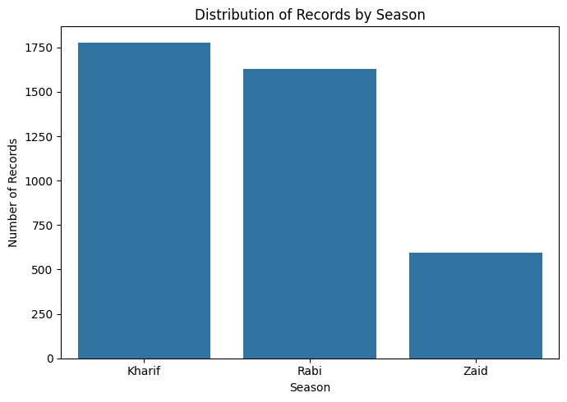
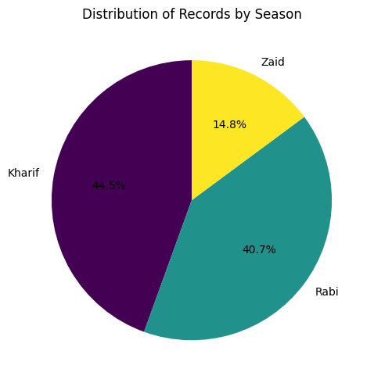
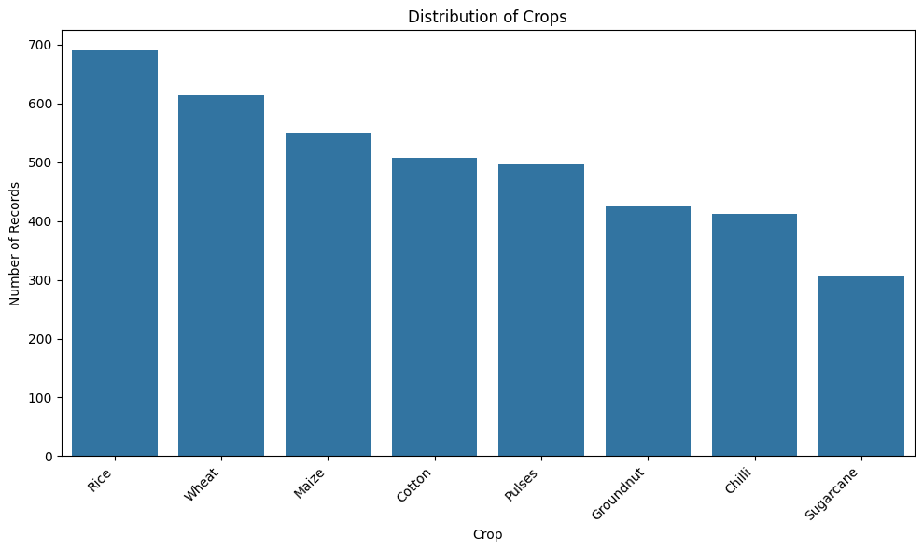
RESULTS
Season & Crop Overview

Slide 7
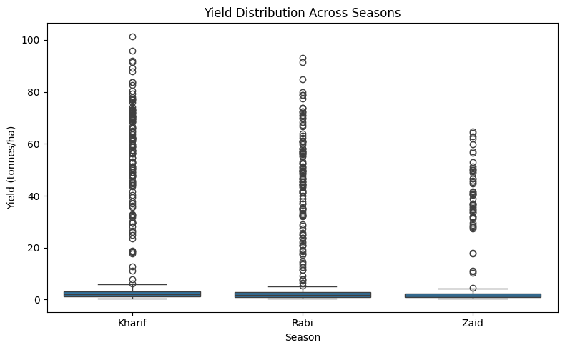
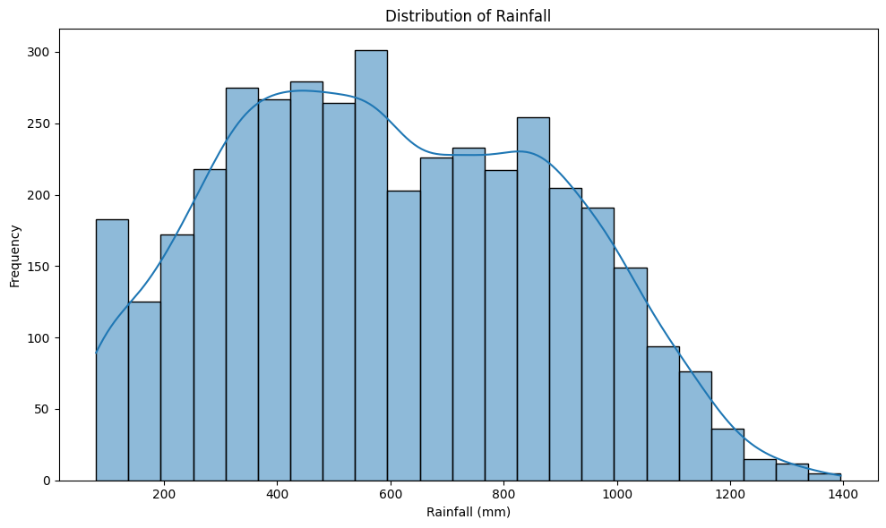
RESULTS
Seasonal Yield Comparison

Slide 8
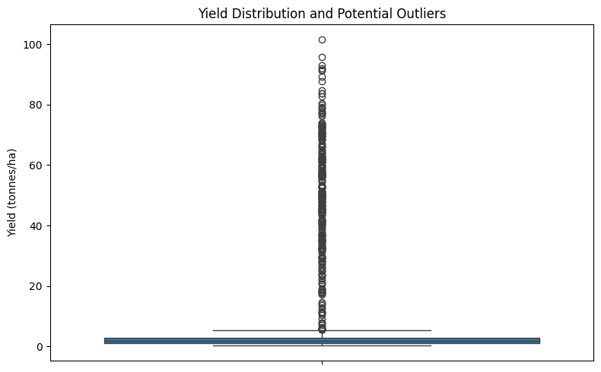
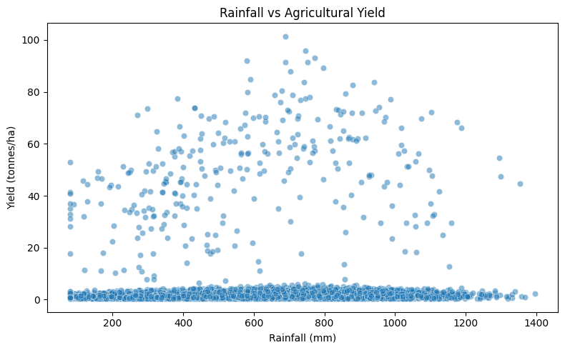
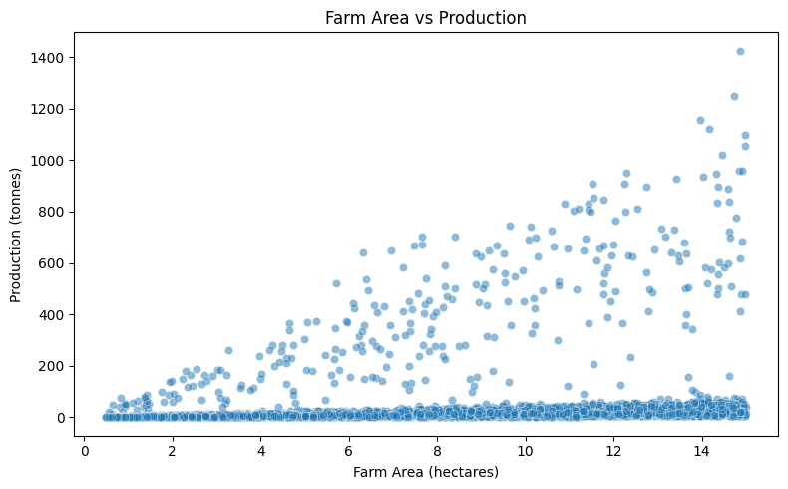
RESULTS
Outlier & Bivariate Relationships

Slide 9
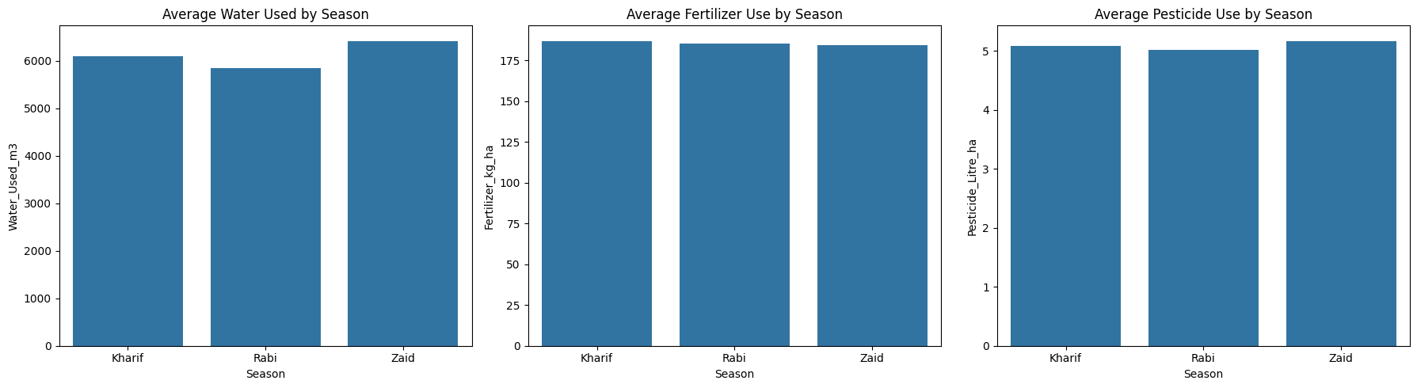
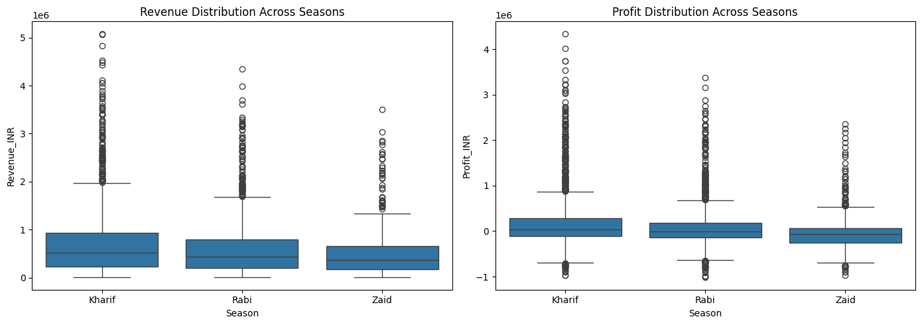
RESULTS
Resource Usage & Economic Outcomes

Slide 10
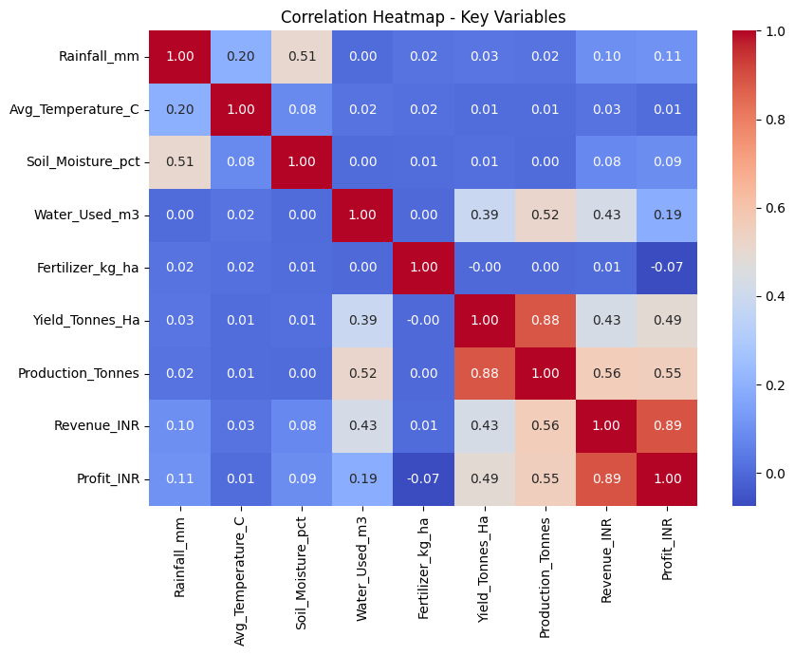
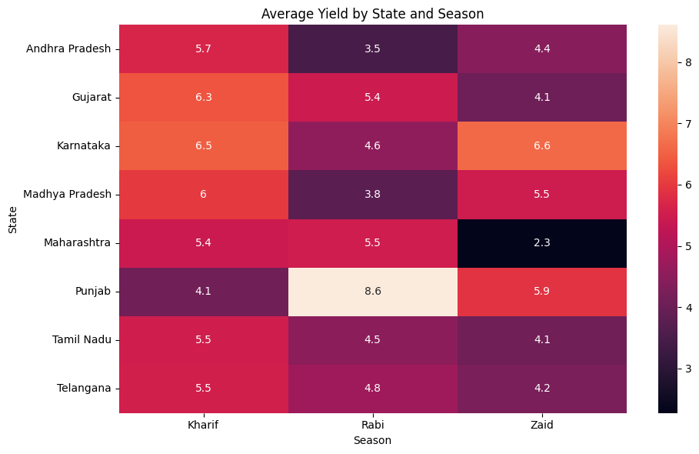
RESULTS
Correlation & Regional Consistency

Slide 11
Future scope
Incorporate crop-specific analysis to identify best-performing crops per season
Apply predictive modeling (e.g., regression) to forecast yield or profit based on environmental and resource inputs
Extend the analysis with time-series data across multiple years to detect long-term seasonal trends
Build an interactive dashboard for farmers/policymakers to explore seasonal performance by state

Slide 12
GitHub Link
https://github.com/VijayChandra70/Seasonal-Agriculture-Performance-Analysis

Slide 13

VOIS Course completion certificate - Course name- Data Visualization

Slide 14
Thank you
From raw agricultural data to seasonal insights:
This project reflects my growing skills in data analysis and interpretation.
So, Thanks a Lot
Vijay Chandra
.
.

