Slide 1
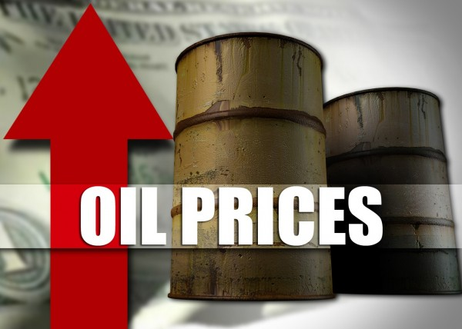

PREDICTION

Slide 2

Project Mentor:
Anavadhya
Project Co-Ordinator:
Karthik muskula
Group - IV Members:
Ms. Vangeti Bhavana
Ms. Himabindu Bangaru
Mr. Prathamesh Manohar Marathe
Thorat Siddesh Rajendra
Ms. Vishnu Priya. R
Mr. Vijaykumar V Dalali
Mr. N. Rajesh

Slide 3
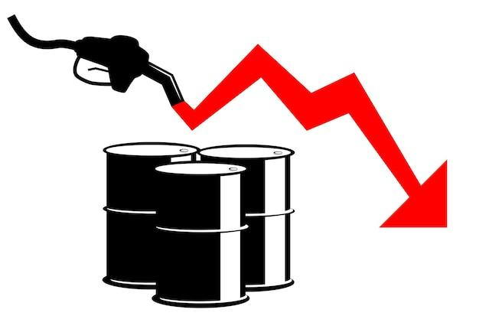
Purpose: The purpose of an oil price prediction data science project is to leverage advanced analytics and machine learning techniques to provide valuable insights into future oil price movements.
Aim: The oil price prediction project is to develop and deploy an accurate and reliable machine learning model capable of forecasting future oil prices.
Key Attributes: Date, Price

Slide 4
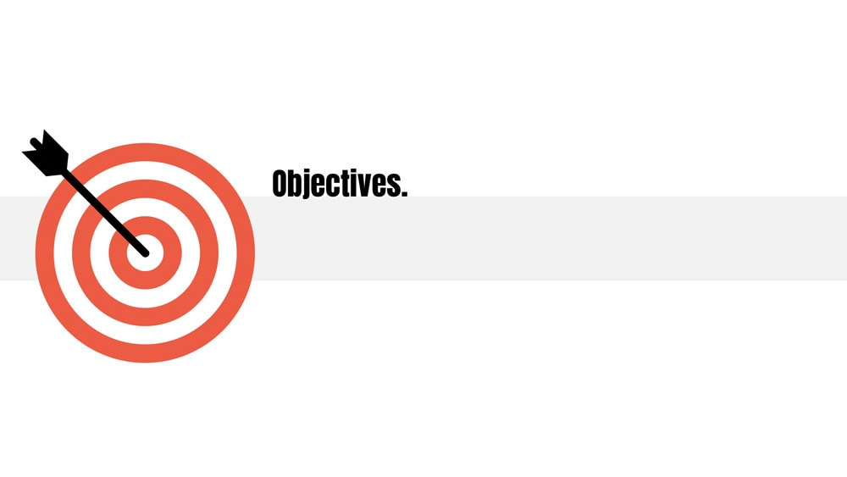
To develop and deploy a machine learning model capable of predicting the daily closing prices of Brent crude oil for the next 365 days.
The model will be trained on historical data spanning the past 4 years, incorporating features such as past Oil prices and Date.
Specifying the time horizon for the predictions. For instance, we are predicting daily price This helps in determining the appropriate level of granularity for the model.
The metric that will be used to evaluate the performance of the model. Common metrics for regression tasks include RMSE(Root Mean Squared Error).
The deployed model will be accessible through a user-friendly interface, providing timely predictions to investors and industry professionals.
Regular updates and retraining will be performed to ensure the model remains accurate in dynamically changing market conditions.

Slide 5

DATASET
Source: Economics Research
Time Period of Data is 4 Years
Predicting for next 365 Days
Link: https://fred.stlouisfed.org/series/DCOILBRENTEU

Slide 6

Analysis
Import Libraries and Load Data
Explore the Data
Visualize Data Distributions

Slide 7

Import Libraries
#Start by importing the necessary libraries
import pandas as pd
import numpy as np
import matplotlib.pyplot as plt
import seaborn as sns
import datetime from statsmodels.tsa.seasonal import seasonal_decompose
from statsmodels.tsa.statespace.sarimax import SARIMAX
from statsmodels.tsa.seasonal import seasonal_decompose
from pmdarima import auto_arima from keras.models import Sequential
from keras.layers import Dense, Dropout
from keras.models import load_model from sklearn.metrics import mean_squared_error,mean_absolute_error, mean_absolute_percentage_error import itertools
import statsmodels.api as sm
from statsmodels.tsa.arima.model import ARIMA, ARIMAResults

Slide 8
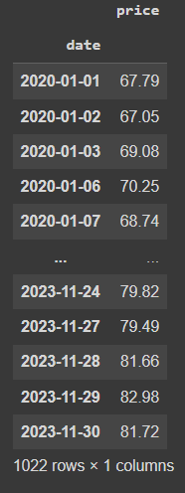
Load Data
# Load your dataset into a Pandas Data Frame
oilprice=pd.read_excel("oil prices.xls",index_col=0, parse_dates=True)
1022 rows × 1 columns
Data Set:
1022 rows of daily data from the previous four years make up the data set.
Two features make up the data, and they are as follows:
Date
Price
Data Types:-
Date :- Date Time
Price :- Float

Slide 9

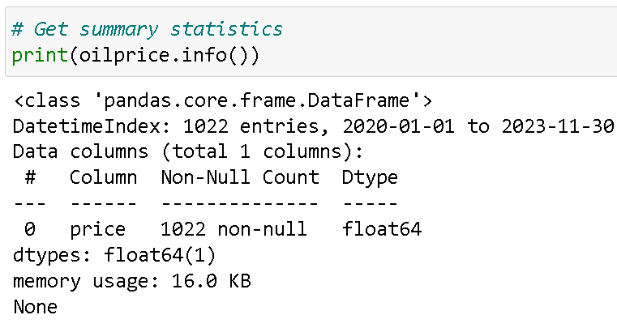
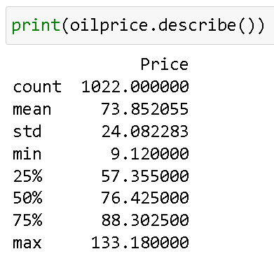
Explore the Data
Observation:
It is evident that there are 1022 observations in the dataset spread across 1 variables. It looks that there are no missing values in the data frame as a result.
Observation:
Use df.describe() to view the dataset's descriptive statistics. The count, mean, standard deviation, min, max, and lower, middle (median), and upper percentiles are included in the result's index for numerical data.

Slide 10
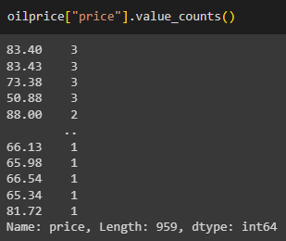
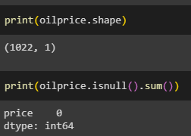
Observation:
It gives back the number of times each value repeats.
Observation:
It indicates that the data set's dimension is (1022,1) and that there are no null values present.

Slide 11

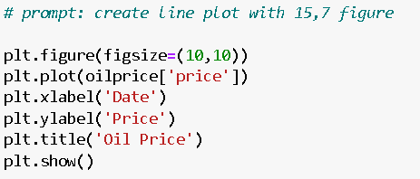
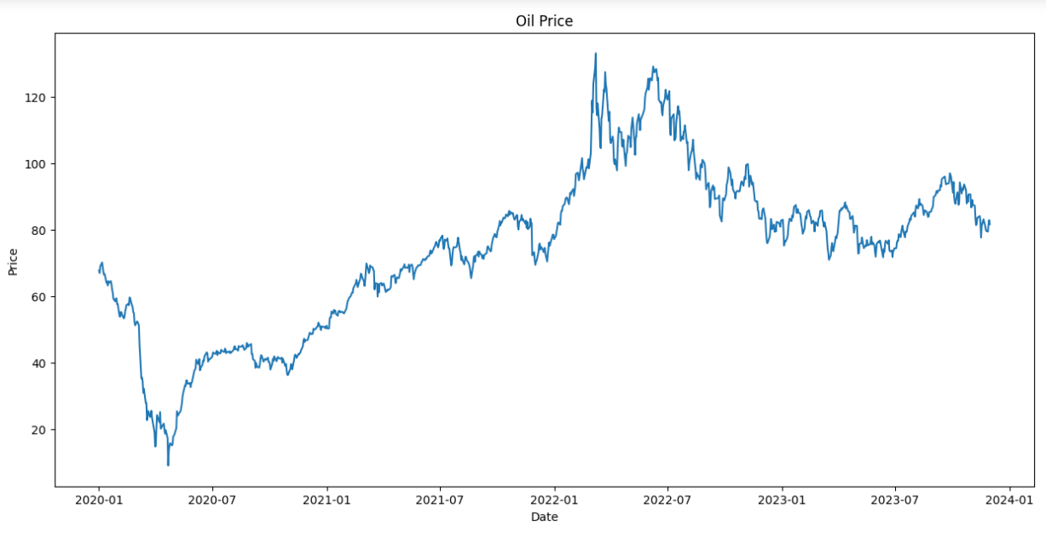
Visualize Data Distributions
Observation:
We can see a significant decline in prices around May 2020.
The COVID-19 Pandemic in May 2020 resulted in the lowest pricing.
Once more, the price increases are noticeable and peaked in 2022–2026.

Slide 12
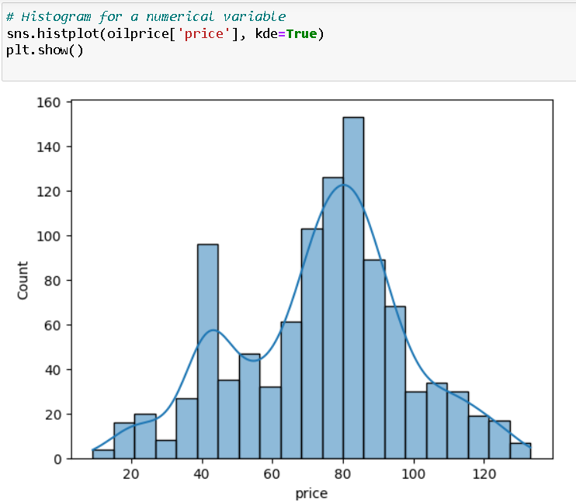
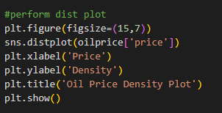
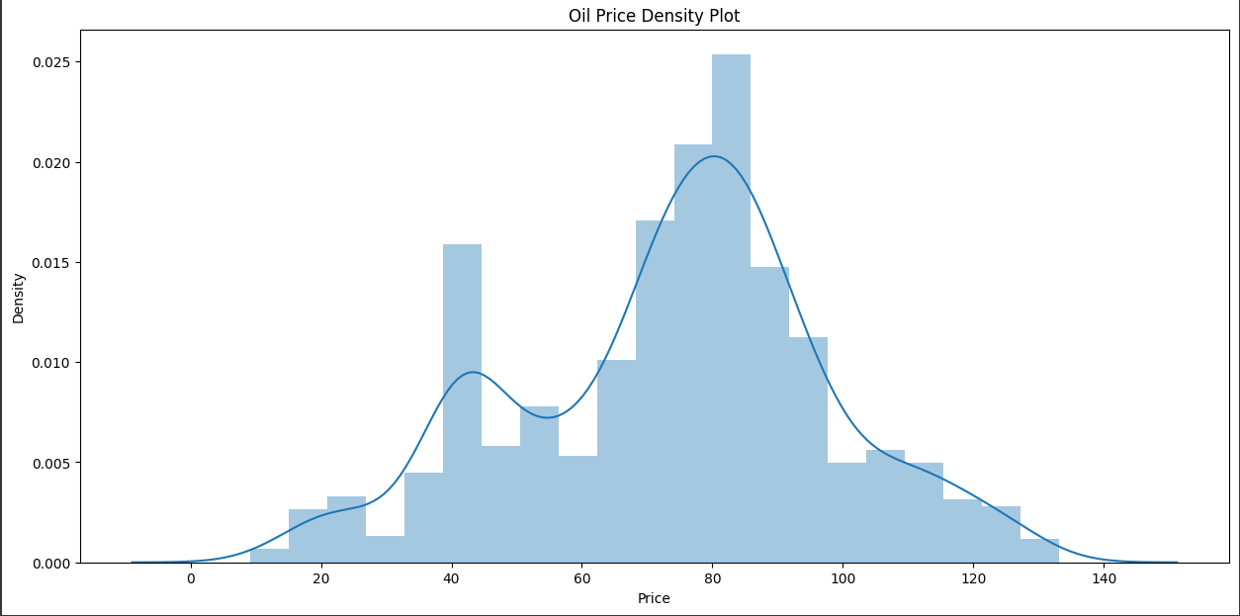
Visualize Data Distributions
Observation:
The distribution of skewness is symmetrical.
That implies mode=mean=median

Slide 13
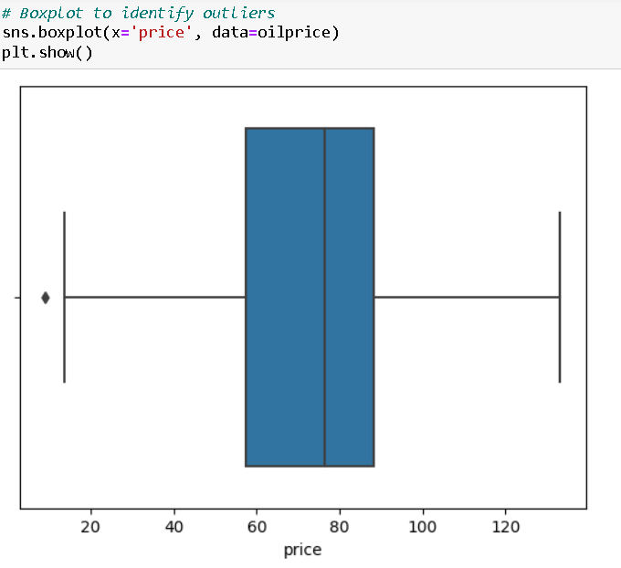
Visualize Data Distributions
Observation:
Few outliers can be observed due to high prices increment in 2022-06
Outliers are taken into account for additional steps.

Slide 14
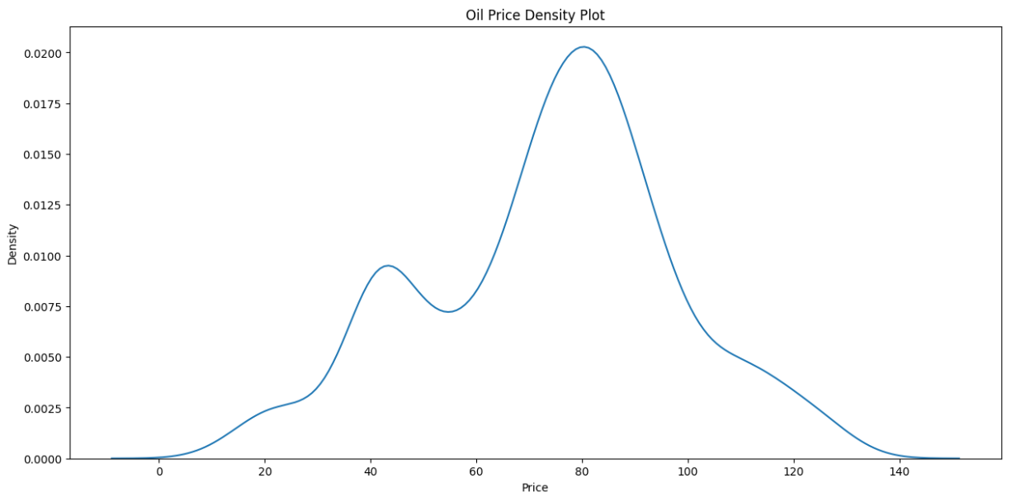
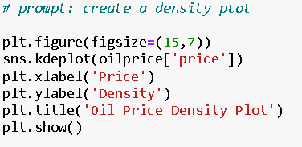
Visualize Data Distributions

Slide 15
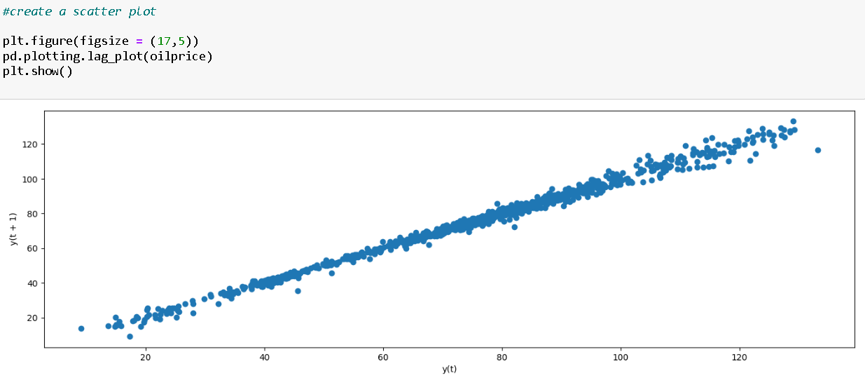
Visualize Data Distributions
Observation:
Represents lag value using scatter plot.
It demonstrates that there is an increasing association between a variable (price) and its lag values (price).
Lag _ Plot

Slide 16
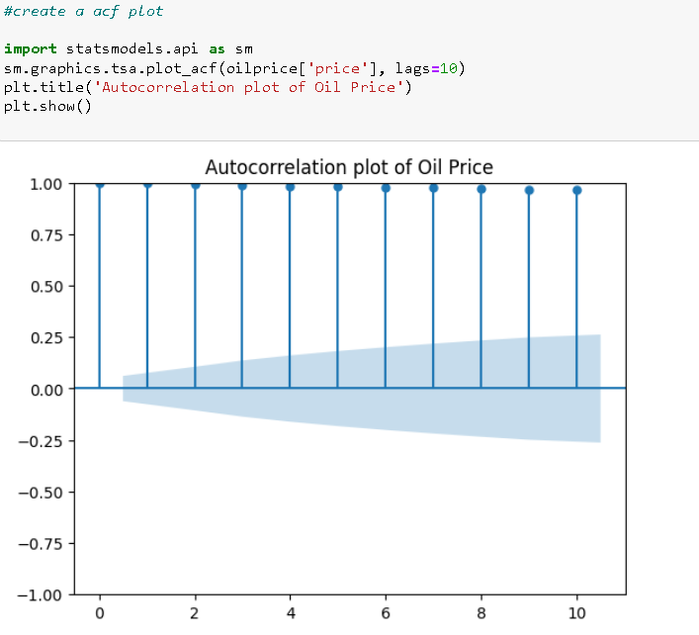
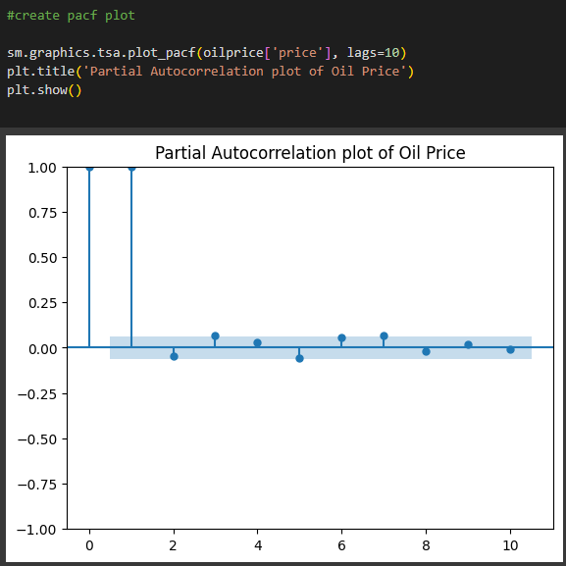
Visualize Data Distributions
Observation:
The correlation between a time series and its lag values is measured by ACF.
After accounting for the influence of the intervening values, PACF calculates the correlation between a time series and its lagged values.
When PACF is calculated, the residual is close to zero.

Slide 17
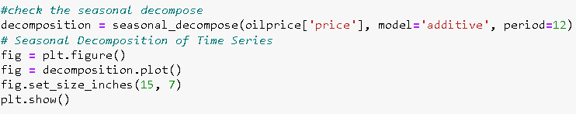
Visualize Data Distributions

Slide 18
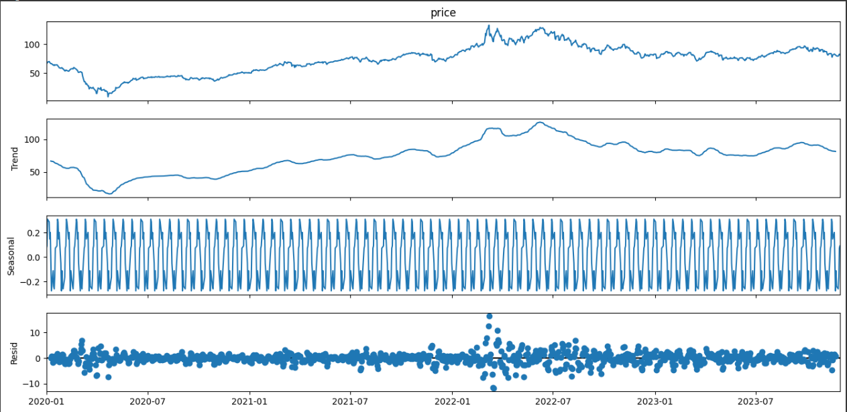
Performed seasonal decomposition to check trend, seasonal, resid.
Observation:-
1.Observed - Actual data
2. Trend – The data fluctuates during the course of the time period, as the graph illustrates. can also observe the extreme swings in 2022.
3. Seasonality- Seasonality was discovered to be a recurring pattern of increases and reductions across time.
4. Residual – It is the annual noise pattern of the time series data that was overlooked by the Trend and Seasonality components. The residue that remains after the two primary components trend and seasonality are broken down.

Slide 19
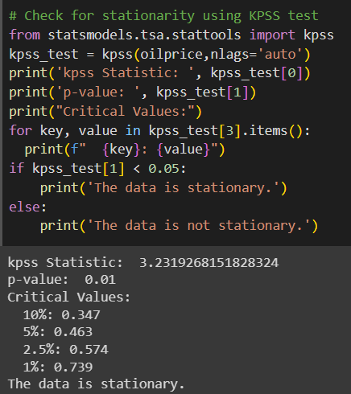
Stationarity check
Observation:-
We employed the KPSS test to verify if the data was stationary or not.
Value of KPSS statistics: 3.2319268151828324.
P-value needs to be smaller than 0.05.
This data set's P-value is 0.01.Thus, we believe that the data is stationary.
Also, the critical values are close to one another as shown below.
• 1% : 0.739
• 2.5% : 0.574
• 5% : 0.463
• 10% : 0.347

Slide 20

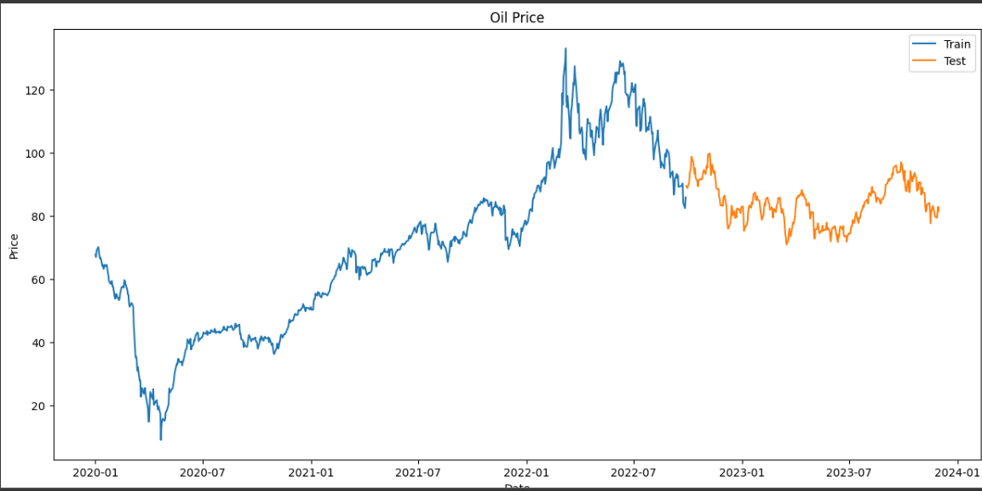
Splitting Data
Observation:-
Splitting 70% of data into train and 30% of data into test

Slide 21
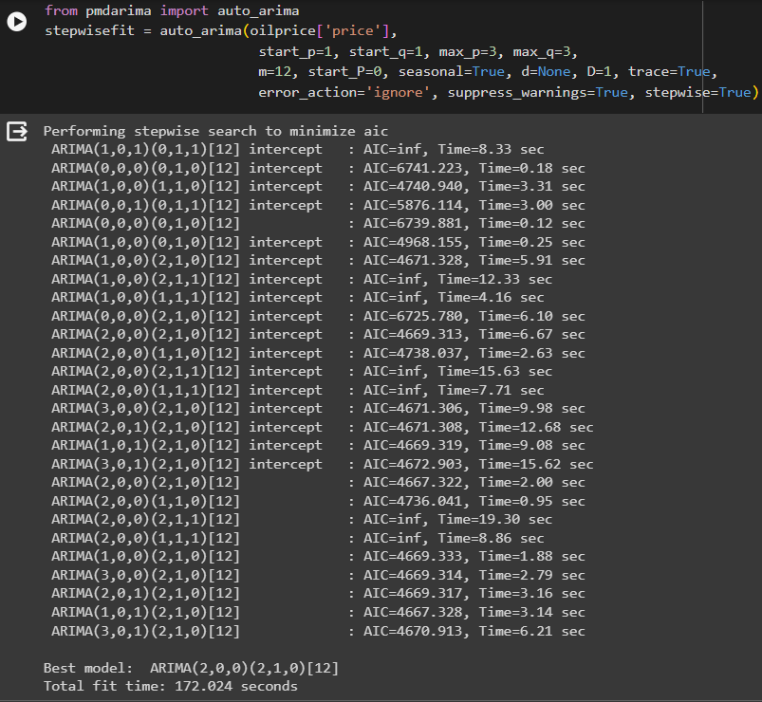
Model Selection
Observation:-
Comparing tried models
Holts winter exponential smoothing with
additive seasonality and additive trend RMSE:
9.192169939702206
Holts winter exponential smoothing with
multiplicative seasonality and additive trend RMSE:
9.162756385924649
LSTM Model RMSE: 7.895736161445294
RNN Model: 7.868199250846617
Arima model RMSE: 7.494392727133029
We experimented with every time series forecasting model available before settling on the Arima model. Because the Arima model’s RMSE value was lower than those of the other models.
We will determine the optimal p, d, and q variables as well as the seasonal order to train the model after choosing Arima.

Slide 22
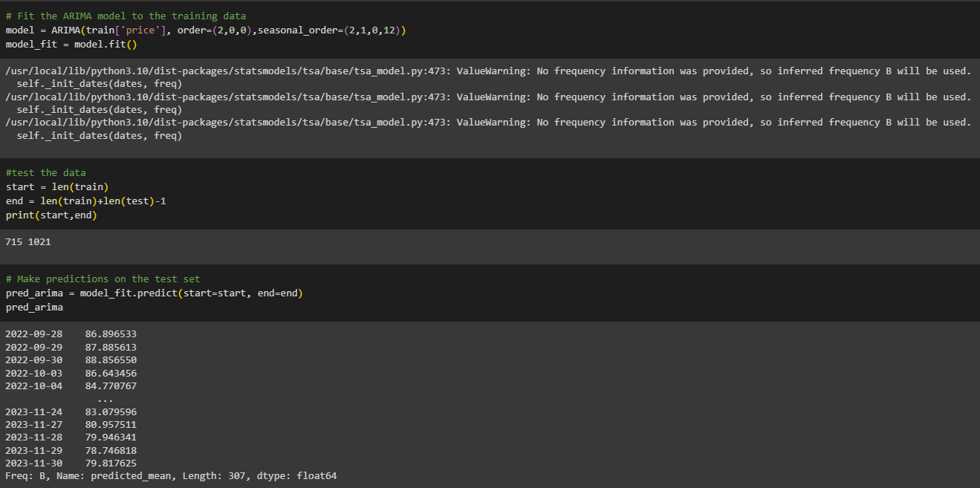
Model Training
Observation:
Upon obtaining the top Arima model.
Fit the training set of data to that Arima model.
Next, test the data and draw conclusions based on the results.

Slide 23
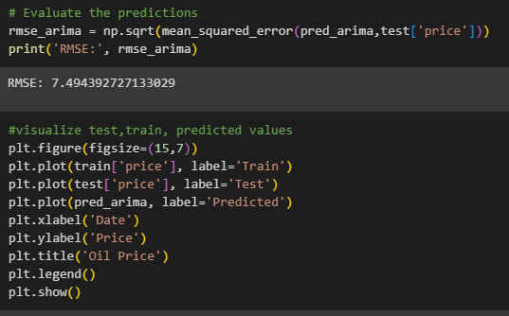
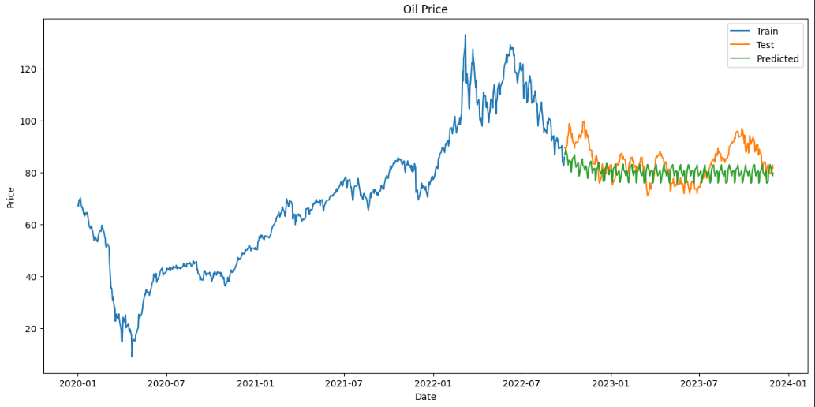
Model Evaluation
Observation:
Examine the forecasts after receiving them based on the tested facts. 7.494392727133029 is the RMSE value.
Afterwards, visualizing the train, test, and price predictions

Slide 24
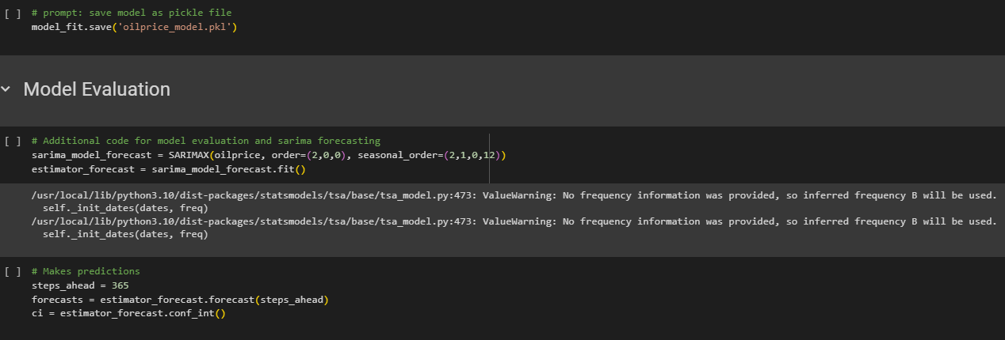
Predictions
Observation:
Save the model as pickle file
Forecasting the predictions of next 365 days

Slide 25
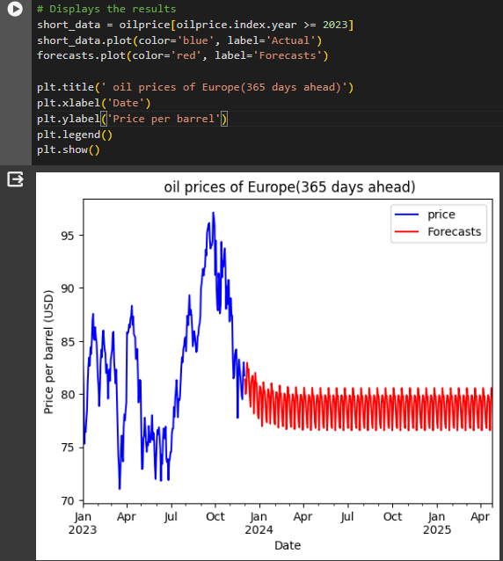
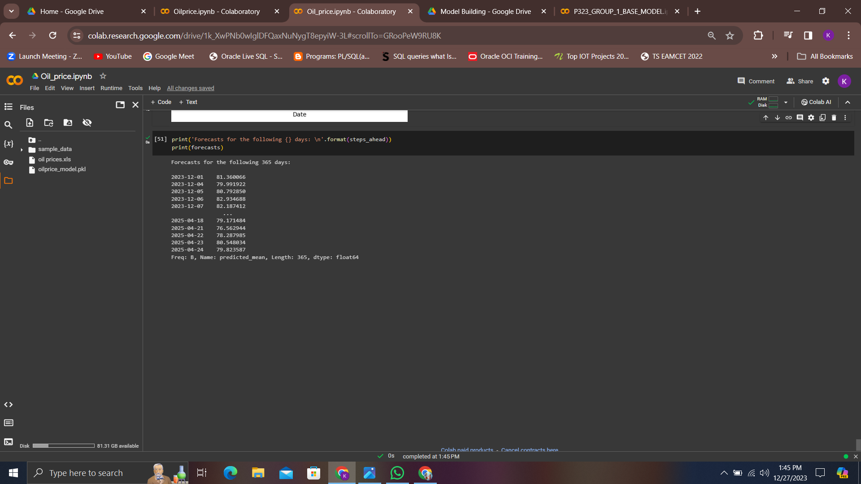
Observation:
Forecasting the future predictions
See the forecasts for the next 365
days in visual form.

Slide 26
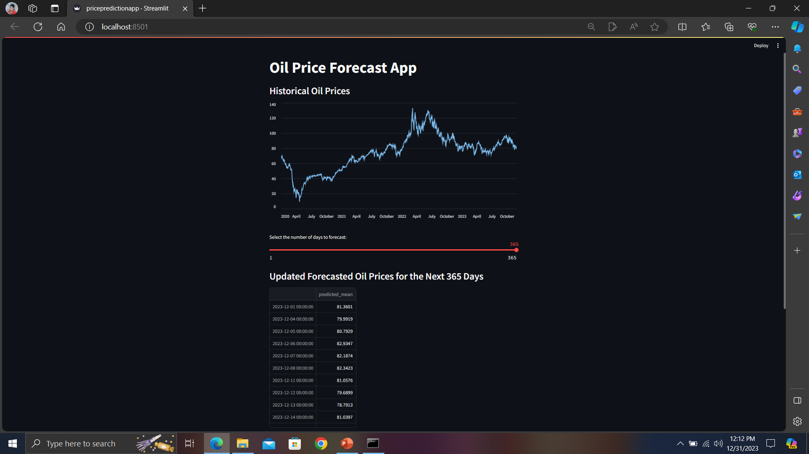
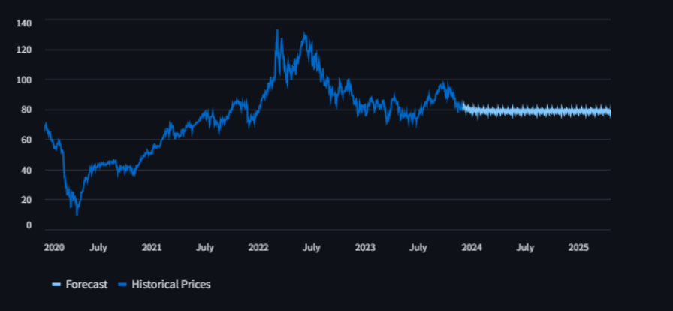
Deployment

Slide 27

It was an exciting challenge to create the dataset for the parameters that influence the price of oil from scratch.
Web scraping content from websites without authorization and Finding alternatives for the same was consequently a difficult task.
It took a long time to select a model by comparing each model's RMSE value.
It is difficult to deploy the work in various ways using streamlit to meet our objectives. For example, regulating the number of days for customized output and giving the user a clear perspective by displaying graphs for the days they need is difficult.

Slide 28


