Slide 1

EVENT PLANNERS
Presented By
VIJAY ELUMALAI
EBEON0222569310
Batch 2021-6973

Slide 2
Contents
Introduction
Problem Statement
Features
Advantages
Requirements
Output
Conclusion

Slide 3

Introduction
The Project Event Planners Software is
for Booking the Events from the Customer
and Stores all their data in the Database.
MySQL is used to Manage the Database.

Slide 4
Problem statement
This Project helps the Customers to make their day more special by making them simpler to book their friends and family events.
Adding the Customers details.
Updating the details of the Customer.
Deleting the Customer Details.
Search a particular details of the Customers.
Viewing all the details from the Database.

Slide 5
Features
In my Project,
The Customers can view The Events.
They can Book their events by simply selecting and providing the list provided.
The Customer can update their details.
Also Customer can delete the details.

Slide 6
Advantages
Manage the Information of customer details.
Can book anywhere at anytime.
User Friendly.
Easy to use and understand.

Slide 7
System Requirements
Operating System : Windows 10
Technology : Core Java, adv Java(JDBC)
Development Environment : Eclipse
Database :MySQL
Software : jdk 1.8.0_202, jre 1.8.0_202

Slide 8
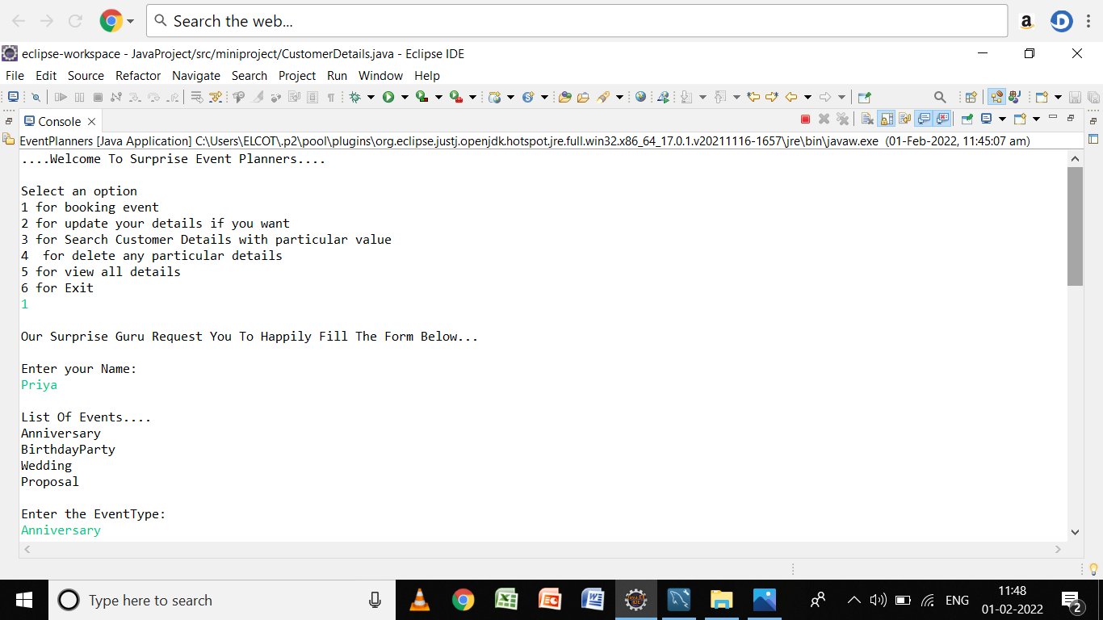
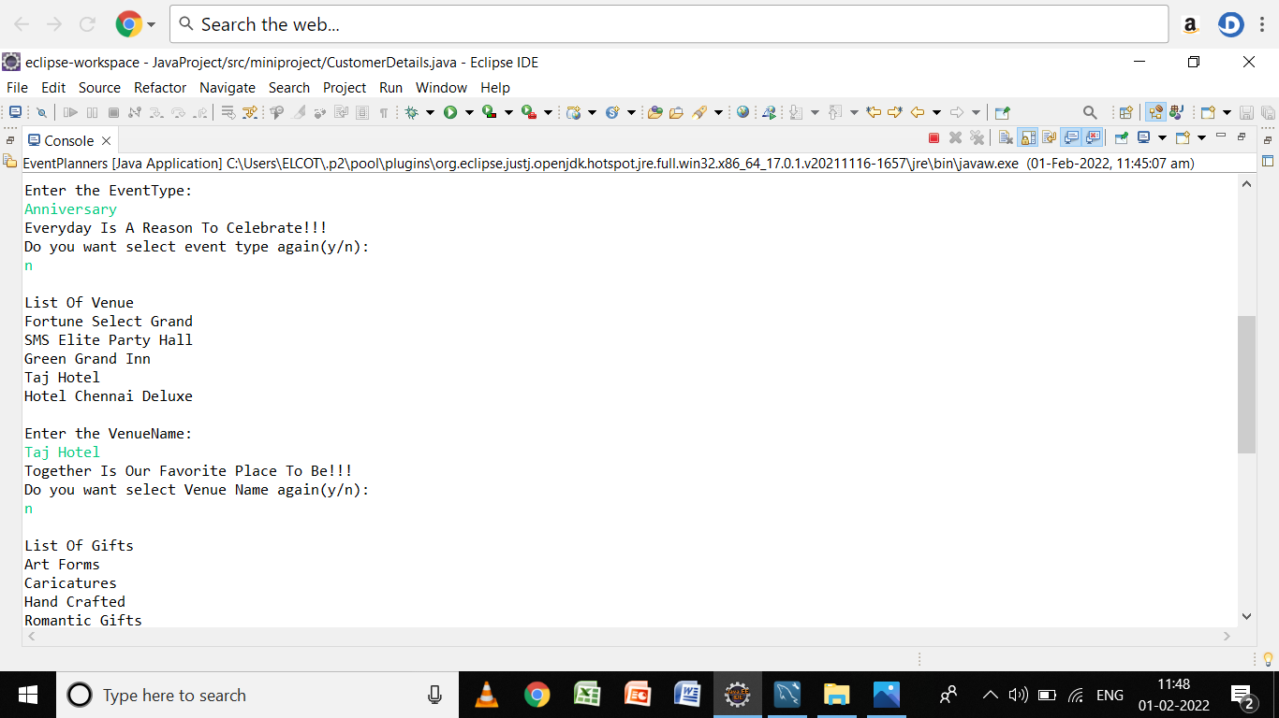
Output

Slide 9
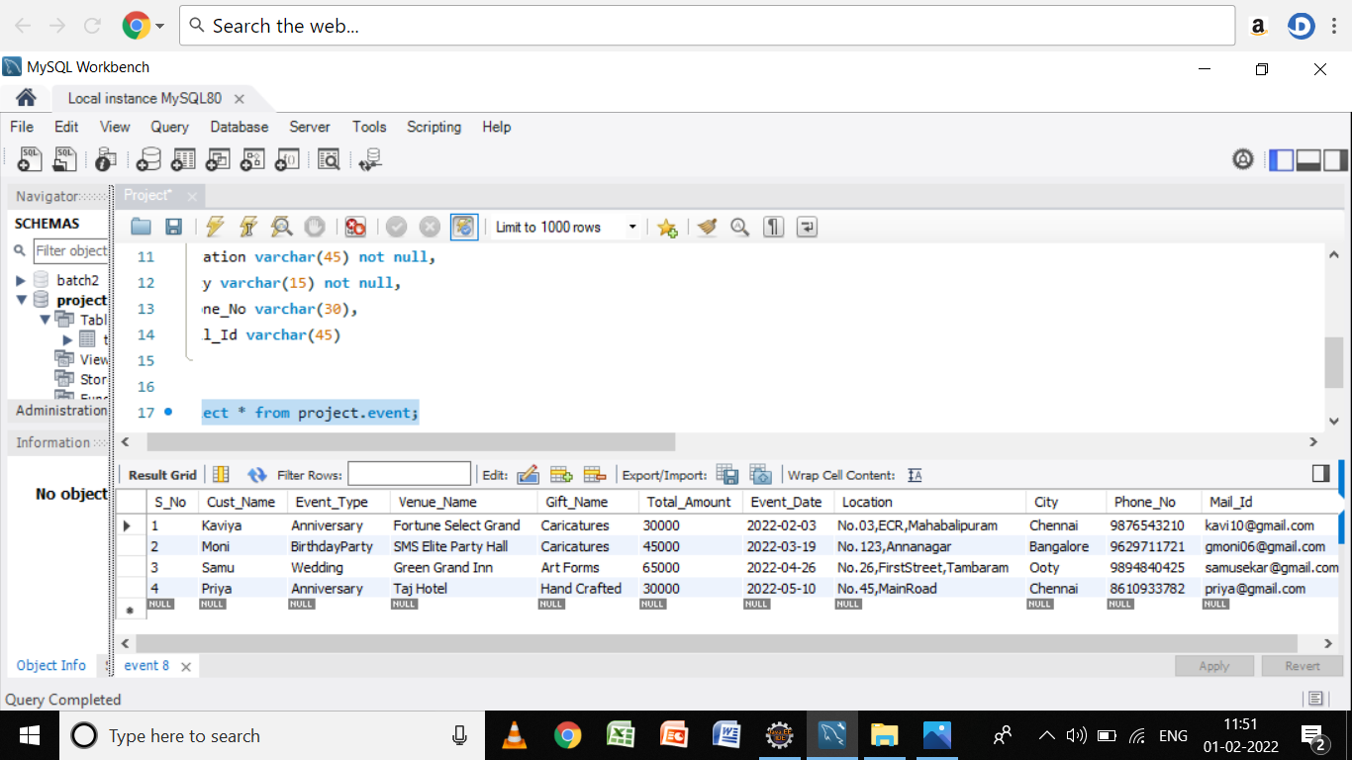
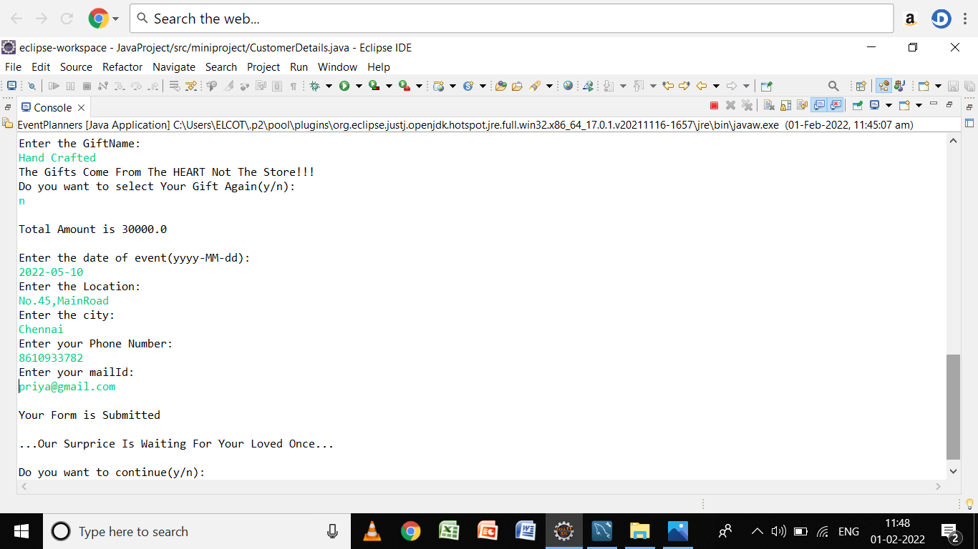

Slide 10
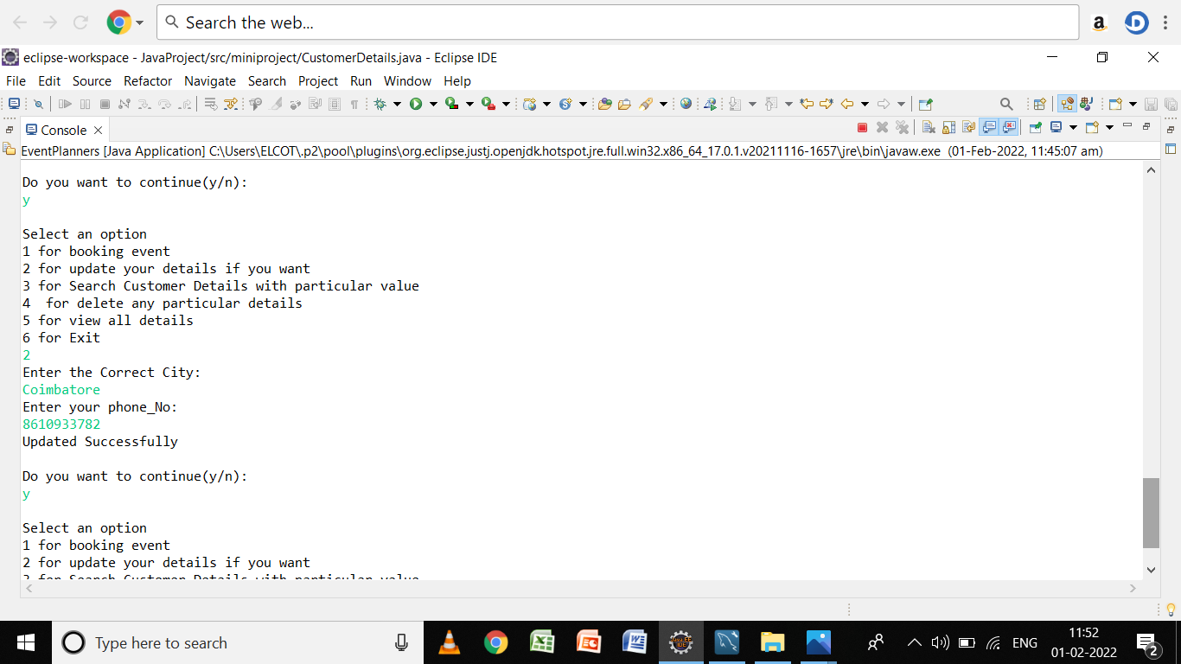
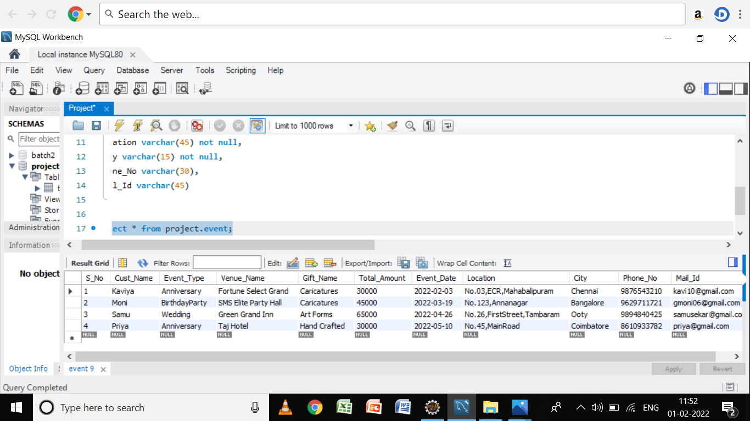

Slide 11
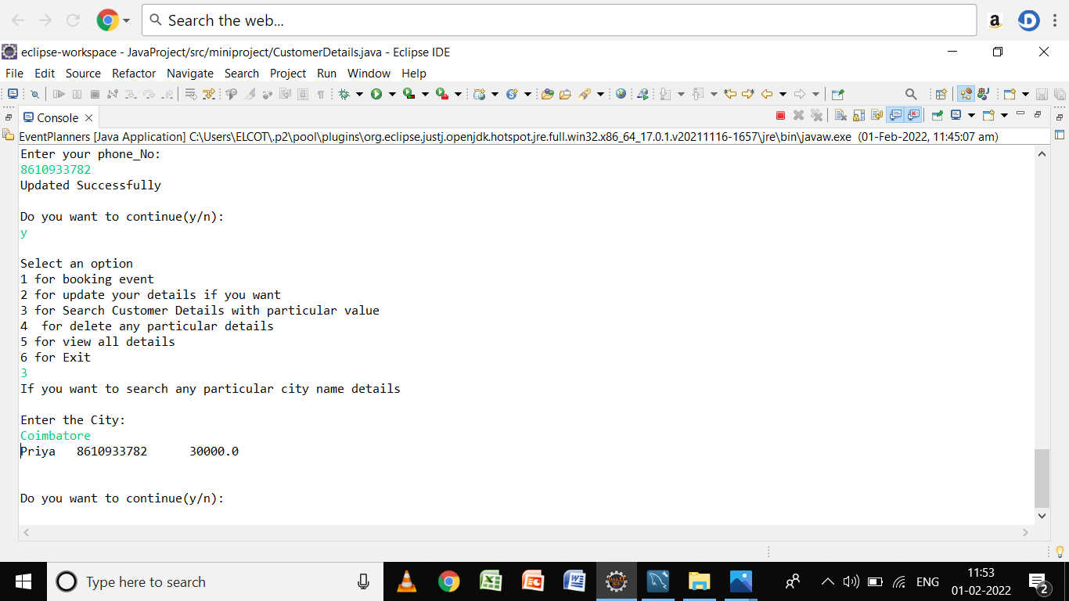
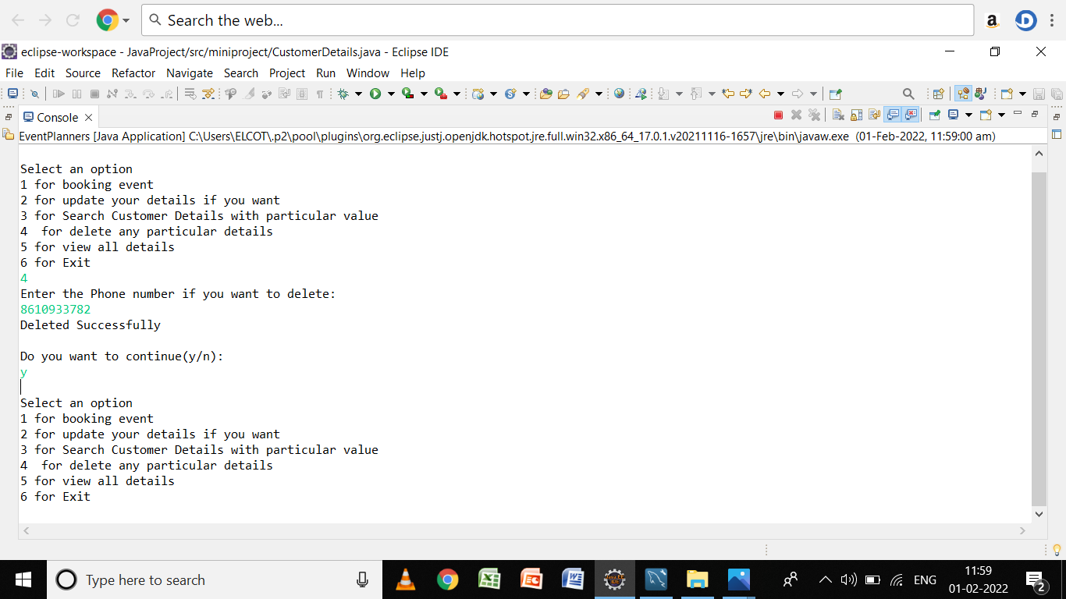

Slide 12
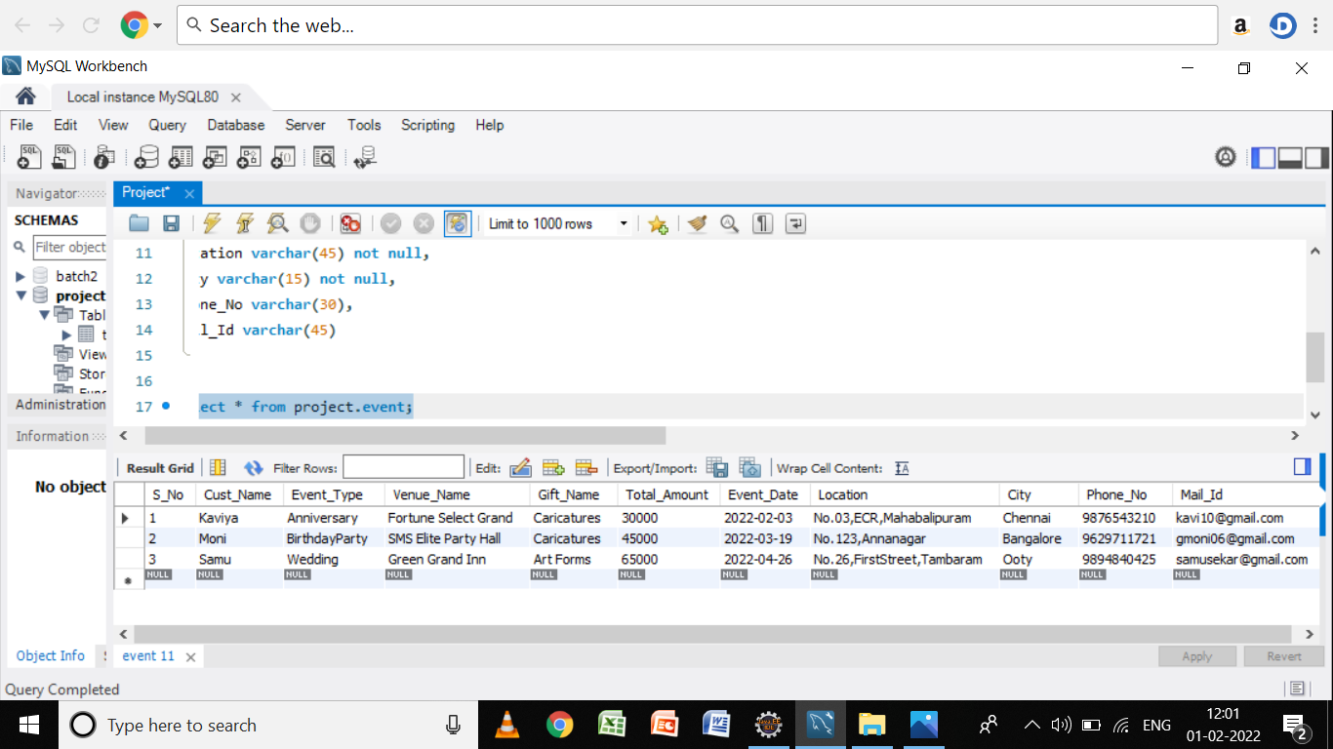
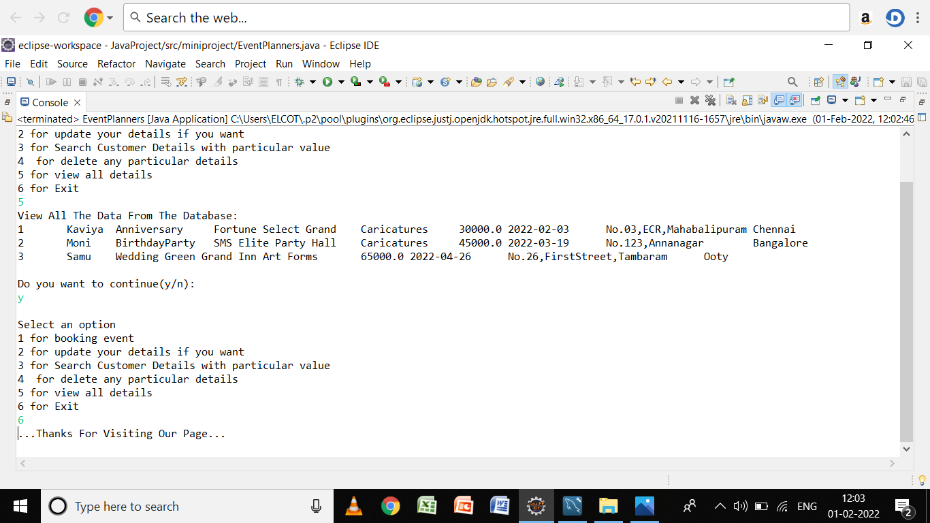

Slide 13
Conclusion
In Conclusion, We can store the Customer details for future purpose using Database and can save the time of the Customers for booking their family and friends events within a time.

Slide 14

THANK YOU

