Slide 1
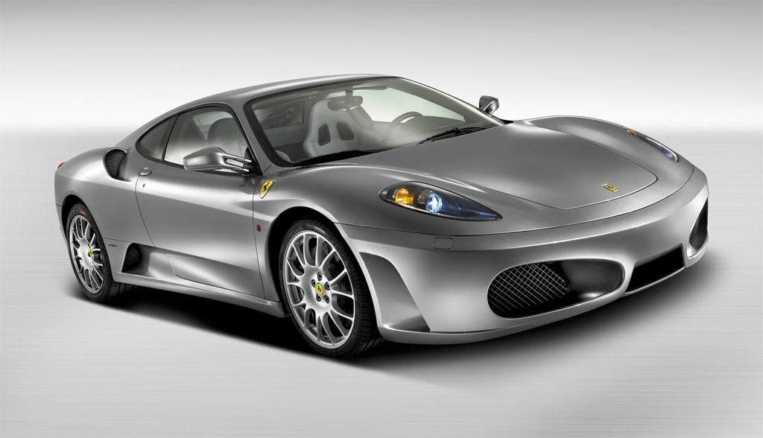
3D Racing
Sean Wild – u4849485
Victoria Hone – u4669558

Slide 2
Summary
We are amazing

Slide 3
Class Diagram
Scan…. Draw…. Write…?

Slide 4
Screen Shots
Of the best game in the world

Slide 5
Screen Shots
yeah

Slide 6
Scaling

