Slide 1
Row-Diagonal Parity for Double Disk Failure Correction
Zack Tillotson
September 2010

Slide 2
Background and Motivation
Data is important
Disks fail
Types of disk failures
Media
Full Disk
RAID
Parity
Example
Double failures?
Mirrored disks

Slide 3
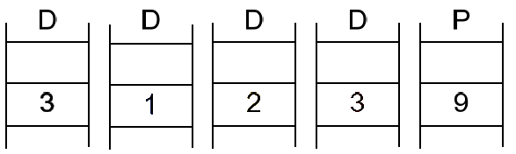
Single Disk Failure Example

Slide 4
Algorithm
Goal
Any 2 disks failing should still allow all data to be reconstructed
Hardware Setup
2 Parity Disks
Data disks
Strategy
Row and diagonal parity for every block of data
Stagger parity
For single failure: Reconstruct disk from row parity

Slide 5
Algorithm
Strategy (cont.)
2nd failure during reconstruction
Row and diagonal parity are staggered in such a way that some data block will always have only 1 missing disk
Reconstruct whichever block you can using diagonal parity
Then reconstruct block using row parity
Can now reconstruct another block from diagonal parity, repeat
Example

Slide 6
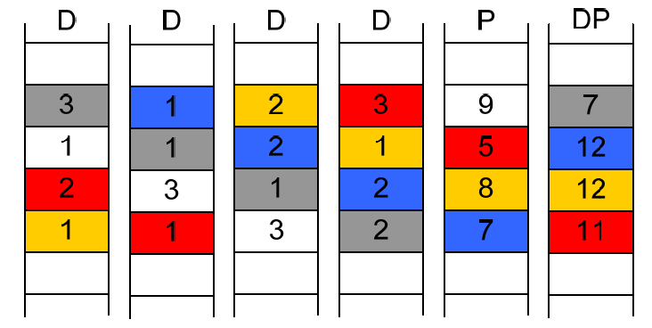
Double Disk Failure Example

Slide 7
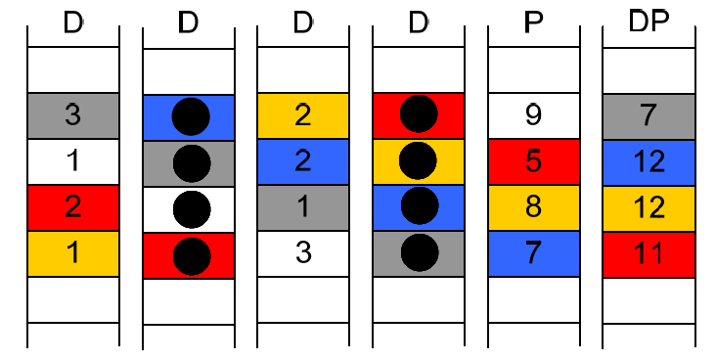
Double Disk Failure Example

Slide 8
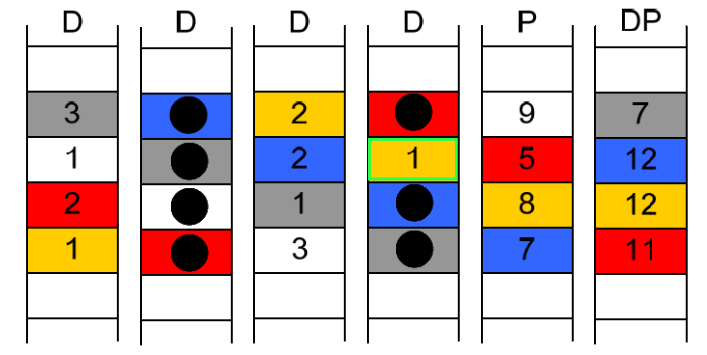
Double Disk Failure Example

Slide 9
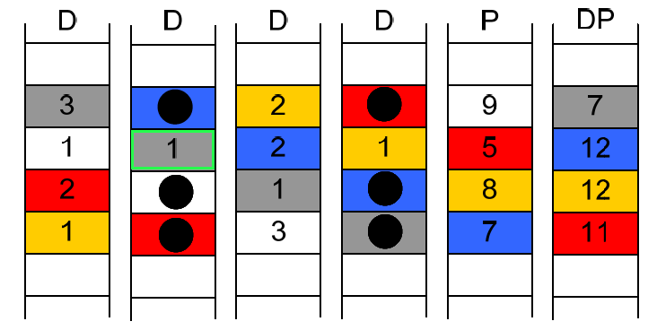
Double Disk Failure Example

Slide 10
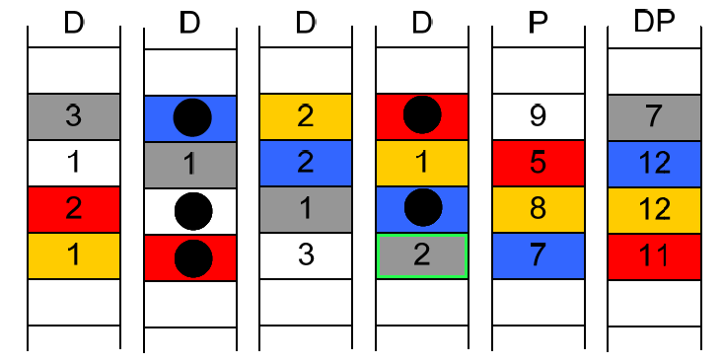
Double Disk Failure Example

Slide 11
Double Disk Failure Example

Slide 12
Performance
Theoretical
Read
Data stored in the clear
Write
Creating double parity cost = 2(p-1)(p-2) xors
Provably optimal when creating double disk failures
Reconstruction
Reconstruction from double parity cost = 2(p-1)(p-2) xors

Slide 13
Construction Per Row XOR Counts
Data Disks | RDP | EVENODD | Difference
4 | 6 | 6.67 | 11.1%
6 | 10 | 10.8 | 8.0%
8 | 14 | 14.86 | 6.1%
12 | 22 | 22.91 | 4.1%
16 | 30 | 30.93 | 3.1%

Slide 14
Reconstruction Per Row XOR Counts
Data Disks | RDP | EVENODD | Difference
4 | 6 | 9.67 | 61.2%
6 | 10 | 13.80 | 38.0%
8 | 14 | 17.86 | 27.6%
12 | 22 | 25.91 | 17.8%
16 | 30 | 33.93 | 13.1%

Slide 15
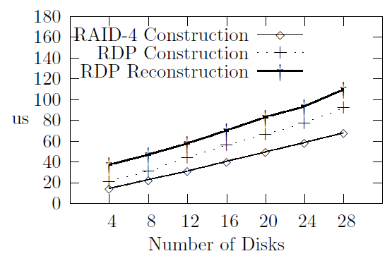
Performance
Implemented

Slide 16
Questions?
References:
RAID-DP: NETWORK APPLIANCE IMPLEMENTATION OF RAID DOUBLE PARITY FOR DATA PROTECTION A HIGH-SPEED IMPLEMENTATION OF RAID 6; Chris Lueth, Network Appliance, Inc. [12/2006]

