Slide 1
Scalable Self-Healing Algorithms for High Performance Scientific Computing
Zack Tillotson
November 2010

Slide 2
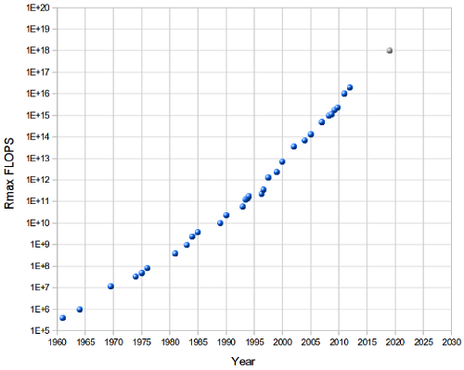
Motivation
The size of HPC systems is outgrowing traditional checkpointing strategies
Disk bandwidth
Multiple failures
=Scalable

Slide 3
Self Healing Framework
1. FT-MPI
2. Diskless Checkpointing
3. Pipelining
4. Weighted Checksums

Slide 4
FT-MPI
MPI + Fault Tolerance
How does it work?
Survives failures
Failure actions:
Processors
Messages
Fast
Scalable

Slide 5
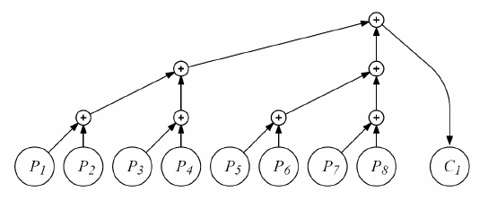
Diskless Checkpointing
Application level/System level
Synchronization points
Size
Heterogeneous environment
Bit stream vs floating point number
Galois field vs Floating point arithmetic
Heterogeneous recovery
Parity/Checksums
Log speed
Scalable

Slide 6
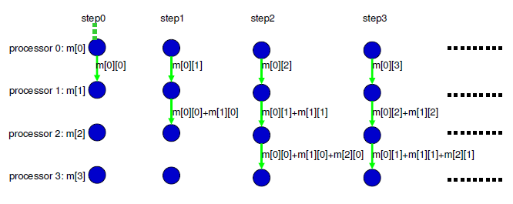
Pipelining
Segment message
Simultaneously send and receive
Checkpoint in p + s + 2
Scalable

Slide 7
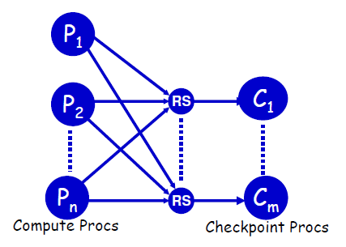
Weighted Checksum
Reed-Solomon encoding
Uses matrices which have special properties
E.g. Vandermonde, Cauchy, Gaussian Random
Use gaussian random matrices with floating point operations
Round off errors
Basic weighted checksum
To handle k errors, k
checkpoint processors
Linear time

Slide 8
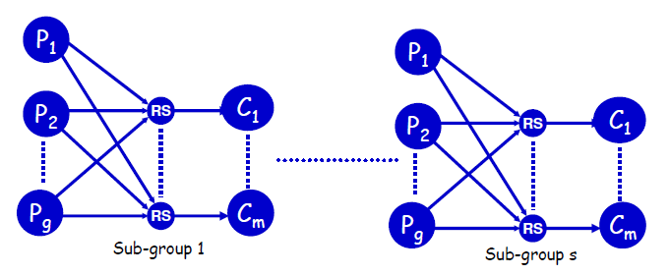
Weighted Checksum
1 Dimensional Weighted Checksum
Split processors into groups of constant size
To handle k errors, k checkpoint processors per group
Constant time with regard to total number of processors

Slide 9
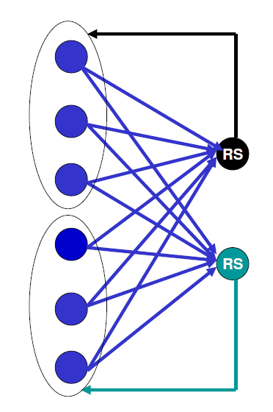
Weighted Checksum
Localized Weighted Checksum
To handle k errors, partition processors into groups of k(k+1) size
Each processor encodes with k+1 other processors
Any k processors going down can be recovered
No dedicated checkpointing processors

Slide 10
Performance
Preconditioned Conjugate Gradient (PCG) program
Basic Weighted Checksum Scheme
Small checkpoints
FT-MPI
Processor rebuild mode
Message drop mode

Slide 11
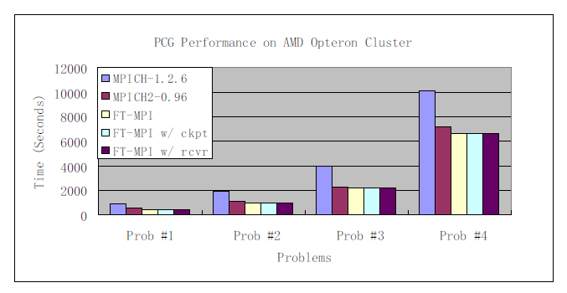
Performance: FT-MPI

Slide 12
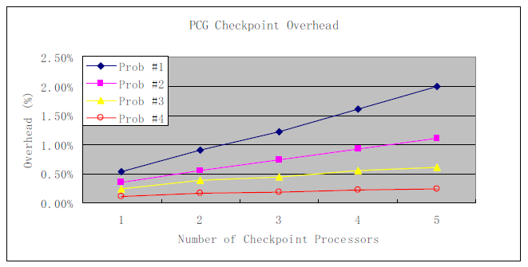
Performance: Pipelining
No faults, all increase in time is due to overhead of computing checkpoints

Slide 13
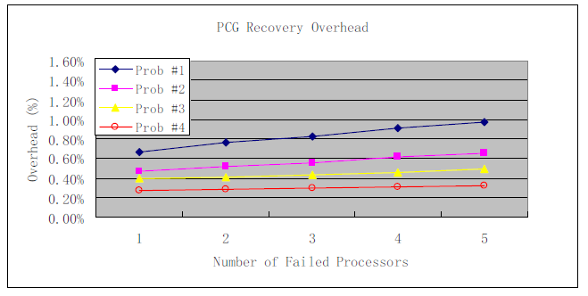
Performance: Pipelining
Failure of processors simulated each run

Slide 14
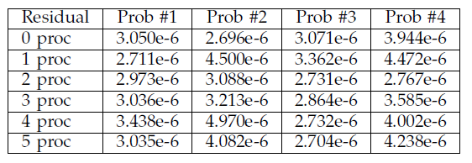
Performance: Round Off Errors
Round off error due to recovery

Slide 15
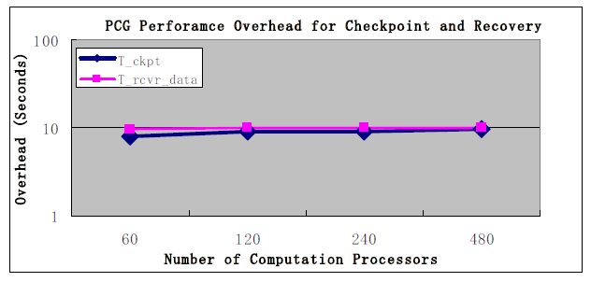
Performance: Scalability

Slide 16
Limitations
Checkpointing
Checkpoint size
Different checkpoint schemes
General failures
Add disk based checkpointing
Application level system

Slide 17
Questions
Zack Tillotson
November 2010

