Slide 1

Logan Linn
Network Application Design
Fall 2010

Slide 2
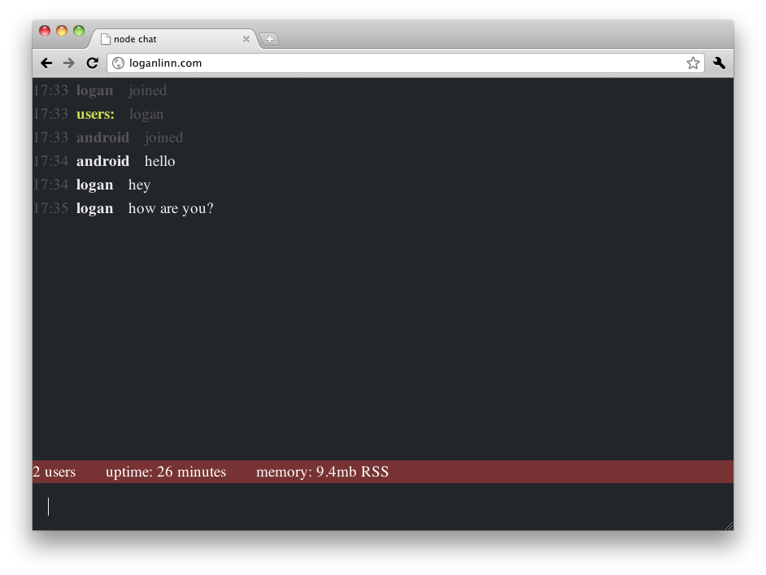

Overview
Connects to server running a simple Node.js chat room application
Initially browser-based chat
Server responds in JSON
My app connects just as the browser-based client does
Messages sent and received in real-time
JSON Notation
{key : value}
[element0, element1, element2]
[{id: 4, name:“foo”},{id:2,name:“bar”}]

Slide 3

Wtf is Node.js?
“Evented I/O framework”
Uses V8 JavaScript engine
Developed by Google
Ships w/ Chrome
Executed server side
Driven by async. events
Everything is non-blocking
Handles concurrent connections using a fraction of the memory thread-based
Highly scalable
“Node tells the operating system (through epoll, kqueue, /dev/poll, or select) that it should be notified when a new connection is made, and then it goes to sleep. If someone new connects, then it executes the callback. Each connection is only a small heap allocation”

Slide 4
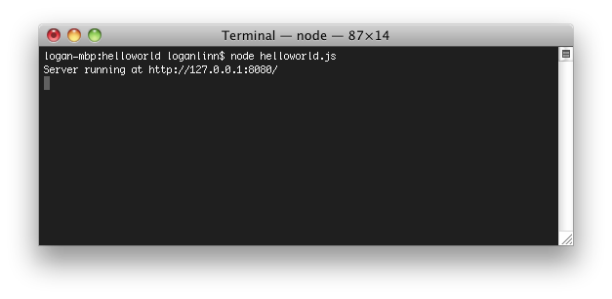
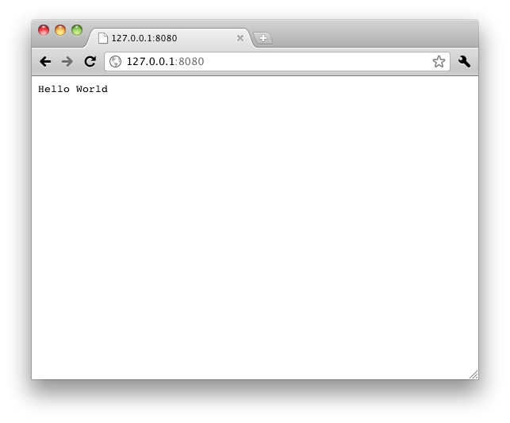
Node.js Hello World
var http = require('http');
http.createServer(function (req, res) {
res.writeHead(200, {'Content-Type': 'text/plain'});
res.end('Hello World\n');
}).listen(8080);
console.log('Server running at http://127.0.0.1:8080/');

Slide 5
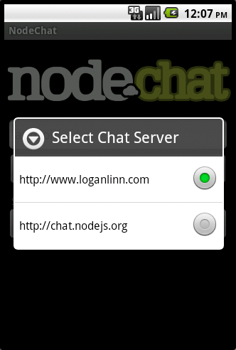
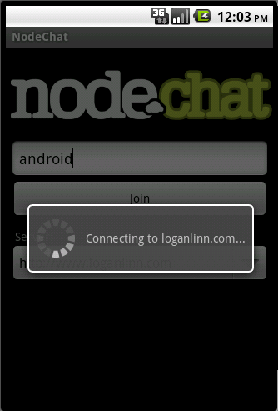
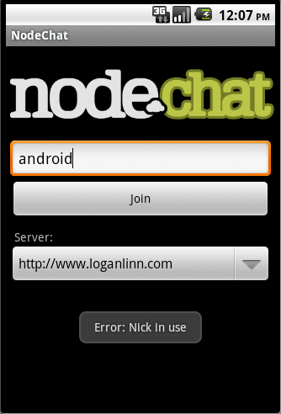
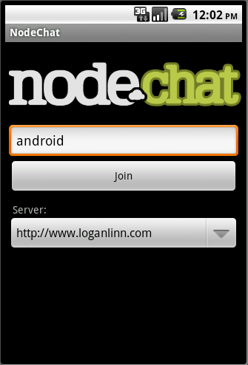
Back to the App: the Join Activity
User sets nickname, chooses server
App sends GET request to join using nickname
If nickname is already in use, user is asked to change nickname
Otherwise, Chat activity is launched

Slide 6
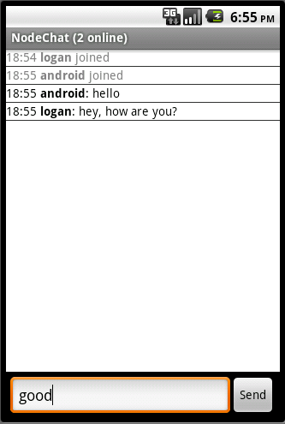
Chat Activity: Long Polling
GET request for messages
App sends time of last msg
If no new messages since last msg, server “drags out” the response
New messages cause the server to write & end the response.
If no new messages after ~30s, server writes & ends response.
Chat Log uses ListView, ArrayAdapter w/ JSONObjects
ListView scrolls w/ chat using transcript mode

Slide 7
Demo / Questions?
www.loganlinn.com

