Slide 1
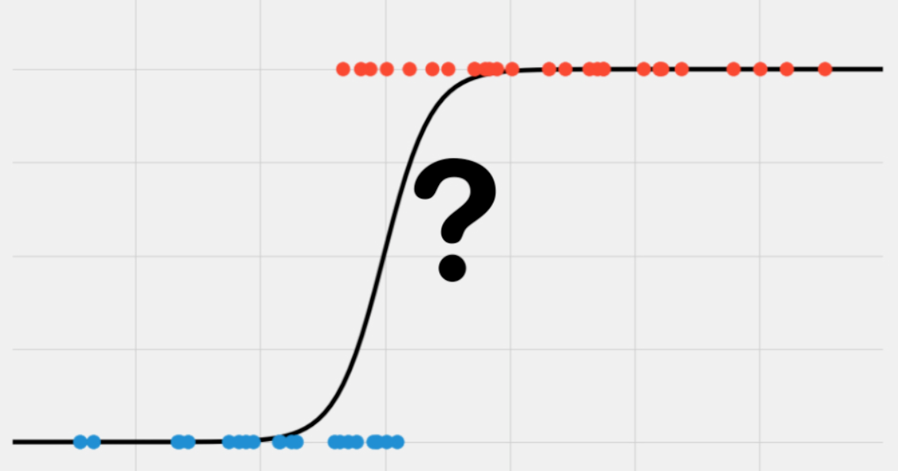
Credit Card Risk Modelling Using Logistic Regression
By – Vijay Kumar
Mentor: Subhadeep Das, EY

Slide 2
TARGET :- To predict whether we should approve mortgage-loan or not based on some features.

Slide 3
Methodologies
In this project, I wish to predict whether a customer default or payoff using Logistic Regression. The key steps involved are as follows:
1. Data collection
2. To deal with the problem of Missing Values using suitable Data Imputation Techniques.
3. Data preprocessing
4. Exploratory Data Analysis
5. Relevant data extraction from large dataset
6. Features selection
7. To build the model using Logistic Regression.
8. Exploring accuracy of the model
9. Model Deploying
10. Web app creation to deploy the model and making it avialabe publically .

Slide 4
Python Library used
Pandas
Pandas-profilling
Scipy
Scorecardpy
Dataprep
Pickle
Sklearn, scikit-learn
Statsmodel
Streamlit

Slide 5
Data Description
The data set is a randomized selection of mortgage-loan-level data collected from the portfolios underlying U.S. residential mortgage-backed securities (RMBS) securitization portfolios and provided by International Financial Research (www.internationalfinancialresearch.org).
The data set mortgage is in panel form and reports origination and performance observations for 50,000 residential U.S. mortgage borrowers over 60 periods.
In this dataset 6,22,489 total observations are there and 28 features with one response variable “status_time”
Some features are like interest_rate_time, balance_time, Interest_Rate_orig_time, gdp_time, LTV_time etc.
My final goal in this study is to predict whether a customer payoff or default so that I may get to know to approve mortgage-loan or not.

Slide 6
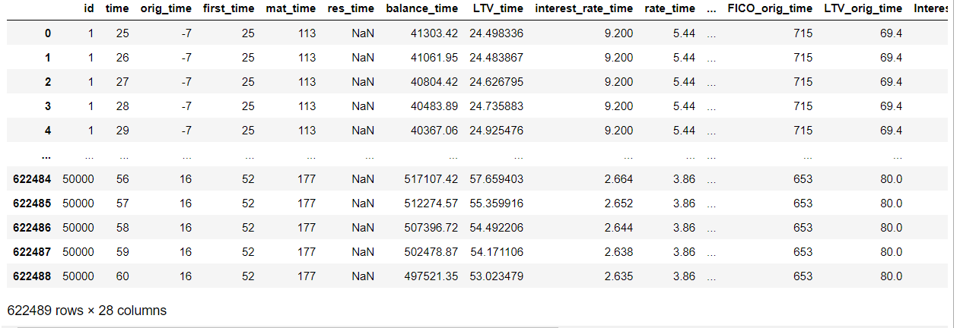
Data Description

Slide 7
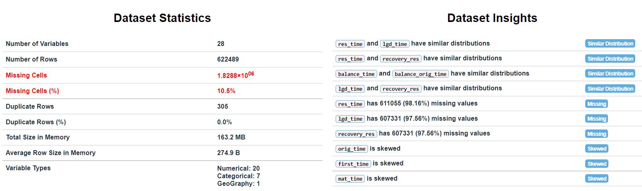
Overview

Slide 8
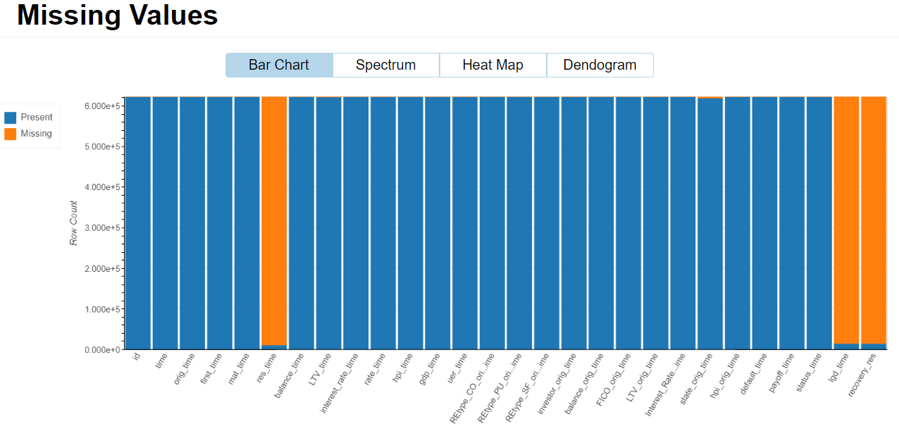
Dealing with Missing Data

Slide 9
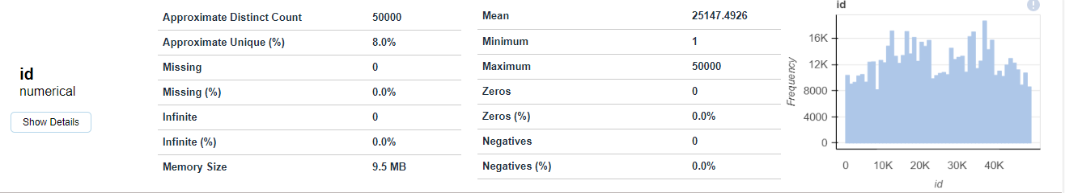
As we can see unique “id”s are only 50000 out of 622489 observations so I extracted relevant data from this large data set for my prediction. A particular id’s transaction is maximum 60 times and minimum 1. So I extracted corresponding data for those ids whose transaction is at least 12 .

Slide 10
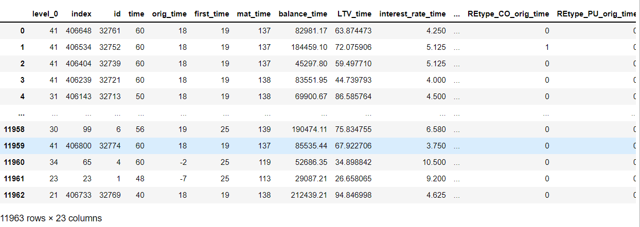
This is relevant data for the purpose of this project. I have dropped some features whose missing values are more than 95%.

Slide 11
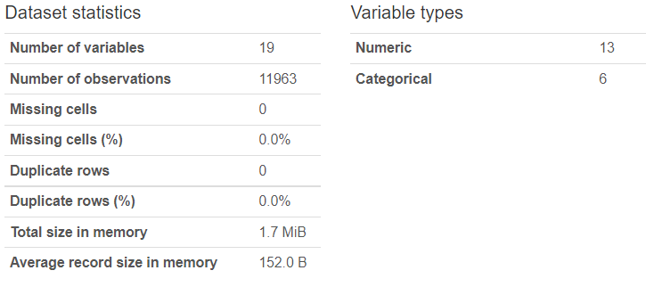
Overview of data after extraction relevant data
As we can see there are only 19 features, I have dropped features ['id','level_0','index','payoff_time'] because these are not playing any significant role for the purpose of our prediction.

Slide 12
Feature Selection Why Variable Selection ?
Variable selection is intended to select the “best” subset of predictors.
We want to explain the data in the simplest way — redundant predictors should be removed.
The principle of Occam’s Razor states that “among several plausible explanations for a phenomenon, the simplest is best. Applied to regression analysis, this implies that the smallest model that fits the data is best”.
2. Collinearity is caused by having too many variables trying to do the same job.
3. Cost: if the model is to be used for prediction, we can save time and/or money by not measuring redundant predictors and interpretability is also better.

Slide 13
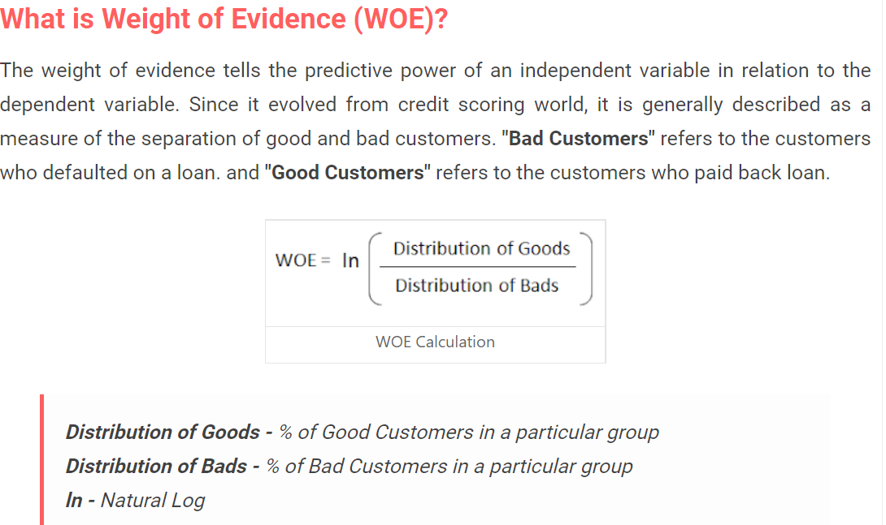
Features Selection
Firstly, I have applied Weight Of Evidence (WOE) technique to filter out variables
according to specified conditions, such as Information Value (IV), missing rate, consistency, etc Weight Of Evidence deleted some features whose IV is less than 0.02.

Slide 14
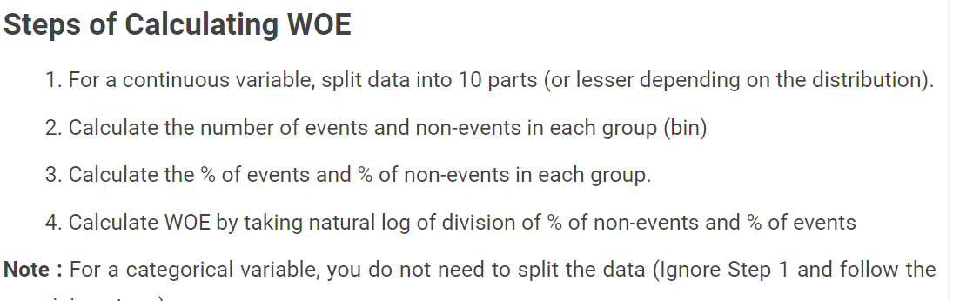
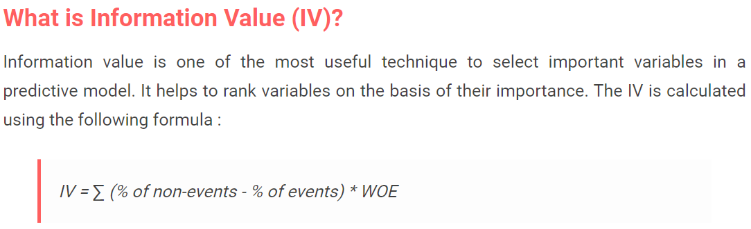

Slide 15
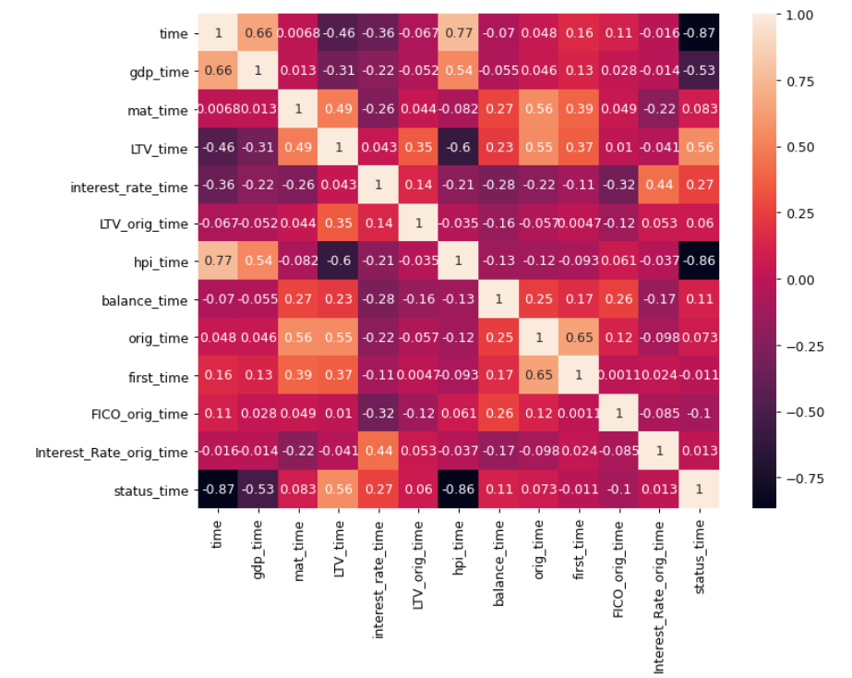
Six features have been deleted by WOE technique, now we use VIF method for features selection and we drop those values whose VIF value is more than 8. We can seen multicollinearity so we drop some features using VIF.

Slide 16
Variance Inflation Factor
This is the factor which is responsible for inflating the sampling variance. The combined effect of dependencies among the explanatory variables on the variance of a term is measured by the VIF of that term in the model.
One or more large VIFs indicate the presence of multicollinearity in the data.
In practice, usually, a VIF greater than 5 or 10 indicates that the associated regression coefficients are poorly estimated because of multicollinearity.
VIF Iterative Algorithm
Compute VIF of all the variables and note the variable with Highest VIF value.
If VIF > 8, remove the variable and recompute VIF of all the remaining variables
If variable with Highest Value > 8 then drop that variable and recompute VIF of all the remaining Variables
Repeat until variable with Highest VIF Value is less than 8

Slide 17
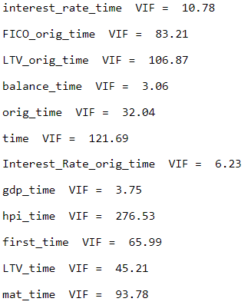
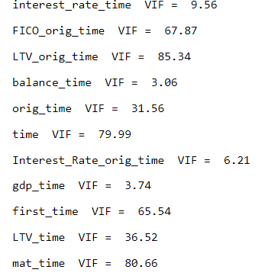
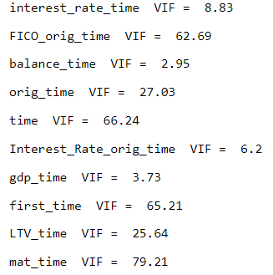
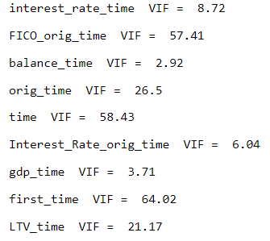
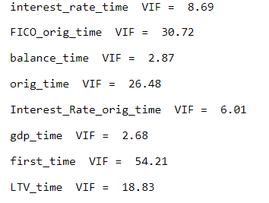
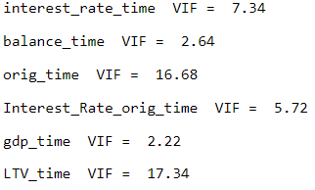
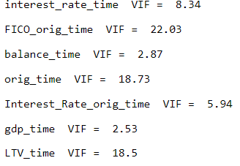

Slide 18
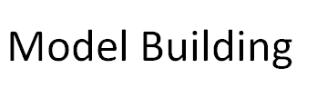
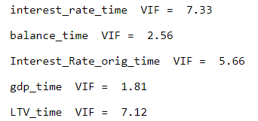

Slide 19
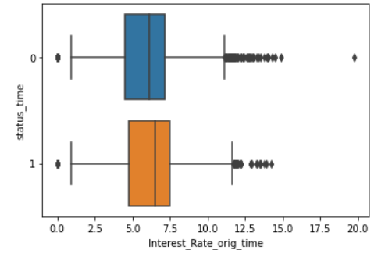
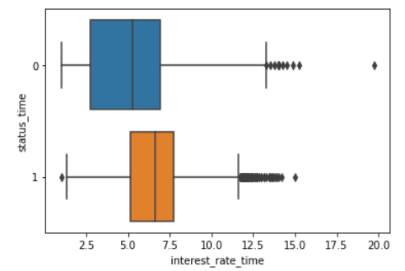
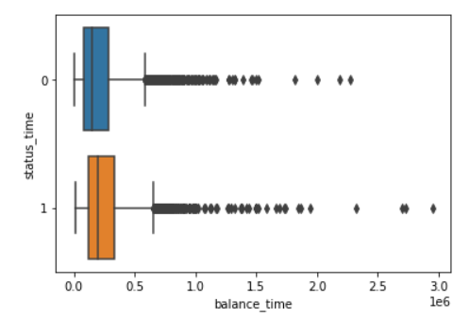
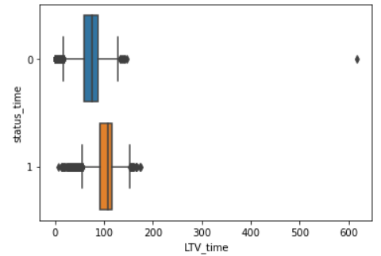
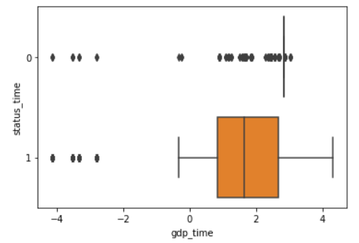
Data Visualization on selected features

Slide 20
Splitting data into training and test data
I have split the data into training and test set with 70%:30% ratio and then the logistic regression model is trained on training data.
I have used WOE technique and converted the features values into WOE values which is very powerful technique because missing values, negative values, zero values and outliers can be handled very efficiently which is required for logistic regression to be more robust.
It can handle missing values as missing values can be binned separately.
Since WOE Transformation handles categorical variable so there is no need for dummy variables.

Slide 21
This is our model on selected features:
log(1/1-y) = b0+b1X1+b2X2+b3X3+b4X4+b5X5
Y : status time (response variable)
X1: interest_rate_time
X2: balance_time
X3: Interest_Rate_orig_time
X4: gdp_time
X5: LTV_time

Slide 22
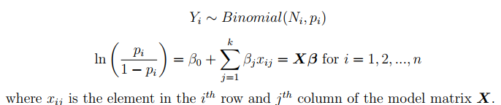
Logistic Regression Model
Binary Logistic Regression model is a special type of Generalized Linear model which is mostly used in classification models, where the response variable is binary.
The prediction is carried out based on a set of explanatory variables, which can either be discrete or continuous.
The ith response variable Yi follows Bernoulli distribution with probability of success p_i.

Slide 23
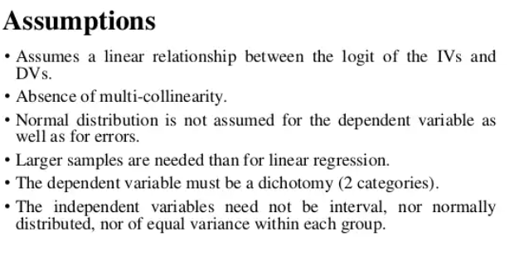
Assumptions in Logistic Regression

Slide 24
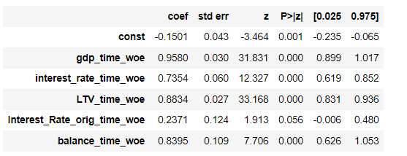
Values of coefficients in the model on training data

Slide 25
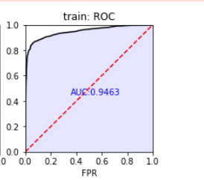
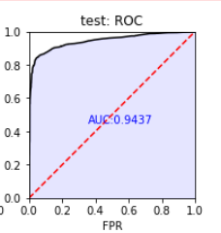
Performance of the Logistic Model on training and test data

Slide 26
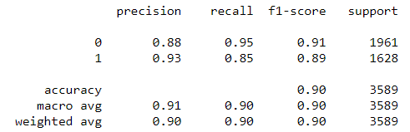
Scores of the model.
in training data
'AUC': 0.9463
‘Gini': 0.8926
in test data
‘ AUC': 0.9437
'Gini': 0.8873

Slide 27
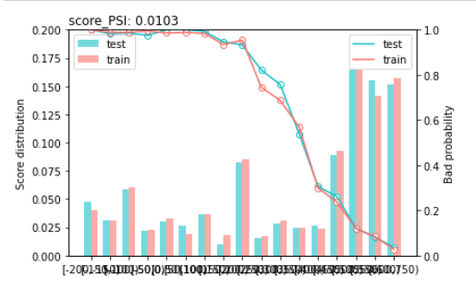
PSI ------calculates population stability index (PSI) and provide credit score distribution based on credit score datasets. PSI < 0.1 - No change. You can continue using existing model. PSI >=0.1 but less than 0.2 - Slight change is required. PSI >=0.2 - Significant change is required. Ideally, you should not use this model any more.

Slide 28
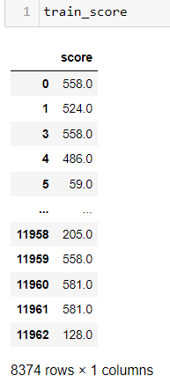
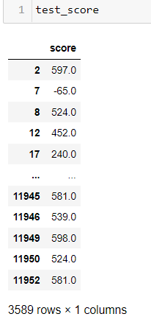
PSI = (% of records based on scoring variable in Scoring Sample (A) - % of records based on scoring variable in Training Sample (B)) * In(A/ B)

Slide 29
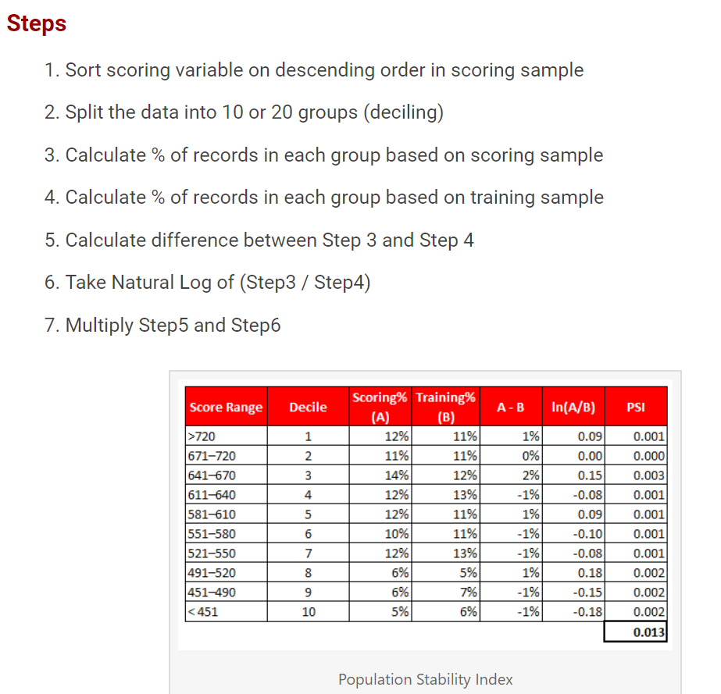
.
.

Slide 30
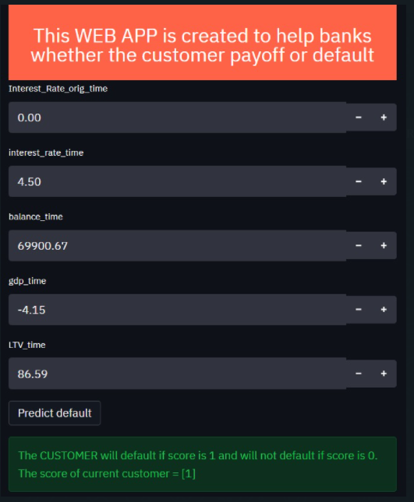
Model Deployment I have deplyoed this model on streamlit python library by which I have created a web app to deploy my model.

Slide 31
Finally I have created Web App link. I have deployed it on Heroku cloud service platform to make it available publically. https://credit-risk-modelling-vijay.herokuapp.com/

Slide 32
Conclusion
In my study, I have successfully modelled the problem of Credit-Risk Prediction in Data using Logistic Regression.
WOE can handle missing values as missing values can be binned separately.
WOE transformation helps you to build strict linear relationship with log odds. Otherwise it is not easy to accomplish linear relationship using other transformation methods such as log, square-root etc. In short, if I would not use WOE transformation, I may have to try out several transformation methods to achieve this.
Our Model performance is 90% accurate.
However, in class of Logistic Regression models and perhaps Linear Classifiers ,my final model achieved one of the highest possible scores.
Logistic Regression Model provides the advantage of explainability which is not present in case of most Non Linear Classifiers.
This advantage boosts the trust of regulators , users in the model and is therefore considered as policy maker’s favourite model for such problems.

Slide 33
Acknowledgement
My journey of accomplishing the project really involves one to whom I am highly obliged.
A special gratitude I give to my respected mentor Mr. Subhadeep Das, Department of
Mathematics and Statistics, IIT KANPUR [2019],
whose contribution in stimulating suggestion, valuable guidance,
constructive criticism and encouragement help me to coordinate my project.
At last I would like to thank my classmate as well as my friend Manas Mishra
for his co-operation throughout the project.
Without their guidance and supervision this project would not have been completed.

Slide 34
THANK YOU !

Slide 38
Model Diagnostics

Slide 39
Results and Conclusion

Slide 40
Model Summary

Slide 41

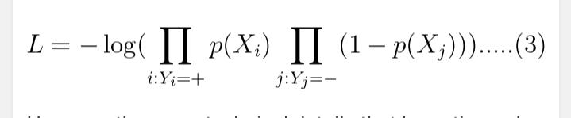
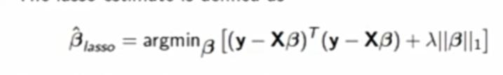
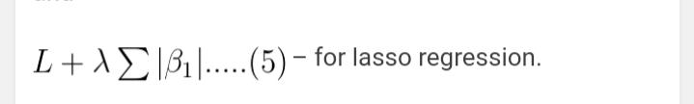

Lasso Regression
Least absolute shrinkage and selection operator
The lasso is a shrinkage method which can be used in class of ill posed problems for variable selection
The lasso Estimate is defined by minimizing the log likelihood given below
Lasso estima0
Lasso estimate can equivalently be obtained by minimizing (3)

Slide 42




Classification Metrics
Accuracy score
Precision Score
Recall Score
F1- Score

Slide 43
Result-1

Slide 44
Result-2
We further observed during modelling that using L1 regularisation on Stepwise Regression Model boosted the scores
However, it doesn’t make practical sense to use L1 regularisation after eliminating Multicollinearity and doing variable selection
In case of models on Principle Components we observed that they performed poorly in comparison to other 2 class of models in our study.
Despite explaining 95% of variability in the data and removing multicollinearity, Principal Complements were not upto mark as regressors.

