Slide 1


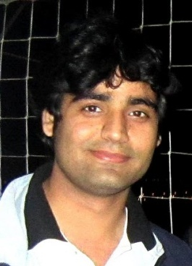



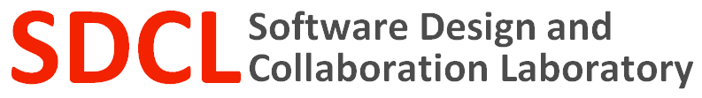
Trendy Bugs Topic Trends in the Android Bug Reports
Vijay Krishna
Palepu
Lee Martie
Hitesh Sajnani
Cristina Lopes

Slide 2
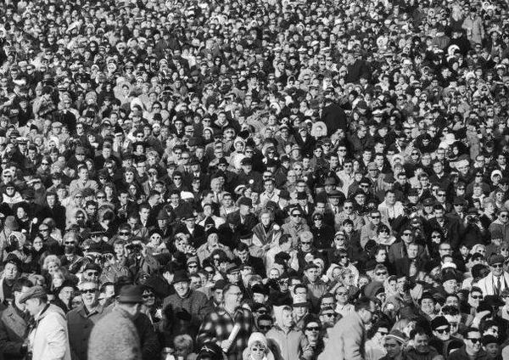
Research question
Can the wisdom of the crowd be used to understand problematic trends in the Android Open Source Project?

Slide 3
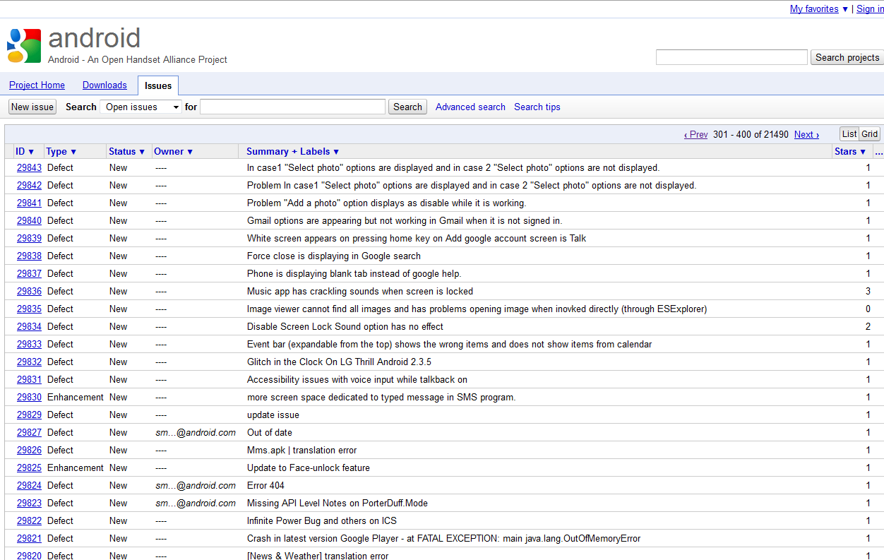
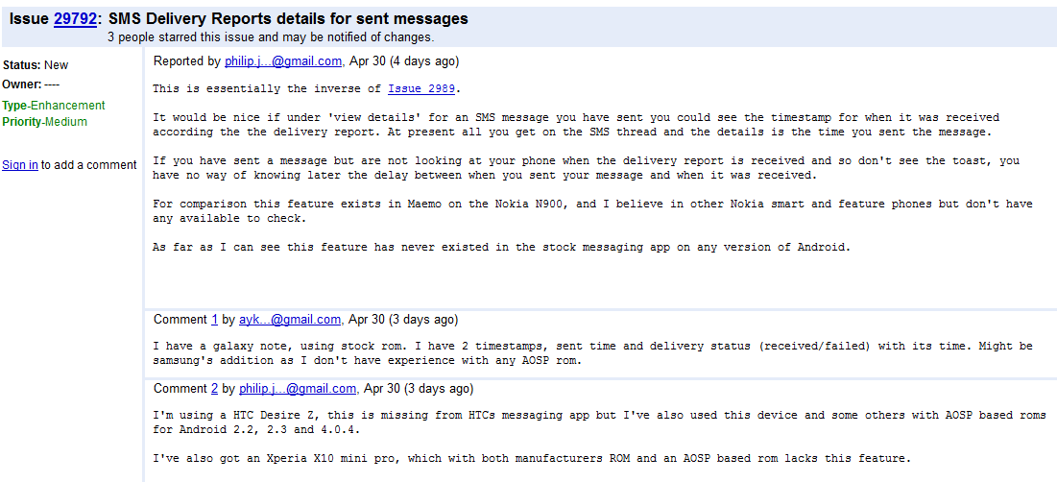
Google issue tracker

Slide 4
The data
<bug>
<bugid>bug number</bugid>
<title>bug title</title>
<status>bug status e.g. new, closed, etc.</status>
<owner>developer who owns the bug</owner>
<type>type of bug e.g. Defect, enhancement etc.</type>
<priority>priority of the bug</priority>
<component>
component of the project the bug belongs to
</component>
<closedOn> when the bug was closed (“null”if not closed) </closedOn>
<stars>how many people voted or starred the issue</stars>
<reportedBy>email id of person reporting the bug</reportedBy>
<openedDate>date the bug was filed</openedDate>
<description>description of the bug</description>
<comment>
<who>person who commented</who>
<when>time when commented</when>
<what>text of the comment</what>
</comment>
</bug>
comment
comment

Slide 5
Example from the 87,899 comments
<openedDate>Thu, 28 Apr 2011 03:24:06 +0000</openedDate>
<title>call this number until it’s not busy</title>
<description>
Instead of just having "call this number" as an option, maybe add "call this number until I get through." I don't know, though-- this might result in folks "calling a number until they get through", and waiting so long that they put the phone down & walk away, leaving the person they called and finally got through to wondering why their phone rang with no one on the other end? But assuming *most* people wouldn't be that irresponsible, *maybe* it's a good idea. Maybe make it optional and default to 'not available as a calling option', as I'd guess most folks don't browse through their settings. Maybe it's *only* an option on a missed call in the call log due to a busy signal. And maybe once you connect, it's removed as an option from everything in the call log for this number. This paragraph is so that folks don't overuse (and maybe abuse) the "call until connected" feature until they at least try ONCE, and get a busy signal. After they try regular dial at least once, and it's busy, if they then visit that entry in the call log, "call until not busy" has appeared. Just a thought.
</description>
<comment> <when>Wed, 04 May 2011 06:15:42 +0000</when> <what>Isn't this what email is for?</what> </comment>
<comment> <when>Wed, 04 May 2011 13:00:25 +0000</when> <what>
Well, to my thinking, yes & no. With email-- IF this contact has email, does your grandma?-- you are pretty sure only that they'll see the message someday. That works for anything that's not time sensitive. But that doesn't work when they REALLY don't get to email very often-- remember, much of the world doesn't get email on their cell phones-- and you really do need to deliver this message soon. To me, the difference is "Hey, I can check my email any ol' time, so why now" vs. "Ooh, hey, the phone is ringing right now." I mean, even if an answering machine picks up, I highly suspect that gets checked more often than email in MOST cases. Just food for the conversation-- thoughts? I know this may turn into a somewhat controversial feature request, that's why it should be talked out well. But hey, open-source technology is changing the landscape of many models we've held for years, why not change the way the phone game is played?
</what>
</comment>
comment
comment
comment

Slide 6





LDA
We used machine learning to fit a LDA model to the data.
LDA is a method for extracting higher level topics in a corpus of documents.
email
email
email
email
…
email
comment
comment
comment
comment
comment
…

Slide 7
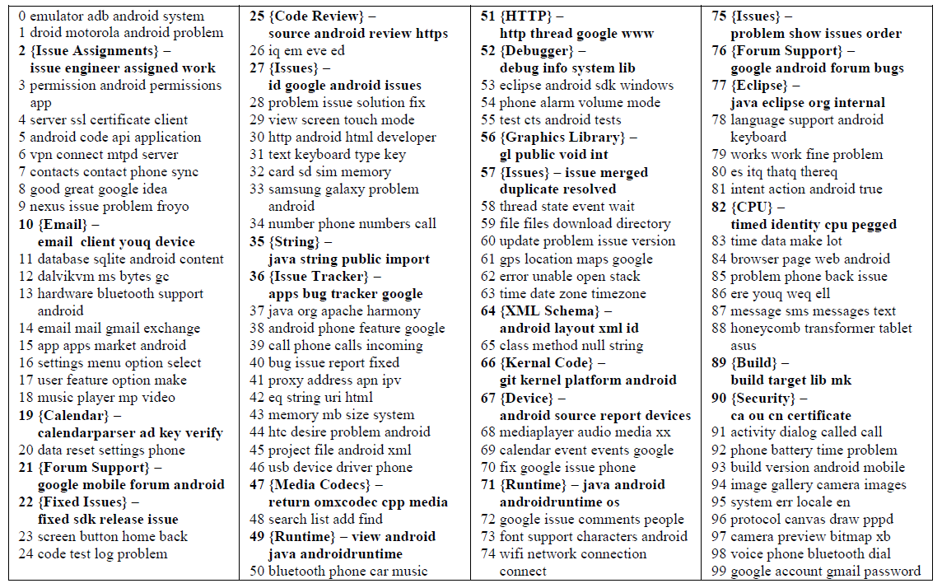
Topics results

Slide 8


Trend lines
email
email
email
…
email
email
comment
2008
comment
2009
comment
2010
comment
comment
2011
comment
…
comment

Slide 9
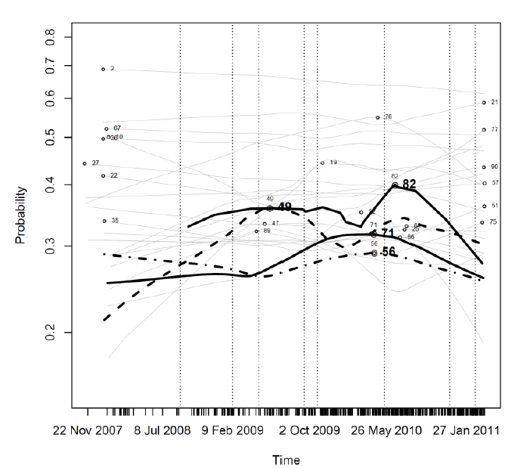
Trend line results

Slide 10
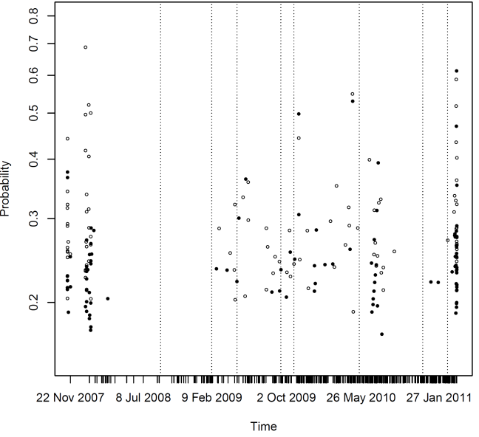
Future work

