Slide 1

Introduction to UML
Majid Ali Khan
Spring 2005
Notes:
Introduce myself

Slide 2
Acknowledgements
Slides material are taken from different sources including:
Prashanth Aedunuthula UML presentation, Fall 2004
Lecture slides from Software Engineering course at UC Berkeley (Professor Necula – Fall 2004)
Lecture slides from a course on web at:
www.sts.tu-harburg.de/ teaching/ws-98.99/OOA+D/3-0-UML.pdf
Notes:
Acknowledgements for this presentation

Slide 3
Overview
What is Modeling?
What is UML?
A brief history of UML
Understanding the basics of UML
UML diagrams
UML Modeling tools
Notes:
Overview of my presentation:
- Essence of modeling, UML, history of UML, Basics of UML, UML modeling tools

Slide 4
Modeling
Describing a system at a high level of abstraction
A model of the system
Used for requirements and specifications
Is it necessary to model software systems?
Notes:
1.
Describing the system at abstract level to comprehend its complexity
2.
Necessary to manage complexity
Good for quick understanding of the systems
Less chances of conflicting views b/w end-user and system designers

Slide 5
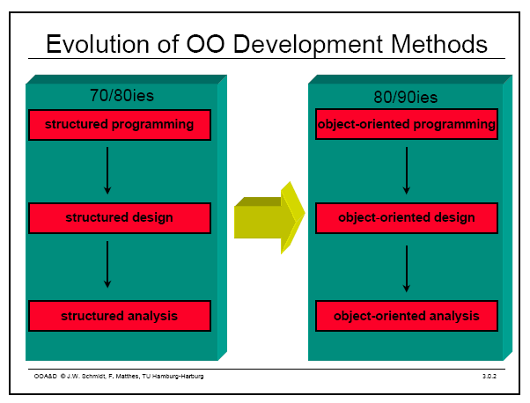
Object Oriented Modeling
Notes:
Evolution of analysis and design techniques
Transition from structured programming to object oriented programming

Slide 6
What is UML?
UML stands for “Unified Modeling Language”
It is a industry-standard graphical language for specifying, visualizing, constructing, and documenting the artifacts of software systems
The UML uses mostly graphical notations to express the OO analysis and design of software projects.
Simplifies the complex process of software design
Notes:
. What does UML stand for?
. Industry standard
. Graphical notation
. Modeling tool … simplifies software design process

Slide 7
Why UML for Modeling
Use graphical notation to communicate more clearly than natural language (imprecise) and code(too detailed).
Help acquire an overall view of a system.
UML is not dependent on any one language or technology.
UML moves us from fragmentation to standardization.
Notes:
. More precise than natural language … less detailed than source code
. Not dependent on any language
. Standardized by various groups

Slide 8
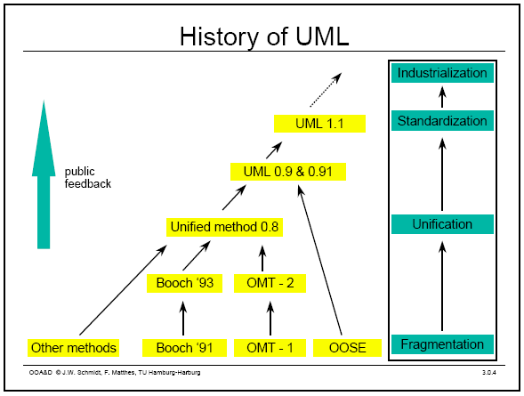
History of UML
Notes:
History:
- Rumbaugh – OMT – object modeling technique
Jacobson – OOSE
UML … unified approach since 1995
UML 1.5 current … UML 2.0 by the end of 2004

Slide 9
Types of UML Diagrams
Use Case Diagram
Class Diagram
Sequence Diagram
Collaboration Diagram
State Diagram
This is only a subset of diagrams … but are most widely used

Slide 10
Use Case Diagram
Used for describing a set of user scenarios
Mainly used for capturing user requirements
Work like a contract between end user and software developers

Slide 11
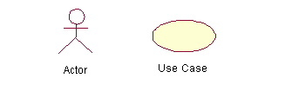
Use Case Diagram (core components)
Actors: A role that a user plays with respect to the system,including human users and other systems. e.g.,inanimate physical objects (e.g. robot); an external system that needs some information from the current system.
Use case: A set of scenarios that describing an interaction between a user and a system, including alternatives.
System boundary: rectangle diagram representing the boundary between the actors and the system.

Slide 12
Use Case Diagram(core relationship)
Association: communication between an actor and a use case; Represented by a solid line.
Generalization: relationship between one general use case and a special use case (used for defining special alternatives)
Represented by a line with a triangular arrow head toward the parent use case.

Slide 13
Use Case Diagram(core relationship)
Include: a dotted line labeled <<include>> beginning at base use case and ending with an arrows pointing to the include use case. The include relationship occurs when a chunk of behavior is similar across more than one use case. Use “include” in stead of copying the description of that behavior.
<<include>>
Extend: a dotted line labeled <<extend>> with an arrow toward the base case. The extending use case may add behavior to the base use case. The base class declares “extension points”.
<<extend>>

Slide 14
Use Case Diagrams
Use Case
Boundary
Actor
Library System
Borrow
Employee
Client
Order Title
Fine Remittance
Supervisor
A generalized description of how a system will be used.
Provides an overview of the intended functionality of the system

Slide 15
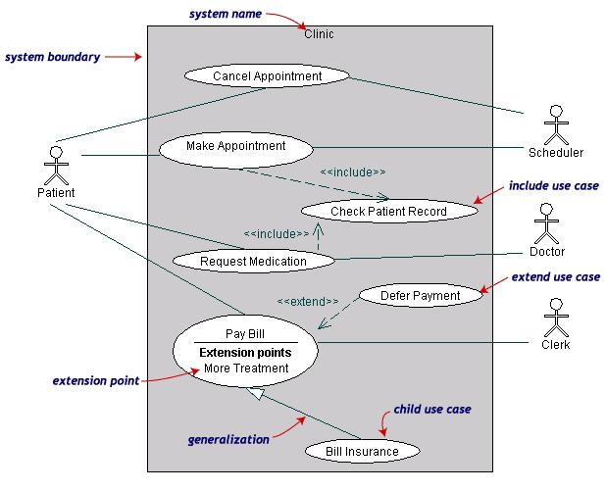
Use Case Diagrams(cont.)
(TogetherSoft, Inc)

Slide 16
Use Case Diagrams(cont.)
Pay Bill is a parent use case and Bill Insurance is the child use case. (generalization)
Both Make Appointment and Request Medication include Check Patient Record as a subtask.(include)
The extension point is written inside the base case
Pay bill; the extending class Defer payment adds the behavior of this extension point. (extend)

Slide 17
Class diagram
Used for describing structure and behavior in the use cases
Provide a conceptual model of the system in terms of entities and their relationships
Used for requirement capture, end-user interaction
Detailed class diagrams are used for developers

Slide 18
Class representation
Each class is represented by a rectangle subdivided into three compartments
Name
Attributes
Operations
Modifiers are used to indicate visibility of attributes and operations.
‘+’ is used to denote Public visibility (everyone)
‘#’ is used to denote Protected visibility (friends and derived)
‘-’ is used to denote Private visibility (no one)
By default, attributes are hidden and operations are visible.

Slide 19
An example of Class
Name
Account_Name
- Customer_Name
- Balance
Attributes
+addFunds( )
+withDraw( )
+transfer( )
Operations

Slide 20
OO Relationships
There are two kinds of Relationships
Generalization (parent-child relationship)
Association (student enrolls in course)
Associations can be further classified as
Aggregation
Composition

Slide 21
OO Relationships: Generalization
Supertype
Example:
Customer
Regular
Customer
Loyalty
Customer
Subtype1
Subtype2
or:
Customer
- Generalization expresses a parent/child relationship among related classes.
- Used for abstracting details in several layers
Regular
Customer
Loyalty
Customer

Slide 22
OO Relationships: Association
Represent relationship between instances of classes
Student enrolls in a course
Courses have students
Courses have exams
Etc.
Association has two ends
Role names (e.g. enrolls)
Multiplicity (e.g. One course can have many students)
Navigability (unidirectional, bidirectional)

Slide 23
Association: Multiplicity and Roles
student
1
*
University
Person
0..1
*
employer
teacher
Role
Multiplicity
Symbol Meaning
1 One and only one
0..1 Zero or one
M..N From M to N (natural language)
* From zero to any positive integer
0..* From zero to any positive integer
1..* From one to any positive integer
Role
“A given university groups many people; some act as students, others as teachers. A given student belongs to a single university; a given teacher may or may not be working for the university at a particular time.”

Slide 24
Class Diagram
Name
Order
class
Multiplicity: mandatory
Attributes
-dateReceived
*
Customer
-isPrepaid
1
-number :String
-name
-price : Money
-address
Operations
+dispatch()
Association
+creditRating() : String()
+close()
1
{if Order.customer.creditRating is
Generalization
"poor", then Order.isPrepaid must
be true }
Corporate Customer
Personal Customer
Constraint
(inside braces{}}
-contactName
-creditCard#
-creditRating
Multiplicity:
Many value
-creditLimit
+remind()
+billForMonth(Integer)
Multiplicity: optional
0..1
*
*
Employee
OrderLine
-quantity: Integer
*
1
Product
-price: Money
-isSatisfied: Boolean
[from UML Distilled Third Edition]

Slide 25
Association: Model to Implementation
*
4
Student
Course
has
enrolls
Class Student {
Course enrolls[4];
}
Class Course {
Student have[];
}

Slide 26
OO Relationships: Composition
Composition: expresses a relationship among instances
of related classes. It is a specific kind of Whole-Part relationship.
It expresses a relationship where an instance of the Whole-class has the responsibility to create and initialize instances of each Part-class. It may also be used to express a relationship where instances of the Part-classes have privileged access or visibility to certain attributes and/or behaviors defined by the Whole-class. Composition should also be used to express relationship where instances of the Whole-class have exclusive access to and control of instances of the Part-classes.
Composition should be used to express a relationship where the behavior of Part instances is undefined without being related to an instance of the Whole. And, conversely, the
behavior of the Whole is ill-defined or incomplete if one or more of the Part instances are undefined.
Whole Class
Class W
Class P₁
Class P₂
Part Classes
Example
Automobile
Engine
Transmission
[From Dr.David A. Workman]

Slide 27
OO Relationships: Aggregation
Container Class
Class C
Aggregation: expresses a relationship among instances
of related classes. It is a specific kind of Container-Containee relationship.
It expresses a relationship where an instance of the Container-class has the responsibility to hold and maintain instances of each Containee-class that have been created outside the auspices of the Container-class. Aggregation should be used to express a more informal relationship than composition expresses. That is, it is an appropriate relationship where the Container and its Containees can be manipulated independently.
Aggregation is appropriate when Container and Containees have no special access privileges to each other.
AGGREGATION
Class E₁
Class E₂
Containee Classes
Example
Bag
Apples
Milk
[From Dr.David A. Workman]

Slide 28
Aggregation vs. Composition
Composition is really a strong form of aggregation
components have only one owner
components cannot exist independent of their owner
components live or die with their owner
e.g. Each car has an engine that can not be shared with other cars.
Aggregations may form "part of" the aggregate, but may not be essential to it. They may also exist independent of the aggregate.
e.g. Apples may exist independent of the bag.

Slide 29
Good Practice: CRC Card
(Class Responsibility Collaborator)
Benefits: It is easy to describe how classes work by moving cards around; allows to quickly consider alternatives.
Class
Reservations
Collaborators
Catalog
User session
Responsibility
Keep list of reserved titles
Handle reservation

Slide 30
Sequence Diagram(make a phone call)
Caller
Phone
Recipient
Picks up
Dial tone
Dial
Ring notification
Ring
Picks up
Hello

Slide 31
Sequence Diagram:Object interaction
A
B
Self-Call: A message that an
Object sends to itself.
Condition: indicates when a message is sent. The message is sent only if the condition is true.
Synchronous
Asynchronous
Transmission delayed
Condition
[condition] remove()
Iteration
*[for each] remove()
Self-Call

Slide 32
Sequence Diagrams – Object Life Spans
Creation
Create message
Object life starts at that point
Activation
Symbolized by rectangular stripes
Place on the lifeline where object is activated.
Rectangle also denotes when object is deactivated.
Deletion
Placing an ‘X’ on lifeline
Object’s life ends at that point
A
Create
B
Activation bar
X
Return
Deletion
Lifeline

Slide 33
Sequence Diagram
Message
Sequence diagrams demonstrate the behavior of objects in a use case
by describing the objects and the messages they pass.
The horizontal dimension shows the objects participating in the interaction.
The vertical arrangement of messages indicates their order.
The labels may contain the seq. # to indicate concurrency.

Slide 34
Interaction Diagrams: Collaboration diagrams
start
6: remove reservation
3 : [not available] reserve title
User
Reservations
6 : borrow title
5: title available
2: title data
1: look up
4 : title returned
Catalog
5 : hold title
Shows the relationship between objects and the order of messages passed between them.
between them.
The objects are listed as rectangles and arrows indicate the messages being passed
The numbers next to the messages are called sequence numbers. They show the sequence
of the messages as they are passed between the objects.
convey the same information as sequence diagrams, but focus on object roles instead of the
time sequence.

Slide 35
State Diagrams (Billing Example)
State Diagrams show the sequences of states an object goes through during its life cycle in response to stimuli, together with its responses and actions; an abstraction of all possible behaviors.
Start
End
Unpaid
Paid
Invoice created
paying
Invoice destroying

Slide 36
State Diagrams (Traffic light example)
Traffic Light
Start
State
Red
Transition
Yellow timer expires
Car trips sensor
Yellow
Green timer expires
Green
Event

Slide 37
UML Modeling Tools
Rational Rose (www.rational.com) by IBM
TogetherSoft Control Center, Borland (http://www.borland.com/together/index.html)
ArgoUML (free software) (http://argouml.tigris.org/ )
OpenSource; written in java
Others (http://www.objectsbydesign.com/tools/umltools_byCompany.html )

Slide 38
Reference
1. UML Distilled: A Brief Guide to the Standard Object Modeling Language Martin Fowler, Kendall Scott
2. IBM Rational
http://www-306.ibm.com/software/rational/uml/
3. Practical UML --- A Hands-On Introduction for Developers
http://www.togethersoft.com/services/practical_guides/umlonlinecourse/
4. Software Engineering Principles and Practice. Second Edition; Hans van Vliet.
5. http://www-inst.eecs.berkeley.edu/~cs169/

