Slide 1


Intelligent Medical
Diagnosis & Treatment System
AI-Powered Multi-Agent Pipeline · Scikit-learn · TensorFlow · LangChain · LangGraph
ML
Deep Learning
RAG
Multi-Agent
Built by Vijay Kumar · Portfolio Project · 2025

Slide 2




THE PROBLEM
Healthcare Faces a Diagnostic Crisis
Diagnostic Errors
Over 40,000 patients die annually in the US due to misdiagnosis
Data Overload
Clinicians spend 34% of their time on documentation, not patients
Siloed Information
Patient vitals, imaging, and lab data rarely analyzed together
→ Our AI system integrates all data streams into one unified, explainable diagnosis pipeline

Slide 3




THE SOLUTION
One Unified Multi-Agent AI Pipeline
Four powerful technologies. One seamless diagnostic workflow.
Scikit-learn
TensorFlow
Disease Risk
Image Analysis
Gradient Boosting classifier on tabular patient vitals — age, BMI, glucose, cholesterol
EfficientNetB0 CNN with transfer learning classifies chest X-rays in 4 categories
LangChain
LangGraph
RAG Knowledge
Orchestration
Retrieves evidence-based treatment plans from indexed medical literature via ChromaDB
Multi-agent state machine with conditional emergency escalation routing

Slide 4

ARCHITECTURE
Multi-Agent Workflow
✓ StateGraph
Patient Input
✓ Conditional Routing
Vitals + X-ray image
✓ Agent Memory
Diagnosis Agent
sklearn + TensorFlow
✓ LLM Synthesis (GPT-4o)
⚠ Emergency
Treatment Agent
Auto-escalate
LangChain RAG
Communication Agent
Patient-friendly report

Slide 5

MODULE 1 / 4
Disease Risk Classifier
Scikit-learn · Gradient Boosting Machine
GradientBoostingClassifier (n_estimators=200, lr=0.05)
StandardScaler preprocessing pipeline
4-class: Healthy / Diabetes / Heart Disease / Hypertension
Outputs confidence % + per-class risk scores
Trained on patient vitals: age, BMI, glucose, BP, cholesterol
88–92% accuracy on tabular patient data
🏆 Model Accuracy: 88–92% on structured patient data

Slide 6

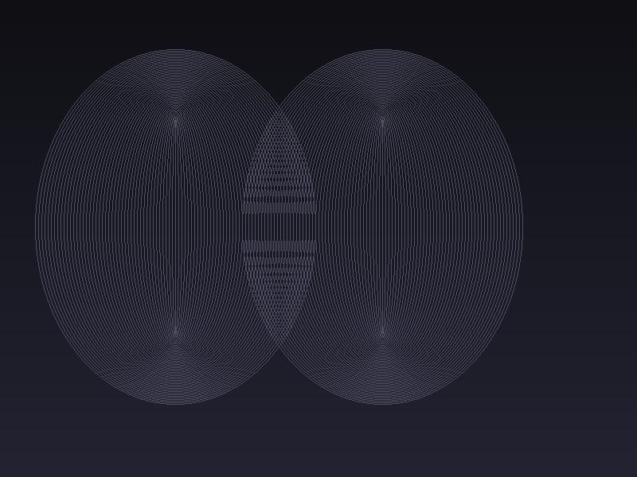
MODULE 2 / 4
Medical Image Analyzer
TensorFlow · EfficientNetB0 · Transfer Learning
Input (224×224×3)
EfficientNetB0 (frozen)
GlobalAvgPooling2D
Dense 256 + BN + Dropout
Softmax (4 classes)
Output Classes:
Normal
Pneumonia
TB
COVID-19
~90% accuracy using EfficientNetB0 transfer learning

Slide 7

MODULE 3 / 4
Medical Knowledge RAG
LangChain · ChromaDB · OpenAI Embeddings · GPT-4o
1
Clinical PDFs
2
Text Chunking
3
Vector Embeddings
PubMed, WHO, guidelines
1000 tokens, 200 overlap
OpenAI text-embedding-3
4
ChromaDB Store
5
Retrieval (top-5)
6
GPT-4o Synthesis
Persistent vector DB
Semantic similarity search
Grounded treatment plan

Slide 8





MODULE 4 / 4
Multi-Agent Orchestration
LangGraph · StateGraph · Conditional Routing · TypedDict State
Diagnosis Agent
Treatment Agent
Runs sklearn + TF CNN, GPT-4o synthesizes final diagnosis
Calls LangChain RAG for evidence-based treatment plans
Communication Agent
Emergency Agent
Translates diagnosis into plain-English patient report
Auto-escalates high-risk cases (>85% critical confidence)
Entry → DiagnosisAgent → [Router] → TreatmentAgent → CommunicationAgent → END

Slide 9
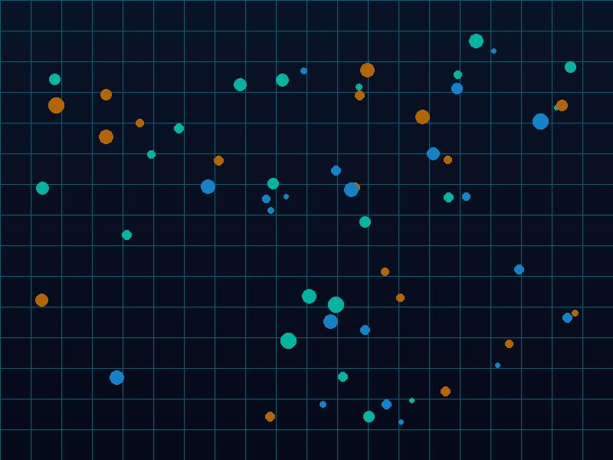


RESULTS & PERFORMANCE
What the System Delivers
88–92%
~90%
~15s
4 Agents
Risk Classifier
Accuracy
X-ray CNN
Accuracy
End-to-End
Pipeline Time
Coordinated
Workflow Steps
Full pipeline: patient data in → diagnosis + treatment + report out in ~15 seconds
Graceful fallback to GPT-4o direct knowledge when no RAG knowledge base is present
Emergency routing auto-triggers for Heart Disease risk > 85% confidence

Slide 10
TECH STACK
Complete Technology Overview
Library / Tool
Role
Why It Was Chosen
Scikit-learn 1.4+
Tabular disease risk classification
Fast, interpretable GBM on structured EHR data
TensorFlow 2.15+
Medical image CNN
Deep learning via EfficientNetB0 transfer learning
LangChain 0.2+
RAG pipeline over clinical literature
Grounds LLM answers in real PubMed / WHO guidelines
LangGraph 0.1+
Multi-agent workflow orchestration
Conditional state machine with emergency routing
ChromaDB 0.4+
Vector store for document embeddings
Persistent, fast semantic retrieval of medical knowledge
GPT-4o (OpenAI)
LLM for synthesis and communication
Human-quality reasoning, diagnosis summary, patient report

Slide 11

ROADMAP
What's Next
Q1
FastAPI REST endpoint for deployment
Q1
Streamlit / Gradio web UI
Q2
DICOM medical image support
Q2
Fine-tune on CheXpert / NIH datasets
Q3
SHAP explainability for ML predictions
Q3
Docker containerization + CI/CD pipeline
Q4
HL7 FHIR EHR integration

Slide 12
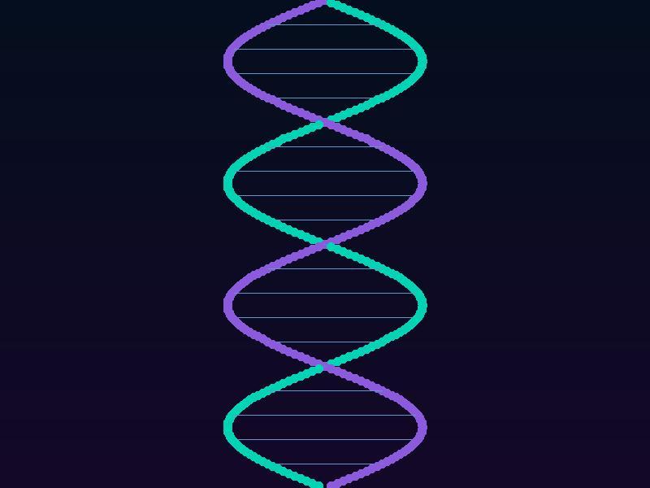


Thank You
Intelligent Medical Diagnosis & Treatment Recommendation System
Scikit-learn × TensorFlow × LangChain × LangGraph — one unified AI pipeline
Built by Vijay Kumar · github.com/VijayKumaro7 · 2025

