Slide 1

Dormitory Manager

Slide 2

Dormitory Manager
A window form that help FPT University manage the dormitories
Two interfaces:
Student interface: Help student check their room status and request for changing room, request for leaving room or any problem happens that need the help of manager.
Manager interface: Help admin manage the requests, rooms and information of dormitories

Slide 3

Manager Interface
Functions:
Add new room
Show room’s information
View student requests
Update monthly fee of a room
Student check in
Student check out
Update student status

Slide 4
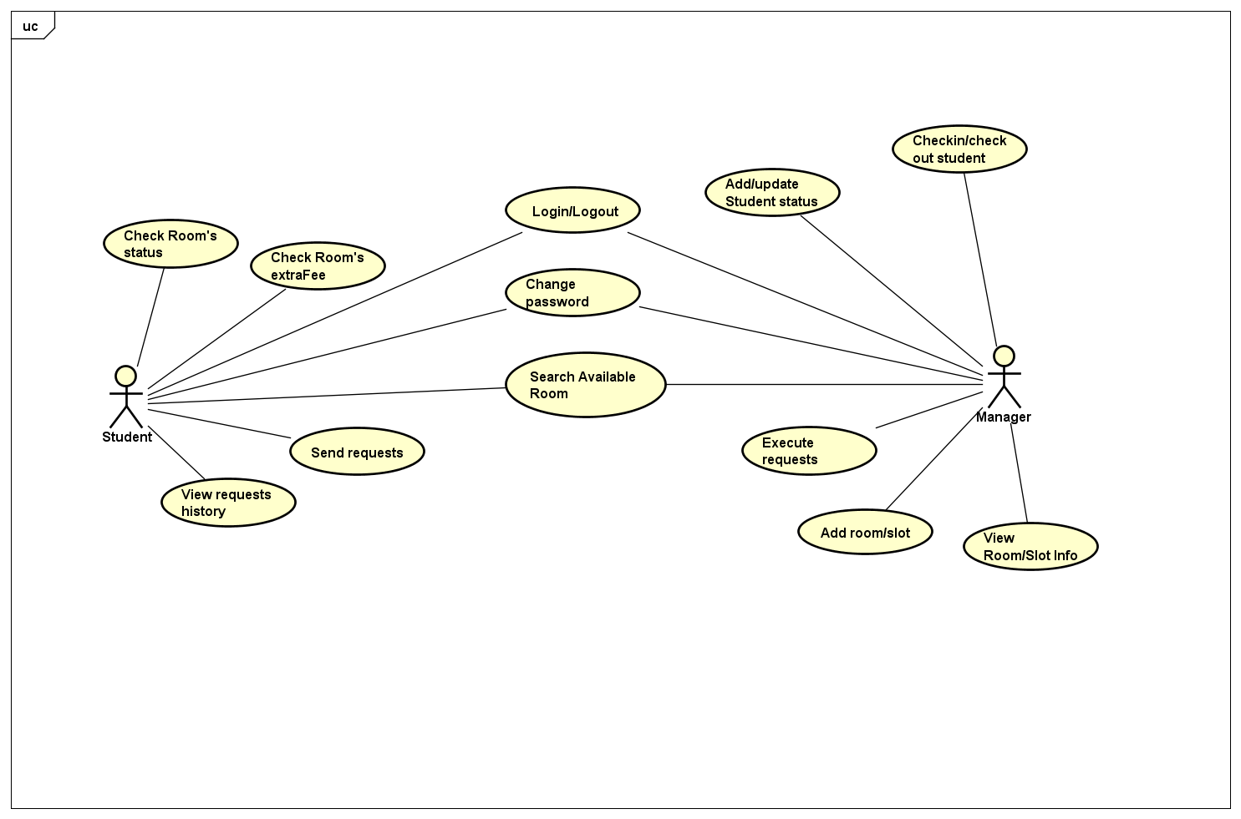
Use Case

Slide 5
Use Case

Slide 6
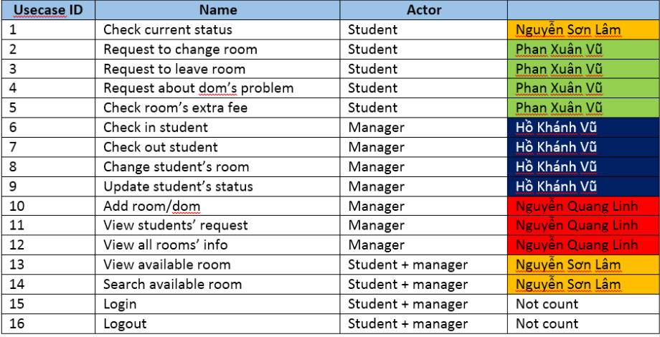
Use Case

Slide 7
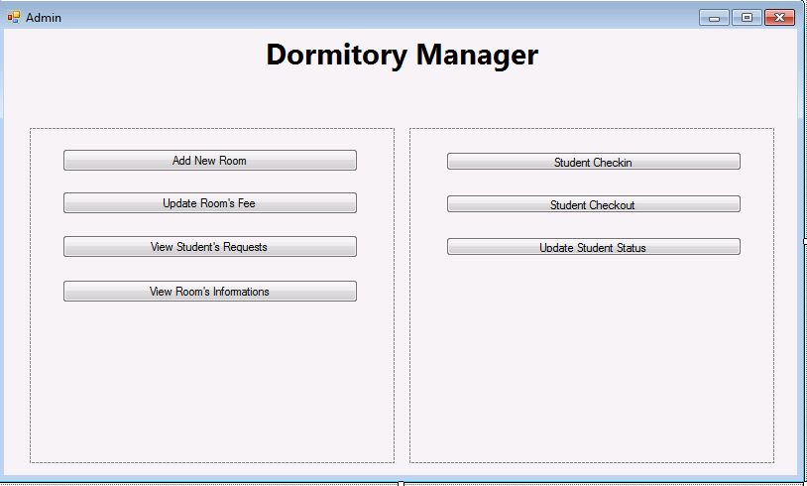

Slide 8
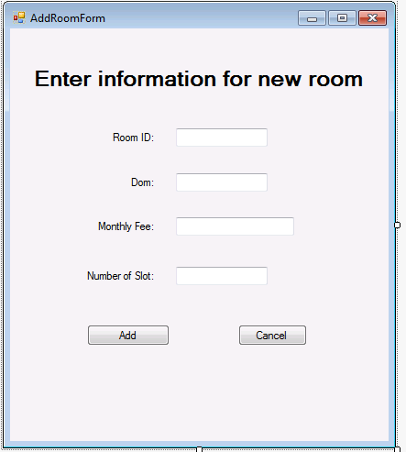

Slide 9
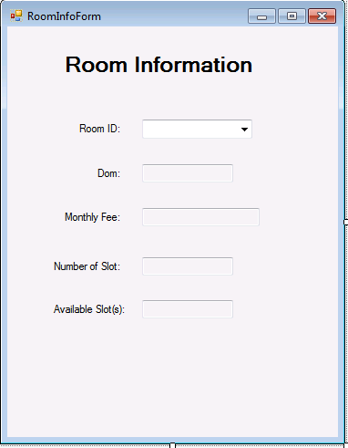

Slide 10
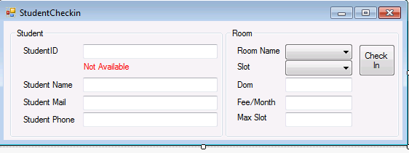
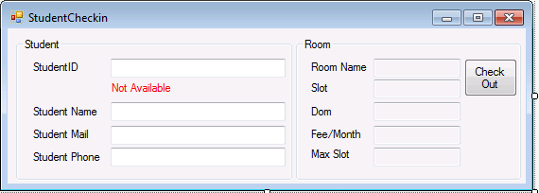

Slide 11
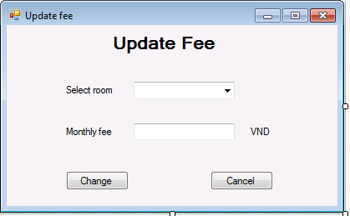

Slide 12
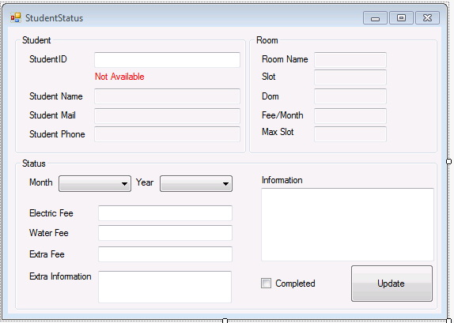

Slide 13
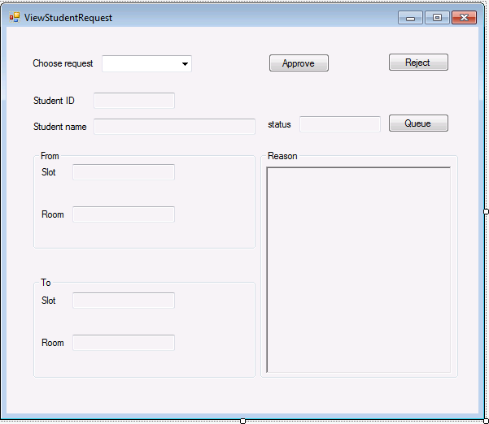

Slide 14



Student interface:
Functions:
Check room’s status
Check extra fee
Search available room
Create request to change room
Create request to leave room
Create request to inform room’s problem
View all requests that have been sent

Slide 15
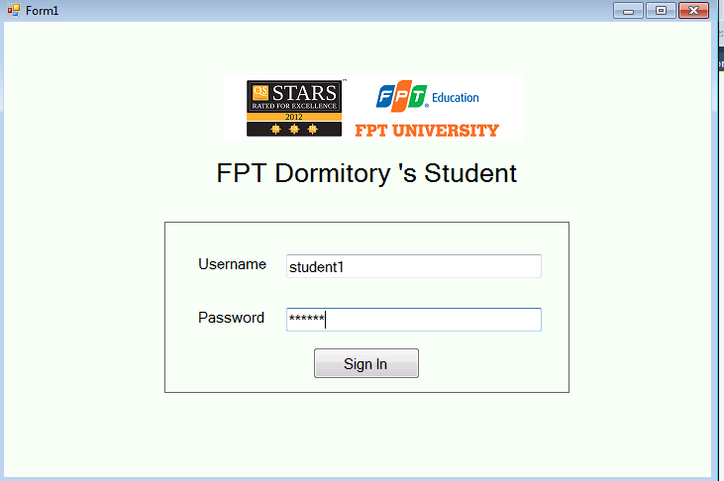

Slide 16
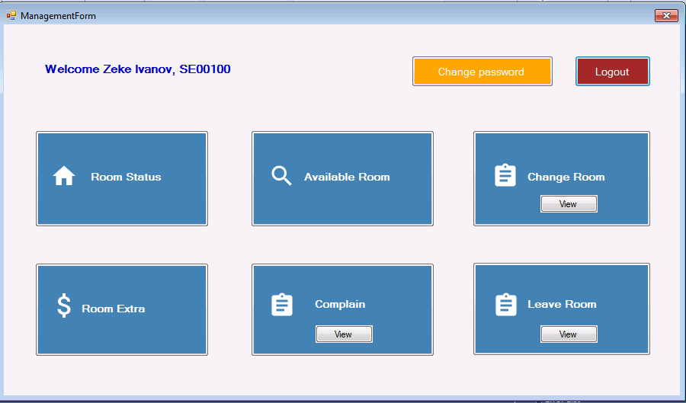

Slide 17
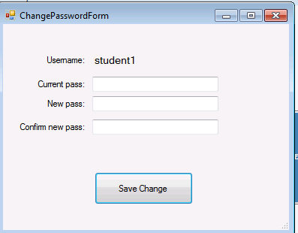

Slide 18
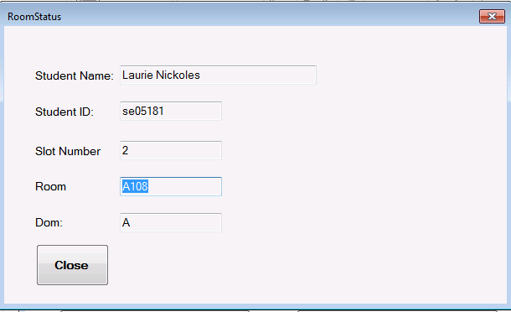

Slide 19
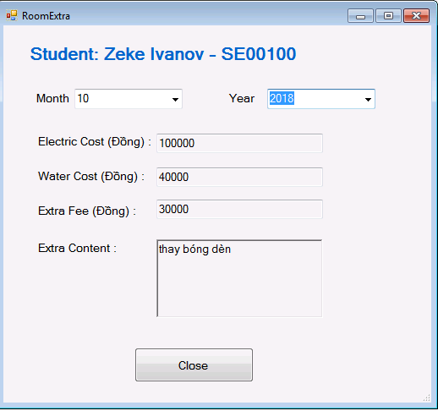

Slide 20
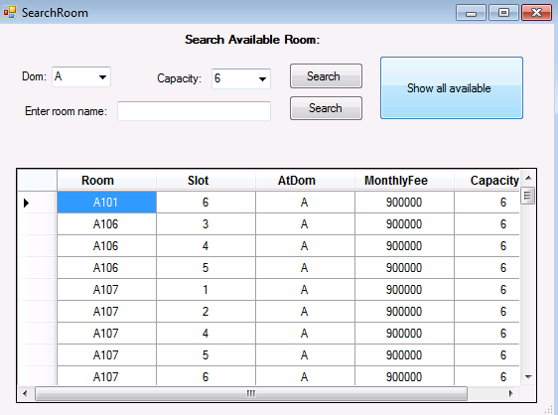

Slide 21
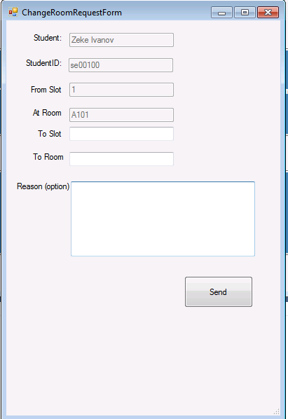

Slide 22
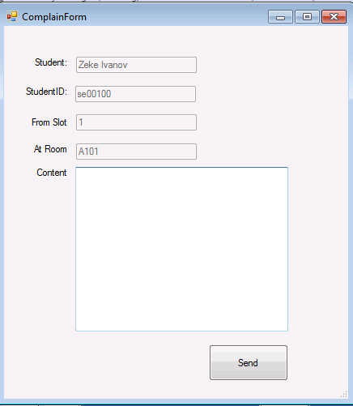

Slide 23
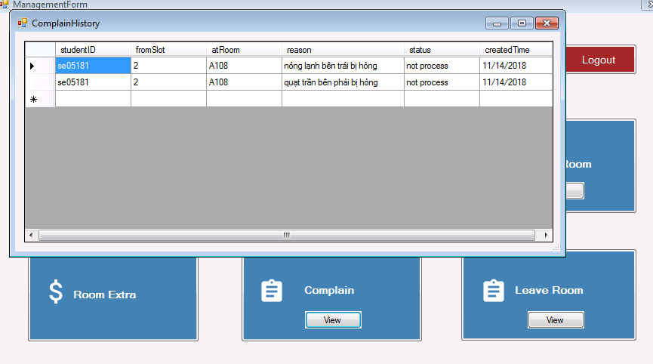

Slide 24
END

