Slide 1
CSP2108: Introduction to Mobile Applications Development
Week 4: Images and groups in Corona

Slide 2
Topics this week
Images
Content Scaling
Configuration Files
Image Sheets
To find out more, see the Corona API docs at https://docs.coronalabs.com/api/index.html
graphics.*
display.*

Slide 3
Images
Recall that images can be loaded in as Display Objects
display.newImage can be used to load an image from file, shows it on the screen, and creates a display object
display.newImageRect is another way to do this that does image scaling differently from display.newImage
Images can also be used to fill shapes (see last week’s lecture example)
Another way to load images for animation uses Image Sheets

Slide 4
display.newImage or display.newImageRect
Both of these can load in an image, but newImageRect works best when using content scaling (but your textbook uses newImage)
Content scaling is a way of dealing with different size displays for different devices
We will use content scaling (it’s easier)

Slide 5
Content scaling
This lets us “pretend” that the display is a certain size, and Corona will figure out how to map from our imaginary display to the actual device display, which may be a different size and shape
Recall when you create a Corona project you get to set the device width and height (default is 320 x 480 on my Mac – this is the right aspect ratio for an iPhone 4)
You can change this by editing the configuration file, config.lua (in the same folder as main.lua)

Slide 6
Setting content area when creating a project

Slide 7
config.lua
The format is a Lua table (application) with other tables as values (e.g. content)
application can have other entries that control aspects of the behaviour of the app.
We’ll look at some of these later.

Slide 8
Syntax for newImage*
display.newImage( filename [, x, y] )
display.newImageRect( filename, width, height )
filename – is the name of the image file. The file needs to be in the same folder as main.lua
[, x, y] – optional x, y, coordinates where the anchor is placed (default is 0,0 – default anchor is the middle of the image)
width, height – this is the size of the image. newImage uses the actual size of the image in pixels

Slide 9
Example

Slide 10
Example on different devices

Slide 11
Change the scaling method
The mapping to the display depends on the width and height of the content area and also on the scaling method (“scale” in the config file)
Change by editing the file. Possible values:
letterbox : this is the default. Keeps aspect ratio, fits display
zoomEven : similar but may not all fit on display
adaptive : width and height dynamically determined – not supported on all devices
zoomStretch : content fits whole display screen, but aspect ratio not preserved

Slide 12
Effect of “zoomStretch” scaling

Slide 13
letterbox v zoomEven

Slide 14
Dynamic resolution
To improve the appearance of images on displays with different resolution, you can provide multiple versions of an image
e.g. I created a 200x200 version of small.png, and added the text “2x” so that you can tell when it is being used. I saved it in a file called small@2x.png
Now is I change the config file like so

Slide 15
Config with dynamic resolution
Note “imageSuffix” table is uncommented now
You can set up multiple different resolutions the same way
This is the result:

Slide 16
Using dynamic resolution
Note only newImageRect picks up the higher resolution version of the image

Slide 17
To use multiresolution images
In config.lua, specify naming convention e.g. ["@2x"] = 2
Make images of different sizes e.g. 2 x original size – named e.g. image@2x.png
Use newImageRect
Corona will find the best match

Slide 18
Image Sheets
It’s handy to have multiple images in one graphics file e.g. frames in an animation
Corona does this using Image Sheets
The idea is to read in the combined image data, and pick out parts of it for the different images

Slide 19
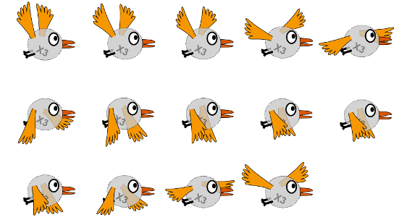
Example file
14 “frames”, each 110x100 pixels
Frame 1 at top-left, then going left-to-right and down the page
110
100

Slide 20
Image Sheets example code

Slide 21
sequence data properties
name – used to identify different sequences
start – the frame number to start on
count – how many frames to use
time – delay between frames
loopCount – how many times to repeat the sequence: 0 for infinite
loopDirection – forward or bounce

Slide 22
more complex
The sequence data can contain more than one sequence, with different names
Sequences can be non-consecutive frames

Slide 23
more complex example code

Slide 24
More info
Can be found in the Corona API docs
Sprite animation guide
https://docs.coronalabs.com/guide/media/spriteAnimation/index.html
Image sheets guide
https://docs.coronalabs.com/guide/media/imageSheets/index.html

