Slide 1
Understanding Operating Systems Sixth Edition
Chapter 12
System Management

Slide 2
Learning Objectives
The tradeoffs to be considered when attempting to improve overall system performance
The roles of system measurement tools such as positive and negative feedback loops
Two system monitoring techniques
The fundamentals of patch management
The importance of sound accounting practices by system administrators

Slide 3
Evaluating an Operating System
Knowledge required
Design goals and history
Users’ communication mechanisms
Resource management techniques
Tradeoffs accepted to achieve goals
Operating system strengths and weaknesses
Weighed against:
Users
Hardware
Purpose

Slide 4
Cooperation Among Components
Performance dependency
One resource depends on other system resources
System improvement
Requires extensive needs analysis
System’s resources, requirements, managers, users
System change results
Trade one problem for another
Consider entire system performance
Not just individual components

Slide 5
Role of Memory Management
Consider actual operating environment
Before memory-related changes
Tradeoff
Memory use versus CPU overhead
Algorithm complexity increases
CPU overhead increases
Overall performance suffers
Additional memory
May or may not help

Slide 6
Role of Processor Management
Multiprogramming system
Requires synchronization
Memory manager, processor manager, and I/O devices
Tradeoff
Better CPU usage versus increased overhead
Slower response time
Decreased throughput

Slide 7
Role of Processor Management (cont'd.)
Problems
System saturation point
CPU fully utilized and accepting additional jobs
Higher overhead and less time to run programs
Heavy loads
CPU time required to manage I/O queues dramatically increases time required to run jobs
Long queues at channels, control units, and I/O devices
CPU idle (waiting for processes to finish I/O)

Slide 8
Role of Device Management
I/O device utilization improvement techniques
Blocking, buffering, rescheduling I/O requests
Tradeoffs
Increased CPU overhead
Additional memory space used
Blocking
Reduces physical I/O requests (good)
Increases overhead (bad)

Slide 9
Role of Device Management (cont'd.)
Buffering
CPU matches slower I/O device speed (and vice versa)
Requires memory space (buffers)
Tradeoffs
Less multiprogramming versus better I/O device use
Rescheduling requests
Optimizes I/O times
Queue reordering technique
Overhead function
CPU and I/O device speeds versus reordering algorithm execution time

Slide 10
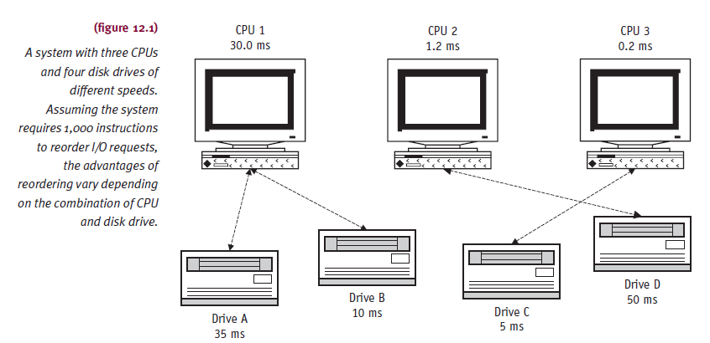
Role of Device Management (cont'd.)

Slide 11
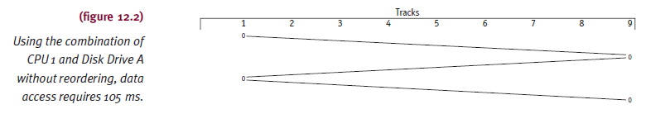
Role of Device Management (cont'd.)
Example: without reordering
CPU 1 and disk drive A
Access track 1, track 9, track 1, track 9
Arm already located at track 1

Slide 12
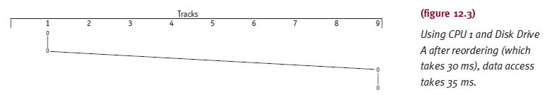
Role of Device Management (cont'd.)
Example: after reordering
Arm performs both accesses on Track 1 before traveling Track 9 (35 ms)

Slide 13
Role of Device Management (cont'd.)
Reordering requests not always warranted
Example: CPU 1 and much faster disk drive C
Without reordering: access time = 5 + 5 + 5 = 15 ms
With reordering: access time = 5 + 30 = 35 ms
Reordering algorithm
Always on or always off
Requires reconfiguration to change
Initial setting
Determined by evaluating system on average

Slide 14
Role of File Management
Secondary storage allocation schemes
Help organize and access system files
Important considerations
File organization
Example: file records stored noncontiguously
Time consuming and requires compaction (CPU time)
Volume directory location
Affects retrieval time
Different schemes offer different flexibility
Tradeoff: file flexibility versus CPU overhead
Closely related to device storing files

Slide 15
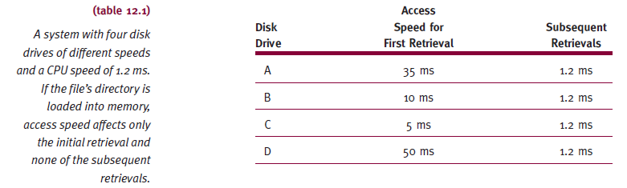
Role of File Management (cont'd.)
File management related to device where files stored

Slide 16
Role of Network Management
Routinely synchronizes remote processor load
Determines message priority
Selects most efficient communication paths
Over multiple data communication lines
Monitors use:
Individual computers and shared hardware
Ensures software license agreements compliance
Simplifies updating data files and programs on networked computers

Slide 17
Measuring System Performance
Total system performance
Efficiency with which computer system meets goals
System efficiency
Not easily measured
Affected by three components
User programs, operating system programs, hardware
System performance
Very subjective
Difficult to quantify
When quantifiable
Not an absolute measure

Slide 18
Measurement Tools
System performance measures:
Throughput
Capacity
Response time
Turnaround time
Resource utilization
Availability
Reliability

Slide 19
Measurement Tools (cont'd.)
Throughput
Composite measure
Indicates system productivity as a whole
Measured under steady-state conditions
Example: quantities
Number of jobs processed per day
Number of online transactions handled per hour
Measures work volume handled by system unit
Monitored: hardware or software

Slide 20
Measurement Tools (cont'd.)
Throughput bottlenecks
Capacity
Maximum throughput level
Resources saturated
Processes not passed along
Thrashing results
Main memory over-committed
Multiprogramming level reaches peak point
Monitored by hardware or software
Bottleneck detection
Monitor queues at each resource

Slide 21
Measurement Tools (cont'd.)
Response time
Online interactive user
Interval required to process user request
From when user presses key to send message until system indicates receipt of message
Turnaround time
Batch job response time
Time from job submission until output returned to user

Slide 22
Measurement Tools (cont'd.)
Dependencies
Workload handled by system at time of request
Type of job or request being submitted
Include
Average values and variance

Slide 23
Measurement Tools (cont'd.)
Resource utilization
How much unit contributing to overall operation
Percentage of time resource actually in use
Example: CPU busy 60 percent of time?
Helps analyst determine
Balance among system units
System category: I/O-bound or CPU-bound

Slide 24
Measurement Tools (cont'd.)
Availability
Indicates likelihood resource ready when needed
Influences
Mean time between failures (MTBF)
Average time unit operational before breaks down
Mean time to repair (MTTR)
Average time needed to fix failed unit and put back in service
Availability (A) =

Slide 25
Measurement Tools (cont'd.)
Reliability
Measures probability unit will not fail during given time period
Function of MTBF

Slide 26
Measurement Tools (cont'd.)
Performance measures
Avoid taking in isolation from system workload
Overall system performance
Varies with time
Important to define actual working environment
Before making generalizations

Slide 27
Feedback Loops
Monitor system resource utilization for adjustments
Prevents processor time spent on overhead
More time executing jobs
Feedback loop types
Negative feedback loop
Positive feedback loop

Slide 28
Feedback Loops (cont'd.)
Negative feedback loop
Process arrival rate decreased when system too congested
Stabilized system
Queue lengths close to estimated mean values
Positive feedback loop
Arrival rate increased when system underutilized
Paged virtual memory systems use this
Implementation more difficult (than negative loops)

Slide 29
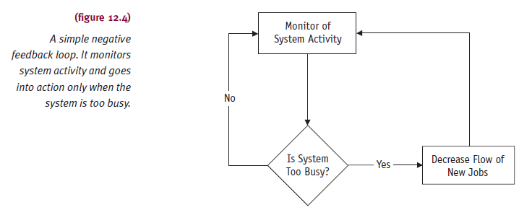
Feedback Loops (cont'd.)

Slide 30
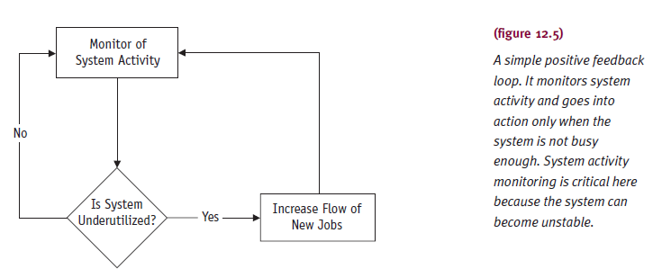
Feedback Loops (cont'd.)

Slide 31
Patch Management
Systematic updating
Operating system or other system software
Patch
Programming code
Replaces or changes software code
Reasons
Provides vigilant security precautions against threats
Assures government regulation compliance
Privacy and financial accountability
Keeps systems running at peak efficiency

Slide 32
Patch Management (cont'd.)
Challenges
System complexity
Operating system, network, various platforms, remote users
Speed vulnerabilities exploited
Worms, viruses, other system assaults
Rigorous patching results
Resources reach top performance
Information best protected
Responsibility: organization dependent
Chief information officer, chief security officer

Slide 33
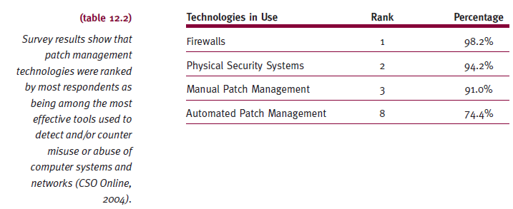
Patch Management (cont'd.)
Manual and automatic patch technologies
Among top eight used by organizations

Slide 34
Patching Fundamentals
Steps
Identify required patch
Verify source and integrity
Test patch in safe environment
Deploy patch throughout system
Audit system
Gauge patch deployment success
Recent data backup in hand
Before patch installation

Slide 35
Patching Fundamentals (cont'd.)
Patch availability
Identify patch criticality category
Critical
Apply patch as soon as possible
Not critical
Delay until regular patch cycle
Patch integrity
Validate source and integrity
Use digital signature or patch validation tool
Validate patch vendor’s digital signature

Slide 36
Patching Fundamentals (cont'd.)
Patch testing
Sample system or isolated machine
Resemble target network complexity
Tests
System reboot after patch installed
Software performs assigned tasks
Test contingency plans for installation failure
Uninstall patch
Recover old software

Slide 37
Patching Fundamentals (cont'd.)
Patch deployment
Installation
Single-user computer
Simple task
Install software and reboot computer
Multiplatform system (many users)
Exceptionally complicated task
Maintain accurate hardware and software inventory
Use network mapping software
Stage patch deployment

Slide 38
Patching Fundamentals (cont'd.)
Audit finished system
Confirm results meet expectations
Verify all computers patched correctly
Performs expected fundamental tasks
Verify all users eligible for patch
No unauthorized software on computers
Verify all users patched
No unpatched computer software

Slide 39
Patching Fundamentals (cont'd.)
Audit finished system (cont'd.)
Document
System changes
Successes and failures: each stage of process
Log all system changes: future reference
User feedback: verify deployment success

Slide 40
Software Options
Patch installation techniques
Manually: one at a time
Automatically: using software
Deployment
Agent-based software
Software assists in patch installation
On all target systems before patch deployed
Agentless software
Attractive for large, complex networks
Time-saving efficiencies

Slide 41
Timing the Patch Cycle
Critical patches
Applied immediately
Less-critical patches
Scheduled at systems group’s convenience
Routine patches
Applied monthly or quarterly
Timed
Coincide with vendor service pack release
Advantage
Thorough review before deployment: patch, testing cycles

Slide 42
System Monitoring
Hardware monitors
More expensive
Minimum impact on system
Outside and attached electronically
Examples: counters, clocks, comparator
Software monitors
Relatively inexpensive
Distortion of analysis results
Software monitor becomes part of system
Developed for each specific system
Difficult to move from system to system

Slide 43
System Monitoring (cont'd.)
Early systems performance measurements
Monitored CPU speed
Today’s measurements
Other hardware units, operating system, compilers, other system software
Measurements made in variety of ways
Real programs: production programs
Run with different configurations of CPUs, operating systems, other components
Results called benchmarks
Using simulation models

Slide 44
System Monitoring (cont'd.)
Benchmarks
Demonstrate specific advantages
New CPU, operating system, compiler, or piece of hardware
Useful when comparing systems experiencing extensive changes
Results dependent upon:
System’s workload
System’s design and implementation
Specific requirements of applications loaded on system

Slide 45
Accounting
Pays bills
Keeps system financially operable
Single-user environment
Easy to calculate system cost
Multiuser environment
Computer costs distributed among users
Basis
Users’ resource usage

Slide 46
Accounting (cont'd.)
Distributing computer costs
Operating system tasks
Set up user accounts
Assign passwords
Identify resources available to each user
Define quotas for available resources: disk space or maximum CPU time allowed per job

Slide 47
Accounting (cont'd.)
Pricing policies vary from system to system
Examples:
Total amount of time spent between job submission and completion
CPU time, main memory usage
Secondary storage used during program execution
Secondary storage used during billing period
Use of system software, number of I/O operations
Time spent waiting for I/O completion
Number of input records read, output records printed, page faults

Slide 48
Accounting (cont'd.)
Pricing policies
Achieve specific operational goals
Pricing incentives
Encourage access of more plentiful and cheap resources
Billing method information
Environment dependent
Maintaining billing records online
User’s status checked before job enters READY queue
Increased overhead

Slide 49
Summary
Operating system orchestrates cooperation
All hardware and software
One part favored at expense of others
Leads to tradeoffs
System managers
Use appropriate measurement tools and techniques
Verify system effectiveness
Evaluate degree of improvement

