Slide 1
CSP2108: Introduction to Mobile Applications Development
Module 10: Data

Slide 2
Topics this week
JSON
SQLite
For many apps, you will want to store various kinds of data when the app is not running and retrieve it when you need it. Two solutions in Corona : JSON – similar to XML, and SQLite, a relational database.

Slide 3
JSON
JavaScript Object Notation
A human-readable, easy to parse, text-based data interchange format
Quite similar syntax to Lua tables
Easy to convert between
Notes:
https://coronalabs.com/blog/2011/08/03/tutorial-exploring-json-usage-in-corona/
http://www.json.org/
https://docs.coronalabs.com/api/library/json/index.html
https://en.wikipedia.org/wiki/JSON
https://coronalabs.com/blog/2014/10/14/tutorial-saving-and-loading-lua-tables-with-json/

Slide 4
JSON basics
Two structures
object : unordered set of name-value pairs
array : ordered collection of values
Values
strings (in double-quotes)
numbers
objects
arrays
true/false/null
Can be nested

Slide 5
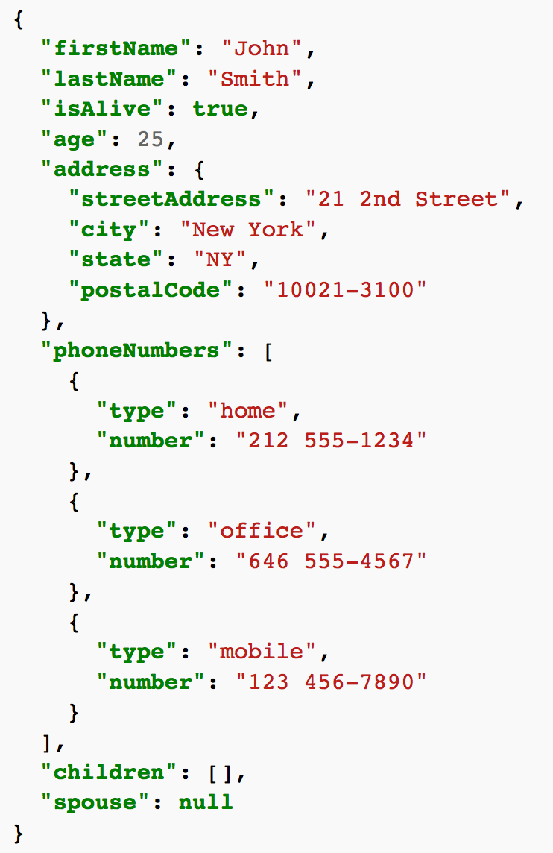
JSON object example
from https://en.wikipedia.org/wiki/JSON
“address” is a name
its value is an object with 4 name/value pairs
“phoneNumbers” is a name
its value is an array with 3 objects
“children” is a name
its value is an empty array

Slide 6
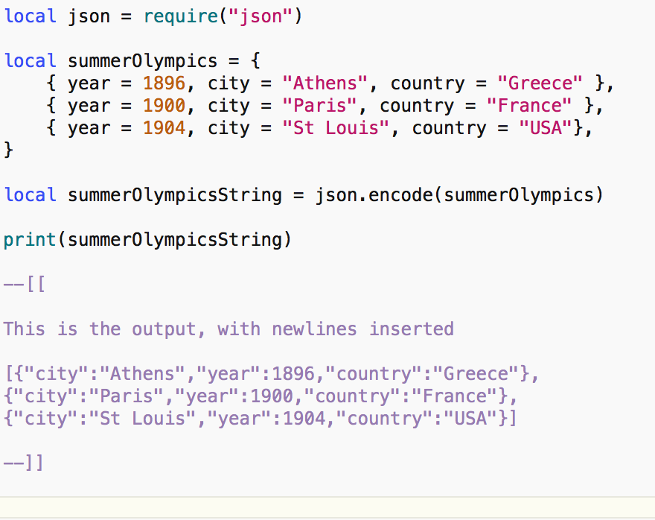
Corona table to JSON
Converting to JSON is easy.
json.encode() converts a table to a string.
The string can then be written to a file, or sent over a network.

Slide 7
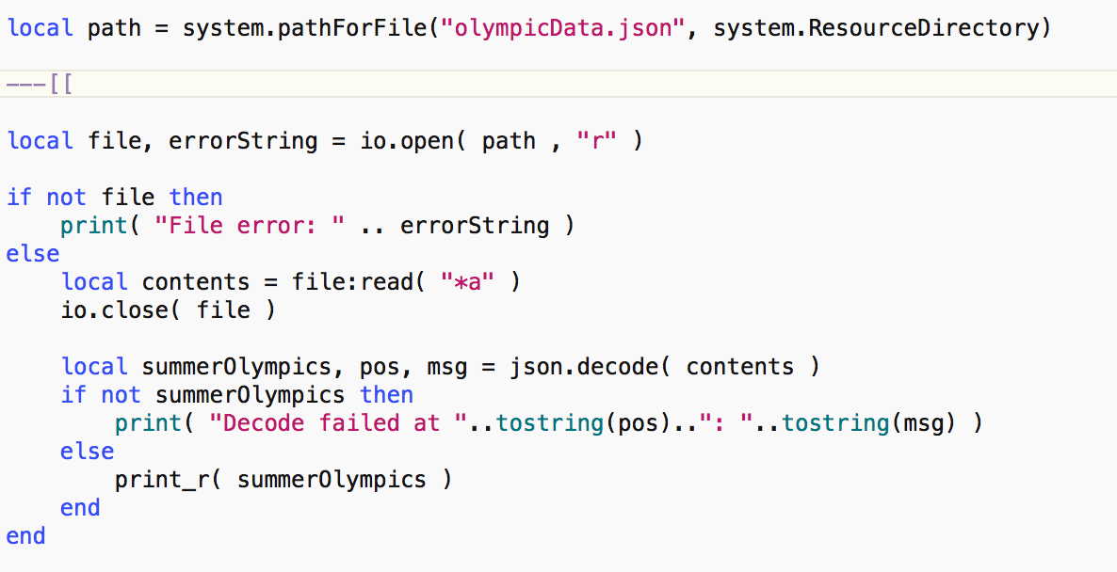
JSON to Corona table
Utility function – see source on Blackboard

Slide 8
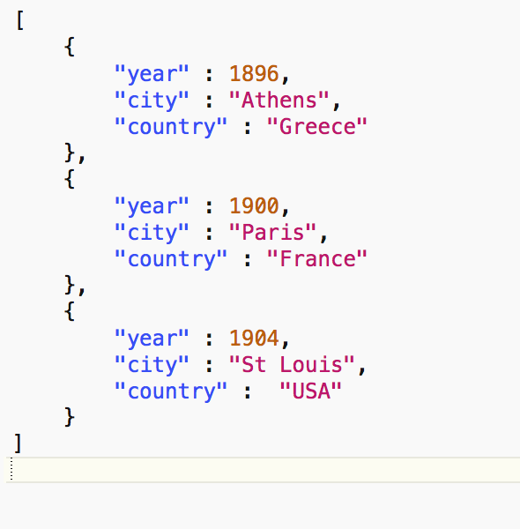
Input file and output for JSON example
table: 0x60800007f640 {
[1] => table: 0x60800007f640 {
[year] => 1896
[city] => "Athens”
[country] => "Greece”
}
[2] => table: 0x60800007f640 {
[year] => 1900
[city] => "Paris”
[country] => "France”
}
[3] => table: 0x60800007f640 {
[year] => 1904
[city] => "St Louis”
[country] => "USA”
}
}

Slide 9
Example use for JSON
There’s a tutorial at https://coronalabs.com/blog/2014/10/14/tutorial-saving-and-loading-lua-tables-with-json/
that shows how you could use JSON to store settings for your app, including default settings when the app first starts. Check it out.

Slide 10
SQLite in Corona
JSON is good for small, simple data storage
SQLite is better for larger, more complicated data needs
Provides for
multiple tables (database tables – not Lua tables)
creation, insertion, deletion, updates
queries, etc
in short – all the relational database functions
Notes:
http://luasqlite.luaforge.net/lsqlite3.html
https://docs.coronalabs.com/api/library/sqlite3/index.html

Slide 11
What is SQL?
SQL (Structured Query Language) is a database language for relational databases
Beyond the scope of this unit (and therefore non-examinable)
We briefly look at this to give you an idea what can be done, especially if you already know SQL
Notes:
https://coronalabs.com/blog/2012/04/03/tutorial-database-access-in-corona/
https://docs.coronalabs.com/api/library/sqlite3/index.html

Slide 12
What is a relational database?
Relational databases consist of a number of tables
A table is like a rectangular grid with rows and columns
Each row (tuple) contains data about some entity, like a person, or a bank account
Each column (attribute) corresponds to one specific piece of data, like a person’s height, or a bank account’s balance
Related data from different tables can be picked out and combined together to answer questions of interest e.g. What is the average bank balance of males versus females?

Slide 13
Example
The rest of these slides are based on the tutorial found at https://coronalabs.com/blog/2012/04/03/tutorial-database-access-in-corona/
The code can be found in a Corona project on Blackboard.

Slide 14
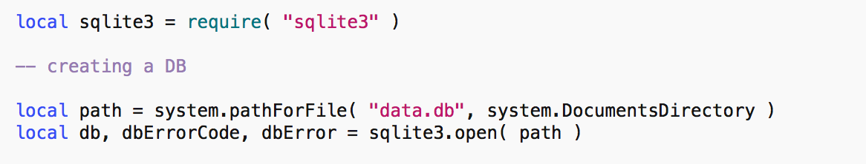
Creating a database
Remember: can’t write to resource directory
Opens or creates a db
db will be nil if there is an error

Slide 15
Creating a table
dbErrorCode will be 0 if there is no error
SQL command as a string
Table name is test
Columns are id, name, description, website

Slide 16
Inserting a row
id will be filled in automatically, starting from 1

Slide 17
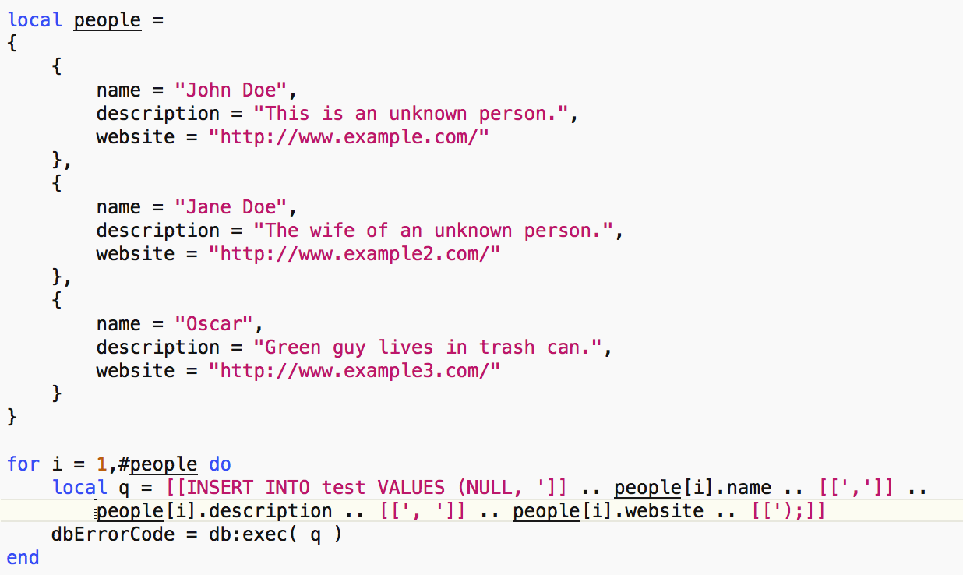
Rows from a Lua table
Note there will be two tuples with the name “John Doe” now

Slide 18
Updating a tuple
“Oscar” will be changed to “Grouch”

Slide 19
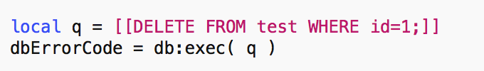
Deleting a tuple
The first “John Doe” will be removed

Slide 20
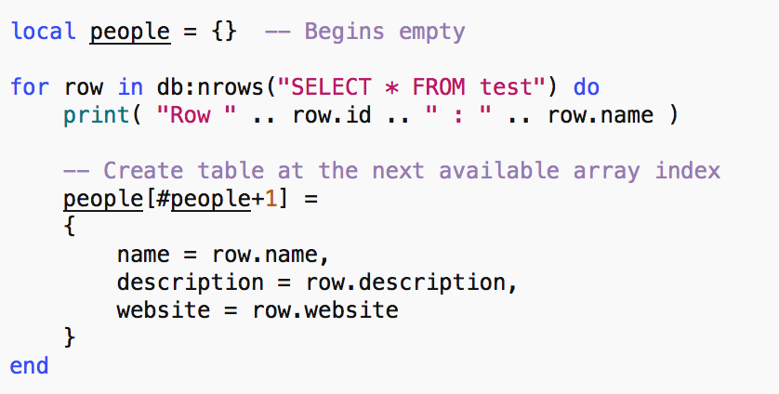
A query
Output is
Row 2 : John Doe
Row 3 : Grouch
Row 4 : Oscar

Slide 21
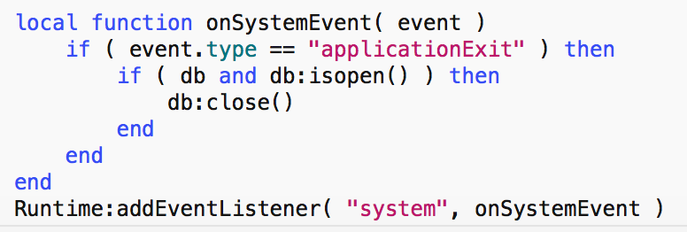
Closing
Close when no longer needed.
This technique makes sure the db is closed when the app has finished.

