Slide 1

Network and Internet Security
Computer Security

Slide 2
General Security Issues
Not all networks are the same
Can be different in terms of
Size/complexity
Topology
Protocols
Number of links to other networks
Wired/wireless/combinations
Devices used (switches, hubs, routers)
Security requirements

Slide 3
TCP/IP
Transmission Control Protocol / Internet Protocol
A set of protocols to allow hosts to communicate and transmit data over the Internet.
E.g. A web browser may use TCP/IP to communicate with a server. The server may use TCP/IP to transmit HTML data.

Slide 4
Lack of Security in TCP/IP
TCP/IP was not created with security in mind
No strong authentication of packets
Vulnerable to packet spoofing/modification/fabrication
No encryption of packets
Vulnerable to interception
Other aspects can also be exploited
E.g TCP Handshaking sometimes exploited in DoS attacks

Slide 5
IPv6
IP Version 6 has been suggested as a solution to a number of problems
IP address space exhaustion (128 bit address as opposed to 32 bit addresses)
Encryption of packet data
Cryptographic authentication of headers
IPv6 seen by many as the answer to many of the inherent problems of IPv4

Slide 6
Network Security Concerns

Slide 7
Scanning, Probing and Discovery
Often a pre-cursor to an attack
An attacker might perform some reconnaissance before committing to a full attack
Tip: if you have logged an attack and cannot determine its source due to IP spoofing or the attack being launched from compromised machines, look in the logs for prior recon attempts
Tools can be used to map the structure of a network, to identify systems and devices on the network and to automatically locate exploitable vulnerabilities

Slide 8
Scanning Tools
Nmap (www.nmap.org)
Powerful and free security scanner
Can discover hosts and services on a network
Nessus (www.tenable.com)
Powerful network vulnerability scanner
60000+ plugins are currently available
Plugins are small programs designed to discover a specific flaw

Slide 9
Packet Spoofing
Spoofing refers to the act of faking the source IP address of a packet or email to conceal the identity of the sender
Packet spoofing is a major network security issue
Often source addresses are used to authenticate packets
Do not assume that the source address is a true indication of the real origins of a packet

Slide 10
Address Resolution Protocol (ARP) Spoofing
ARP links a MAC address with an IP address
When one host using IP on a LAN is trying to contact another it needs the MAC address
When a host on a LAN asks
“Who has IP address x.x.x.x?”
The attacker can reply with
“x.x.x.x is at 00:16::::”
Traffic intended for the right recipient will be forwarded to the attacker

Slide 11
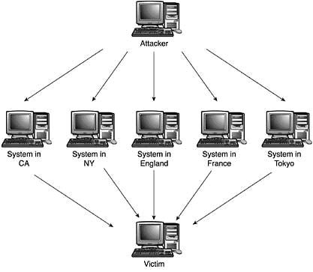
Denial of Service (DoS)
Send a large number of packets to a host
Slows down or crashes the host
Typically associated with botnets

Slide 12
Wireshark - Packet Sniffer
Free and open source packet analyser
Can be used to breach confidentiality of data
Typically used for;
Network troubleshooting
Network analysis
Network forensics

Slide 13
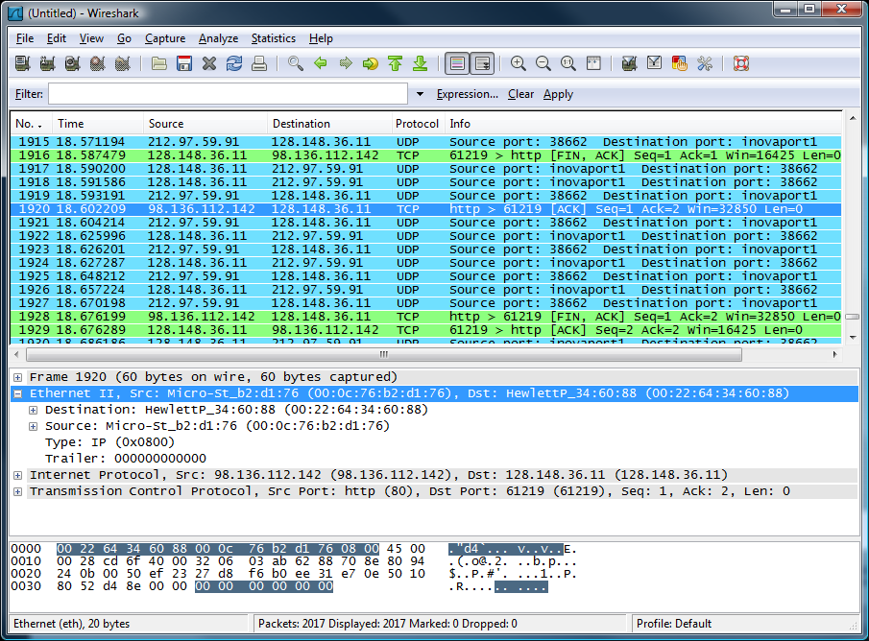
Wireshark
⬅ menu
⬅ filter toolbar
⬅ packet list pane
⬅ packet details pane
⬅ packet bytes pane
⬅ status bar

Slide 14
Port Knocking
Port knocking is a method to grant remote access to a host without leaving a port constantly open
Server must have a firewall with the knock-daemon listening for a specific TCP/UDP knock sequence
A client will “knock” at particular ports in a particular order to dynamically alter the firewall rule sets…granting remote access

Slide 15
Port Knocking cont…
Fairly secure against brute force attacks since there are 65536^{k} combinations, where k is the number of ports knocked
If port knocking daemon dies, the system may have limited or non-existent remote access
Process monitoring daemon can ensure that port knocking daemon is always up

Slide 16
Wired vs. Wireless Networks
Wireless networking
802.11a/b/g/n, Bluetooth, WiMAX
Convenient
Introduces additional network threats
Traffic interception/injection, theft of bandwidth, network intrusion, DoS
You automatically give your attacker ‘access to the wire’ because there is no wire
Puts you at a security disadvantage to start with

Slide 17
Wireless Legal Issues
Assuming you have no wireless security
If someone uses your wireless network to access and download illegal or inappropriate material, should you be held responsible?
Did you encourage someone to misuse your wireless network?
These issues are increasingly prevalent in the legal/security/network community

Slide 18
Wardriving and Warchalking
Process of driving around searching for and pinpointing wireless networks
GPS devices log locations to post online
Software such as NetStumbler for Windows
Use antennas to increase range
Warchalking involves leaving chalk marks

Slide 19

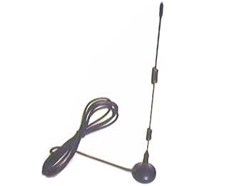
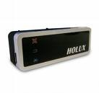
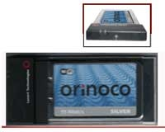
Wardriving Tools
Netstumbler
Antenna for db gain
Wireless card with monitor mode enabled
Global Positioning System (GPS)

Slide 20
Network Security Countermeasures?

Slide 21
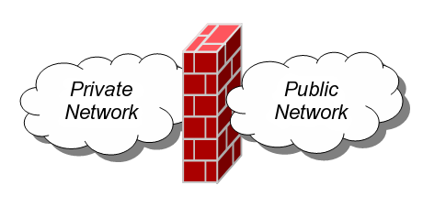
Firewalls
A firewall is collection of security measures designed to prevent unauthorized access to a networked computer
A network firewall is similar to firewalls in building construction, because in both cases they are intended to isolate one "network" or "compartment" from another

Slide 22
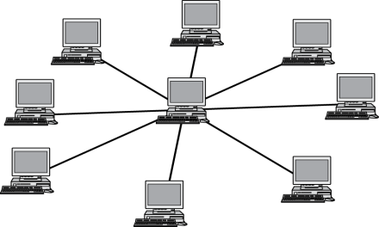




Firewall Policies
A firewall can be used to filter incoming or outgoing traffic based on a predefined set of rules called firewall policies
Trusted internal network
Firewall policies
Untrusted
Internet
Firewall

Slide 23
Firewall Policy Actions
A firewall can determine how to handle packets based on 1 of 3 rules
Accept – allowed through firewall to destination
Drop – not allowed through firewall with no notification sent to source
Reject – not allowed through firewall with notification sent to source informing that the packet was rejected

Slide 24
Firewall Blacklist vs. Whitelist
Blacklist approach
All packets are allowed through except those that fit the rules defined specifically in a blacklist.
This type of configuration is more flexible in ensuring that service to the internal network is not disrupted by the firewall, but is naïve from a security perspective in that it assumes the network administrator can enumerate all of the properties of malicious traffic.
Whitelist approach
A safer approach to defining a firewall rule set is the default-deny policy, in which packets are dropped or rejected unless they are specifically allowed by the firewall.

Slide 25

Firewall Types
Stateless firewall
Stateful firewall
Application firewall
Circuit level gateway
Personal firewall

Slide 26

Stateless Firewall
A stateless firewall doesn’t maintain any state with respect to the packets it is processing
SYN
Seq = x
Port=80
Client
SYN-ACK
Seq = y
Ack = x + 1
ACK
Seq = x + 1
Ack = y + 1
Trusted internal
network
Server
Firewall
Allow outbound SYN packets, destination port=80
Allow inbound SYN-ACK packets, source port=80

Slide 27
Stateful Firewalls
Stateful firewalls maintain tables containing information on each active connection
IP addresses
Ports
Sequence numbers of packets
Reduces the required computational processing power to handle rulesets

Slide 28
Stateless vs. Stateful Firewall Table
STATELESS FIREWALL
Source IP | Source Port | Destination IP | Destination Port | Action
Any | Any | 10.1.1.50 | Any | Allow
10.1.1.60 | Any | Any | Any | Allow
Any | Any | 10.1.1.20 | 23 | Deny
Any | Any | Any | Any | Deny
STATEFUL FIREWALL
Source IP | Source Port | Destination IP | Destination Port | State
10.1.1.2 | 23 | 10.1.1.50 | 23 | Established
10.1.1.60 | 80 | 10.1.1.35 | 80 | Established
10.1.1.4 | 1063 | 10.1.1.20 | 80 | Established
10.1.1.90 | 1130 | 10.1.1.2 | 80 | Established

Slide 29
Application Firewall
Controls inputs, outputs and access to or from an application or service
Network based or host based
Popular application firewalls include
WinGate
ModSecurity
Allows logging and monitor of traffic

Slide 30
Circuit Level Gateway
Examines IP address and port information
Once connections are verified they simply pass bytes through
Used by DSL routers – Network Address Translation
Gateway communicates directly with 3rd party hosts on behalf of internal LAN hosts

Slide 31
Software/Personal Firewalls
The defining characteristics of this type of firewall is that they are software that runs directly on the systems that is being protected
As opposed to network firewalls that typically act as a form of perimeter defence
Most personal firewalls
Control incoming connections (ingress filtering)
Control outward communication (egress filtering)
Verifying applications (hashing executables)

Slide 32
Personal Firewalls
Some personal firewalls also integrate anti-virus and content filtering features
Examples include
Comodo Internet Security
Bitdefender Internet Security
Zonealarm Firewall
Norton Internet Security
Are commonly packaged with anti-virus, phishing detection, ad blocking etc.

Slide 33
Intrusion Detection Systems (IDS)
Detect and react to attacks on a network
Intrusion Detection
The identification through intrusion signatures and report of intrusion activities
Intrusion Prevention
The process of both detecting intrusion activities and managing automatic responsive actions throughout the network

Slide 34
Rule Based IDS
Rules identify the types of actions that match certain known profiles for an intrusion attack
Signatures must be kept up-to-date, in much the same way as anti-virus software
Susceptible to new un-documented attacks
Attacker could also disguise or conceal the attack by varying it slightly so that it does not match a known signature

Slide 35
Anomaly (Statistical) Based IDS
A profile is built, which is a statistical representation of the typical ways that a user acts or a host is used “what is considered normal”
Thresholds are set to determine what is abnormal
A careful attacker might be able to draw out an attack so that the thresholds are not reached
What if an attacker can slowly change the IDS’ view of what is normal?

Slide 36
Honeypots/Honeynets
Countermeasure based on deception
Honeypot / Honeynet simulates a system or an entire network
Attacker is lured into the honeypot thinking that it is a computer system or network
Honeypot provides the responses that the attacker would expect to see if they were attacking a real system
Success depends on deceptive capabilities

Slide 37
Virtual Private Networks (VPN)
Allows a host to communicate with other hosts as if it were directly part of the network
Used to provide a secure connection over an un-trusted network (the Internet)
Cheaper alternative to leased lines, dedicated lines etc
Provides confidentiality and authentication

Slide 38
Some Uses for VPNs
PC
PC
PC
VPN Gateway
PC
VPN Gateway
VPN Tunnel
PC
Untrusted Network
PC
PC
PC
Site to Site VPN
PC
PC
VPN Gateway
PC
VPN Tunnel
PC
Untrusted Network
PC
Host to Site VPN (Road Warrior configuration)

Slide 39
VPN Tunnelling
Common VPN protocols include
IPSEC
PPTP (Point to point Tunnelling Protocol)
L2TP (Layer 2 Tunnelling Protocol)
VPNs work by establishing encrypted, authenticated tunnels between end points
PPTP authenticates by the use of passwords
IPSEC can authenticate using shared secrets (passwords/secret keys), but is mainly geared towards the use of certificates on clients

Slide 40
SSL/TLS
Protocols such as Secure Sockets Layer (SSL) and Transport Layer Security (TLS) also allow the creation of encrypted tunnels
SSL 2.0 → SSL 3.0 → TLS 1.0
Confidentiality is achieved through the use of encryption, authenticity through the use of certificates and message integrity through the use of HMACs

Slide 41
Uses of TLS
Secure channel between web browser and web client
Internet banking, transfer of online credit card payments and other sensitive information
Secure channel between mail clients and servers
Prevents snooping and eavesdropping (between the mail server and client anyway)
Also used in some VPN products

Slide 42
Internet Security Issues
Internet and WWW security

Slide 43
Usage Logging and Auditing
Many organisations have an interest in using logging and auditing to detect misuse of the Internet and WWW
Aside from improving performance and reducing costs through caching, proxy servers are in a good position to log WWW usage

Slide 44
Proxy Servers
To do something ‘by proxy’ means to have someone to something on your behalf
A web proxy fetches web pages on behalf of a web client and returns those pages to the client
Such proxies can cache (keep a local copy of) frequently used pages in order to improve performance and reduce network traffic costs
Proxy servers are also in a good position to filter web content or log web accesses

Slide 45
Content Filtering
Could be done for a number of reasons
To filter out objectionable content
To enforce organisational policies
To filter out advertisements, web bugs, cookies etc
Can save bandwidth and help to preserve privacy
Can be done by proxy servers
Several approaches
By IP address – A site may share IP addresses with legitimate sites
By keyword – May lead to unintentional blocking. Blocking the word ‘sex’ may block the “Essex Cricket Club” site
By URL – Websites can often change their locations

Slide 46
Proxy Logs
Proxy servers can keep detailed logs of accesses to websites
These logs can be very useful for detecting cases of misuse of the WWW
Often log file analysis tools are required due to large number of records stored in log files

Slide 47
Interception
Emails are very vulnerable to interception
In transit
Most emails are sent in plain text
From the mail server
Email servers could be compromised
Individual passwords and accounts could be compromised
Server backups could also be targeted
From a local machine
Cached copies of mails

Slide 48
