Slide 1
CSP2108: Introduction to Mobile Applications Development
Week 7: Physics

Slide 2
Topics this week
Sensors
Physics

Slide 3
Physics Engines
A physics engine is a library that carries out the calculations needed to simulate movement and interaction of objects according to physical laws
Handles things like
rigid and soft-body dynamics
collisions
Notes:
https://docs.coronalabs.com/guide/physics/physicsSetup/index.html
See text pp 79-83

Slide 4
Box2D
Corona uses Box2D
An open source library often used for games
Calculates rigid body dynamics, with
bodies composed of polygons, circles
joined by joints
include gravity, frictions, restitution (bouncing)

Slide 5
Box2D in Corona
Display Objects in Corona can have “physics” added
All objects made physical can then automatically interact/move/collide/bounce off each other
Uses a coordinate system with
0,0 in the top left
1 pixel = 1/30 of a meter
angles in degrees

Slide 6
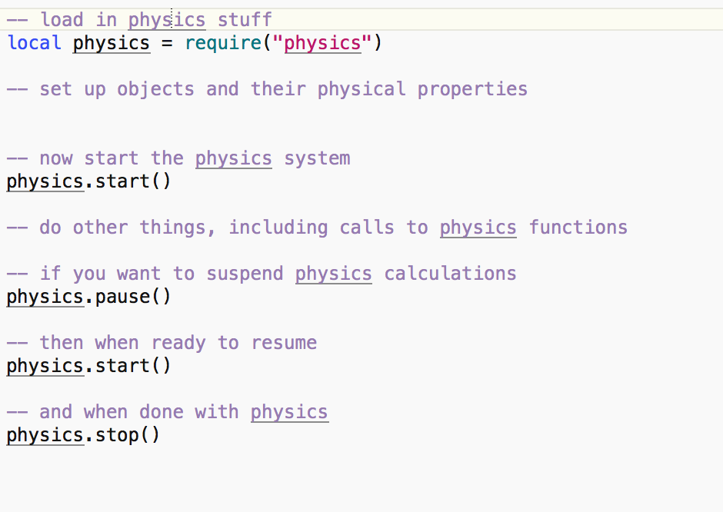
Starting and stopping physics

Slide 7
Physics options - sleeping
physics.start(true) – prevent objects from “sleeping” when inactive
saves CPU – but objects don’t respond to gravity unless in a collision
default is false
individual objects can be prevented from sleeping (object.isSleepingAllowed = false)

Slide 8
physics options - gravity
x and y components of gravity can be set
default is (0, 9.8) ms⁻²
physics.setGravity(x, y)

Slide 9
physics options - scale
physics.setScale(s)
default is 30 : 30 pixels is about 1 meter

Slide 10
physics options – draw mode
Very useful for debugging
physics.setDrawMode(m)
“normal” – objects displayed as normal
“debug” – object outlines used for collisions are shown instead
“hybrid” – both are shown
There are more options – read about them in the Corona docs

Slide 11
An example program
On blackboard you can find a simple demo app called Tumble
Download and unzip it and open it in Corona
You can’t test it in the simulator (it uses gravity)
Download the apk an install on an android device to test it.
We’ll examine the code.

Slide 12
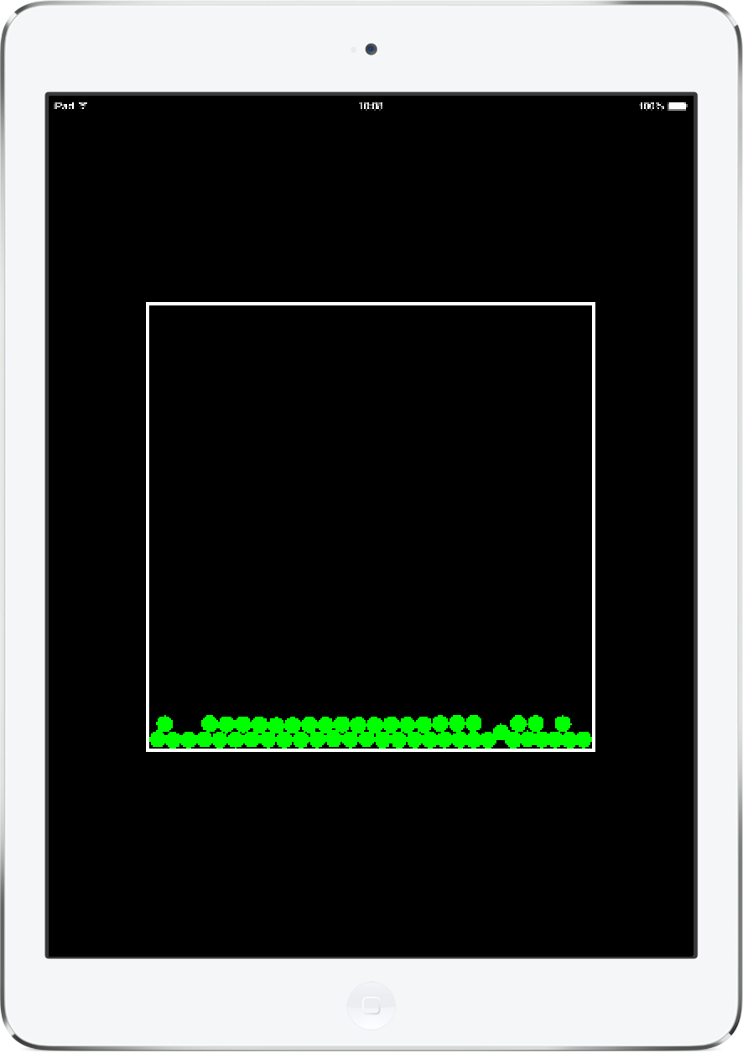
Tumble code walk-through
Here’s how it looks in the simulator.
There is a square “room” containing a number of green “gems”.
At the start, they are at the top of the screen, and then they fall under gravity towards the bottom.
They bounce off each other and off the walls.
After a while, they stop moving and look like this.
On a real device, you can tilt the device to change the direction of gravity, making the gems start falling about and bouncing again.

Slide 13
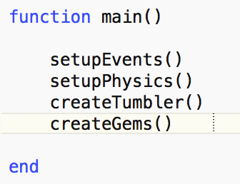
Tumble
This is the function that runs when the app starts.
It gets ready for accelerometer events, initialises the physics engine, then creates and inserts the walls of the room and the gems.

Slide 14
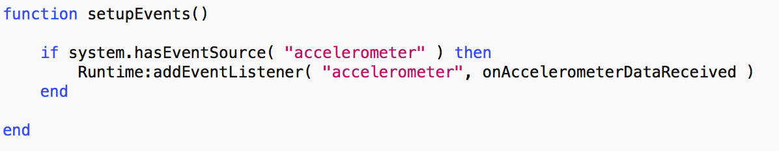
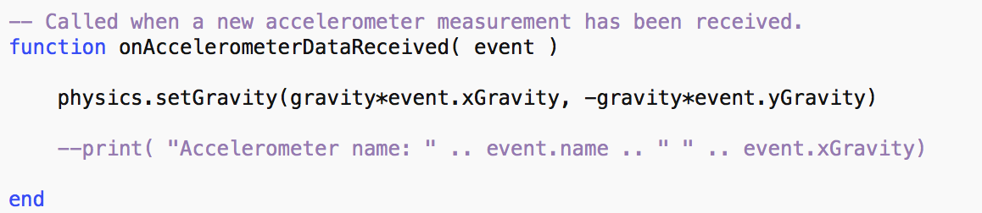
Tumble
Here’s where the listener is installed
And here’s the listener
Notes:
This sets up gravity to match the up-down orientation of the device, relative to portrait layout

Slide 15
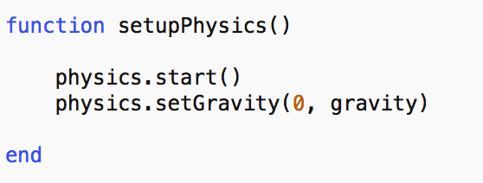
Tumbler
Here the physics engine is set up.
gravity is a constant defined earlier, which is more than the default, making things fall faster than normal.

Slide 16
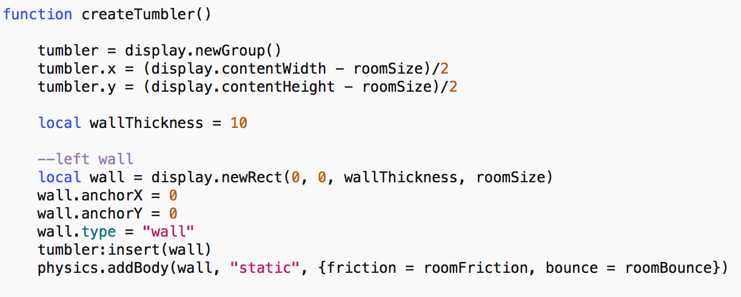
Tumbler
Each wall is created as a display object, and then included in the physics, with its own friction and elasticity
the other walls are added in the same way

Slide 17
Making objects physical : properties
physics.addBody(object, {properties})
properties
density (water = 1.0). Mass = area x density
friction (0 = none, 1 = lots)
bounce : how much energy retained after collision (1.0 no loss, >0.3 is bouncy)

Slide 18
Making objects physical : bodyType
bodyType
dynamic : full physics, including gravity, collisions
static : no velocity
kinematic : velocity but no gravity
Collisions
only occur where at least one body is dynamic
Either
physics.addBody(object, “static”, {properties} ), or
physics.addBody(object, {properties}); object.bodyType = “static”

Slide 19
Making objects physical : body shapes
When you use physics.addBody(), a rectangular bounding box is created and used for collisions
You can change this, e.g.
set the radius property to get a circular body
define a polygon and use it as the shape property to get a convex polygon body
for other options, see the guide in the Corona docs at Docs / Guides / Physics / Physics Bodies ( https://docs.coronalabs.com/guide/physics/physicsBodies/index.html )

Slide 20
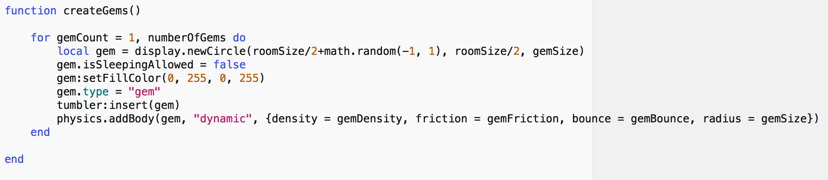
Tumbler : the gems
Stop gems falling asleep
Using circle bodies

Slide 21
That’s it for Tumbler
But there’s more . . .

Slide 22
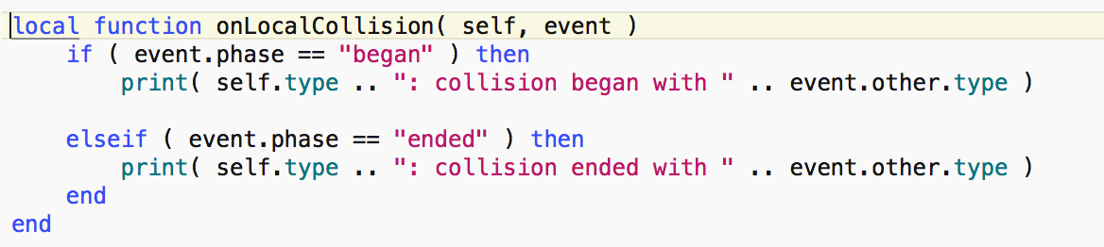
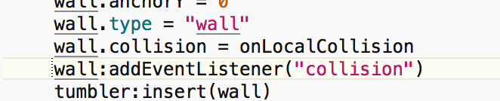
Collisions : simple local
Create an event listener (note the self parameter)
Add it to each object (gems also)

Slide 23
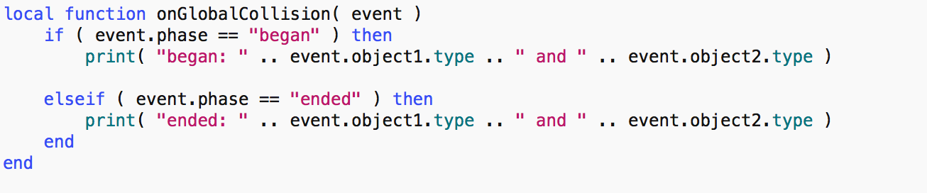
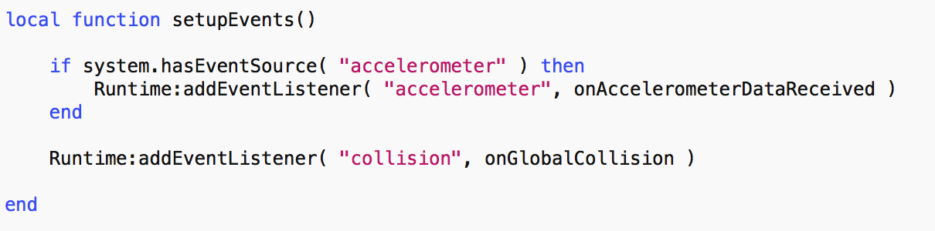
Collisions : simple global
Create a global event listener (note no self parameter)
object1 and object2 can be in any order
Register global collision listener

Slide 24
Collisions can be complicated
More info in Corona docs at Docs / Guides / Physics / Collision Detection
Pre- and post- collision events can be used to control collisions, get more information (e.g. forces)
Filtering can be done to control which collisions are reported

Slide 25
Sensors
Objects can be set up as “sensors”, so that they don’t interact with other objects, but collision events are generated when other objects pass through them
physics.addBody(object, “static”, {isSensor = true})

Slide 26
Controlling bodies
Some methods to manipulated bodies
object.setLinearVelocity( 2, 4 ) – x and y in pixels per second
object.applyForce( 500, 2000, object.x, object.y ) – push the object. If applied off centre, the object will rotate
object.applyLinearImpulse( 60, 20, object.x, object.y ) – similar but gives a one-off shove
object.applyTorque(2) – applies a rotational force
. . .
Don’t use these in a collision listener. (If you must, use a time delay)

Slide 27
Still more
There are more things to explore, such as jointed objects
See the Corona Docs at Docs / Guides / Physics

