Slide 1
CSP2108: Introduction to Mobile Applications Development
Week 7: Sensors

Slide 2
Topics this week
Using sensors
Physics

Slide 3
Mobile device sensors
Camera – captures still images and/or video
Microphone – records sound
GPS – location – see Module 11
Touch screen – can be pressure sensitive
Accelerometer – gravity and motion
Proximity – detects nearby objects
Magnetometer/Compass – measures magnetic fields
Light – detects level of ambient lighting
Corona supports those in red (provided the device has them)

Slide 4
Mobile device sensors
Fingerprint
Barometer
Thermometer
Pedometer
Heart-rate
Gyroscope – measures rotation
Explore Corona Docs / API/ Events
Many are not supported in the simulator – so you have to test on the device (although there are add-ons/workarounds)

Slide 5
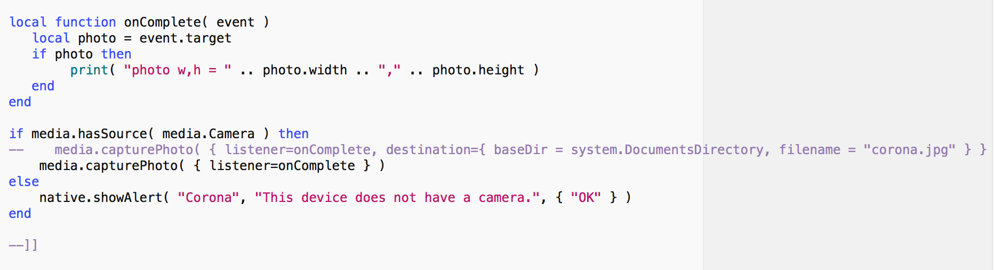
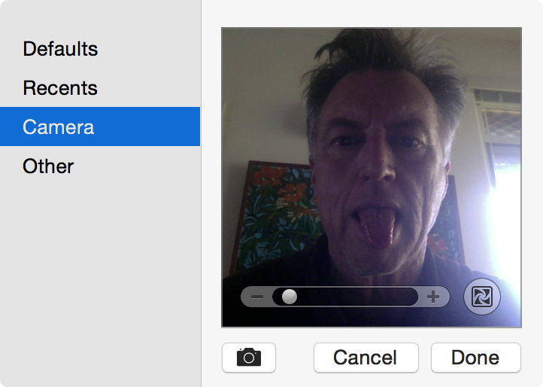
Camera with Corona
Here’s what happens when run in the simulator. The image is added to the display.
Alternatively, you can save to file.

Slide 6
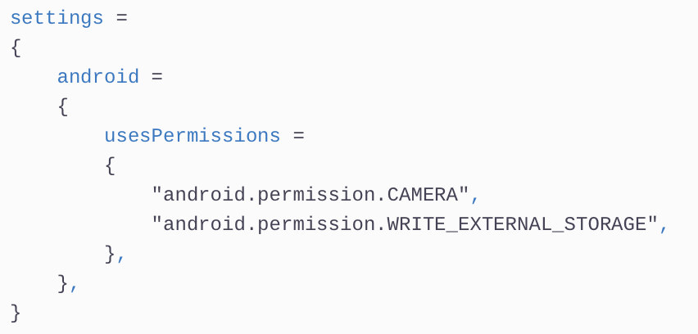
Camera with Corona
These entries are needed in build.settings for Android.

Slide 7
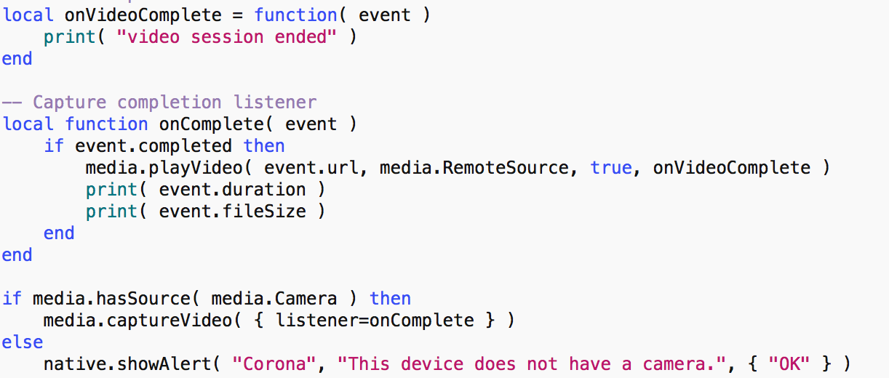
Video with Corona
The simulator does not support video – must test on the device.

Slide 8
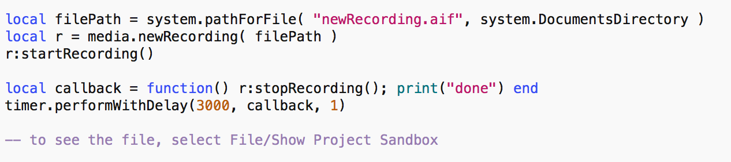
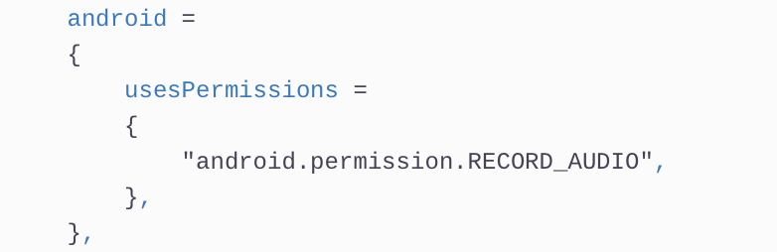
Audio recording with Corona
These entries are needed in build.settings for Android.

Slide 9
Sensors reporting via Runtime
Some sensors work with the Runtime object
accelerometer

Slide 10
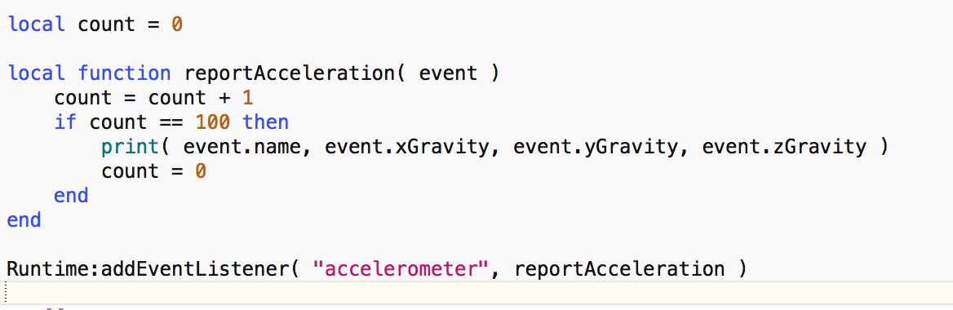
Accelerometer in Corona
Does not work in the simulator. Typical output:
Device vertical:
accelerometer -0.0038762082580787 -0.90791993083739 -0.11642116485647
Device flat
accelerometer 0.014726536767233 -0.01720733116237 -0.99908631638052

Slide 11
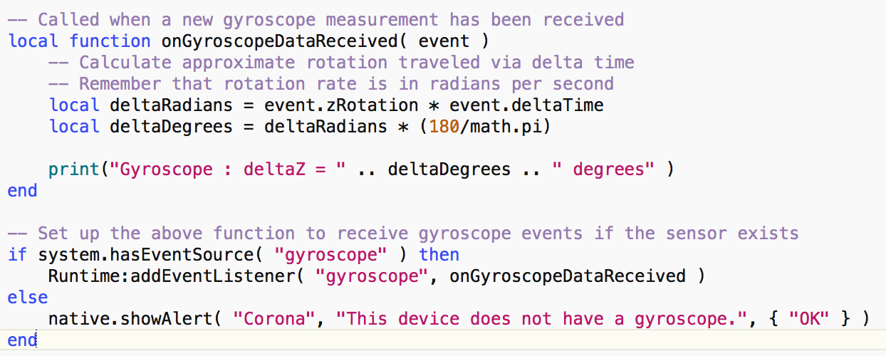
Gyroscope in Corona
Does not work in the simulator. Typical output:
Gyroscope: deltaZ = 0.085047852998514 degrees
x and y Rotation also available

Slide 12
Orientation in Corona
When the user changes between landscape/portrait, up/down, left/right, face up/face down
Useful when using accelerometer/gyroscope, as those are relative to portrait orientation
Android: left<->right, portrait<->portraitUpsideDown note reported
ioS supports faceUp/faceDown
If build settings have only 1 orientation, all changes reported
Otherwise only for supported orientations

Slide 13
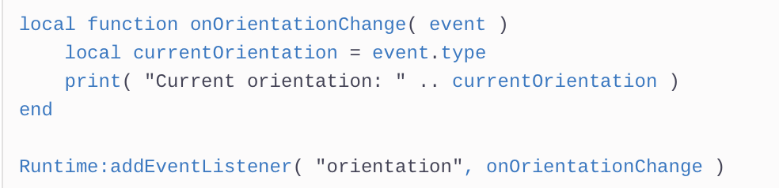
Orientation in Corona

