Slide 1
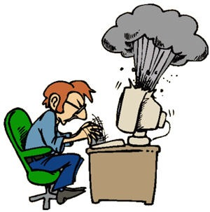
Introduction and Aims of Security
Computer Security

Slide 2
Welcome…
Lecturer background…
What to expect in the unit…

Slide 3
Housekeeping
Turn your mobile phone off or put it on silent in every lecture and tutorial
Do not bring food or drinks into lectures or tutorials
There have been accidents with spilt drinks/food in the past, you don’t want to have to pay for repairs/cleaning!

Slide 4
Unit Conduct
The readings are not optional. You are expected to read them all.
You should check your email and the discussion board at least twice a week
If you have a problem make sure you DO contact me before it becomes an issue. Preference for contact is email first, but if it is urgent please phone and advice.

Slide 5
Emailing Your Lecturer/Tutor
Your emails must originate from your ECU student email account ONLY
Please put the unit code in the subject line i.e. CSIxxxx – Assignment 1 Question
Turn around time for answering emails can be up to 2 business days – but usually is within a couple of hours

Slide 6
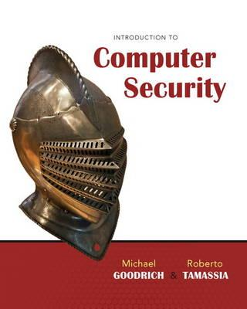
Unit Conduct
It is highly recommended that you purchase the text book.
There are allocated readings for each module in the unit.

Slide 7
Assessments

Slide 8
Assessments
There are five assessable items in this unit
Test 1 (2.5%)
Test 2 (2.5%)
Assignment 1 (20%)
Assignment 2 (25%)
Exam (50%)
In order to pass the unit, students must achieve 50% or more overall AND 50% or more in the exam

Slide 9
Tests
You will have a maximum of 30 minutes to complete the assessable and non-assessable quizzes
After 30 minutes, any unanswered questions will count as an incorrect answer
You are only permitted 1 attempt at the quiz
The quiz assesses the content learnt throughout the semester
i.e. a test may incorporate questions from everything learnt in the semester thus far

Slide 10
Assignments
There are two assignments
Assignment 1 (20%)
Assignment 2 (25%)

Slide 11
Assignment Expectations
Assignment markers will expect to see:
Evidence of your own original thought and analysis
It is NOT enough to simply repeat what is found in books and on web pages
Original material to be supported with quality, critically evaluated references
Assignment markers will pay attention to the ways in which you use references and the quality of the references that you choose

Slide 12
Collusion
Collusion is when students work together in unauthorised ways and present work that is very similar
Students can talk to other students about assignments, but what you submit must be your OWN work

Slide 13
Assignment Tips
Do NOT leave your assignments to the last minute
Make sure that you know the due dates
Proof read your assignments carefully
If you need help with assignment writing skills, contact the faculty learning advisor
Follow assignment submission instructions
Remember: An assignment is an opportunity for you to demonstrate your brilliance

Slide 14
Blackboard
ECU on-campus and on-line students will study this unit using the University’s MyECU (Blackboard) system
Backboard can be found at myecu.edu.au
Blackboard contains all of the unit materials, assignments and readings for this unit

Slide 15
Lecture 1: Basic Principles and Aims of Security
Computer Security

Slide 16
Sun Tzu – The Art of War
If you know the enemy and know yourself, you need not fear the result of a hundred battles.
If you know yourself but not the enemy, for every victory gained you will also suffer a defeat.
If you know neither the enemy nor yourself, you will succumb in every battle

Slide 17

Is the Internet dangerous?
Lets start by looking at some examples of dangers that exist in today’s online world...

Slide 18
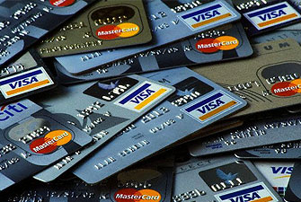
Heartland Payment System
Provides debit, credit card, payroll processing
Attack occurred in March 2008
Approximately 134 million credit cards exposed
Attackers used spyware to capture data
Financial losses exceeded $140 million
http://www.csoonline.com/article/499527/heartland-ceo-on-data-breach-qsas-let-us-down

Slide 19
Epsilon
Provides marketing and email services for the largest companies in the world
Criminals captured and exposed names and emails of millions of customers
Could be used for clever phishing scans
Breach is estimated to have cost $4 billion
http://blogs.csoonline.com/1457/epsilon_hack_notification_letters

Slide 20
Stuxnet
A computer worm predominantly targeting Siemens Industrial hardware/software
Payload targets Supervisory Control and Data Acquisition (SCADA) systems
SCADA systems control and monitor industrial infrastructure and processes
YES! That includes power stations…
…you get the picture!

Slide 21
Sony PlayStation Network
Considered the worst gaming data breach of all time
April 20th 2011
77 million accounts affected
12 million unencrypted credit cards captured
Sony never officially announced $$$ losses
Combination of malware and DoS attacks
http://www.csoonline.com/article/681136/sony-apologizes-details-playstation-network-attack

Slide 22
VeriSign
Operates network infrastructure and naming services
During 2010
Attackers gained access to privileged systems and data
The attack vector is unknown - ???
VeriSign did not publicise the attack until they were legally obliged
http://blogs.csoonline.com/data-protection/2013/verisign-hit-hackers

Slide 23
Department of Veterans Affairs
May 2006
An unencrypted database containing 26.5 million names, SSNs, DOB was stored on a laptop and an external hard disk
The laptop and hard disk were stolen during a random (untargeted burglary)
Costs estimated at ~$500 million
http://www.csoonline.com/article/215541/va-chief-information-security-officer-resigns

Slide 24
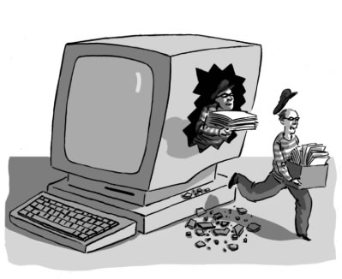
Relevance of Examples
These preceding slides describe breaches of computer and information security
There are some generally accepted aims of security
Exactly how many aims there are depend a little on which books/journal you read…

Slide 25
Aims of Security
Generally the following are consider to be the aims of computer and information security
Confidentiality
Integrity
Availability
Authenticity
Non-repudiation
Some consider all five to be the aims of security
Others consider only the first three

Slide 26

Confidentiality
Confidentiality ensures that information or systems should only be read and accessed by authorised people
Information should be kept private, secret and out of the hands of unauthorised people

Slide 27

Hypothetical Breach of Confidentiality
Organisations that store medical records may have a legal, moral and ethical obligation to keep the information private
If sensitive medical records were accidentally disclosed to the public

Slide 28
Importance of Confidentiality
Breaching confidentiality may result in a...
Loss of revenue
Loss of reputation
Loss of clients/customers
Embarrassment
You may be in breach of a legal/moral/ethical obligation to keep information confidential

Slide 29
Ensuring Confidentiality
Encryption: the transformation of data using a secret, so that the transformed data can only be read using another secret
Access control: rules and policies that limit access to those people and/or systems with a “need to know”

Slide 30
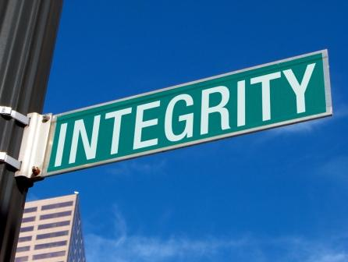
Integrity
Integrity ensures that information and systems have not been altered in an unauthorised way
This is to ensure that information or systems are not tampered with

Slide 31
Hypothetical Breach of Integrity
A hard disk in a computer malfunctions and corrupts the data
An employee make unauthorised changes to values in a database
Malware modifies files on a server

Slide 32
Importance of Integrity
Breaching integrity may result in...
Important decisions being made on information that is no longer trustworthy, correct and free of corruption
Corrupted information being difficult to detect
Untrustworthy/unreliable backups

Slide 33

Ensuring Integrity
Regular backups
Checksums
Data correcting codes

Slide 34
Availability
Availability ensures that information or systems are accessible and modifiable in a timely fashion by those authorized to do so
A lack of availability is often referred to as a denial of service.

Slide 35
Hypothetical Breach of Availability
A web site is overwhelmed by fake requests and cannot provide services to clients
An employee switches off a critical server
A hard disk malfunctions
An Ethernet cable is removed from a switch

Slide 36
Importance of Availability
An organisation may have a committed service level agreement for its clients.
Customers who are unable to make purchases online may take their business elsewhere.
Critical decisions may need to be made, based on certain information being readily available.

Slide 37
Ensuring Availability
Access control
Computational redundancies
Physical protection mechanisms

Slide 38
Authenticity
Authenticity ensure that an entity is able to prove or verify that it is who or what it claims to be
Examples:
Is this person really who they say they are?
Is this document really what it purports to be?
Is this really my bank’s web sever?

Slide 39
Non-Repudiation/Accountability
Ensuring that people can’t falsely deny their actions
Examples
Alice sends an email and then denies sending it
Bob denies receiving an email when in fact he did receive it
Frank refuses to pay the bill for an on-line purchase saying that the goods were not received when in fact they were

Slide 40
Three or Five Aims?
Some people consider Confidentiality, Integrity and Availability to be the major aims of security
Some consider authenticity and non-repudiation to be aspect of first three aims
Others consider authenticity and non-repudiation to be aims in their own right
It depends a little on what books you read

Slide 41
Statistics on Computer Abuse
Often difficult to get accurate statistics
Attacks may never be detected
Attacks that are detected may not be reported
Difficulties in quantifying losses
How much was that data actually worth?
How much will it cost to retrieve/recover the data?
If you were a large prominent business, would you want to publicise that you were attacked?

Slide 42
Security is Difficult to Sell
Management may ask
What does it cost?
What do we get?
How much will it cost to maintain?
Will we need to train our staff?
Imagine attempting to sell your friend “something” that they cannot see or touch and trying to prove to them that they need it!
Would you buy asteroid insurance?

Slide 43
Ethics and Legal Issues

Slide 44
Warning
In this unit we will discuss a number of threats
It is very difficult to discuss computer security without discussing such threats
However students must be sure to use this knowledge responsibly, ethically and legally

Slide 45
Use of the World Wide Web
Some security related sites may be somewhat less than reputable
Some sites may contain material that people might find offensive
We have made an effort not to link directly to such sites in this unit. However some sites might link to sites, which link to other sites, which links to other sites etc
Students are encouraged to explore the resources offered by the world wide web, but are also urged to exercise caution and judgement when looking for security related issues
If you do go off on tangents when looking for security related information, please be sure to adhere to any relevant laws, policies and guidelines

Slide 46
Use of security tools
The legality of security tools will vary in certain jurisdictions
For example, encryption tools are illegal in some countries
Some tools might be legal for use in some ways but not others
For example, use or possession of tools (without just cause) such as packet sniffers will put you in breach of laws

Slide 47
Ethical Behaviour
In this unit, students will be expected to behave:
In accordance with Federal and State Laws
In accordance with university policies
In an ethical manner
Australian Computer Society code of ethics http://www.acs.org.au/index.cfm?action=show&conID=coe

Slide 48
Final Comments
Backup your work for ALL units regularly
You should at the very least use a personal firewall and anti-virus scanner
If it sounds too good to be true, it usually is
Do not download and install unknown software
Each semester we get students who have “accidently” download software resulting in data loss, and corruption of the operating system…don’t become a statistic!

