Slide 1
Understanding Operating Systems Sixth Edition
Chapter 11
Security and Ethics

Slide 2
Learning Objectives
The role of the operating system with regard to system security
The effects of system security practices on overall system performance
The levels of system security that can be implemented and the threats posed by evolving technologies
The differences among computer viruses, worms, and blended threats
The role of education and ethical practices in system security

Slide 3
Role of the Operating System in Security
Key role
Operating system level vulnerability opens entire system to attack
Operating system complexity and power increases
More vulnerable to attack
System administrator’s role
Provide operating systems with all available defenses against attack

Slide 4
System Survivability
System’s capability to fulfill mission
Timely manner
In presence of attacks, failures, or accidents
Survivable systems’ key properties
Attack resistance
Attack and resulting recognition
Essential services recovery after attack
System defence mechanism adaptation and evolution
Mitigate future attacks

Slide 5
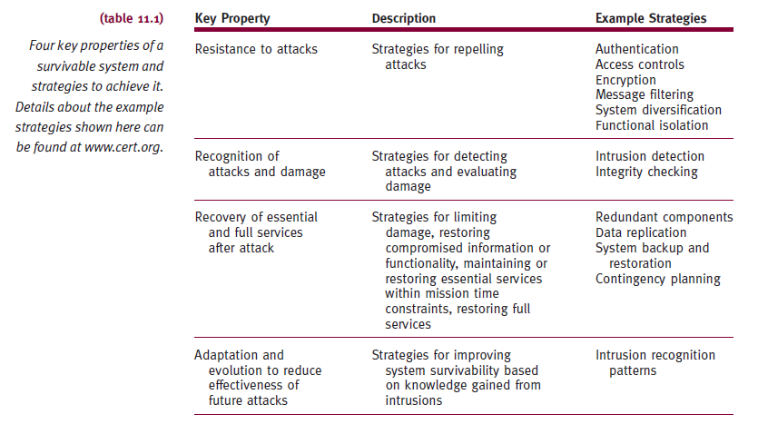
System Survivability (cont'd.)

Slide 6
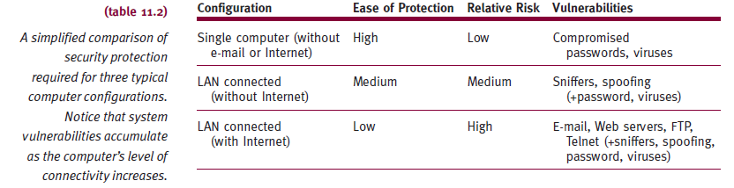
Levels of Protection
System administrator
Evaluate each computer configuration intrusion risk
Depends on connectivity level given to system

Slide 7
Backup and Recovery
Policies
Essential for most computing systems
System manager
Uses layered backup schedule
Backups
One set stored off-site
Crucial for disaster recovery
System management essential elements
Written policies and procedures
Regular user training

Slide 8
Backup and Recovery (cont'd.)
Written security procedures recommendations
Frequent password changes
Reliable backup procedures
Guidelines for loading new software
Software license compliance
Network safeguards
Guidelines for monitoring network activity
Terminal access rules

Slide 9
Security Breaches
System security gaps
Malicious or not
Intrusions classifications
Due to uneducated users and unauthorized access to system resources
Purposeful disruption of system operation
Purely accidental
Examples: hardware malfunctions, undetected errors in operating system or applications, natural disasters
Any security breach
Severely damages system credibility

Slide 10
Unintentional Intrusions
Security breach or data modification
Not resulting from planned intrusion
Examples
Accidental incomplete modification of data
Nonsynchronized processes access data records
Modify some record fields
Errors due to incorrect storage of data values
Field not large enough to hold numeric value stored

Slide 11
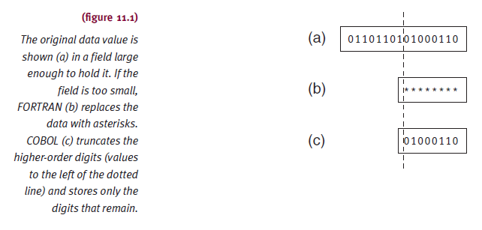
Unintentional Intrusions (cont'd.)

Slide 12
Intentional Attacks
Attack types
Intentional unauthorized access
Denial of service attacks, browsing, wire tapping, repeated trials, trap doors, trash collection
Viruses and worms
Trojans
Bombs
Blended threats

Slide 13
Intentional Attacks (cont'd.)
Intentional unauthorized access
Denial of service (DoS) attacks
Synchronized attempts denying service to authorized users causing computer to perform repeated unproductive task
Browsing
Unauthorized users gain access to search through secondary storage directories or files for information they should not have the privilege to read

Slide 14
Intentional Attacks (cont'd.)
Intentional unauthorized access (cont'd.)
Wire tapping
Unauthorized users monitor or modify transmission
Passive wire tapping: transmission monitored
Passive wire tapping reasons
Copy data while bypassing authorization procedures
Collect specific information (password)
Active wire tapping: modifying data
Methods include “between lines transmission” and “piggyback entry”

Slide 15
Intentional Attacks (cont'd.)
Intentional unauthorized access (cont'd.)
Repeated trials
Enter system by guessing authentic passwords
Trap doors
Unspecified and undocumented system entry point
Diagnostician or programmer install
System vulnerable to future intrusion
Trash collection
Discarded materials (disks, CDs, printouts) to enter system illegally

Slide 16
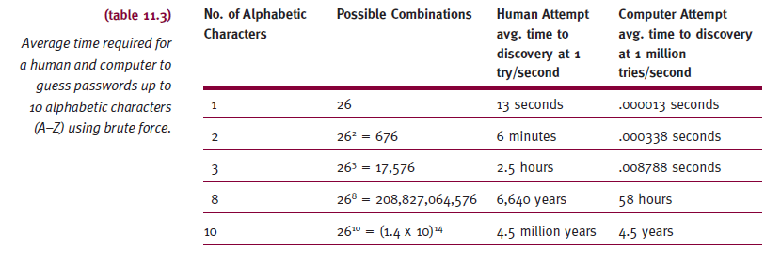
Intentional Attacks (cont'd.)
This is now fixed thanks to GPUs! We just need an afternoon ☺

Slide 17
Intentional Attacks (cont'd.)
Malicious computer attacks
Possible state and federal law violation
Convictions
Significant fines and jail terms
Computer equipment confiscation

Slide 18
Intentional Attacks (cont'd.)
Viruses
Small programs altering computer operations
No user permission to run
Two criteria
Self-executing and self-replicating
Operating system specific (usually)
Spread using wide variety of applications
Macro virus
Attaches itself to template (such as NORMAL.DOT)
In turn: attaches to word processing documents

Slide 19
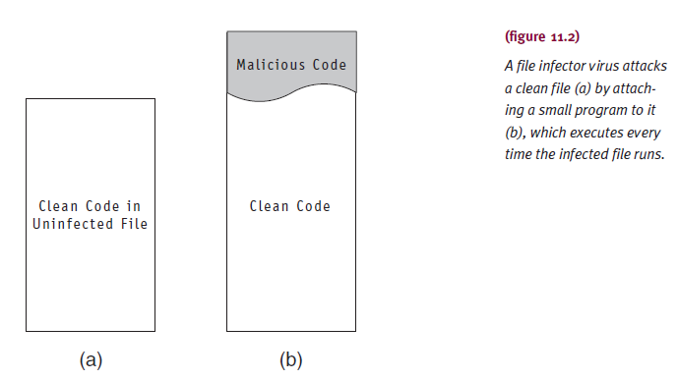
Intentional Attacks (cont'd.)

Slide 20
Intentional Attacks (cont'd.)
Worm
Memory-resident program
Copies itself from one system to next
No aid from infected program file
Slower processing time of real work
Especially destructive on networks
Trojan
Destructive program
Disguised as legitimate or harmless program
Allows program creator secret access to system

Slide 21
Intentional Attacks (cont'd.)
Logic bomb
Destructive program with fuse (triggering event)
Keystroke or connection with Internet
Spreads unnoticed throughout network
Time bomb
Destructive program triggered by specific time
Day of the year
Blended threat
Logic bomb and time bomb characteristics combined
Single program including virus, worm, Trojan, spyware, other malicious code

Slide 22
Intentional Attacks (cont'd.)
Blended threat (cont'd.)
Characteristics
Harms affected system
Spreads to other systems using multiple methods
Attacks other systems from multiple points
Propagates without human intervention
Exploits vulnerabilities of target systems
Protection
Combination of defenses with regular patch management

Slide 23
System Protection
No single guaranteed method of protection
System vulnerabilities
File downloads, e-mail exchange
Vulnerable firewalls
Improperly configured Internet connections
Security issues require continuous attention
Multifaceted system protection
Protection methods
Antivirus software, firewalls, restrictive access, and encryption

Slide 24
Antivirus Software
Combats viruses only
Preventive, diagnostic, or both
Preventive programs calculate checksum for each production program
Diagnostic software compares file sizes and looks for replicating instructions or unusual file activity
Removes infection and leaves remainder intact
Sometimes
Cannot repair worms, Trojans, blended threats
Malicious code in entirety

Slide 25
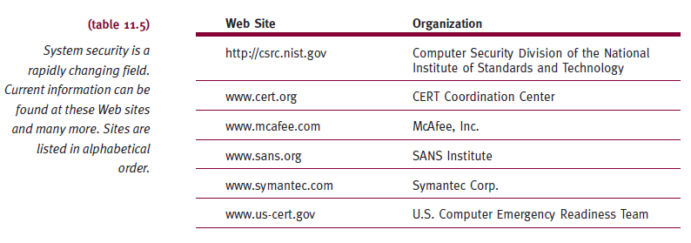
Antivirus Software (cont'd.)

Slide 26
Firewalls
Set of hardware and/or software
Designed to protect system
Disguises IP address from unauthorized users
Sits between Internet and network
Blocks curious inquiries and potentially dangerous intrusions
From outside system
Firewall mechanisms to perform tasks
Packet filtering
Proxy servers

Slide 27
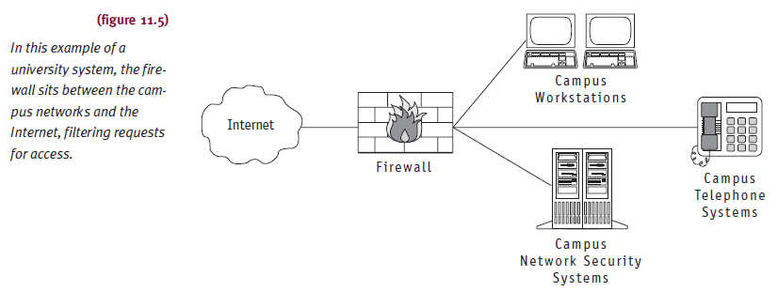
Firewalls (cont'd.)

Slide 28
Firewalls (cont'd.)
Typical firewall tasks
Log activities accessing Internet
Maintain access control
Based on senders’ or receivers’ IP addresses
Maintain access control
Based on services requested
Hide internal network from unauthorized users
Verify virus protection installed and enforced
Perform authentication
Based on source of a request from the Internet

Slide 29
Firewalls (cont'd.)
Packet filtering
Firewall reviews header information
Incoming and outgoing Internet packets
Verify source address, destination address, protocol authenticity
Proxy server
Hides important network information from outsiders
Network server invisible
Determines validity of network access request
Invisible to users
Critical to firewall success

Slide 30
Authentication
Verifying authorization of individual accessing system
Kerberos
Network authentication protocol
Provides strong authentication for client/server applications
Uses strong cryptography
Requires systematic revocation of access rights from clients
Who no longer deserve access

Slide 31
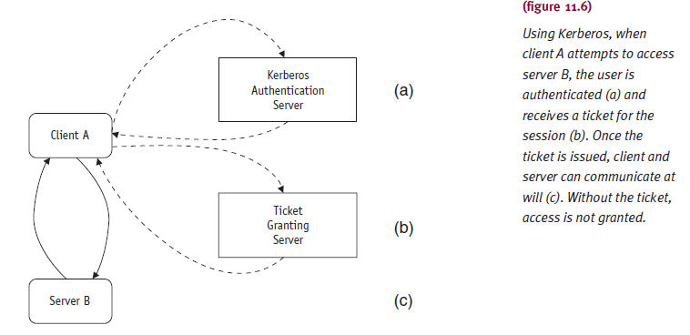
Authentication (cont'd.)

Slide 32
Encryption
Extreme protection method
Sensitive data put into secret code
System communication
Data encrypted, transmitted, decrypted, processed
Sender inserts public key with message
Receiver uses private key to decode message
Disadvantages
Increased system overhead
System dependent on encryption process itself

Slide 33
Encryption (cont'd.)
Sniffers
Programs on computers attached to network
Peruse data packets as they pass by
Examine each packet for specific information
Particularly problematic in wireless networks
Spoofing
Assailant fakes IP address of Internet server
Changes address recorded in packets sent over Internet
Unauthorized users disguise themselves as friendly sites

Slide 34
Password Management
Basic techniques protect hardware and software
Good passwords
Careful user training

Slide 35
Password Construction
Good password
Unusual, memorable, changed often
Password files
Stored in encrypted form
Password length
Directly affects ability of password to survive password cracking attempts

Slide 36
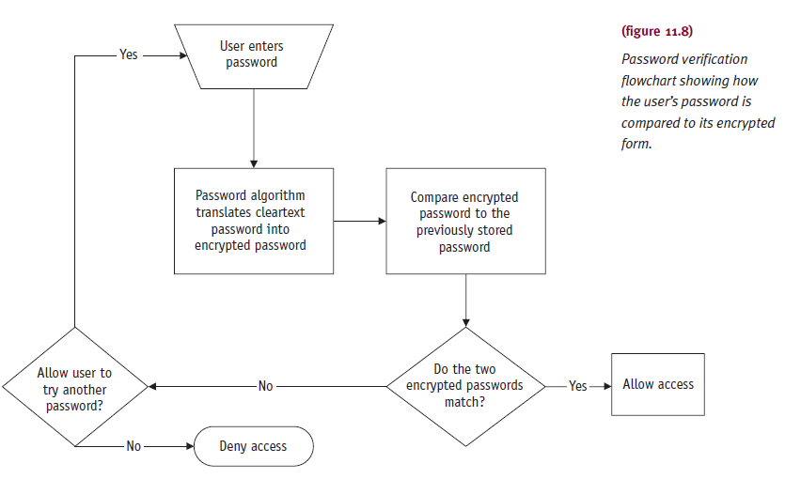
Password Construction (cont'd.)

Slide 37
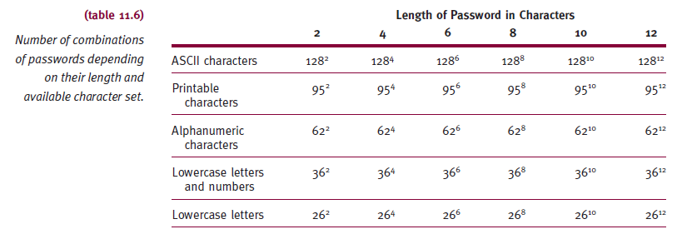
Password Construction (cont'd.)

Slide 38
Password Construction (cont'd.)
Good password techniques
Use minimum of fourteen characters
Including numbers and nonalphanumeric characters
Create variations of memorable sentences
Use upper and lowercase characters (if allowed)

Slide 39
Password Construction (cont'd.)
Dictionary attack
Method of breaking encrypted passwords
Requirements
Copy of encrypted password file
Algorithm used to encrypt passwords
Prevention
“Salt” user passwords with extra random bits
Makes them less vulnerable to dictionary attacks

Slide 40
Password Alternatives
Smart card use
Requires “something you have and something you know”
Displays constantly changing multidigit number
Synchronized with identical number generator in system
User must enter number appearing on smart card
Added protection: user enters secret code
User admitted to system if both number and code validated

Slide 41
Password Alternatives (cont'd.)
Biometrics
Science and technology of identifying individuals
Based on each person’s unique biological characteristics
Current research focus
Analysis of human face, fingerprints, hand measurements, iris/retina, voice prints
Positively identifies person being scanned
Critical factor
Reducing margin of error
Expensive

Slide 42
Password Alternatives (cont'd.)
Graphics and pattern clicks
Evolving subject
Establish sequence of clicks on photo/illustration
Repeat sequence to gain access
Advantages
Eliminates keyboard entries
Resistant to dictionary attack
Disadvantages
Very predictable input

Slide 43
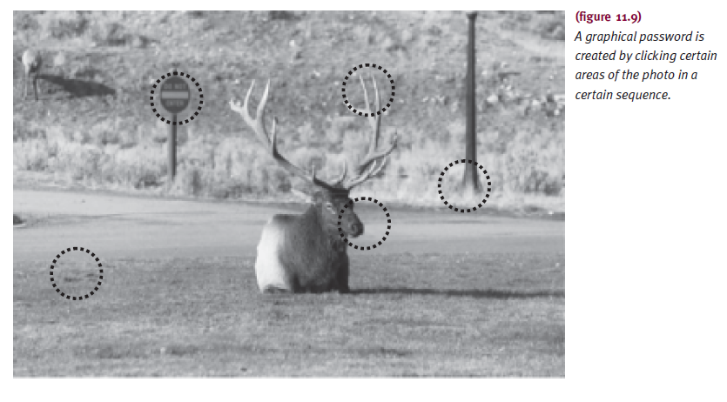
Password Alternatives (cont'd.)

Slide 44
Social Engineering
Technique
System intruders gain access to information about a legitimate user
Learn active passwords
Looking in and around user’s desk for written reminder
Trying logon ID as password
Searching logon scripts
Telephoning friends and coworkers to learn information (family member names, pet names, vacation destinations, hobbies, car model)

Slide 45
Social Engineering (cont'd.)
Phishing
Intruder pretends to be legitimate entity
Asks unwary user to reconfirm personal and/or financial information
Example: 2003 incident involving eBay customers
Default passwords
Pose unique vulnerabilities
Widely known
Routinely shipped with hardware or software
Routinely passed from one hacker to next
Change immediately

Slide 46
Ethics
Ethical behavior: Be good. Do good.
IEEE and ACM issued standard of ethics in 1992
Apparent lack of computing ethics
Significant departure from other professions
Consequences of ethical lapses
Illegally copied software: lawsuits and fines
Plagiarism: illegal and punishable by law
Eavesdropping on e-mail, data, or voice communications: sometimes illegal and usually unwarranted

Slide 47
Ethics (cont'd.)
Consequences of ethical lapses (cont'd.)
Cracking (malicious hacking)
Owner and users question validity of system data
Unethical use of technology
Clearly the wrong thing to do
Activities to teach ethics
Publish policies clearly stating actions tolerated
Teach regular seminar including real-life case histories
Conduct open discussions of ethical questions

Slide 48
Summary
Must emphasize importance of secure system
System only as good as integrity of stored data
Single security breach damages system’s integrity
Catastrophic or not
Accidental or not
Damaged integrity threatens viability of:
Best-designed system, its managers, its designers, its users
Vigilant security precautions are essential

