Slide 1

Applications Security
Computer Security

Slide 2
Security Issues
Attackers who takeover applications, can usually execute commands with the access permissions of the compromised application.
Many application run with admin/root privileges.
So taking over the application gives the attacker total control of the host.

Slide 3
Why admin/root privileges?
Program may make changes to registry
Program may need to access or alter system files
You may need to make major changes to the OS (i.e. installing drivers)
What happens in an ECU computer lab when you try and install a program into C:\Program Files ??

Slide 4
Application Vulnerabilities
Like Operating Systems, applications are complex systems
They will have
Design flaws
Implementation errors
Leading to vulnerabilities

Slide 5
Security Requirements
Secure is an attribute that all software should possess
Software may have particularly high
Confidentiality requirements
Integrity requirements
Availability requirements
What consequence would there be if the above security requirements of KeePass were not met in the S/W?

Slide 6
Principle of Least Privilege
Every process, user or a program must be only access the information and resources that are necessary for its legitimate purpose.
A user designed to backup a computer system should not be given privileges to install additional software

Slide 7
Software Bugs
As a general rule;
more lines of code ➔ more bugs
more bugs ➔ more vulnerabilities
As the number of lines of code grow, it becomes difficult to eliminate bugs
We need to assume that any software beyond what is trivially simple WILL have bugs

Slide 8
Tight Integration
Tight integration with Operating Systems
Tight integration of multiple packages
All programs in an integrated package are accessed via a common launch pad
Does any application consist of one .exe file?
How many applications install completely into their own directory and are completely standalone?
How many applications share components?

Slide 9
Application and OS Integration
Advantages
Less overall code which means less bugs
If you write good quality ‘secure’ code then overall the application should be secure
Disadvantages
A bug in a shared component can be shared across many applications
Vulnerabilities can be shared
The software writer may purposefully implement vulnerabilities to be exploited at a later date

Slide 10
Security Problems with App Development
Security is often not considered at all
Security is often an ‘add on’
Security can be scoped out as project deadlines approach
Security is omitted to improve performance
Clients notice if functionality is missing in an app – they tend not to notice so much when security measures are cut out.

Slide 11
Design Issues
Security must be built in from the start

Slide 12
Design Issues
Security problems are often built into software from the design phase
Useability is more important than security
Security measures are often seen as infringing upon useability
What will the lifespan of the application be?
Many Y2K problems were caused by applications that were not supposed to be in service as long as they were

Slide 13
Models of Software Development
Prototyping methods can lead to security problems
Prototypes are created and presented to end-users
Prototypes are refined to meet user requirements
Prototype is re-implemented once requirements determined
Security issues raised
Often the last prototype becomes the final system
Users are often unaware of security issues
It is often difficult to build in security from the start

Slide 14
Implementation Issues
Software Errors

Slide 15
Buffer Overflow / Buffer Overrrun
A buffer is a section of memory used to temporarily store data
A buffer overflow, also known as a buffer overrun is a condition whereby the input data placed into a buffer or data holding area exceeds its allocated capacity

Slide 16
Buffer Overflow / Buffer Overrrun cont…
A programming error when a process attempts to store data beyond the limits of a fixed-sized buffer
This subsequently overwrites adjacent memory locations
The locations could hold other program variables, parameters, or program control flow data

Slide 17
Buffer Overflow Example
char A[8] =“”;
int B = 1979;
Variable name | A |  |  |  |  |  |  |  | B
Value | [null string] |  |  |  |  |  |  |  | 1979
Hex value | 00 | 00 | 00 | 00 | 00 | 00 | 00 | 00 | 07 | BB
During runtime the null terminated string “excessive” is entered by the user
“excessive” is 9 characters (bytes) long plus a 1 byte terminator
Variable name | A |  |  |  |  |  |  |  | B
Value | e | x | c | e | s | s | i | v | 25856
Hex value | 65 | 78 | 63 | 65 | 73 | 73 | 69 | 76 | 65 | 00

Slide 18
Buffer Overflow / Buffer Overrrun cont…
Consequences
Corruption of program data
Unexpected transfer of control
Memory access violations
Execution of code chosen by attacker
C assumes that the programmer knows that they are doing and as a result it is up to the programmer to find and fix mistakes

Slide 19
Stack-Based Buffer Overflow
int main(int argc, char * argv[])
{
Create a buffer on the stack
char buff[256];
Does not check size of buffer
strcpy(buff, argv[1]);
Print the contents of buffer
printf(“%s\n”,buff);
return 1;
}
In this instance a buffer has been created with a size of 256 characters
If 10 characters are entered the program works correctly
If 500 characters were entered, a buffer overflow occurs

Slide 20
Stack-Based Buffer Overflow Countermeasure
int main(int argc, char * argv[])
{
Create a buffer on the stack
char buff[256];
Does not check size of buffer
strcpy(buff, argv[1], sizeof(buff));
Print the contents of buffer
printf(“%s\n”,buff);
return 1;
}
In this instance the sizeof(buff) has been added to the argument
Should the buffer exceed 256 characters, the only the first 256 characters will be copied

Slide 21
Arithmetic Overflow Example
int main(int argc, char * argv[])
{
unsigned int connections = 0
//insert network code here
connections++;
if (connections < 5)
grant_access();
else
deny_access();
return 1;
}
Unfortunately the connection variable will only increment once
The number of connections may exceed 100 but access will still be granted

Slide 22
Arithmetic Overflow Example Countermeasure
int main(int argc, char * argv[])
{
unsigned int connections = 0
//insert network code here
if (connections < 5)
connections++;
grant_access();
else
deny_access();
return 1;
}
In this instance by a simple re-arrangement of code, the program is now safe and would not exceed 5 connections at a time

Slide 23
Exploiting Buffer Overflows
To exploit a buffer overflow an attacker needs to identify a buffer overflow vulnerability in a program
If the buffer overflow contain instructions, these instructions would be processed by the processor
Modern computers make no distinction between instructions and data
If a processor can be fed instructions when it should be seeing data, it will happily go about executing the passed instructions

Slide 24
Windows XP Example of a Buffer Exploit
Application login page
Enter a username between 6 and 22 characters
Attacker types the following username/attack code
HomerSimpson1234567890rundll32%20shell.dll,cmdprompt
Application fails to check the input and puts entire code onto stack
Code from character 23 may begin execution

Slide 25
Shellcode and Instruction Pointers
Suppose an attacker can cause a buffer overflow to occur…
Also suppose the attacker didn’t just try and insert random data
What if the ‘data’ is actually a carefully crafted set of instructions?
What if the attacker can also manipulate the instruction pointer
The instruction pointer indicates the next instruction that the processor is to execute
If the attacker can get the instruction pointer to point to the shellcode, the code will be executed by the system
This is one way in which an attacker can ‘get into’ a system
This is quite a simplification of the whole process but it should give you an idea of what a buffer overflow is

Slide 26
Shellcode
Shellcode is a series of machine code instructions (hexadecimal opcodes) designed to be fed into an overflowed buffer
Shellcode is usually written to be as small, compact and efficient as possible.
Shellcode can be created in a few different ways;
Write hex opcodes directly (not for the faint hearted)
Write / disassemble assembly code to retrieve opcodes
Use a high level language and disassemble to retrieve opcodes

Slide 27
What Can Shellcode Do?
If shellcode can begin execution, it can perform a huge variety of actions
Initially the aim was often to open a command shell with a high level of privilege
Hence the term ‘shell code’
On linux/unix systems, a shell with root privileges can give an attacker almost complete control over a system
Shellcode can be written to do much more, however shellcode writers will usually try to keep the code quite small
Often the shellcode will be used as a ‘way into’ the system

Slide 28
Exploiting Buffer Overflows
Attacks can use automated software to help identify operating systems and applications that are vulnerable to buffer overflows
Nessus is one such tool
www.nessus.org
Nessus can be extended through the use of plugins

Slide 29
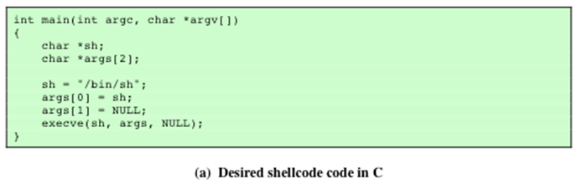
Example shellcode to spawn shell

Slide 30
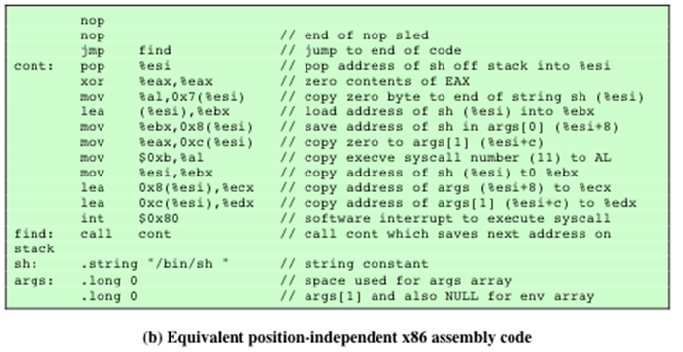
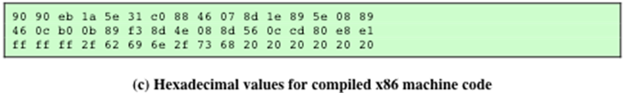
Example shellcode to spawn shell

Slide 31
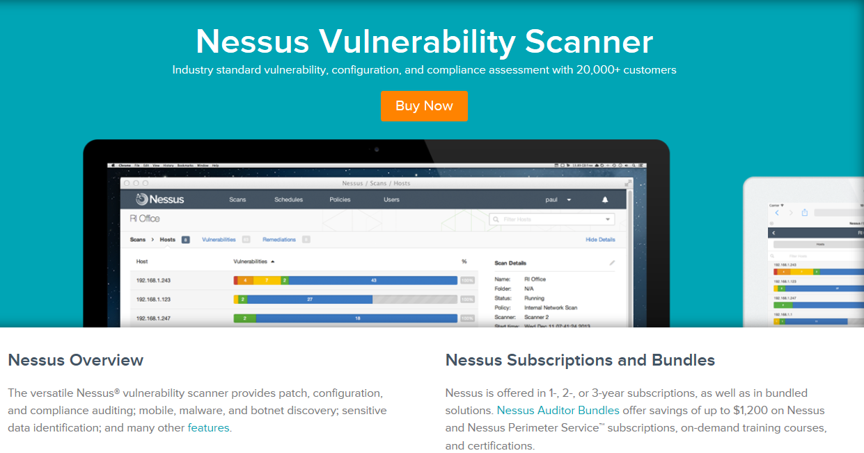
Detecting Buffer Overflows

Slide 32
Other Common Programming flaws
Login credentials hard coded into programs or scripts
Off-by-one errors
E.g. a function loops one too many times, a ‘less than’ comparison should be ‘less than or equal to’

Slide 33
Other Common Programming flaws
Memory Leaks
Programs reserve memory, but do not return it properly when it is no longer needed
The program keeps using more and more memory, degrading system performance
Conversion errors
Incorrect Metric <> Imperial conversions have had disastrous consequences in the past e.g. Mars project

Slide 34
Date Related Programming Flaws
Y2K problem – years expressed with two digits
Many other similar date related problems
Leap years / leap seconds
For a rather mind-bending view of time see http://tycho.usno.navy.mil/leapsec.html and
Some systems store dates and times as the number of seconds since Jan 1, 1970
These systems store dates and times in 32 bits
The number of seconds since 01/01/1970 will outgrow this data type at 03:14:08(UTC), January 19, 2038
See http://en.wikipedia.org/wiki/Year_2038_problem

Slide 35
Testing Issues
Test…test…and then test some more

Slide 36
Basic Types of Testing
Functional Testing (black box)
Involves testing components/modules to ensure that it performs the correct functions.
Tests inputs and outputs.
Structural Testing (white box)
Examines code to ensure that it behaves properly
A worked example

Slide 37
Basic Types of Testing
Unit Testing
Individual functions/components/modules are tested prior to these being integrated with others to build a system
System Testing
Tests the system as a whole. Pays particular attention to making sure that components work together properly
Third Party testing
Testing may also be done by an outside organisation (Bishop, 2003)

Slide 38
Secure Application Development
Too often, security is an afterthought
Often there is an attempt to bolt on security to existing products rather than design systems with security in mind
Security features are also often seen as expendable
Often sacrificed in favour of features as product release dates loom near

Slide 39
Software Maintenance
Patching an updating systems

Slide 40
Patching
Software is often updated in the form of patches
Patches may correct functionality related problems
However, they often fix security related problems
Keeping software up-to-date with patches is usually considered to be vital for improving the security and stability of systems
However patching can also cause a range of problems…

Slide 41
Patching Issues
If a vulnerability is discovered and a patch is released, there is a window of opportunity for an attacker to exploit this vulnerability between the discovery of the vulnerability and the installation of the patch
Therefore, it is important to minimise this window of opportunity by reduce the time from the from the vulnerability being discovered to the patch being installed

Slide 42
Patch Testing
Once a vulnerability has bee discovered…
Vendors need to develop a patch
Vendors are under pressure to get a patch released
Patches often released soon after the broadcast of a vulnerability
This does not leave much time for testing by the vendor
Customers need to install the patch, however…
Does the patch fix what it is intended to fix?
Does the patch break anything else?
Does it introduce new vulnerabilities?
Does it degrade system performance?

Slide 43
Patching
Install the patch too soon and you risk breaking existing systems
Install the patch too late and you leave a larger window of opportunity for a potential attacker
A balance is required

Slide 44
Concluding remarks
Which do you think is ‘more secure’, open or closed source software?
Why?
What are the advantages and disadvantages of each?

