Slide 1
CSP2108: Introduction to Mobile Applications Development
Week 8: Scenes and Composer

Slide 2
Topics this week
Display Groups
Scenes and Composer

Slide 3
Display Groups
Display Objects in Corona are drawn onto the stage – think of it as a really large sheet of paper, with a x-y coordinate system
But they can also be drawn as part of a Display Group – think of these as transparent sheets that can be laid on top of the stage
Notes:
https://docs.coronalabs.com/guide/graphics/group.html

Slide 4
Display Groups
Each Display Group has its own x-y coordinate system
The whole coordinate system can be moved around within the stage coordinate system
Display Groups can contain Display Groups in a hierarchy (like folders and subfolders)
Display Groups can also have properties (e.g. alpha) that apply to all their Drawing Objects

Slide 5
Group Transforms
Display Groups can be transformed (moved, rotated, scaled)
All Objects in them are transformed
Including Display Groups (which can be themselves transformed, hierarchically)
Does not play well with Physics! Don’t mix them.

Slide 6
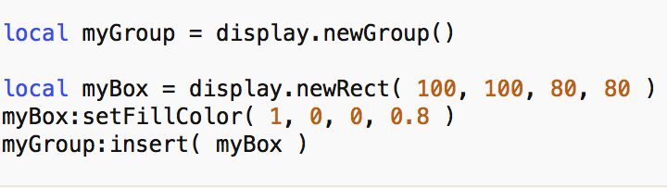
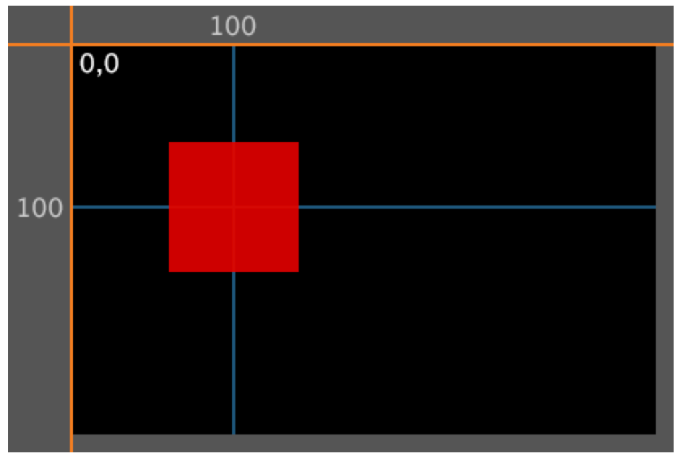
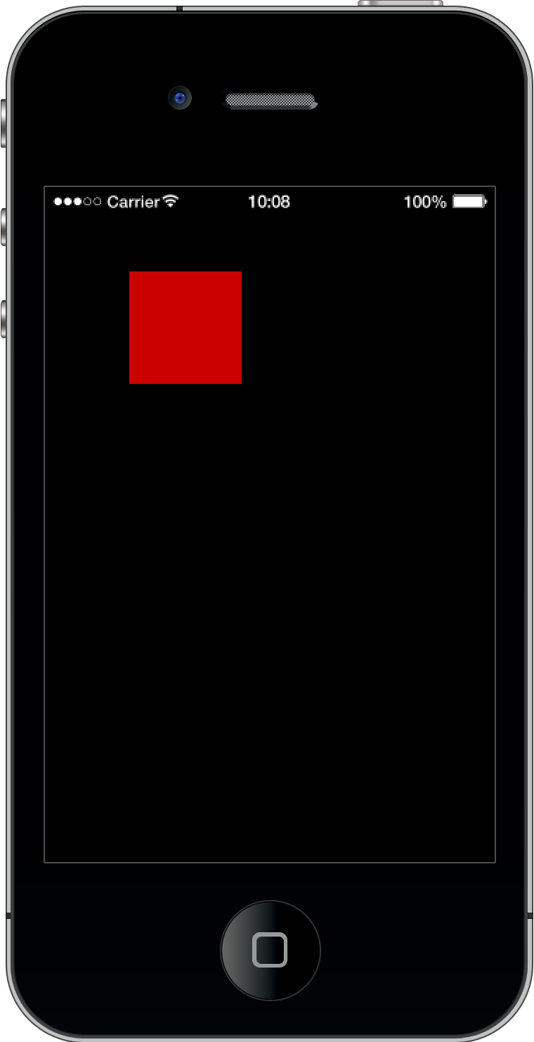
Group Transforms example: 1
myBox becomes a child of myGroup
Anchor of myGroup (0,0) is located at the top-left of the display by default.

Slide 7
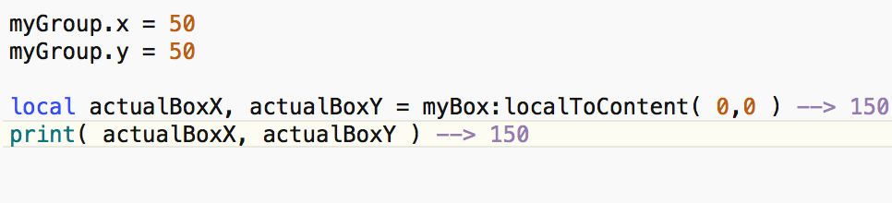
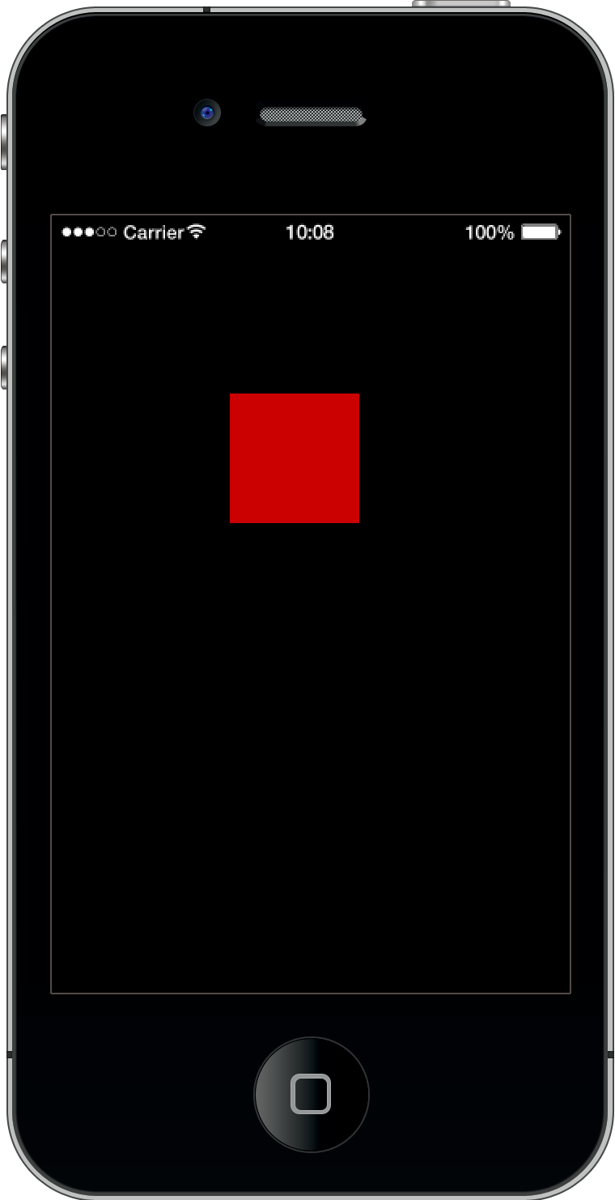
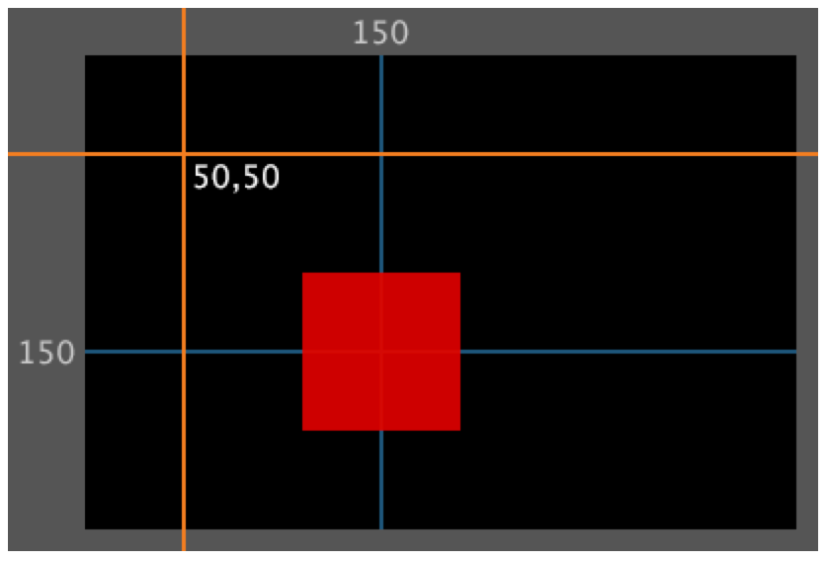
Group Transform example: 2
myGroup’s (0,0) point has now been moved to (50,50) in content coordinates, so the red square is now at (150,150) in content coordinates (but still at (100, 100) in display group coordinates).
*See the Guide for more – including what happens if you change anchorX/anchorY of myGroup

Slide 8
Scenes and Composer
Display Groups allow Display Objects to be treated en-masse, and are the key mechanism used in the Composer library
This library allows an app to have different “scenes” for different tasks, using their own Display Objects, and to move these on and off the display easily and conveniently
Notes:
https://docs.coronalabs.com/guide/system/composer/index.html

Slide 9
Scenes
Using the Composer library:
divide your app into “scenes” (like screens/windows in a desktop GUI app)
each scene has its own .lua file, which has to have a certain structure
main.lua does any global initialisation, and then uses the Composer Library to “load in” the first scene when the app starts by calling composer.gotoScene(). The first scene then “takes control”.
handing control from one scene to another (switching scenes) is done by calling composer.gotoScene()

Slide 10
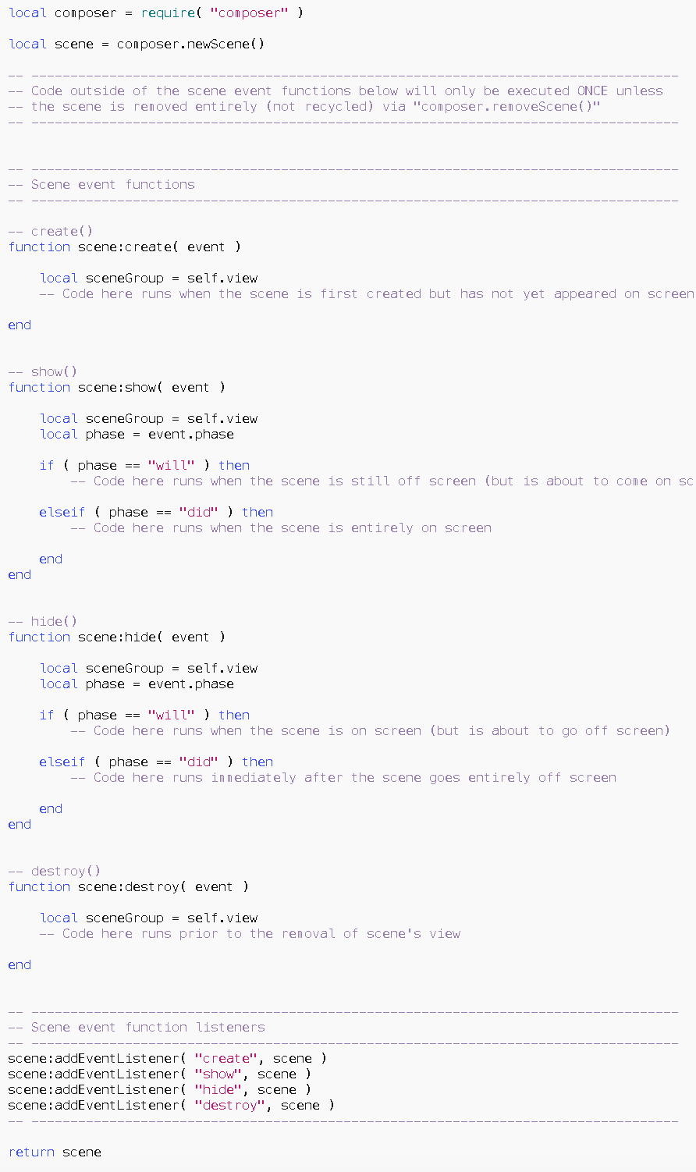
Scene structure: 1
The Guide (Docs / Guide / UI/Scenes / Composer Library) contains a template for scene file
We’ll take a look

Slide 11
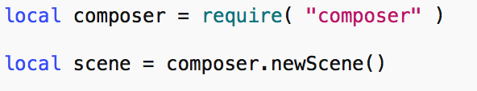
Scene structure: 2
Each scene requires the Composer library

Slide 12
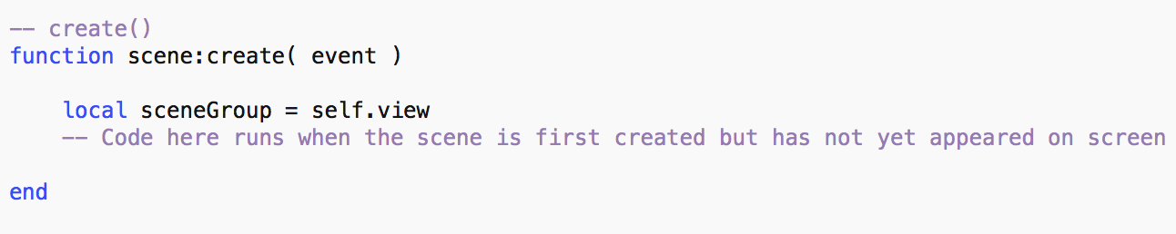
Scene structure: 3
This is an event handler – called when the scene is first loaded, and before anything appears on the display.
Use this to create Display Objects, load audio, and any other one-time initialisation for the scene.

Slide 13
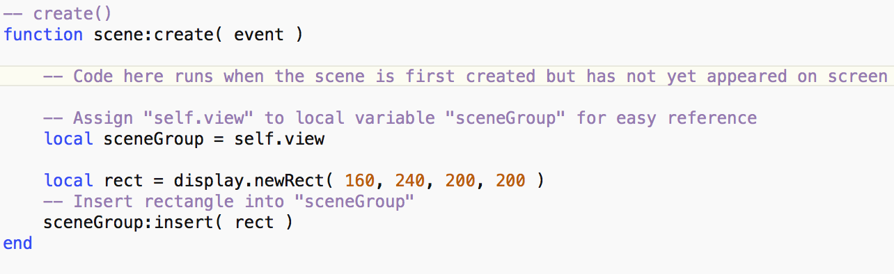
scene:create() example
All Display Objects should be inserted into self.view, which is a Display Group. This is what allows them to be moved on and off the display etc by the Composer library en masse.

Slide 14
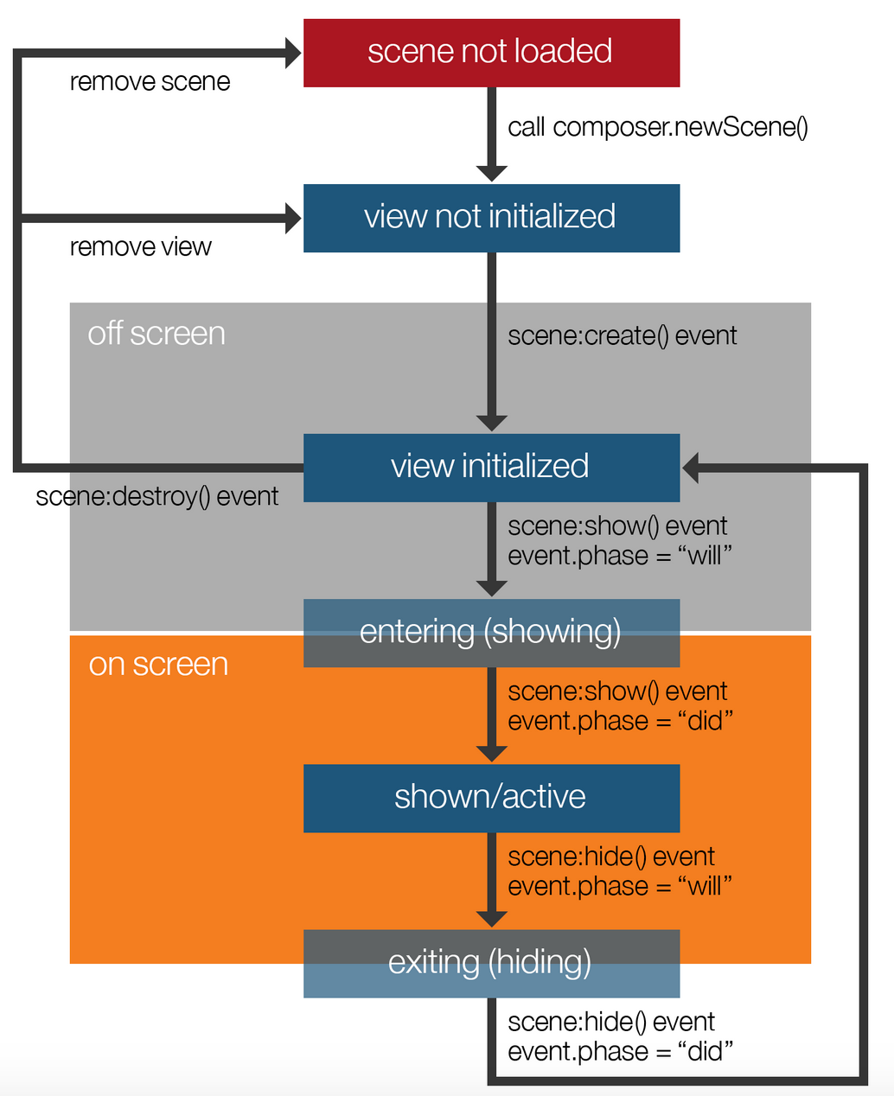
Scene life cycle
This diagram shows the sequence of events in the life-cycle of a scene
4 listeners must be provided (though they don’t all have to do anything)
scene:create()
scene:show()
scene:hide(), and
scene:destroy()

Slide 15
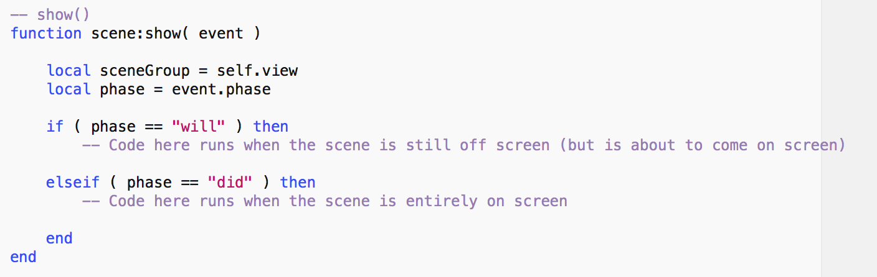
Scene structure: 4
This is called
just before the scene is shown on the display i.e. the first time it is shown, and whenever the app switches back to the scene (event.phase= “will”), and
immediately after it appears (event.phase = “did”)
Use e.g. to start timers, physics, play scene-specific audio etc

Slide 16
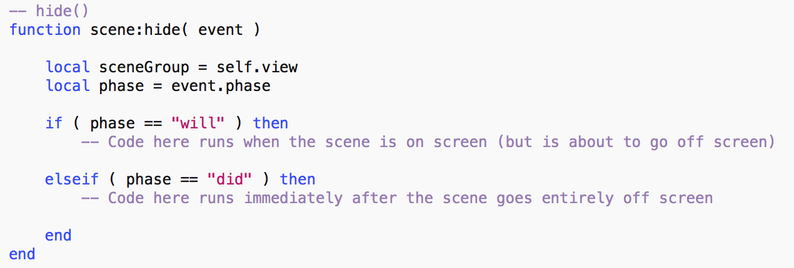
Scene structure: 5
Similar to show()
Called just before and after the scene goes off the display

Slide 17
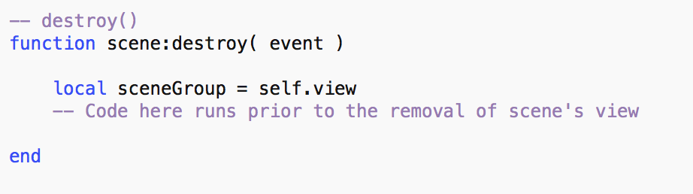
Scene structure: 6
Call when the scene is no longer required
Use to clean up anything scene-specific e.g. unload audio, close network connections etc

Slide 18
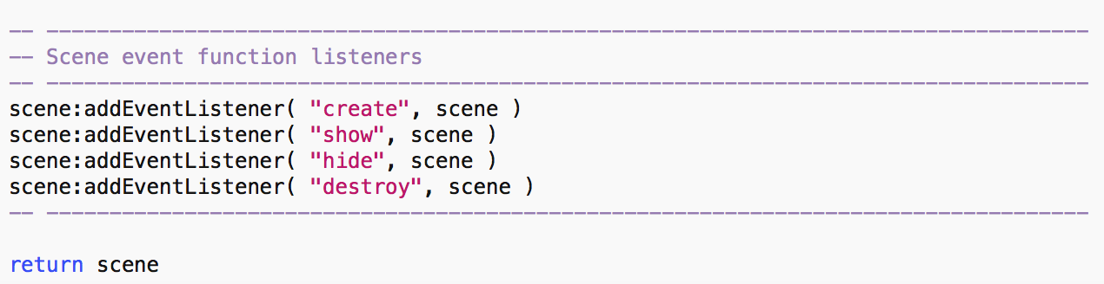
Scene structure: 6
Leave this part in place. It registers the 4 event listener and returns the scene.

Slide 19
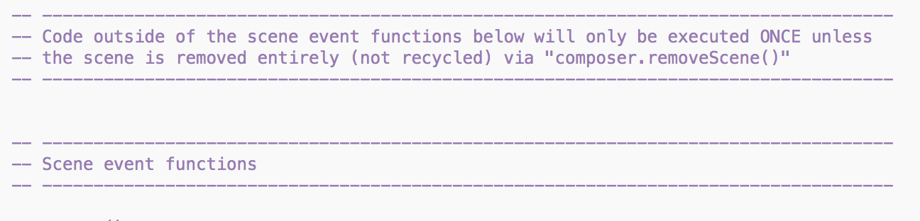
Scene structure: 7
In this gap, place any code that you want to run once, outside the event handlers, along with auxiliary function definitions etc.

Slide 20
More composer stuff
Read more about the Composer library in the Docs at Docs / Guides / UI/Scenes / Composer Library
A couple of examples – see Concentration app on Blackboard
Play about with it to explore

Slide 21
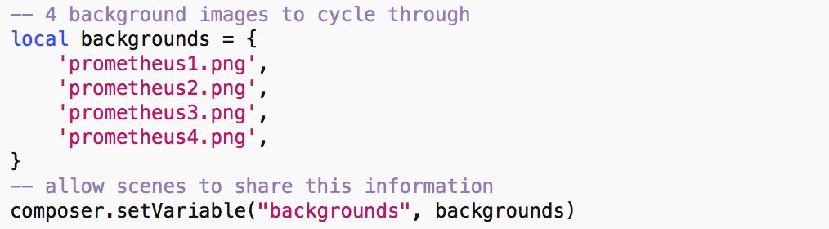
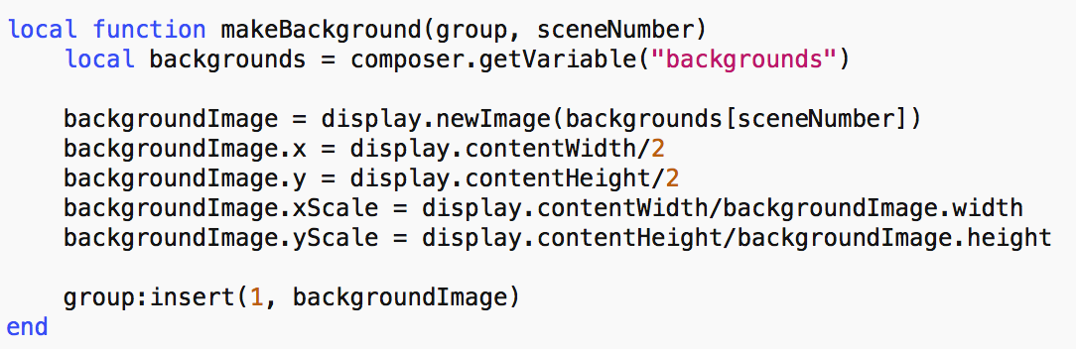
Composer variables
in main.lua
setVariable() and getVariable() allows sharing of variables between scenes
in gameScene.lua

Slide 22
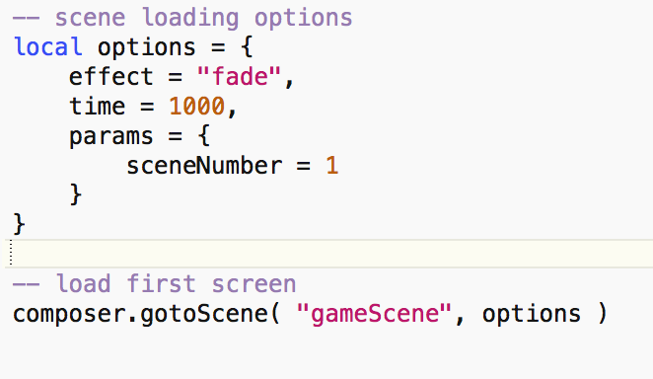
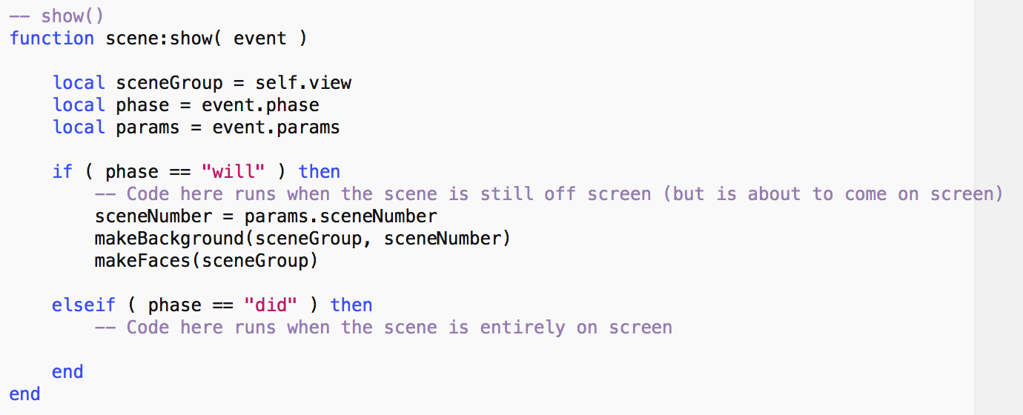
Passing parameters to a scene
main.lua
Specify a transition, and how long it should take, when loading the scene
params will be available in create() and show() scene events
gameScene.lua

