Slide 1
Communicating in an IT Environment: Sustainability, Equity and Access (M. Brogan)

Slide 2
Ethics
What is ethics?
A branch of philosophy that involves systematizing, defending and recommending concepts of right and wrong conduct (Fieser, 2009)
Behavior may be ethically wrong , but legal
Can you think of examples?
A study of moral behaviour in humans and how they should act.
Applied ethics is the study of ethics in real world situations
Notes:
We have considered interpersonal communication skills so far in this unit. This lecture is about Intrapersonal communication skills.

Slide 3
Ethics in ICT
Software engineering
Quality management
Software testing
Known errors in software go un-addressed
Applications that do harm
Privacy and confidentiality
Actions that infringe privacy and violate confidentiality
Un-ethical business practice
Under shooting (low balling) and under delivering
Collusion
Price gauging
Exploiting client ignorance

Slide 4

Class Activity: Ethics in SE
Review the following case study in software engineering
Mcfarland, S.J. (2012). Occidental Engineering Case Study: Part 1
(http://www.onlineethics.org/Resources/Cases/OccidentalEng.aspx)
Decide for yourself if you think software engineer Wayne Davidson’s decision to sign off on the air traffic control software was ‘ethical’. Give your reasons.

Slide 5
Sustainability
The idea of “development that meets the needs of the present without compromising the ability of future generations to meet their needs.”
(World Commission on Environment and Development, 1987)
More recently defined by the idea of the Triple Bottom Line (TBL) where an organization demonstrates sustainability via environmental performance, economic performance and social performance

Slide 6
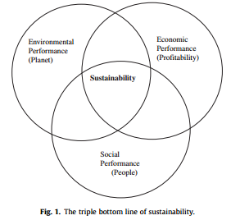
TBL Sustainability
Dao, V., Langella, I., & Carbo, J. (2011).

Slide 7
Sustainability in action: Greening IT
Reducing the carbon footprint of IT infrastructure
Energy consumption of server farms and data centres
Reducing the carbon footprint of organizations by reducing emissions and waste
Video conferencing v. F2F
Reducing pollution
Reducing E-waste through component re-cycling
Reducing or removing toxic chemicals from components and landfill
Reducing emissions from backup power generation

Slide 8
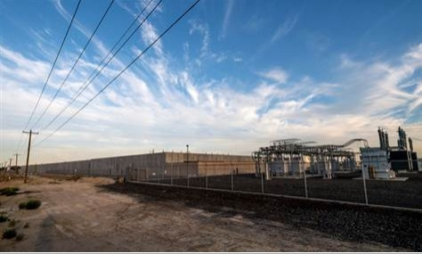
Case Study: Microsoft
Cheap electrical power attracted Microsoft to rural Grant County in Washington State
In 2006, it built a data centre that relied on backup diesel generators for business continuity
Extensive use resulted in particulate pollution
Power bills for residents soared as server farms gobbled up electricity production and created local shortages
http://www.nytimes.com/2012/09/24/technology/data-centers-in-rural-washington-state-gobble-power.html?pagewanted=all&_r=1&

Slide 9
Greening IT
Gartner estimates that data centres accounted for between 1.1% and 1.5% of the world’s total energy use in 2010
Decide if the following technologies are green positive or negative:
Algorithmic efficiency
Virtualization
SSD (Solid State Drives)

Slide 10
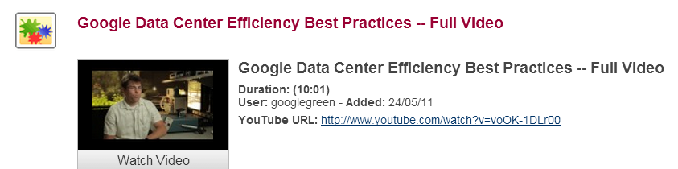

Greening data centers

Slide 11
Accessibility
According to W3C, Web accessibility means:
“that people with disabilities can perceive, understand, navigate, and interact with the Web, and that they can contribute to the Web. Web accessibility also benefits others, including older people with changing abilities due to aging.“
Impairments that affect Web accessibility include:
blindness, visual impairment, deafness, or physical handicap
As little as 3% of Web sites may be fully accessible

Slide 12
Why accessibility?
1 in 5 Australians experience long term impairment (3.95 million people)
2.6 million of people with disabilities are under age 65 (equates to 15% of the <65 population)
86% of people with disability report a core limitation i.e. mobility, communication, restriction in schooling or employment
(Conway, 2011)

Slide 13
Common accessibility issues
Images in web pages without ALT tags
Links requiring a mouse or an equivalent pointing device. Unsupported by keyboard.
Missing heading tags in HTML that describe read order
Formats that do not support read aloud screen readers (e.g. pdf)
Acrobat 7-9 very limited support
Acrobat X-XI improved support (‘Make Accessible Wizard’)

Slide 14
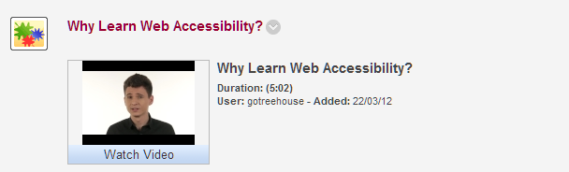
Why accessibility?
The right thing to do
Leads to good practice in Web design
Reduces legal risk
Some degree of compliance is mandatory (WCAG 1.0, WCAG 2.0)

Slide 15
Equity
Equity is about fairness.
Equity derives from a concept of social justice. It represents a belief that there are some things which people should have, that there are basic needs that should be fulfilled, that burdens and rewards should not be spread too divergently across the community, and that policy should be directed with impartiality, fairness and justice towards these ends. (Falk et al. 1993, p. 2)
Equity issues in ICT include:
Equity of access to ICT infrastructure and services
Information literacy that enables digital citizenship
Gender equity

Slide 16
Infrastructure and services
Location and geography have shaped access to services
Regional and rural users mostly have inferior Internet (access options, price and service speed) compared with suburban users
Idea of the Community Service Obligation (CSO) evolved as
Lower SES groups have issues of affordability with fixed line and mobile services
Australia is a middle ranking country in terms of affordabiity

Slide 17
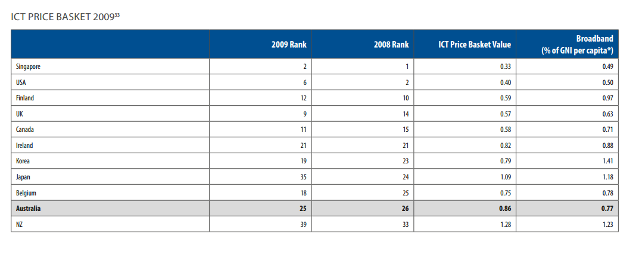
Affordability
ACS (2011, p.60)

Slide 18
Information & ICT literacy
Disadvantage may also grow from information and ICT illiteracy
Social groups experience information and ICT illiteracy in different ways:
Literacies need to be investigated with respect to different social groups and their specific needs, taking age, gender, class, ethnicity, disabilities and minority status into account

Slide 19
Gender equity
Range of issues including:
Under representation in ICT workforce (ACS, 2011)
In 2010, females comprised 23.31% of the Australian ICT workforce
Gender proliferation in lower paid jobs
Gender pay gap (Belgorodskiy et al., 2012)

Slide 20
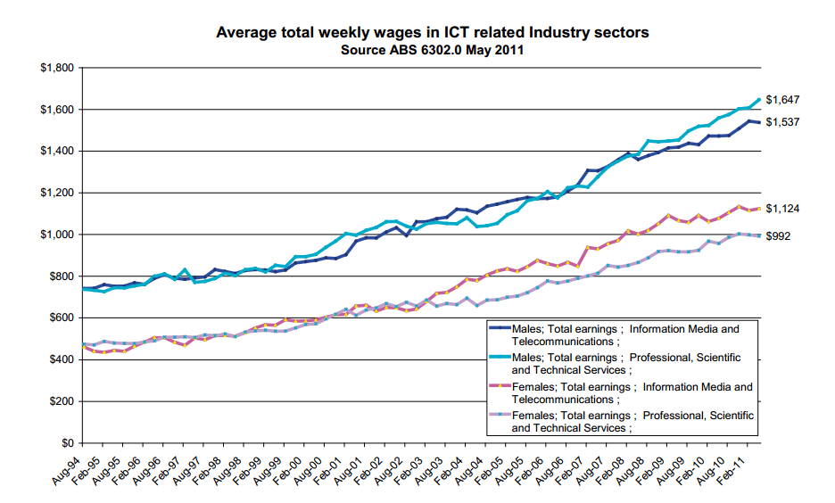
Gender equity: The Pay Gap

Slide 21
Conclusions
Professional practice needs to be aligned with ethical conduct
In ICT decisions with ethical consequences can be seen in software engineering, the handling of private and confidential information and in business practices
Sustainability means development that meets the needs of the present without compromising the ability of future generations to meet their needs

Slide 22
Conclusions
Applications include reducing the carbon footprint of ICT and orgnizations, reducing toxic waste and pollution
Web accessibility means that people with disabilities can perceive, understand, navigate, and interact with the Web, and that they can contribute to the Web. Web accessibility also benefits others, including older people with changing abilities due to aging.

Slide 23
Conclusions
Equity is about fairness and social justice
Issues include:
Equity of access to ICT infrastructure and services
Information literacy that enables digital citizenship
Gender equity
ICT that is takes into account issues of equity and access is likely to be more sustainable in the long run.

Slide 24
References
Fieser, J. (2009). Ethics. Internet Encyclopedia of Philosophy: A Peer Reviewed Academic Resource. (Retrieved 24 September, 2013 from http://www.eip.utm.edu./ethics/)
Dao, V., Langella, I., & Carbo, J. (2011). From green to sustainability: Information technology and an integrated sustainability framework. Journal of Strategic Information Systems, 20(1), 63-79. doi:10.1016/j.jsis.2011.01.002
Salafsky, N. (2010). Sustainability through computing. Nature, 465(7297), 425-425. doi:10.1038/465425a

Slide 25
References
Belgorodskiy, A., Crump, B., Griffiths, M., Logan, K., Peter, R., & Richardson, H. (2012). The gender pay gap in the ICT labour market: Comparative experiences from the UK and new zealand. New Technology, Work and Employment, 27(2), 106-119. doi:10.1111/j.1468-005X.2012.00281.x
Australian Computer Society. Australian ICT Statistical Compendium 2011. Retrieved from www.acs.org.au/2011compendium

