Slide 1
CSG1207/CSI5135 Systems and Database Design
Lecture 07
Data Definition Language
and Constraints

Slide 2
Objectives
After completing this lesson, you should be able to do the following:
Describe and use Transact-SQL DDL;
Create databases and tables
Alter table definitions
Drop databases and tables
Create and drop constraints

Slide 3
Data Definition Language
DDL is a subset of SQL that is used to create databases and their tables (and other database objects)
Creates the structure, not the content
A normalised database design is implemented into a database server using DDL
A data dictionary should provide all the information needed

Slide 4
Naming Rules
Database, table and column names:
Must begin with a letter or _ (underscore)
@ and # also allowed, but have special meanings
Can then be followed by letters, numbers, _, $, @ and #
Be consistent – if you have itemOrder, don’t make Cust_Address
Can be 1 to 128 characters long
Cannot contain spaces or special characters
Must be unique within its own visible range
i.e. different tables per database, different columns per table…
Must not be an SQL server reserved word
Notes:
http://msdn.microsoft.com/en-gb/library/ms175874.aspx
I would recommend keeping names as simple, informative and consistent as possible at all times.
Abbreviating things can be handy and keep queries short, but avoid abbreviating things to the point where their meaning is hard to determine.
Be consistent with your naming – the way you use capitals and underscores, etc. Item_ID, item_id, itemID, etc… This will make writing queries much simpler, since you won’t need to keep checking your table structure to see what column names to use.
Names must only be unique within their own visible range – aka “local scope” in programming terminology. So no two databases can have the same name. Within a single database, no two tables can have the same name, but two tables in DIFFERENT databases can. No two columns in a single table can have the same name, but columns in different tables can…
There’s a difference between a reserved word and a key word. Key words are all words that have special meaning in SQL – there’s many, many of them. Reserved words are the ones which you cannot use as a name – typically the main ones / the ones which would cause problems if used as names. Most key words only have a special meaning when in a certain context, so using them as a name isn’t a problem.
Still, if you can avoid it and use another name that is just as descriptive, then you may as well avoid key words as well.

Slide 5
Creating a Database
Syntax for creating a database:
CREATE DATABASE database_name
[ON [ PRIMARY ] [ <filespec> [ ,...n ]
[ , <filegroup> [ ,...n ] ]
[ LOG ON { <filespec> [ ,...n ] } ] ]
[COLLATE collation_name]
[ WITH <external_access_option> ]
Everything apart from the first line is optional – allows you to specify various attributes of the database
Common database creation simply involves:
CREATE DATABASE database_name
Notes:
http://msdn.microsoft.com/en-us/library/ms176061.aspx

Slide 6
Creating a Table
Table creation syntax:
Syntax notes:
[ ] indicates that something is optional
{ } indicates that something can occur multiple times
i.e. you may have multiple columns and constraints
<column_description> defines the nature of the column:
Data type and length, default value, identity, null, constraint…
CREATE TABLE table_name
( column_name1 <column_description1>
{[, column_name2 <column_description2>] …}
[table_constraint1]
{[, table_constraint2 …]}
);
Notes:
http://msdn.microsoft.com/en-us/library/ms174979.aspx

Slide 7
Creating a Table
Basic table creation example:
Simply defines name of table, names of columns, and their data types/lengths – no primary or foreign keys specified
It is always better to specify a table as thoroughly as you can from the beginning, rather than having to alter it later
Remember: You may need to refresh the Object Explorer in SSMS after creating a table before it appears
CREATE TABLE user ( user_id INT,
name VARCHAR(20),
access CHAR(6),
reg_date SMALLDATETIME
);
Notes:
Note the lack of a comma at the end of the last column definition.

Slide 8
Column Definitions – The DEFAULT Option
You can give columns a default value
If a row is inserted into a table and no value is specified for that column, the default value is used
Literal values, expressions, SQL functions are acceptable values, but the name of another column isn’t
The default data must match the column data type
A default value is often not necessary or suitable for a column (most columns will not have a default value)
CREATE TABLE item
( name VARCHAR(50) DEFAULT 'No Name',
stock SMALLINT DEFAULT 100,
reorder SMALLINT DEFAULT 25,
ordered DATETIME DEFAULT GETDATE()
);
Notes:
http://msdn.microsoft.com/en-gb/library/ms187083.aspx
http://msdn.microsoft.com/en-gb/library/ms191289.aspx
Most of the examples here are self explanatory…
The DATETIME field’s default of GETDATE() is an example of using an SQL function as a default value.
GETDATE() gets the current date/time, so if a value is not specified for the column, it gets the current date/time – making it work like a timestamp*.
* There is actually a TIMESTAMP data type… it doesn’t do what you would think it does, though. In fact, it’s generally considered to be pretty useless, and is likely to be changed in the future. MySQL has a much more useful TIMESTAMP data type.

Slide 9
Column Definitions – The IDENTITY Option
The IDENTITY option creates an auto-incrementing integer
Can only be applied to INT-based columns
When a row is inserted, the server generates a value for the IDENTITY column by incrementing the last value it generated
Numbers are never repeated, even if rows deleted
Value is always unique, so it’s perfect for a primary key
You can specify the initial value and increment
If you don’t, it starts at 1 and increments by 1 each time
1000, 1005, 1010, 1015, 1020, 1025…
CREATE TABLE pet
( pet_id INT IDENTITY );
CREATE TABLE owner
( owner_id INT IDENTITY(1000, 5) );
Notes:
INT-based columns are TINYINT, SMALLINT, INT, BIGINT – there are several data types specifying different ranges of integers. This was covered in more detail last week.
IDENTITY is something you will use often, since it is very very useful for creating primary keys that you do not need to worry about. Just make an INT-based id column, give it the IDENTITY option, and make it a primary key and you’re done.
You probably won’t need to modify the initial value and increment very often, but it has its uses.
You don’t normally specify a value for an IDENTITY field when inserting data – the server generates it for you. You can just leave the column out of the insert statement, or give it a NULL value (which will be overridden with the identity value)

Slide 10
Constraints
Constraints enforce rules at the table/column level
Give columns conditions to ensure that the database integrity remains intact and free of errors
These rules are checked whenever you try to insert, update or delete data from the table
Available constraint types in SQL Server:
NULL / NOT NULL
PRIMARY KEY
FOREIGN KEY
UNIQUE
CHECK
Notes:
http://msdn.microsoft.com/en-gb/library/ms189862(SQL.90).aspx

Slide 11
Constraints
Constraints can be defined at the column level (as part of a column definition) or the table level (after column definitions)
This simply changes where it appears in the CREATE TABLE
Constraints can also be added to a table after its creation
This may be required if your entities have circular relationships
You can name a constraint (useful if you need to refer to it)
SQL Server will generate a name for it if you don’t
You can view constraints via the Object Explorer in SSMS

Slide 12


Column Level Constraints
Defining a constraint at the column level is easier, but not suitable for certain things, e.g. compound primary keys
You do not need to give the constraint a name:
Syntax is simply the constraint itself
But you can if you wish:
Syntax:
CONSTRAINT name <constraint>
CREATE TABLE cat
( cat_id INT IDENTITY PRIMARY KEY );
CREATE TABLE cat
( cat_id INT IDENTITY CONSTRAINT cat_pk PRIMARY KEY );

Slide 13
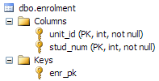
Table Level Constraints
Defining a constraint at the table level requires the full syntax but can, handle more complex constraints
Allows for compound keys:
Constraint name is not optional
You should become familiar with BOTH ways of doing it!
CREATE TABLE enrolment
( unit_id INT,
stud_num INT,
CONSTRAINT enr_pk PRIMARY KEY (unit_id, stud_num)
);
Notes:
If this is confusing, look into the creation scripts and examples in this lecture, as well as other examples on the documentation website and other websites. The best way to learn is by seeing and playing with examples, rather than reading slides.

Slide 14
Column & Table Level Constraint Summary
Constraint names are optional with column level constraints, but mandatory for table level constraints
Compound keys can only be created with table level constraints
NULL / NOT NULL constraints can only be created with column level constraints
These are often thought of as a property/option of a column, like DEFAULT and IDENTITY, rather than as a constraint
Outside of these conditions, which one you use is largely a matter of personal preference

Slide 15
Constraints – NULL / NOT NULL Constraint
Giving a column NOT NULL means it must have a value
Any important/required columns should be NOT NULL
Giving a column NULL means it can be null
Any optional columns can be NULL
Any columns where data may not be known, may be unspecified or may be invalid for some rows can be NULL
NULL is the default (doesn’t usually need to be specified)
PRIMARY KEY or IDENTITY columns cannot be NULL
Automatically set to NOT NULL
CREATE TABLE cat
( cat_id INT IDENTITY PRIMARY KEY,
name VARCHAR(20) NOT NULL,
owner_id INT NULL,
birthdate DATETIME NULL
);
Notes:
http://msdn.microsoft.com/en-gb/library/ms189265.aspx
“A null value, or NULL, is different from zero (0), blank, or a zero-length character string such as "". NULL means that no entry has been made. The presence of NULL typically implies that the value is either unknown or undefined”
In SQL Server, if you don’t specify either null or not null, it defaults to NULL – i.e. columns are optional unless you specify otherwise. Applying certain constraints/options on columns will change this – e.g. if you specify that the column is a primary key, it will automatically be set to not null.

Slide 16
Constraints – PRIMARY KEY
Defines the primary key column(s) of a table
The column(s) uniquely identify each row in the table
i.e. Every row must have a different value in the PK column(s)
Each table can only have one primary key constraint
Primary key can be compound – involve multiple columns
Compound keys can only be created with table level constraints
CREATE TABLE cat
( cat_id INT IDENTITY PRIMARY KEY,
name VARCHAR(20) NOT NULL
);
CREATE TABLE enrolment
( unit_id INT,
stud_num INT
CONSTRAINT enr_pk PRIMARY KEY (unit_id, stud_num)
);
Notes:
http://msdn.microsoft.com/en-gb/library/ms191236.aspx

Slide 17
Constraints – UNIQUE Constraint
Column must be unique for each row in table
Like a primary key, but can have multiple unique constraints
Unlike a PK, unique columns allow NULL… but only once
Foreign keys can reference a unique constraint
Unique constraints can be compound, like PKs
CREATE TABLE user_account
( user_id INT IDENTITY PRIMARY KEY,
username VARCHAR(20) NOT NULL UNIQUE
);
CREATE TABLE user_account
( user_id INT IDENTITY PRIMARY KEY,
f_name VARCHAR(20) NOT NULL,
surname VARCHAR(20) NOT NULL,
CONSTRAINT full_name UNIQUE (f_name, surname)
);
Notes:
http://msdn.microsoft.com/en-gb/library/ms191166.aspx

Slide 18

Constraints – FOREIGN KEY
Defines the foreign keys of a table
Establishes/Enforces a link between columns in two tables
Foreign key in one table references the primary key (or a column with a unique constraint) of another table
Self-referencing relationships have a FK with the same table
Enforces referential integrity – will prevent conditions which lead to broken PK->FK relationships
Can have more than one in a table
Column level example:
CREATE TABLE cat
( cat_id INT IDENTITY PRIMARY KEY,
name VARCHAR(20) NOT NULL,
owner INT FOREIGN KEY REFERENCES owner(owner_id)
);
Notes:
http://msdn.microsoft.com/en-gb/library/ms175464.aspx
The REFERENCES part of the constraint is followed by the table and column that the foreign key points to – you only need to include the column name if it differs from the column you are adding the constraint to. In this example, it is called owner in the cat table, and owner_id in the owner table. If they were both called owner_id, you would not need to include the “(owner_id)” part in the FK constraint.

Slide 19
Constraints – FOREIGN KEY
The table/column that the foreign key references must already exist – i.e. Have been created. Remember “creation order”
Table level example:
Syntax:
CONSTRAINT <constraint_name> FOREIGN KEY (<column(s)>)
REFERENCES <pk_table>(<pk_column(s)>)
The (<pk_column(s)>) part is optional, if it is the same as the (<column(s)>) part – i.e. column name is the same in both tables
CREATE TABLE cat
( cat_id INT IDENTITY PRIMARY KEY,
name VARCHAR(20) NOT NULL,
owner INT,
CONSTRAINT owner_fk FOREIGN KEY (owner)
REFERENCES owner(owner_id)
);
Notes:
http://msdn.microsoft.com/en-gb/library/ms175464.aspx
The REFERENCES part of the constraint is followed by the table and column that the foreign key points to – you only need to include the column name if it differs from the column you are adding the constraint to. In this example, it is called owner in the cat table, and owner_id in the owner table. If they were both called owner_id, you would not need to include the “(owner_id)” part in the FK constraint.

Slide 20
Constraints – CHECK Constraint
Limit the values accepted by a column using an expression
Logical expression must be true for value to be accepted
Can use all normal logic and arithmetic operators
Can define multiple check constraints in a table, and even multiple check constraints on a single column
Checked whenever inserting or updating a row of data
CREATE TABLE employee
( emp_id INT PRIMARY KEY CHECK (emp_id > 0),
f_name VARCHAR(20) NOT NULL,
surname VARCHAR(20) NOT NULL,
salary SMALLINT NOT NULL,
CONSTRAINT sal_con CHECK (salary BETWEEN 1000 AND 5000),
CONSTRAINT name_con CHECK (LEN(f_name) + LEN(surname) > 3)
);
Notes:
http://msdn.microsoft.com/en-gb/library/ms188258.aspx
This table definition contains a few constraints…
The first one is an unnamed column level constraint, and makes sure that emp_id is bigger than 0, making sure we don’t have any negative employee ids. (would be better off using IDENTITY, though)
The second is a table level constraint called sal_con, which ensures that salary must be between 1000 and 5000 – much more useful!
The third is another table level constraint, this one called name_con. The LEN() function just counts how many characters are in a string, so this one just makes sure that the employees first name and surname total more than 3 characters.

Slide 21
Altering a Table
The ALTER TABLE command can be used to modify table structure once it has been created
Add a column
Alter a column
Drop a column
Add a constraint
Drop a constraint
Better to get the table structure correct when creating it, but sometimes circumstances change and you need to alter it
Certain things may not be alterable, if they are crucial to the way the table operates

Slide 22
Adding a Column
To add a single column:
Column will be added to table named after ALTER TABLE
Notice there is no ( ) around the ADD clause
Column definition as normal after ADD
To add multiple columns, just put a comma between them:
To use NOT NULL, you must specify a DEFAULT or use IDENTITY, or the table must have no rows in it
ALTER TABLE employee
ADD uni_degree VARCHAR(50) NULL;
ALTER TABLE employee
ADD uni_degree VARCHAR(50) NULL,
home_phone INT NOT NULL DEFAULT 0,
access_level CHAR(1) NULL DEFAULT 'C';
Notes:
http://msdn.microsoft.com/en-US/library/ms190273.aspx
The reason for the restrictions on NOT NULL when adding columns is obvious – if the new column doesn’t allow NULL values, then it needs to be told what to put in the column for all the existing rows. A default value works, as does a server-generated auto incrementing int (identity)... Otherwise, if the table has no rows in it, then that’s fine too.
The new column is added after the last column in the table.

Slide 23
Altering a Column
To change an existing column’s definition:
Very much like adding a column
Can only alter one column at a time
Certain alterations to columns can cause problems:
Altering columns with constraints
Shortening the length/size of a column
Changing to incompatible data type (e.g. CHAR to INT)
The server will typically inform you of any potential problems, and prevent you from altering a column if needed
You may need to drop constraints before altering a column
ALTER TABLE employee
ALTER COLUMN home_phone CHAR(15) NULL;
Notes:
The server will let you shorten a column (e.g. CHAR(10) to CHAR(5)) if it does not result in the loss of data – i.e. if there are no rows where that column has more than 5 characters.
You can change the data type of the column as long as the server is able to convert between them. E.g. character types to other character types, numeric types to other numeric types… If a FLOAT (or other decimal numeric type) is converted to an INT (or other int-based type), the decimal portion of the number is lost – 6.875 becomes 6.

Slide 24
Dropping a Column
To drop (delete) a column:
All of the data in the column will be lost (cannot be undone)
Multiple columns can be dropped at once by putting a comma between each column name
You cannot drop a column when it is…
Part of a constraint (PK, FK, UNIQUE or CHECK)
Has a default value associated with it
To drop these types of columns, you will normally need to drop the constraints/defaults associated with them first
ALTER TABLE employee
DROP COLUMN eye_colour;

Slide 25
Adding and Dropping a Constraint
To add a constraint to an existing column:
Syntax for the constraint is same as creating a table level constraint during a CREATE TABLE statement
You can create any kind of constraint (as long as it is valid)
To drop an existing constraint from a column:
Much easier and more readable if you named the constraint
Can add or drop multiple constraints at once with commas
Must still adhere to creation/dropping order
ALTER TABLE employee
ADD CONSTRAINT mgr_fk FOREIGN KEY (manager_id)
REFERENCES employee(employee_id);
ALTER TABLE employee
DROP CONSTRAINT mgr_fk;
Notes:
Remember that you must adhere to the creation/dropping order when creating or dropping constraints. E.g. you cannot drop a PK constraint that a FK constraint is linked to, unless you drop the FK constraint first.

Slide 26
Dropping Tables and Databases
Very simple syntax for dropping tables and databases:
All of the data will be lost (cannot be undone)
Any constraints will be dropped along with the table/database
Remember the dropping order if there are foreign keys
Can drop more than one at a time:
TRUNCATE TABLE can be used to delete all rows in a table, but keep the structure of it (columns, constraints, etc)
Will also reset any IDENTITY columns to their starting value
DROP TABLE employee;
DROP DATABASE company;
DROP TABLE walk, owner, pet, park;
DROP DATABASE company, enrolments;
Notes:
Drop table: http://msdn.microsoft.com/en-gb/library/ms173790.aspx
Drop database: http://msdn.microsoft.com/en-gb/library/ms178613aspx
Truncate: http://msdn.microsoft.com/en-gb/library/ms177570aspx
Truncate is a very handy command, essentially letting you “reset” a table to its newly created state… or at least, the state of it at the last time its structure was changed via ALTER TABLE… All rows deleted, IDENTITY columns reset.

Slide 27
Data Definition Language Summary
This table summarises the main DDL commands:
Command | Description
CREATE DATABASE | Create a database
CREATE TABLE | Create a table (define columns and can define constraints)
ALTER TABLE | Modify table structure (columns and constraints)
DROP TABLE | Drop a table (delete all rows and the table structure)
TRUNCATE TABLE | Delete all rows from a table and reset IDENTITY columns
DROP DATABASE | Drop a database

Slide 28
Considerations when creating tables
Keep your table creation script (collection of all necessary CREATE TABLE statements) neat and tidy
Each column on a new line, use spaces or tabs to align things
Consistent naming of columns and constraints
Consistent ordering of options and constraint creation
Save a copy of your table creation script
This will allow you to re-create your database structure
Remember to update the creation script if you alter a table
Add comments to your script to make it clearer
To make your table creation script more flexible, you may want to include statements to drop the database first, so that the script re-creates everything from scratch each time
Notes:
Comments are simply explanatory text that has no effect or impact on anything – they are just there for the people reading a script. Use them for headings or to provide important information, etc.
You can create a single line comment by starting the line with --
To create a comment that goes over multiple lines, put a /* at the start of the first line, and a */ at the end of the last line
-- this is a single line comment
/* this comment
Goes over
Multiple lines */

Slide 29
Considerations when creating tables
It may be necessary to create tables without foreign key constraints and them add them once tables are created
Where primary and foreign keys relate in a circular manner
Remember that foreign keys simply enforce referential integrity
In this diagram, employees work in a
department, and departments have a
manager (who is an employee)
While you can create the necessary
columns for FK values, you cannot create
both constraints until both tables exist
Create one constraint, then add the other once populated
department
employee
Notes:
The department/employee relationships in the company database are a good example of this – if you look at the creation script, you’ll see that they are worked around:
The tables that are problematic are first created without the problematic constraint.
They are then populated with data, before adding the final constraint.

Slide 30
Example database: group_work
unit
unit_code
unit_name
unit_desc
credit_points
student_num
student_name
gender
birthdate
student
assignment
assignment_type
assn_type_id
assn_type
group_member
work_group
assn_id
unit_code
assn_type
assn_name
assn_desc
weighting
student_num
group_id
group_id
assn_id
group_name
creation_date
Notes:
So! We have units – just a few basic details with unit_code as the PK.
Each unit may have multiple assignments (or none) – each assignment must be for a unit.
We’re storing assignment details as you would expect, with FKs for the unit_code and assignment type.
The assignment type is a lookup table/entity, that simply stores an id and type name. Ids will be auto-incrementing, and names will be things like Essay, Report, Project Plan, Programming, etc.
Each assignment may have multiple groups of students doing it (or none – e.g. individual assignment). Group id is an auto incrementing PK, and assignment id is a FK. The table is named work_group since group is a keyword
The relationship between students and groups is handled by the group_member intermediary table – compound PK, and FKs linking to the other tables.
Finally, student is for student details, with student number as a PK. Students can be in multiple groups, or none.

Slide 31
Example database: group_work
Table creation order
(numerous orders possible)
1
unit
2
4
3
student
assignment
assignment_type
6
5
group_member
work_group
Notes:
Create the PKs before the FKs… 1 sides before M sides...

Slide 32
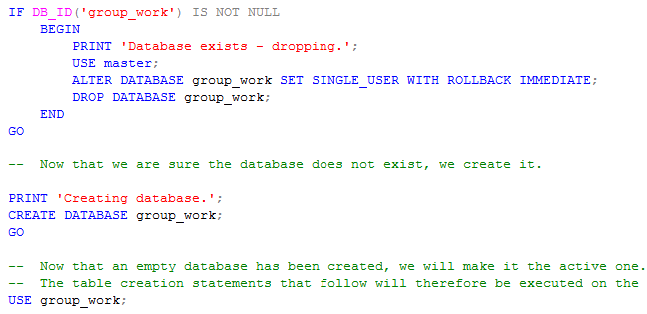
Example database: group_work
Creation script part 1/3, the initial preparation…
Drop database if it exists
Create new (empty) database
Sets it as the current database for the rest of the statements

Slide 33
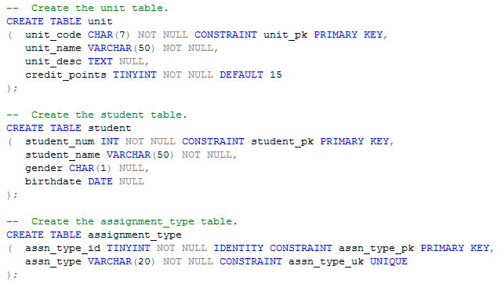
Example database: group_work
Creation script part 2/3, the first three tables….

Slide 34
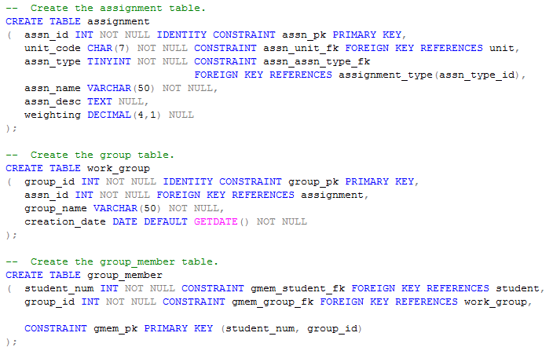
Example database: group_work
Creation script part 3/3, the last three tables….

Slide 35
Summary
We covered the main DDL commands to create, alter and drop databases, tables, columns and constraints
Use consistent naming for all databases, tables, columns and constraints
Columns must have a name and data type, and can also have default values, special properties, constraints…
Common constraints are NULL/NOT NULL, PRIMARY KEY, FOREIGN KEY, UNIQUE and CHECK
Can be created at column or table level

Slide 36
Example database challenge
Have a go at completing the following changes/additions:
Add an ‘enrolment’ table as an intermediary table between student and unit, containing a compound primary key of student_num and unit_code and the necessary foreign keys
Add a ‘group_leader’ column to work_group table, which is a foreign key reference to the student_num column in student
Add an optional ‘prerequisite’ column to the unit table, which is a self-referencing foreign key to the unit_code column
Update the creation script to incorporate all of these change
Notes:
We are assuming that units can only have one prerequisite in this scenario.

