Slide 1
CSP2108: Introduction to Mobile Applications Development
Mobile Applications

Slide 2
Summary
Why mobile applications?
Mobile devices
Mobile operating systems
Mobile development tools
Notes:
Some links :
http://www.bbconsult.co.uk/expertise/mobileapplications/mobiletechnology
https://en.wikipedia.org/wiki/Mobile_application_development

Slide 3
Why Mobile Apps?
Before looking at the next slide, why do you think mobile applications development is interesting/important?
Try googling “why mobile apps”, but beware of sales hype.

Slide 4
Why Mobile Apps?
Estimated 2 billion smartphone users
The “app economy” estimated at about USD50 billion
Estimated 10% of all IT jobs in Australia
Smartphone/tablet/app use growing
Notes:
Sources:
http://appindex.com/app-development/mobile-app-developer-statistics-roundup/
http://www.statista.com/statistics/330695/number-of-smartphone-users-worldwide/
http://venturebeat.com/2016/02/10/the-app-economy-could-double-to-101b-by-2020-research-firm-says/
http://www.progressivepolicy.org/wp-content/uploads/2014/07/2014.07-Mandel_Jobs-in-the-Australian-App-Economy.pdf

Slide 5
Why Mobile Apps?
Mobile apps are good for
Being always available
Quick, easy user interface
Integration with email, address book, calendar, social media etc
Advertising/marketing – users spend lots of time using apps
Camera, microphone
Casual games
Location awareness

Slide 6
Mobile devices - typical
Small (typically handheld)
Mobile (can easily move from place to place)
Computing device
Display screen with touch input
Wireless connectivity
Notes:
Link:
https://en.wikipedia.org/wiki/Mobile_device

Slide 7
Mobile devices examples
(Smart) mobile phones
Tablet computers
Wearable devices
Smart watches
Head-mounted displays
Fitbits
etc.
Personal Digital Assistants (PDAs)
Handheld game consoles
Etc.

Slide 8
Mobile device components
Input (some of)
Touch screen
Stylus
Keyboard
Buttons
Audio
Accelerometer (gravity sensor) – motion and tilt
Compass
Camera (still/video)
GPS (Global Positioning System)

Slide 9
Mobile device components
I/O (Input/Output)
Wireless
WIFI
Bluetooth
I/O ports
HDMI
USB
Firewire
Etc.

Slide 10
Mobile device components
Output
Display
Audio
Lights/vibration
Power
Rechargeable battery
Small backup battery

Slide 11
Mobile device components
CPU (Central Processor Unit)
Runs programs : Operating System (OS) and Apps
Other processors
Graphics
Audio
Memory
ROM (Read-only memory) / Flash memory
OS, Apps
Slow
Persistent
RAM (Random Access Memory)
Running programs
Fast(er)
Volatile
On a smartphone, CPU, other processors, memory and interfaces may be combined on a System on a Chip (SoC)

Slide 12
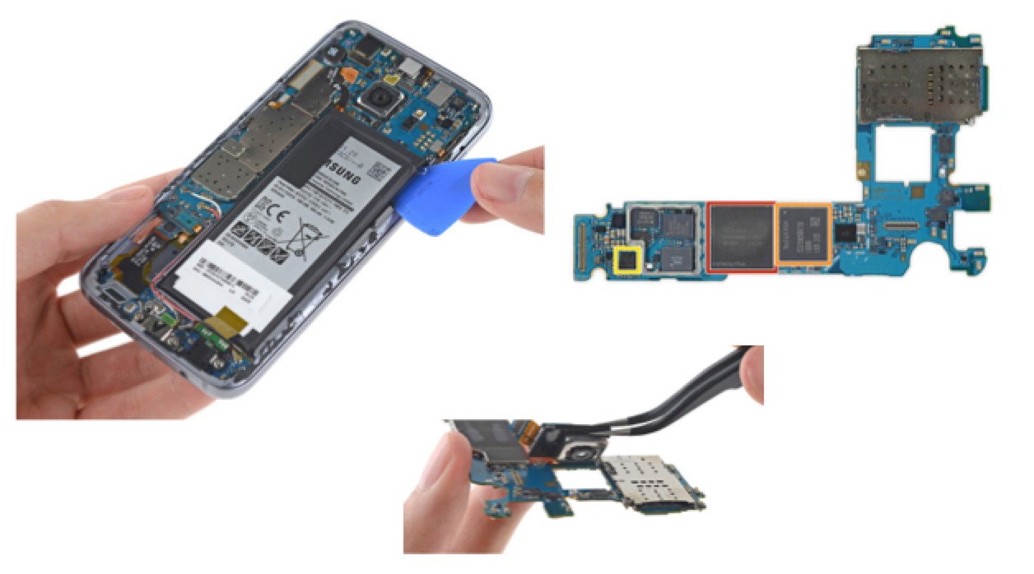
Example: Samsung Galaxy S7
battery
audio
4GB SDRAM
ROM
32GB Flash
camera
https://www.ifixit.com/Teardown/Samsung+Galaxy+S7+Teardown/56686

Slide 13
Mobile Operating Systems
An operating system (OS) is system software that manages computer hardware and software resources and provides common services for computer programs.
Examples of Mobile OS’s
Android (Google)
iOS (Apple)
Windows 10 Mobile (Microsoft)
Others e.g. BlackBerry 10
Notes:
Some links:
https://en.wikipedia.org/wiki/Mobile_operating_system
https://www.netmarketshare.com/operating-system-market-share.aspx?qprid=8&qpcustomd=1

Slide 14
Android
62% market share (2016)
Developed by Google
Based on Linux kernel
As well as smartphones and tablets, variants for other electronic devices
User interface based on direct interaction : touch/gestures
Apps from Google Play
Apps written in Java
Current version 6.0 (Marshmallow)

Slide 15
iOS
Market share 28.4% (2016)
Developed by Apple
Based on Darwin core OS (version of Unix)
For IPhone, IPod touch, IPad, Apple TV
User interface based on direct interaction : multi-touch/gestures
Apps from Apple’s App Store
Apps written in Swift or Objective-C
Current version 9.3

Slide 16
Windows 10 Mobile
Market share 4% (2016)
Developed by Microsoft
Closed-source and proprietary
For Windows Phone devices
Similar user-interface to Windows desktops
Apps from Microsoft Store
Apps written using Visual Studio (C#, Visual Basic, Visual C++…)
Current version Redstone

Slide 17
Native or Web?
Another deployment option is the Mobile Web, or Web 3.0
Applications are built to run within a web browser
Trade-off
Access to user interface
Access to hardware and software
Cross-platform development
Developments such as HTML5 and jQuery are closing the gap in functionality
Native apps have better functionality
Web apps don’t need multiple versions for different OS’s, frequent updates
Notes:
Link:
http://www.bbconsult.co.uk/expertise/mobileapplications/mobiletechnology

Slide 18
App Development Architecture
Mobile apps often use remote services as well as code running on the mobile device
We will concentrate on the mobile device side and only touch briefly on the “back-end”
More advanced applications and issues will be covered in CSP3108 Advanced Mobile Applications Development

Slide 19
Tools : SDK’s (Software Development Kits)
Android SDK
For native Android apps
Android Studio IDE (Integrated Development Environment)
Java based
Includes debugger, libraries, handset emulator

Slide 20
Tools : SDK’s (Software Development Kits)
iOS SDK
For native iOS apps
Xcode IDE
Objective-C, Swift based
Includes debugger, libraries, handset emulator

Slide 21
Tools : SDK’s (Software Development Kits)
Corona SDK
Cross-platform
Same source builds for iOS, Android, NOOK, Windows Phone 8, Windows Desktops
Corona Editor IDE
Lua code – simple to learn
Includes debugger, libraries, handset emulator

Slide 22
Tools :SDKs
There are many others
See https://en.wikipedia.org/wiki/Mobile_application_development
Some web-based, some native Android or native iOS, some cross-platform
We will use Corona

