Slide 1
Chapter 3 Memory Management: Virtual Memory

Slide 2
Learning Objectives
After completing this chapter, you should be able to describe:
The basic functionality of the memory allocation methods covered in this chapter: paged, demand paging, segmented, and segmented/demand paged memory allocation
The influence that these page allocation methods have had on virtual memory

Slide 3
Learning Objectives
The difference between a first-in first-out page replacement policy, a least-recently-used page replacement policy, and a clock page replacement policy
The mechanics of paging and how a memory allocation scheme determines which pages should be swapped out of memory
The concept of the working set and how it is used in memory allocation schemes
The impact that virtual memory had on multiprogramming
Cache memory and its role in improving system response time

Slide 4
Introduction
Evolution of virtual memory
Paged, demand paging, segmented, segmented/demand paging
Foundation for current virtual memory methods
Improvement areas
Need for continuous program storage
Need for placement of entire program in memory during execution
Fragmentation
Overhead due to relocation

Slide 5
Introduction
Page replacement policies
First-In First-Out
Least Recently Used
Clock replacement and bit-shifting
Mechanics of paging
The working set
Virtual memory
Concepts and advantages
Cache memory
Concepts and advantages

Slide 6
Virtual Memory Model
Essential for multiprogramming & multitasking environments
Essential for platforms allowing portable executables
Modern (multitasking) operating systems all use a VMM
After a program is compiled memory addresses are absolute
To avoid conflicts every program would need to use different memory addresses
This is obviously not feasible

Slide 7
Virtual Memory Model
The VMM approach has each program compiled to use “virtual addresses”
Each process sees that it has half of the memory space available to it
2GB in 32bit
32EB in 64bit
The other half is reserved for operating system (kernel) use
The above is true regardless of the amount of actual memory available or the presence of other processes

Slide 8
Virtual Memory Model
Each process allocates/deallocates memory as it needs to within the virtual address space
The VMM translates these to physical addresses in memory and manages the allocation/deallocation to keep track of the actual memory available

Slide 9
Paged Memory Allocation
Divides each incoming job into pages of equal size
Best condition
Page size = Memory block size (page frames) = Size of disk section (sector, block)
Sizes depend on operating system and disk sector size
Memory manager tasks prior to program execution
Determines number of pages in program
Locates enough empty page frames in main memory
Loads all program pages into page frames
Advantage of storing program non-contiguously
New problem: keeping track of job’s pages

Slide 10
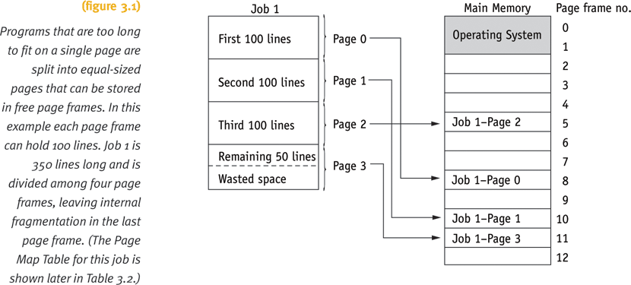
Paged Memory Allocation

Slide 11
Paged Memory Allocation
Three tables for tracking pages
Job Table (JT)
Size of job
Memory location where its PMT is stored
Page Map Table (PMT)
Page number
Corresponding page frame memory address
Memory Map Table (MMT)
Location for each page frame
Free/busy status

Slide 12
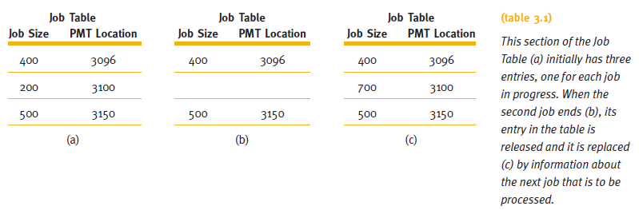
Paged Memory Allocation

Slide 13
Paged Memory Allocation
Displacement (offset) of a line
Determines line distance from beginning of its page
Locates line within its page frame
Relative value
Determining page number and displacement of a line
Divide job space address by the page size
Page number: integer quotient from the division
Displacement: remainder from the division

Slide 14
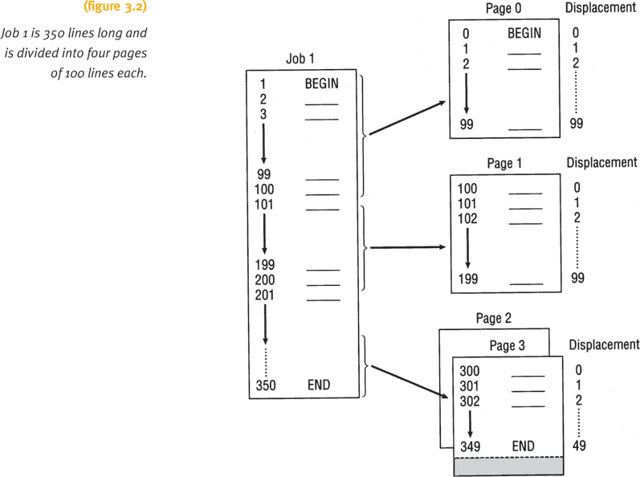
Paged Memory Allocation

Slide 15
Paged Memory Allocation
Steps to determining exact location of a line in memory
Determine page number and displacement of a line
Refer to the job’s PMT
Determine page frame containing required page
Obtain address of the beginning of the page frame
Multiply page frame number by page frame size
Add the displacement (calculated in first step) to starting address of the page frame
Address resolution
Translating job space address into physical address
Relative address into absolute address

Slide 16
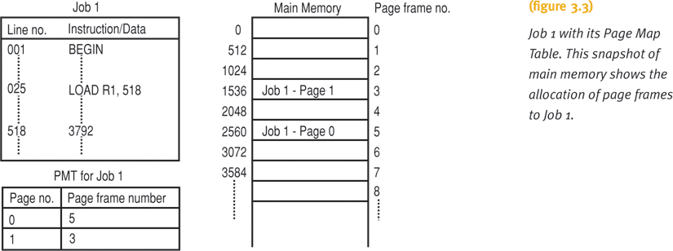
Paged Memory Allocation

Slide 17
Paged Memory Allocation
Advantages
Allows job allocation in non-contiguous memory
Efficient memory use
Disadvantages
Increased overhead from address resolution
Internal fragmentation in last page
Must store entire job in memory location
Page size selection is crucial
Too small: generates very long PMTs
Too large: excessive internal fragmentation

Slide 18
Demand Paging
Pages brought into memory only as needed
Removes restriction: entire program in memory
Requires high-speed page access
Exploits programming techniques
Modules written sequentially
All pages not necessary needed simultaneously
Examples
User-written error handling modules
Mutually exclusive modules
Certain program options: mutually exclusive or not accessible
Tables given fixed amount of space: fraction used

Slide 19
Demand Paging
Allowed for wide availability of virtual memory concept
Provides appearance of almost infinite or nonfinite physical memory
Jobs run with less main memory than required in paged memory allocation scheme
Requires high-speed direct access storage device
Works directly with CPU
Swapping: how and when pages passed in memory
Depends on predefined policies

Slide 20
Demand Paging
Memory Manager requires three tables
Job Table
Page Map Table: three new fields
If requested page is already in memory
If page contents have been modified
If page has been referenced recently
Determines which page remains in main memory and which is swapped out
Memory Map Table

Slide 21
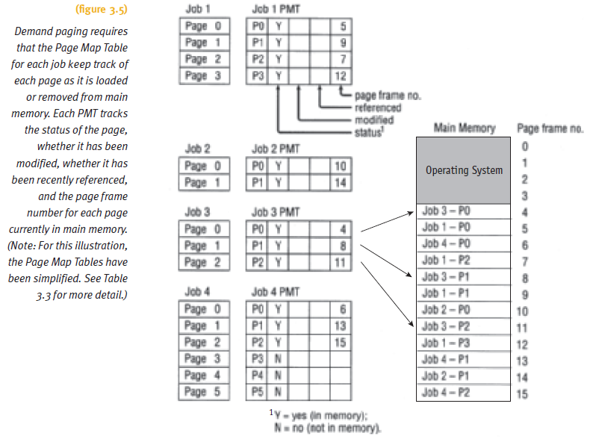
Demand Paging

Slide 22
Demand Paging
Swapping Process
Exchanges resident memory page with secondary storage page
Involves
Copying resident page to disk (if it was modified)
Writing new page into the empty page frame
Requires close interaction between:
Hardware components
Software algorithms
Policy schemes

Slide 23
Demand Paging
Hardware instruction processing
Page fault: failure to find page in memory
Page fault handler
Part of operating system
Determines if empty page frames in memory
Yes: requested page copied from secondary storage
No: swapping occurs
Deciding page frame to swap out if all are busy
Directly dependent on the predefined policy for page removal

Slide 24
Demand Paging
Thrashing
An excessive amount of page swapping between main memory and secondary storage
Due to main memory page removal that is called back shortly thereafter
Produces inefficient operation
Occurs across jobs
Large number of jobs competing for a relatively few number of free pages
Occurs within a job
In loops crossing page boundaries

Slide 25
Demand Paging
Advantages
Job no longer constrained by the size of physical memory (concept of virtual memory)
Utilizes memory more efficiently than previous schemes
Faster response
Disadvantages
Increased overhead caused by tables and page interrupts

Slide 26
Page Replacement Policies & Concepts
Policy to select page removal
Crucial to system efficiency
Page replacement polices
First-In First-Out (FIFO) policy
Best page to remove is one in memory longest
Least Recently Used (LRU) policy
Best page to remove is least recently accessed
Mechanics of paging concepts
The working set concept

Slide 27
First-In First-Out
Removes page in memory the longest
Efficiency
Ratio of page interrupts to page requests
FIFO example: not so good
Efficiency is 9/11 or 82%
FIFO anomaly
More memory does not lead to better performance

Slide 28
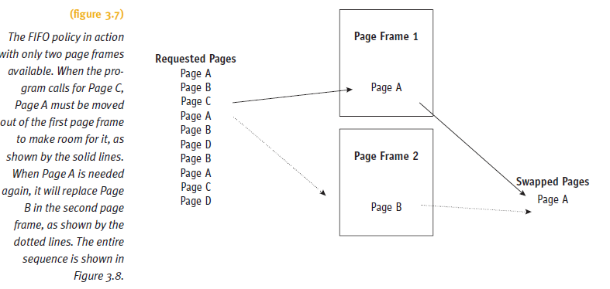
First-In First-Out

Slide 29
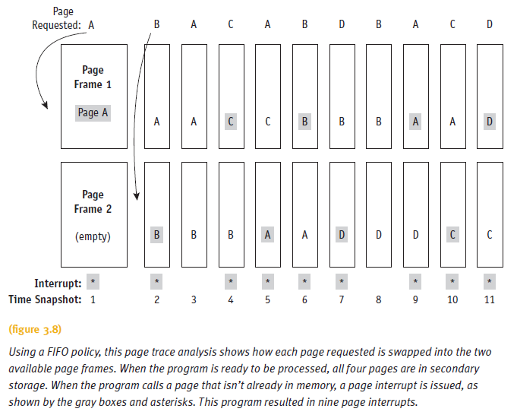
First-In First-Out

Slide 30
Least Recently Used
Removes page least recently accessed
Efficiency
Causes either decrease in or same number of interrupts
Slightly better (compared to FIFO): 8/11 or 73%
LRU is a stack algorithm removal policy
Increasing main memory will cause either a decrease in or the same number of page interrupts
Does not experience FIFO anomaly

Slide 31
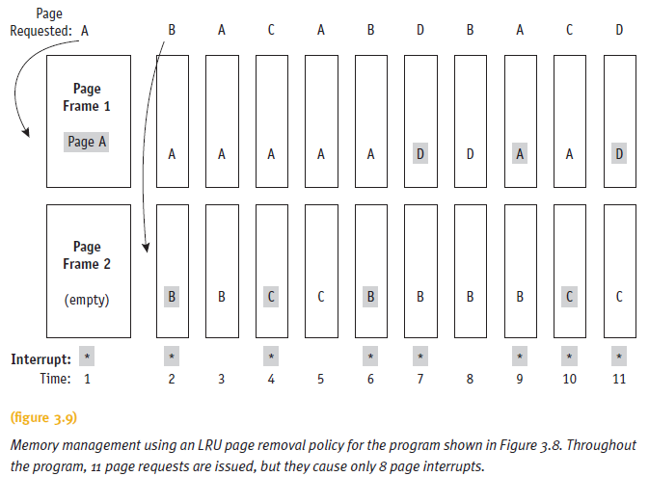
Least Recently Used

Slide 32
Least Recently Used
Two variations
Clock replacement technique
Paced according to the computer’s clock cycle
Bit-shifting technique
Uses 8-bit reference byte and bit-shifting technique
Tracks usage of each page currently in memory

Slide 33
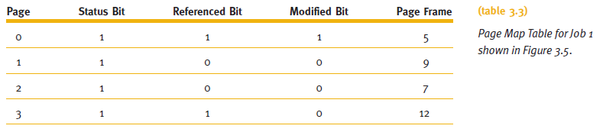
The Mechanics of Paging
Page swapping
Memory manage requires specific information
Uses Page Map Table Information
Status bits of: “0” or “1”

Slide 34
The Mechanics of Paging
Page map table bit meaning
Status bit
Indicates if page currently in memory
Referenced bit
Indicates if page referenced recently
Used by LRU to determine page to swap
Modified bit
Indicates if page contents altered
Used to determine if page must be rewritten to secondary storage when swapped out
Four combinations of modified and referenced bits

Slide 35
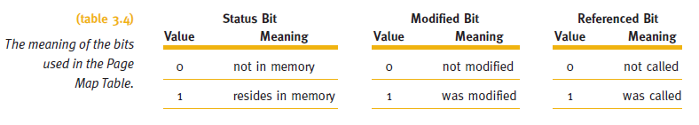
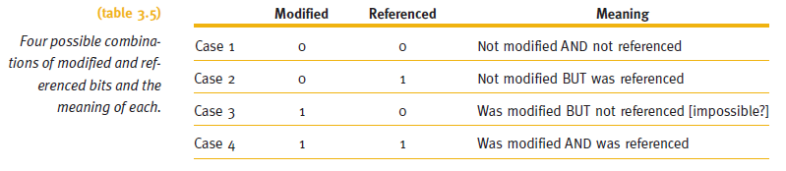
The Mechanics of Paging

Slide 36
The Working Set
Set of pages residing in memory accessed directly without incurring a page fault
Improves performance of demand page scheme
Requires concept of “locality of reference”
Occurs in well-structured programs
Only small fraction of pages needed during program execution
Time sharing systems considerations
System decides
Number of pages comprising working set
Maximum number of pages allowed for a working set

Slide 37
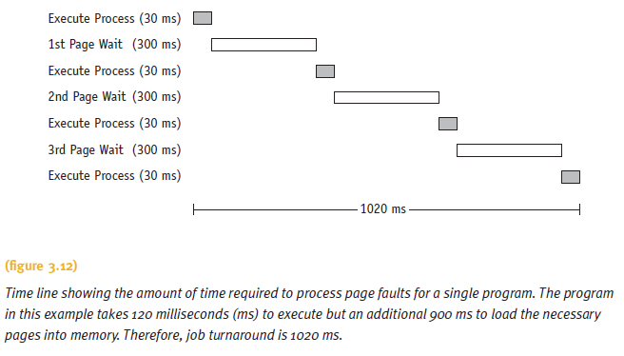
The Working Set

Slide 38
Segmented Memory Allocation
Each job divided into several segments
Segments are different sizes
One for each module containing related functions
Reduces page faults
Segment’s loops not split over two or more pages
Main memory no longer divided into page frames
Now allocated dynamically
Program’s structural modules determine segments
Each segment numbered when compiled/assembled
Segment Map Table (SMT) generated

Slide 39
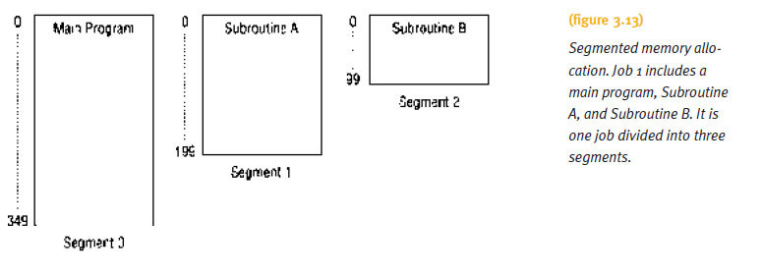
Segmented Memory Allocation

Slide 40
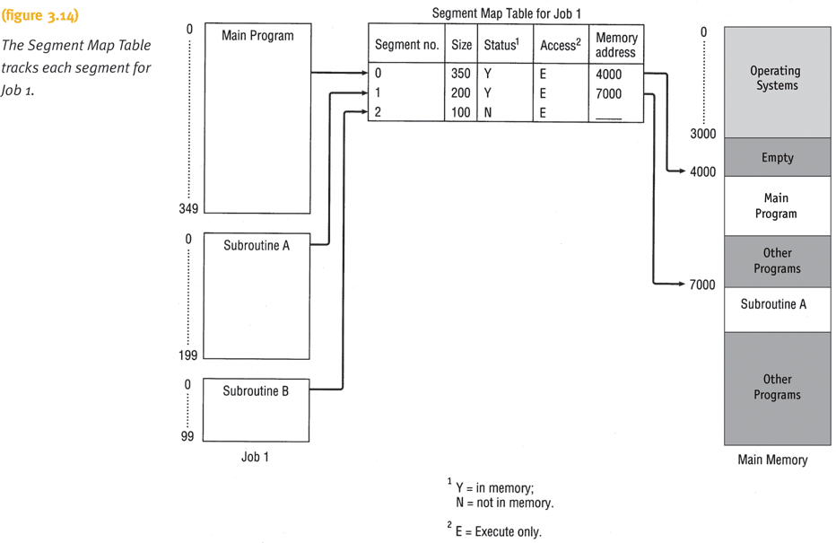
Segmented Memory Allocation

Slide 41
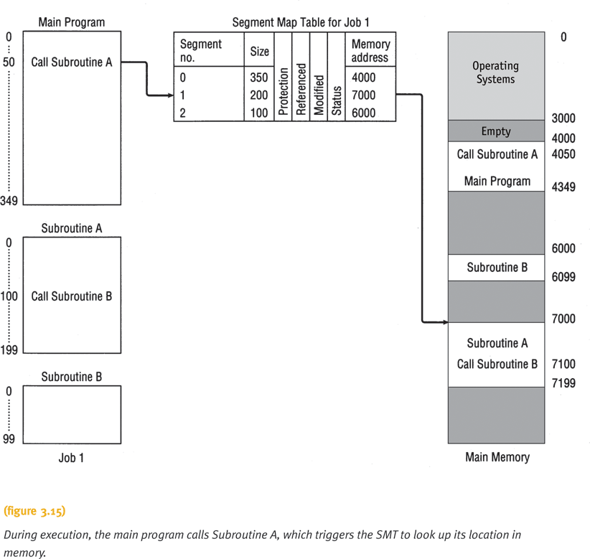
Segmented Memory Allocation

Slide 42
Segmented/Demand Paged Memory Allocation
Memory Manager tracks segments using tables
Job Table
Lists every job in process (one for whole system)
Segment Map Table
Lists details about each segment (one for each job)
Memory Map Table
Monitors allocation of main memory (one for whole system)
Instructions with segments ordered sequentially
Segments not necessarily stored contiguously

Slide 43
Segmented/Demand Paged Memory Allocation
Addressing scheme requirement
Segment number and displacement
Advantages
Internal fragmentation is removed
Memory allocated dynamically
Disadvantages
Difficulty managing variable-length segments in secondary storage
External fragmentation

Slide 44
Segmented/Demand Paged Memory Allocation
Subdivides segments into pages of equal size
Smaller than most segments
More easily manipulated than whole segments
Logical benefits of segmentation
Physical benefits of paging
Segmentation problems removed
Compaction, external fragmentation, secondary storage handling
Addressing scheme requirements
Segment number, page number within that segment, and displacement within that page

Slide 45
Segmented/Demand Paged Memory Allocation
Scheme requires four tables
Job Table
Lists every job in process (one for the whole system)
Segment Map Table
Lists details about each segment (one for each job)
Page Map Table
Lists details about every page (one for each segment)
Memory Map Table
Monitors allocation of page frames in main memory (one for the whole system)

Slide 46
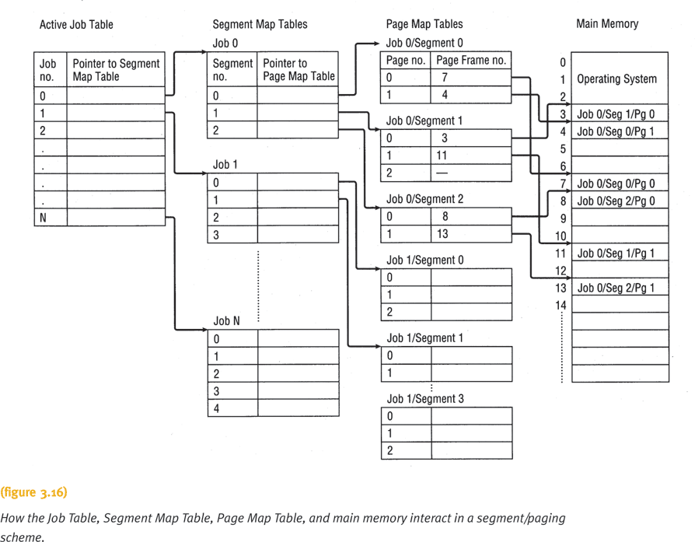
Segmented/Demand Paged Memory Allocation

Slide 47
Segmented/Demand Paged Memory Allocation
Advantages
Large virtual memory
Segment loaded on demand
Logical benefits of segmentation
Physical benefits of paging
Disadvantages
Table handling overhead
Memory needed for page and segment tables

Slide 48
Segmented/Demand Paged Memory Allocation
Associative memory
Several registers allocated to each job
Associate segment and page numbers with main memory
Uses two simultaneous searches for page
One search of registers
One search of SMT and PMT
Minimizes number of references
Used to speed up process
Disadvantage
High cost of complex hardware required to perform parallel searches

Slide 49
Virtual Memory
Allows program execution even if not stored entirely in memory
Requires cooperation between memory manager and processor hardware
Advantages
Job size not restricted to size of main memory
Memory used more efficiently
Allows an unlimited amount of multiprogramming
Eliminates external fragmentation and minimizes internal fragmentation

Slide 50
Virtual Memory
Advantages (cont'd.)
Allows the sharing of code and data
Facilitates dynamic linking of program segments
Disadvantages
Increased processor hardware costs
Increased overhead for handling paging interrupts
Increased software complexity to prevent thrashing

Slide 51
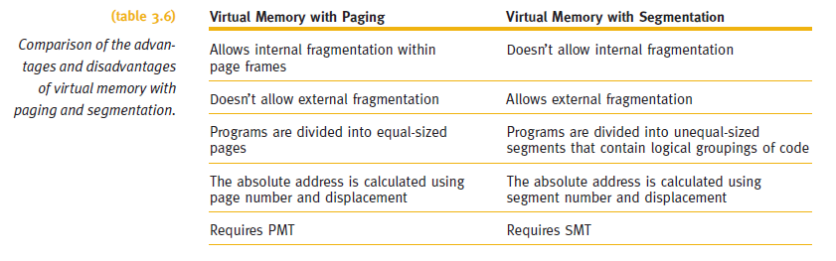
Virtual Memory

Slide 52
Cache Memory
Small high-speed intermediate memory unit
Performance of computer system increased
Memory access time significantly reduced
Faster processor access compared to main memory
Stores frequently used data and instructions
Two levels of cache
L2: Connected to CPU; contains copy of bus data
L1: Pair built into CPU; stores instructions and data
Data/instructions move from main memory to cache
Uses methods similar to paging algorithms

Slide 53
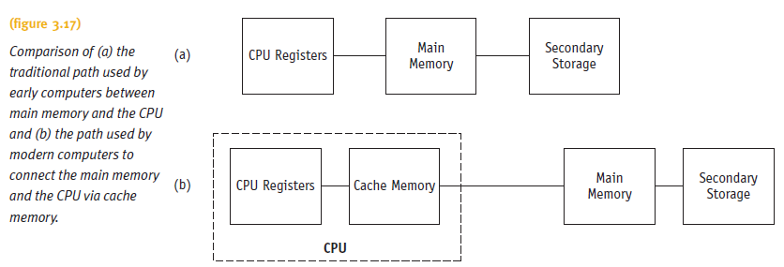
Cache Memory

Slide 54
Cache Memory
Four cache memory design factors
Cache size, block size, block replacement algorithm, and rewrite policy
An optimal selection of cache and replacement algorithm necessary
May lead to 80-90% of all requests in cache
Efficiency measures
Cache hit ratio (h)
Percentage of total memory request found in cache
Miss ratio (1-h)
Average memory access time
AvgCacheAccessTime + (1-h) * AvgMemACCTime

Slide 55
Summary
Paged memory allocation
Efficient use of memory
Allocate jobs in noncontiguous memory locations
Problems
Increased overhead
Internal fragmentation
Demand paging scheme
Eliminates physical memory size constraint
LRU provides slightly better efficiency (compared to FIFO)
Segmented memory allocation scheme
Solves internal fragmentation problem

Slide 56
Summary
Segmented/demand paged memory
Problems solved
Compaction, external fragmentation, secondary storage handling
Associative memory
Used to speed up the process
Virtual memory
Programs execute if not stored entirely in memory
Job’s size no longer restricted to main memory size
Cache memory
CPU can execute instruction faster

Slide 57
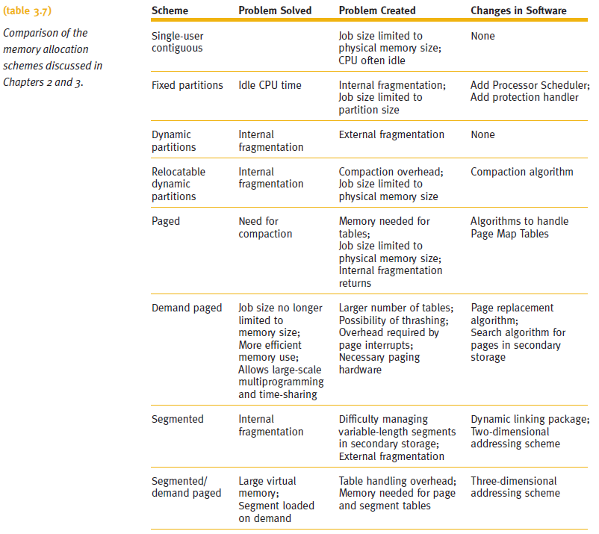
Summary (cont'd.)

