Slide 1
CSP2108: Introduction to Mobile Applications Development
Module 9: Development Methodology

Slide 2
Topics this week
Development Methodologies for Mobile Apps
The Scrum

Slide 3
Software Development Methodologies
Software development projects benefit from good management
Various Software Development Methodologies have been developed over time for different kinds of development projects
In this lecture we will have a brief look at one that seems well-suited to mobile app development
First – a quick overview
Notes:
Overview from https://en.wikipedia.org/wiki/Software_development_process

Slide 4
Waterfall
Sequential development
requirements
design
implementation
testing
deployment
maintenance
Emphasis on tight control, planning, deadlines

Slide 5
Incremental
A series of mini-waterfalls, each covering part of the system, or
Series of incremental mini-waterfalls withing an overall design context, or
System core define via waterfall, then incremental implimentation

Slide 6
Spiral
Cycles through
determine objectives
identify and resolve risks
develop and test
plan next cycle
Increasing scope with each cycle

Slide 7
Rapid Application Development (RAD)
Iterative use of prototypes
Iterates over
requirements planning
prototyping
Output is combined business requirements/technical design

Slide 8
Agile
Iterative development
With continuous feedback
Using cross-functional teams
(We will look at Scrum)

Slide 9
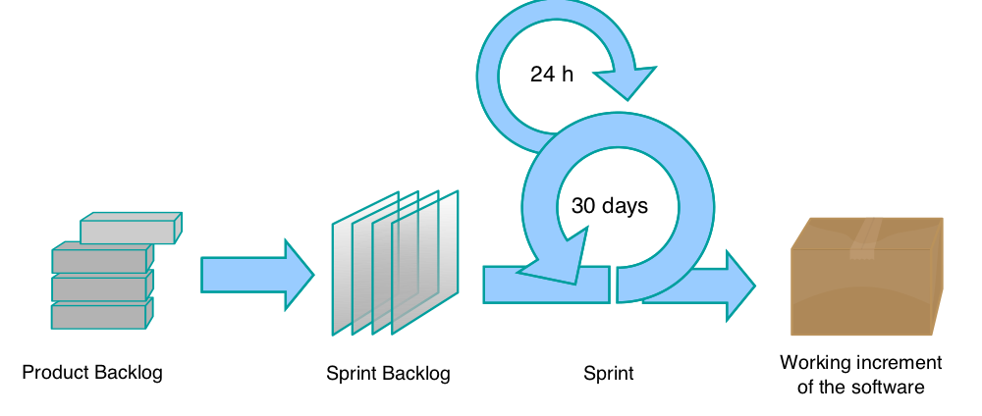
Scrum Process - overview
By Lakeworks - Own work, GFDL, https://commons.wikimedia.org/w/index.php?curid=3526338
Notes:
https://en.wikipedia.org/wiki/Scrum_(software_development)

Slide 10
Syndicate exercise– why agile?
Read the online article http://www.gartner.com/newsroom/id/2823619
and watch the UTube video (about the first 15 mins) https://www.youtube.com/watch?v=nBh8wEXneKg
Your Question: Why use agile methods for mobile app development?
Notes:
Constraints of the platform
limited screen size
limited storage
short sessions
small downloads
network connectivity -> helps to experiment with options, reduce unnecessary features
Users not familiar with apps -> use of prototypes/incremental updates etc for user feedback
Rapid pace of change
In app instrumentation and analytics -> refining apps based on experience
Device diversity->Need for frequent revision/testing across a range of devices and OSs
Users do not tolerate crashes and errors -> frequent testing during development

Slide 11
Scrum
The Scrum framework in 30 seconds
A product owner creates a prioritized wish list called a product backlog.
During sprint planning, the team pulls a small chunk from the top of that wish list, a sprint backlog, and decides how to implement those pieces.
The team has a certain amount of time — a sprint (usually two to four weeks) — to complete its work, but it meets each day to assess its progress (daily Scrum).
Along the way, the ScrumMaster keeps the team focused on its goal.
At the end of the sprint, the work should be potentially shippable: ready to hand to a customer, put on a store shelf, or show to a stakeholder.
The sprint ends with a sprint review and retrospective.
As the next sprint begins, the team chooses another chunk of the product backlog and begins working again.
“When Jeff Sutherland created the scrum process in 1993, he borrowed the term "scrum" from an analogy put forth in a 1986 study by Takeuchi and Nonaka, published in the Harvard Business Review. In that study, Takeuchi and Nonaka compare high-performing, cross-functional teams to the scrum formation used by Rugby teams.“
source: https://www.scrumalliance.org/why-scrum
Notes:
https://www.scrumalliance.org/why-scrum
The Scrum Guide can be found at http://www.scrumguides.org/docs/scrumguide/v2016/2016-Scrum-Guide-US.pdf#zoom=100

Slide 12
Scrum
Read the Scrum Guide and then do a syndicate exercise:
Doing the unit project using Scrum

Slide 13
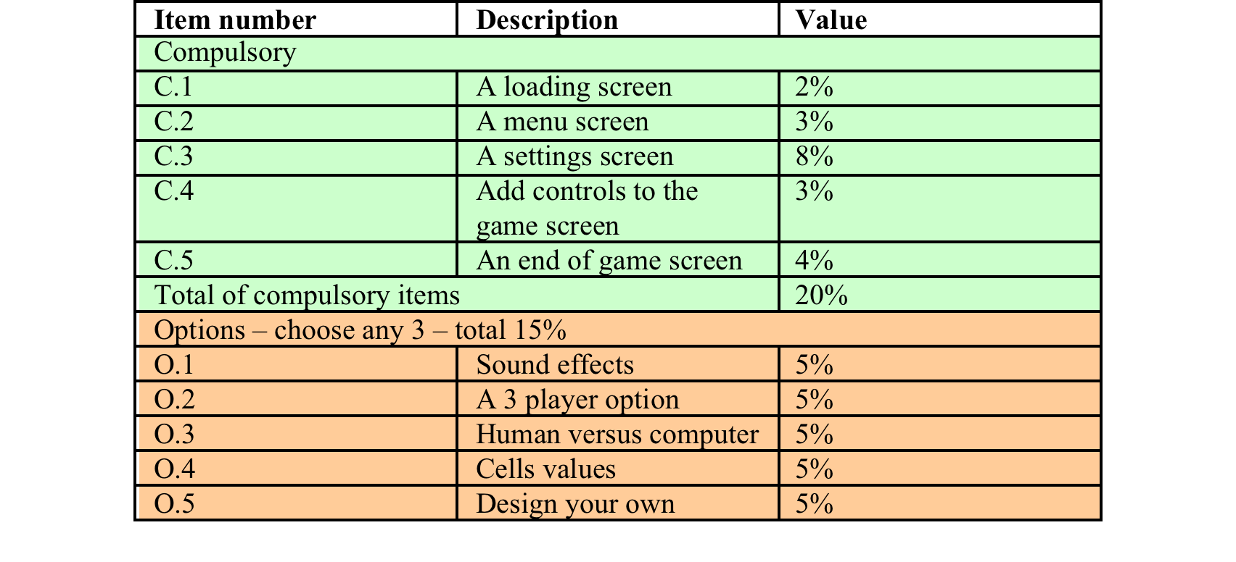
Syndicate Exercise - Project as Scrum
Let us treat the project requirements as the Product Backlog:

Slide 14
Roles
Who would be the Product Owner?
Who would be the Development Team?
Who would be the Scrum Master?
Notes:
Possible answers:
Not appropriate for this context! Closest thing might be the unit coordinator.
The project team
Could be any team member – becomes a kind of team leader – but more of a coach/facilitator

Slide 15
Sprints
What would be the sprints?
How long would each sprint take?
Notes:
Would seem natural to have one sprint per project requirement
If started early enough, this would mean about a week for each sprint.

Slide 16
Sprint planning
Attempt sprint planning for the first sprint
What can get done?
How will it get done?

Slide 17
How well would it work?
Imagine using Scrum for the project
daily scrums
weekly sprint review and retrospective
maintaining a product backlog and sprint backlogs
How well do you think this would work, and why?

