Slide 1
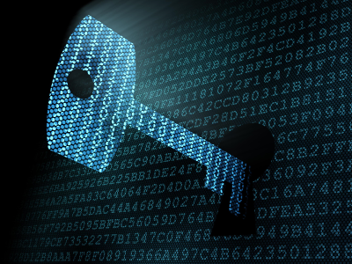
Cryptography
Computer Security
© ECU, 2005

Slide 2
Terminology
Encryption
To establish confidential communication over an insecure channel (such as the Internet)
Cipher
An algorithm for encryption or decrypting data
Plaintext
The original, readable message
Cipher text
The output of the encrypted plaintext message

Slide 3
Terminology
Cryptography
The creation and development of encryption
Cryptanalysis
The study of breaking encryption
Cryptology
Combination of Cryptography and Cryptanalysis

Slide 4


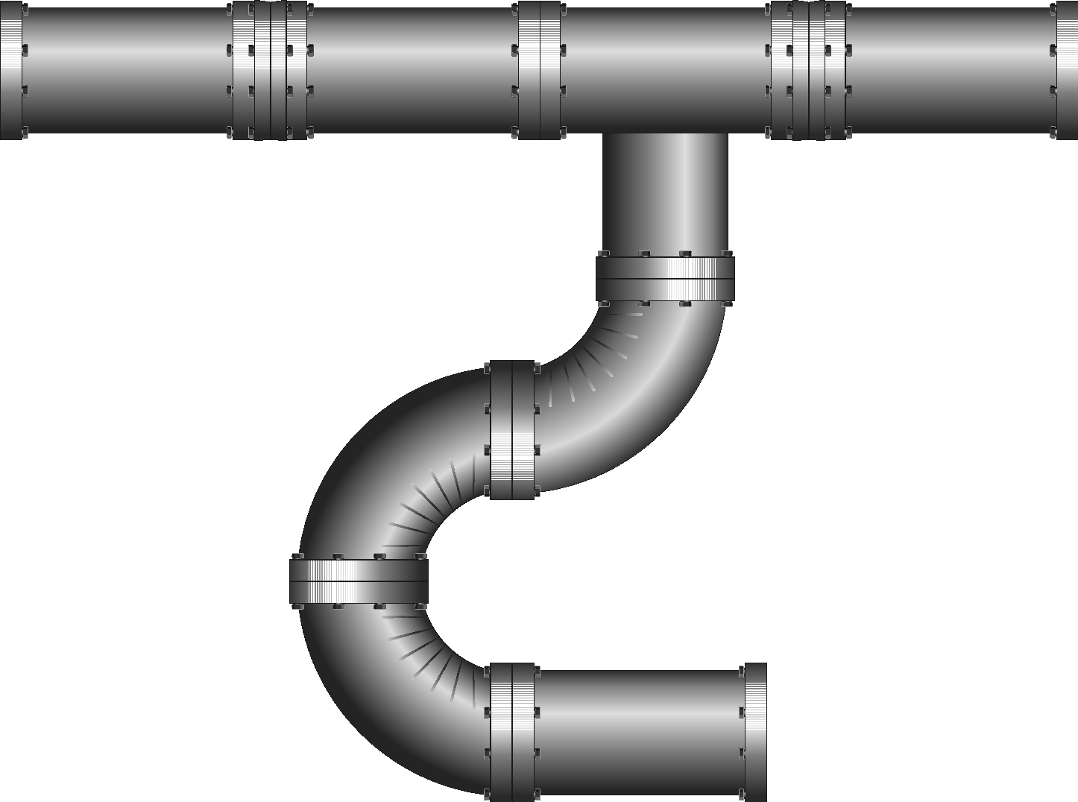

Why is Encryption is Important?
Alice
Bob
Eve

Slide 5
The Role of Cryptography
One of the most important and fundamental computer security tools
Used to hide the meaning of information or communication (confidentiality)
When sending highly sensitive documents
Undertaking banking online
When storing confidential organisational data

Slide 6
Codes and Ciphers
Codes
Replacing a phrase or message with a word or symbol
“be right back” could be replaced with “brb”
“attack at midnight” could be replaced with “aam”
Ciphers
Replacing individual characters, digits or bits
“be right back” could be replaced with “cf sjhiu cbdl”

Slide 7
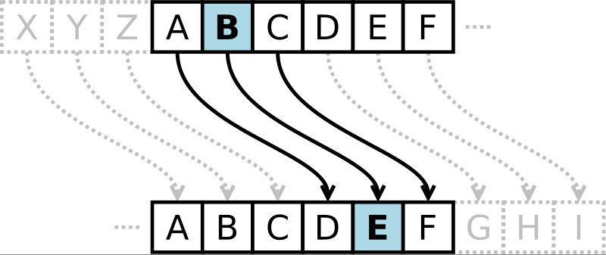
Caesar Cipher
Replace each letter with the one “three over” in the alphabet

Slide 8
Ciphers Categorised
Ciphers
Classical
Modern
Substitution
Transposition
Symmetric
Asymmetric
Stream
Block

Slide 9
Scenario
Alice wants to send a message (plaintext) to Bob
The Internet is insecure – eavesdropping
If Alice and Bob have previously agreed on a secret key and an encryption algorithm, Alice can use this key to encrypt the plaintext message and send the cipher text to Bob

Slide 10
Symmetric Encryption
Communication channel
Sender
Recipient
encrypt
decrypt
Cipher text
plaintext
plaintext
shared
secret
key
shared
secret
key
Attacker
(eavesdropping)

Slide 11
Symmetric Encryption
Same key is used for encryption and decryption
Simple mathematical operations
Well suited to for basic computer systems
Think of the key as a password that must be entered/used every time data is encrypted or decrypted

Slide 12
Symmetric Key Distribution Problem
Everyone needs to know the key!!!!
shared
secret
shared
secret
shared
secret
shared
secret
shared
secret
shared
secret

Slide 13
Symmetric Key Sharing
How do the sender and recipient share the key?
If it is emailed, it could be intercepted
Meeting in person is not always practical
A courier can not always be trusted
What if you no longer want an individual to be able to decrypt a message?
What if a key is leaked?

Slide 14
The problems inherent with symmetric key encryption can be solved through asymmetric based encryption…

Slide 15
Asymmetric Encryption
One key is used for encryption and another for decryption
Private key (recipients key)
Must be kept secret
Security of system relies on secrecy of this key
Public key
Can be given to anyone
Could be attached to emails
Published on a web page

Slide 16
Use of Asymmetric Keys
Recipient can give public key to anyone
Senders can then use recipient’s public key to encrypt messages
Recipient can use private key to decrypt message
Recipient has kept the key in their possession at all times
No secret information needs to be transmitted in an unencrypted form

Slide 17
Asymmetric Encryption
Communication channel
Sender
Recipient
encrypt
decrypt
plaintext
Cipher text
plaintext
plaintext
public
key
private
key
Attacker
(eavesdropping)

Slide 18
Block Ciphers
Plaintext/ciphertext have a fixed length b (e.g. 128 bits)
A plaintext of length n is partitioned into a sequence of m blocks, P[0], …, P[m−1], where n ≤ bm < n + b
Each message is divided into a sequence of blocks and encrypted or decrypted in terms of its blocks
Requires padding
with extra bits.
Plaintext
Blocks of
plaintext

Slide 19
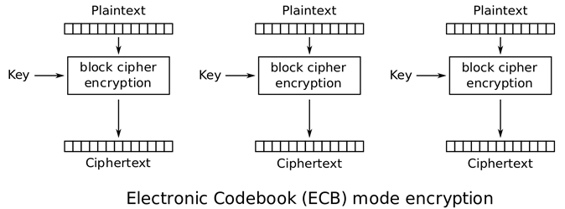
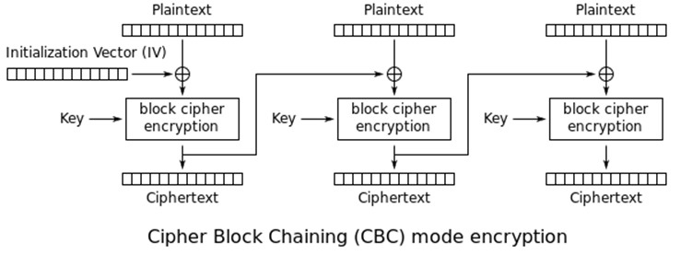
Block Cipher Mode of Operation (Examples)

Slide 20
Stream Cipher
Symmetric cryptosystem where cipher text C is obtained as the exclusive OR of the plaintext message M and a pseudo-random binary vector S generator from the secret key
Seed
Message
Cipher text
Key stream Generator
Key stream

Slide 21
Symmetric Block Ciphers – DES/3DES
Data Encryption Standard (DES)
Developed by IBM in 1977
64 bit blocks, 56 bit keys (+8 bits for parity)
Small key space make exhaustive attack possible
Triple DES (3DES)
Effective key length of 168 bits
Tried to resurrect DES, but computationally inefficient
Cipher text = E_{KC}(D_{KB}(E_{KA}(P)))

Slide 22
Symmetric Block Cipher - AES
Advanced Encryption Standard (AES)
Selected by NIST in 2001 through open international competition and public discussion
128-bit blocks
128, 192 and 256 bit key lengths
Exhaustive key search attack is not currently possible

Slide 23
Symmetric Stream Cipher – RC4
Rivest Cipher 4 designed by Ron Rivest from RSA Security in 1987
Used in SSL and WEP
Simple and computationally efficient
Key sizes range from 40 – 2048bits

Slide 24
Asymmetric Cipher RSA
Designed by Rivest, Shamir and Adelman (RSA)
It is easy to multiply 2 numbers and calculate a product, but difficult to take a product and determine all of its factors
Usually deals with very large prime numbers
Common key lengths are 512, 1024, 2048 or even 4096 bits

Slide 25
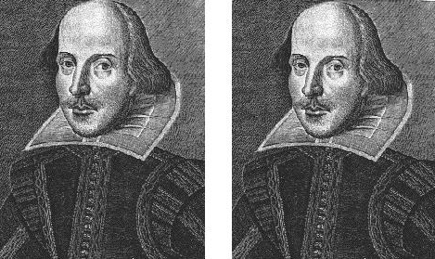
Steganography
Involves hiding data within data
A picture could be hidden in another picture
Messages do not attract the intention

Slide 26


Steganography cont…
The following bit sequence represents 1 pixel
Assuming we want to embed the message Aha! into the background of a picture
Notes:
http://www.computerworld.com/s/article/71728/How_It_Works

Slide 27
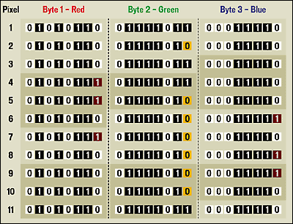
Steganography cont…
11 pixels in a picture had their LSB altered
You can embed data ~10% of file size
Each bit from the previous slide is included in the table above.
(Column 1, row 1), (Column 2, row 1), (Column 3, row 1) etc.

Slide 28
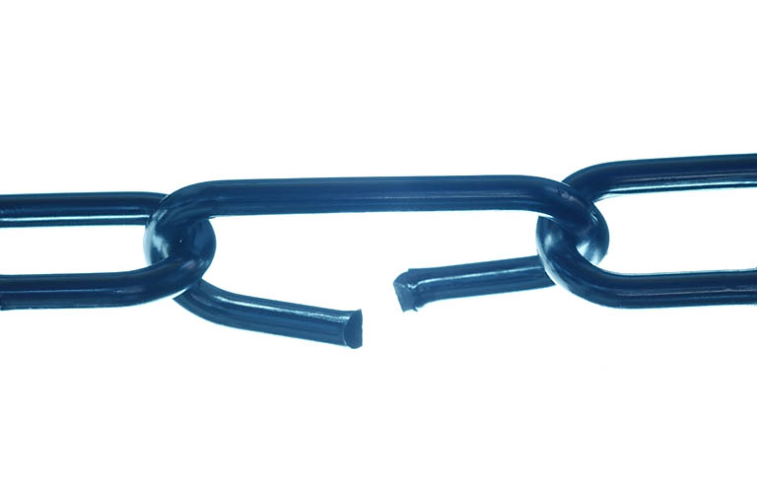
Attacking Crypto

Slide 29
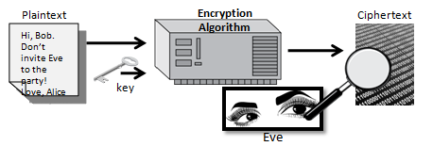
Cipher-text Only Attack (COA)
Cryptanalyst has access to the cipher text all of which were encrypted using the same key
The goal is to determine the plaintext
E.g. determine plaintext from “cf sjhiu cbdl”

Slide 30
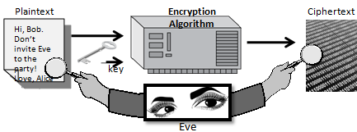
Known Plaintext Attack
The cryptanalyst has access to one or more original plaintext messages and the resultant cipher text
The goal is to determine the key

Slide 31
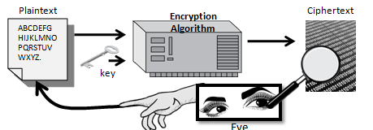
Chosen Plaintext Attack
Cryptanalyst has access to the crypto system used
Introduces plaintext and monitor cipher text
The goal is to determine key and cipher

Slide 32
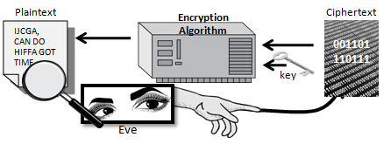
Chosen Cipher-text Attack
Cryptanalyst has access to the crypto system used
Introduces cipher-text and monitors plaintext
The goal is to determine key and cipher

Slide 33
Brute Forcing Symmetric Ciphers
Brute force attacks are also known as key space attack.
The keys pace is the set of all possible keys for a given cipher
The key space possibilities are determined by the key length
Bits | 2^x | Combinations
1 | 2^1 | 2
2 | 2^2 | 4
3 | 2^3 | 8
4 | 2^4 | 16
5 | 2^5 | 32
6 | 2^6 | 64
7 | 2^7 | 128
8 | 2^8 | 256
9 | 2^9 | 512

Slide 34
Some Basic Probability
In terms of cryptography, we often talk about some very large numbers
But how big are some of these numbers?
Take DES for example…
DES has 56 effective bits in its key length 2⁵⁶ = ~72 quadrillion keys
If you reached into this “key space” and selected a random key, what would is the probability of obtaining the correct decryption key?

Slide 35
Some sense of scale in numbers
Odds of being killed by lightening (per day) | 1 in 2³³
Odds of winning major prize in US state lottery | 1 in 2²²
Odds of winning lottery and being killed by lightening on same day | 1 in 2⁵⁵
Time until sun goes nova | 2³⁰ years
Estimated age of universe | 2³⁴ years
Number of atoms in planet | 2¹⁷⁰
Number of atoms in sun | 2¹⁹⁰
Number of atoms in galaxy | 2²²³
Number of atoms in universe | 2²⁶⁵
Volume of Universe | 2²⁸⁰ cm²
(Schneier, 1996)

Slide 36
Brute Force Attacks
You systematically test every key until the correct key is found
A brute force attack has a 100% chance of being successful – given enough time
Or you can now pre-compute them and store them in binary form known commonly as rainbow tables

Slide 37
DES Brute Force Example
If we could do 1 test every millisecond (1000/second)
72,057,594,037,927,936 keys
72,057,594,037,928 seconds
1,200,959,900,632 minutes
20,015,998,343 hours
833,999,930 days
2,284,931 years to go through the entire key space

Slide 38
DES Challenge 1
Initiated in late 1997
Four months later the message was deciphered
Involved thousands of Internet connected PCs
Less than 25% of the keyspace was searched when the correct key was found
Key was found by a Pentium 90 PC

Slide 39
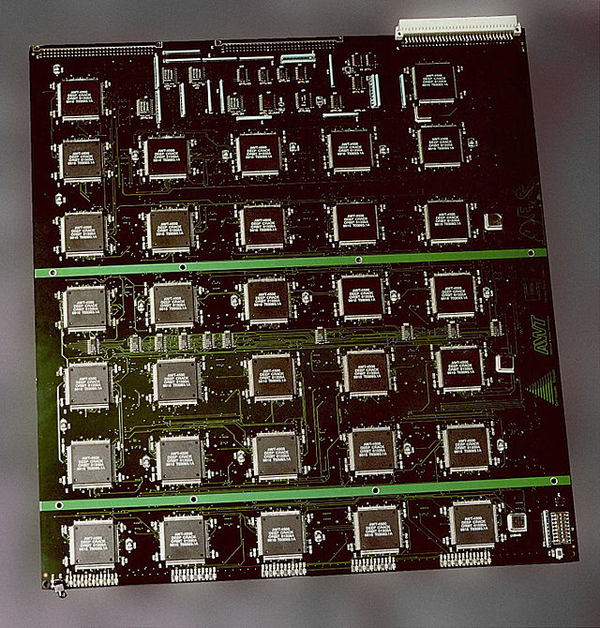
DES Challenge 2
Won be a device built by the Electronic Frontiers Foundation (EFF)
Custom built multiprocessor system
Device was built by July 17th, 1998
Cost $250,000 USD to build
Cracked DES message in 3 days
Won $10,000 USD prize

Slide 40
Cracking AES?
According to NIST…
If you had a machine that could crack DES in 1 second, it would take that machine 149 trillion years to crack 128 bit AES
That assumes computing power remains constant for the next 149 trillion years

Slide 41
Brute Forcing Asymmetric Algorithms
Brute forcing asymmetric ciphers such as RSA usually relies on being able to factor very large prime numbers
It is easy to multiply two numbers to get a product, but considerably more difficult to start with the product and determine all of its factors

Slide 42
Brute Forcing Asymmetric Ciphers
However
Some clever mathematician could come up with a revolutionary new way of factoring numbers
There is always the possibility that a breakthrough in mathematics could render current forms of encryption vulnerable

Slide 43
Traffic Analysis
However, even if the content of the messages is not known, patterns of communication might convey information
The number and timing of transmitted messages might convey certain information even if the content of the messages is not known

Slide 44
Encryption in Practice
Enough about algorithms and theory, what about the practicalities?

Slide 45
Poor Uses of Encryption
The way in which a crypto system is used could be a weakness
You encrypt your confidential documents but leave plain text copies on your hard disk!
You have implemented the same password/key for all your accounts, encryption programs etc.

Slide 46
Does trust exist in encryption?
Can we trust our encryption software?
Do Governments or other agencies have a vested interest in stopping us from using encryption….
Backdoors
‘Master’ decryption keys
Which is more ‘trustworthy’?
Commercial or open source software?
Freeware/shareware?

Slide 47
Encryption Related Social Issues
It can and is used to cover up any number of criminal or malfeasant acts
Illegal activity - drug/arms deals, terrorist activities
Trade in illegal digital material such as child pornography
Theft of intellectual property
Extortion i.e. encryption of a victims device

Slide 48
