Slide 1
Understanding Operating Systems Sixth Edition
Chapter 4 Processor Management

Slide 2
Learning Objectives
After completing this chapter, you should be able to describe:
The difference between job scheduling and process scheduling, and how they relate
The advantages and disadvantages of process scheduling algorithms that are preemptive versus those that are nonpreemptive

Slide 3
Learning Objectives
The goals of process scheduling policies in single-core CPUs
Up to six different process scheduling algorithms
The role of internal interrupts and the tasks performed by the interrupt handler

Slide 4
Overview
Single-user systems (two states)
Busy state: executing a job
Idle state: all other times
Simple processor management
Program (job)
Inactive unit
File stored on a disk
A unit of work submitted by a user
Not a process

Slide 5
Overview
Process (task)
Active entity
Requires resources to perform function
Processor and special registers
Executable program single instance
Thread
Portion of a process
Runs independently
Processor
Central processing unit (CPU)
Performs calculations and executes programs

Slide 6
Overview
Multiprogramming environment
Processor allocated for a time period
Deallocated at appropriate moment: delicate task
Interrupt
Call for help
Activates higher-priority program
Context Switch
Saving job processing information when interrupted
Single processor
May be shared by several jobs (processes)
Requires scheduling policy and scheduling algorithm

Slide 7
About Multi-Core Technologies
Processor (core)
Located on chip
Multi-core CPU (more than one processor)
Dual-core, quad-core
Single chip may contain multiple cores
Multi-core engineering
Resolves leakage and heat problems
Multiple calculations may occur simultaneously
More complex than single core: discussed in Chapter 6

Slide 8
Job Scheduling Versus Process Scheduling
Processor Manager
Composite of two submanagers
Hierarchy between them
Job Scheduler: higher-level scheduler
Job scheduling responsibilities
Job initiation based on certain criteria
Process Scheduler: lower-level scheduler
Process scheduling responsibilities
Determines execution steps
Process scheduling based on certain criteria

Slide 9
Job Scheduling Versus Process Scheduling
Job Scheduler functions
Selects incoming job from queue
Places in process queue
Decides on job initiation criteria
Process scheduling algorithm and priority
Goal
Sequence jobs
Efficient system resource utilization
Balance I/O interaction and computation
Keep most system components busy most of time

Slide 10
Process Scheduler
Chapter focus
Process Scheduler functions
Determines job to get CPU resource
When and how long
Decides interrupt processing
Determines queues for job movement during execution
Recognizes job conclusion
Determines job termination
Lower-level scheduler in the hierarchy

Slide 11
Process Scheduler
Exploits common computer program traits
Programs alternate between two cycles
CPU and I/O cycles
Frequency and CPU cycle duration vary
General tendencies exists
I/O-bound job
Many brief CPU cycles and long I/O cycles (printing documents)
CPU-bound job
Many long CPU cycles and shorter I/O cycles (math calculation)

Slide 12
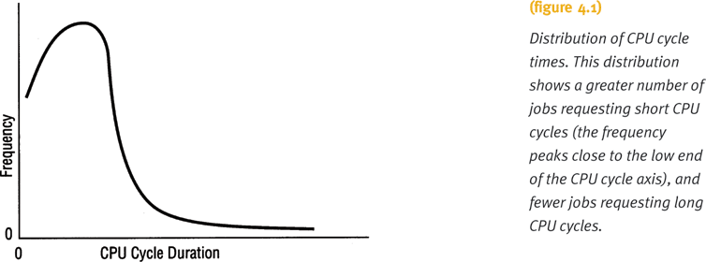
Process Scheduler
Poisson distribution curve
CPU cycles from I/O-bound and CPU-bound jobs

Slide 13
Process Scheduler
Middle-level scheduler: third layer
Found in highly interactive environments
Handles overloading
Removes active jobs from memory
Reduces degree of multiprogramming
Results in faster job completion
Single-user environment
No distinction between job and process scheduling
One job active at a time
Receives dedicated system resources for job duration

Slide 14
Job and Process Status
Jobs move through the system
Five states
HOLD
READY
WAITING
RUNNING
FINISHED
Called job status or process status

Slide 15
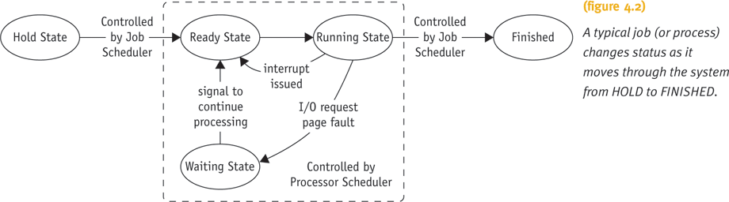
Job and Process Status

Slide 16
Job and Process Status
User submits job (batch/interactive)
Job accepted
Put on HOLD and placed in queue
Job state changes from HOLD to READY
Indicates job waiting for CPU
Job state changes from READY to RUNNING
When selected for CPU and processing
Job state changes from RUNNING to WAITING
Requires unavailable resources
Job state changes to FINISHED
Job completed (successfully or unsuccessfully)

Slide 17
Job and Process Status
Job Scheduler (JS) or Process Scheduler (PS) incurs state transition responsibility
HOLD to READY
JS initiates using predefined policy
READY to RUNNING
PS initiates using predefined algorithm
RUNNING back to READY
PS initiates according to predefined time limit or other criterion
RUNNING to WAITING
PS initiates by instruction in job

Slide 18
Job and Process Status
Job Scheduler (JS) or Process Scheduler (PS) incurs state transition responsibility (cont'd.)
WAITING to READY
PS initiates by signal from I/O device manager
Signal indicates I/O request satisfied; job continues
RUNNING to FINISHED
PS or JS initiates upon job completion
Satisfactorily or with error

Slide 19
Process Control Blocks
Data structure
Contains basic job information
What it is
Where it is going
How much processing completed
Where stored
How much time spent using resources

Slide 20
Process Control Blocks
Process Control Block (PCB) components
Process identification
Unique
Process status
Job state (HOLD, READY, RUNNING, WAITING)
Process state
Process status word register contents, main memory info, resources, process priority
Accounting
Billing and performance measurements
CPU time, total time, memory occupancy, I/O operations, number of input records read, etc.

Slide 21
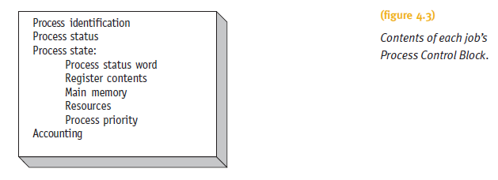
Process Control Blocks

Slide 22
PCBs and Queuing
Job PCB
Created when Job Scheduler accepts job
Updated as job executes
Queues use PCBs to track jobs
Contains all necessary job management processing data
PCBs linked to form queues (jobs not linked)
Manage queues using process scheduling policies and algorithms

Slide 23
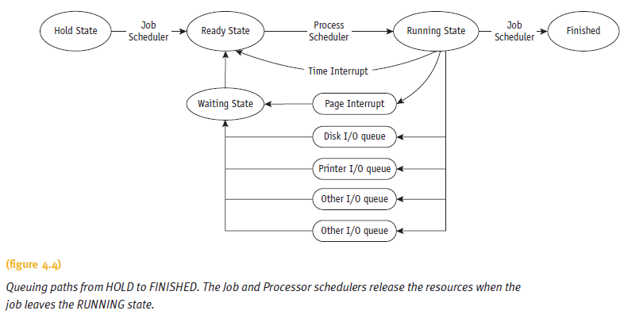
PCBs and Queuing

Slide 24
Process Scheduling Policies
Multiprogramming environment
More jobs than resources at any given time
Operating system pre-scheduling task
Resolve three system limitations
Finite number of resources (disk drives, printers, tape drives)
Some resources cannot be shared once allocated (printers)
Some resources require operator intervention (tape drives)

Slide 25
Process Scheduling Policies
Good process scheduling policy criteria
Maximize throughput
Run as many jobs as possible in given amount of time
Minimize response time
Quickly turn around interactive requests
Minimize turnaround time
Move entire job in and out of system quickly
Minimize waiting time
Move job out of READY queue quickly

Slide 26
Process Scheduling Policies
Good process scheduling policy criteria (cont'd.)
Maximize CPU efficiency
Keep CPU busy 100 percent of time
Ensure fairness for all jobs
Give every job equal CPU and I/O time
Final policy criteria decision in designer’s hands

Slide 27
Process Scheduling Policies
Problem
Job claims CPU for very long time before I/O request issued
Builds up READY queue and empties I/O queues
Creates unacceptable system imbalance
Corrective measure
Interrupt
Used by Process Scheduler upon predetermined expiration of time slice
Current job activity suspended
Reschedules job into READY queue

Slide 28
Process Scheduling Policies
Types of scheduling policies
Preemptive
Used in time-sharing environments
Interrupts job processing
Transfers CPU to another job
Non-preemptive
Functions without external interrupts
Infinite loops interrupted in both cases

Slide 29
Process Scheduling Algorithms
Base on specific policy
Allocate CPU and move job through system
Six algorithm types
First-come, first-served (FCFS)
Shortest job next (SJN)
Priority scheduling
Shortest remaining time (SRT)
Round robin
Multiple-level queues
Current systems emphasize interactive use and response time (use preemptive policies)

Slide 30
First-Come, First-Served
Non-preemptive
Job handled based on arrival time
Earlier job arrives, earlier served
Simple algorithm implementation
Uses first-in, first-out (FIFO) queue
Good for batch systems
Unacceptable in interactive systems
Unpredictable turnaround time
Disadvantages
Average turnaround time varies; seldom minimized

Slide 31
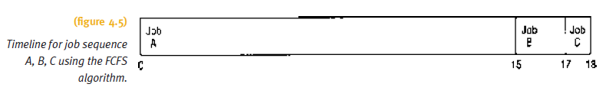
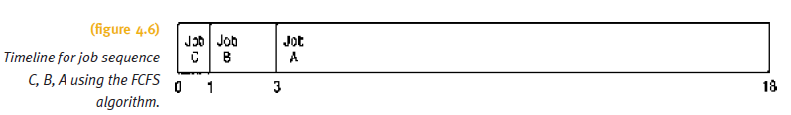
First-Come, First-Served

Slide 32
Shortest Job Next
Non-preemptive
Also known as shortest job first (SJF)
Job handled based on length of CPU cycle time
Easy implementation in batch environment
CPU time requirement known in advance
Does not work well in interactive systems
Optimal algorithm
All jobs are available at same time
CPU estimates available and accurate

Slide 33
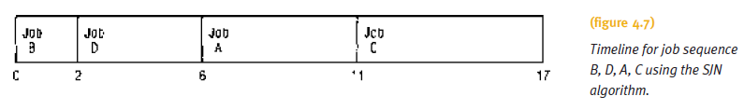
Shortest Job Next (cont'd.)

Slide 34
Priority Scheduling
Non-preemptive
Preferential treatment for important jobs
Highest priority programs processed first
No interrupts until CPU cycles completed or natural wait occurs
READY queue may contain two or more jobs with equal priority
Uses FCFS policy within priority
System administrator or Processor Manager use different methods of assigning priorities

Slide 35
Priority Scheduling
Processor Manager priority assignment methods
Memory requirements
Jobs requiring large amounts of memory
Allocated lower priorities (vice versa)
Number and type of peripheral devices
Jobs requiring many peripheral devices
Allocated lower priorities (vice versa)

Slide 36
Priority Scheduling
Processor Manager priority assignment methods (cont'd.)
Total CPU time
Jobs having a long CPU cycle
Given lower priorities (vice versa)
Amount of time already spent in the system (aging)
Total time elapsed since job accepted for processing
Increase priority if job in system unusually long time

Slide 37
Shortest Remaining Time
Preemptive version of SJN
Processor allocated to job closest to completion
Preemptive if newer job has shorter completion time
Often used in batch environments
Short jobs given priority
Cannot implement in interactive system
Requires advance CPU time knowledge
Involves more overhead than SJN
System monitors CPU time for READY queue jobs
Performs context switching

Slide 38
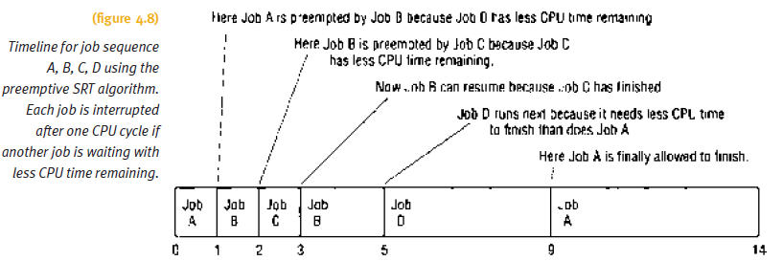
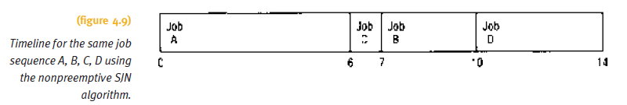
Shortest Remaining Time

Slide 39
Round Robin
Pre-emptive
Used extensively in interactive systems
Based on predetermined slice of time
Each job assigned time quantum
Time quantum size
Crucial to system performance
Varies from 100 ms to 1-2 seconds
CPU equally shared among all active processes
Not monopolized by one job

Slide 40
Round Robin
Job placed on READY queue (FCFS scheme)
Process Scheduler selects first job
Sets timer to time quantum
Allocates CPU
Timer expires
If job CPU cycle > time quantum
Job preempted and placed at end of READY queue
Information saved in PCB

Slide 41
Round Robin
If job CPU cycle < time quantum
Job finished: allocated resources released and job returned to user
Interrupted by I/O request: information saved in PCB and linked to I/O queue
Once I/O request satisfied
Job returns to end of READY queue and awaits CPU

Slide 42
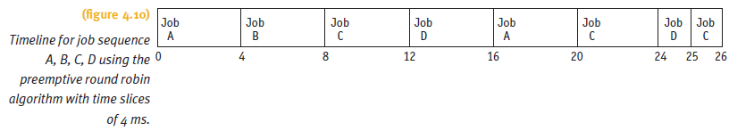
Round Robin (cont'd.)

Slide 43
Round Robin
Efficiency
Depends on time quantum size
In relation to average CPU cycle
Quantum too large (larger than most CPU cycles)
Algorithm reduces to FCFS scheme
Quantum too small
Context switching occurs
Job execution slows down
Overhead dramatically increased

Slide 44
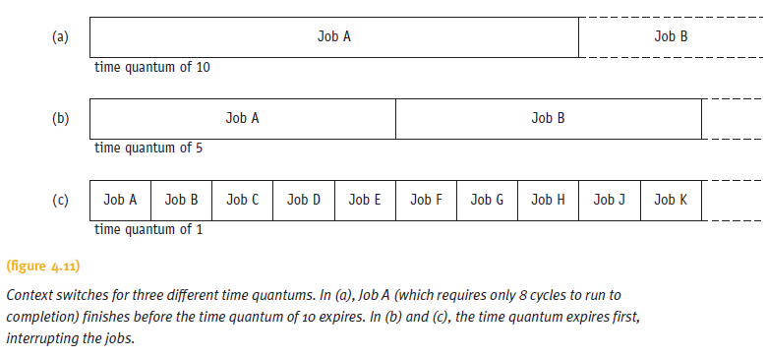
Round Robin

Slide 45
Round Robin
Best quantum time size
Depends on system
Interactive: response time key factor
Batch: turnaround time key factor
General rules of thumb
Long enough for 80% of CPU cycles to complete
At least 100 times longer than context switch time requirement

Slide 46
Multiple-Level Queues
Works in conjunction with several other schemes
Works well in systems with jobs grouped by common characteristic
Priority-based
Different queues for each priority level
CPU-bound jobs in one queue and I/O-bound jobs in another queue
Hybrid environment
Batch jobs in background queue
Interactive jobs in foreground queue
Scheduling policy based on predetermined scheme
Four primary methods

Slide 47
Case 1: No Movement Between Queues
Simple
Rewards high-priority jobs
Processor allocated using FCFS
Processor allocated to lower-priority jobs
Only when high-priority queues empty
Good environment
Few high-priority jobs
Spend more time with low-priority jobs

Slide 48
Case 2: Movement Between Queues
Processor adjusts priorities assigned to each job
High-priority jobs
Initial priority favorable
Treated like all other jobs afterwards
Quantum interrupt
Job preempted
Moved to next lower queue
May have priority increased
Good environment
Jobs handled by cycle characteristics (CPU or I/O)
Interactive systems

Slide 49
Case 3: Variable Time Quantum Per Queue
Case 2 variation: movement between queues
Each queue given time quantum size
Size twice as long as previous queue
Fast turnaround for CPU-bound jobs
CPU-bound jobs execute longer and given longer time periods
Improves chance of finishing faster

Slide 50
Case 4: Aging
Ensures lower-level queue jobs eventually complete execution
System keeps track of job wait time
If too “old”
System moves job to next highest queue
Continues until old job reaches top queue
May drastically move old job to highest queue
Advantage
Guards against indefinite unwieldy job postponement
Major problem: discussed further in Chapter 5

Slide 51
A Word About Interrupts
Interrupt Types
Page interrupt (memory manager)
Accommodate job requests
Time quantum expiration interrupt
I/O interrupt
Result from READ or WRITE command issuance
Internal interrupt
Synchronous
Result from arithmetic operation or job instruction
Illegal arithmetic operation interrupt
Dividing by zero; bad floating-point operation

Slide 52
A Word About Interrupts
Interrupt Types (cont'd.)
Illegal job instruction interrupt
Protected storage access attempt
Interrupt handler
Control program
Handles interruption event sequence

Slide 53
A Word About Interrupts
Non-recoverable error detected by operating system
Interrupt handler sequence
Interrupt type described and stored
Interrupted process state saved
Interrupt processed
Processor resumes normal operation

Slide 54
Summary
Processor Manager allocates CPU among all users
Job Scheduler
Assigns job to READY queue
Based on characteristics
Process Scheduler
Instant-by-instant allocation of CPU
Scheduling algorithm is unique
Characteristics, objectives, and applications
System designer selects best policy and algorithm
After careful strengths and weaknesses evaluation

Slide 55
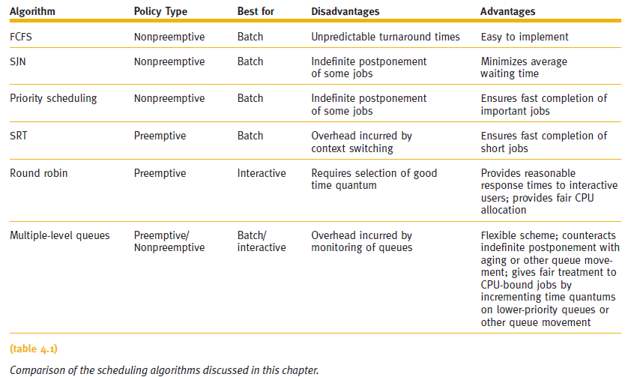
Summary

