Slide 1
CSG1207/CSI5135 Systems and Database Design
Lecture 05
Simple Database Queries & SQL Server Management Studio

Slide 2
Objectives
Introduction to SQL
Sample database (used in lectures and labs)
Simple SELECT statements
SQL Server 2008 & SQL Server Management Studio

Slide 3
Introduction to SQL
Last week, we covered…
Brief introduction to Structured Query Language (SQL)
What it is and what it is for
Variations in implementation of SQL between RDBMSs
Subsets of SQL, defined by their purpose
Data Definition Language (define/modify schemas)
Data Manipulation Language (select/insert/update/delete data)
Data Control Language (control user access and abilities)
Table creation and dropping commands (DDL)

Slide 4
History of SQL
SQL is a relational database language, which emerged in response to Edgar Codd’s 1970 paper which defined the relational database model
Prototype of SQL originally developed for IBM’s first relational database project, System R, in the 1970s
Relational Software Inc (now Oracle) developed the first commercially available implementation of SQL for Oracle V2
IBM then released commercially available RDBMSs with SQL support in the late 1970s and early 1980s
Various versions standardised by ANSI and ISO since 1986
Notes:
When it was developed for System R it was originally named SEQUEL, but this was changed to SQL as SEQUEL was already trademarked by an aircraft company. For what it’s worth, the original recognised standards of it define the official pronunciation of it as “es queue el”, not “sequel”.

Slide 5
Introduction to SQL
SQL is a set-oriented language
Can query multiple rows from one or more tables using just one statement (in contrast to record-oriented language, that processes one record at a time)
SQL is non-procedural
Statements/Commands describe what a user wants, rather than how a task is accomplished step by step
Opposite of imperative programming languages, where statements are used to accomplish a task step by step

Slide 6
Common SQL Commands
Here is a list of some common SQL commands…
Data Retrieval | SELECT
Data Manipulation Language (DML) | INSERT UPDATE DELETE
Data Definition Language (DDL) | CREATE DATABASE/TABLE ALTER DATABASE/TABLE DROP DATABASE/TABLE RENAME DATABASE/TABLE TRUNCATE TABLE
Transaction Control | BEGIN/SAVE TRANSACTION COMMIT ROLLBACK
Data Control Language (DCL) | CREATE/ALTER/DROP USER GRANT REVOKE

Slide 7
From Concept to Database
Model of system in client’s mind
Table model of the E-R model
(using data dictionary)
Types
RDBMS
Unit
Tenant
Physical E-R model of client’s model
(in 3NF or higher)
Tables on disk
in a RDBMS
Notes:
In the first four weeks, we’ve covered database design and modelling, which covers the first two stages of this diagram. The data dictionaries we discussed last week make it much easier to convert a design into an actual database.

Slide 8
ERD to Database Tables
Each entity in a physical ERD translates directly to a table
Entities (ERD)
Attribute(s)
Record(s)
Primary Key(s)
Foreign Key(s)
Tables (DB)
Column(s)
Row(s)
Primary Key(s)
Foreign Key(s)
Types
Unit
Tenant

Slide 9
Sample Database – “Company”
job_history
7
department
5
location
3
employee_id, start_date
department_id, job_id, …
department_id, manager_id,
location_id, …
location_id, country_id, …
dept. manager
dept. manager
job
4
employee
6
country
2
job_id, …
employee_id,
department_id, job_id, manager_id, …
country_id,
region_id, …
emp. manager
job_grade
8
region_id, …
region
1
grade_level, …
job_grade has no FKs – creation order not important
The relationship in red is added after creation and population to prevent issues with circular references
Notes:
The job_grade table is something that we’ve added to the database after creation – it has no FK relationships with other tables, so it doesn’t matter at what stage it is created.
It is possible to create a self-referencing relationship when creating a table, but the two relationships between department and employee cannot be created when the tables are created since the foreign keys each require the other to already exist.
To get around this, we’ll create one of the relationships and not the other – just creating the table with the FK column but without declaring it as a FK. We can then declare the FK relationship after that.
(In reality, we’re going to wait until we’ve inserted our sample data before declaring the relationship, otherwise it would require optional relationships, NULL values, inserts followed by updates, etc...)

Slide 10
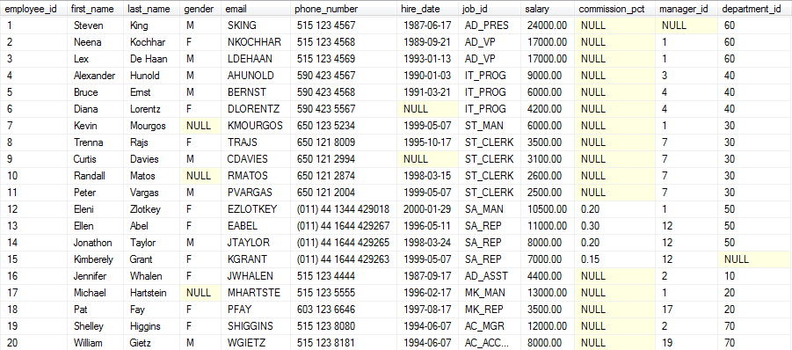
The Company Database
employee

Slide 11
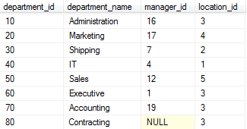
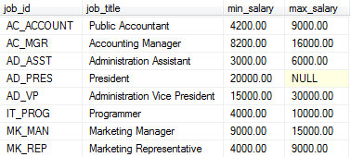
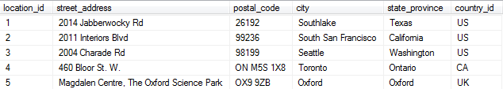
The Company Database
department
job
location

Slide 12
Relational Database Terminology Recap
Table (Relation).
Row (Record).
Column (Attribute).
Primary Key.
Foreign Keys.
Field.
Null (No Value).

Slide 13
Capabilities of SELECT Statement
Projection
Selection
(select certain cols)
(select certain rows)
FK
PK
Join two tables via keys
Notes:
Capabilities of SQL SELECT Statements
A SELECT statement retrieves information from the database. Using a SELECT statement, you can do the following:
Projection: You can use the projection capability in SQL to choose the columns in a table that you want returned by your query. You can choose as few or as many columns of the table as you require.
Selection: You can use the selection capability in SQL to choose the rows in a table that you want returned by a query. You can use various criteria to restrict the rows that you see.
Joining: You can use the join capability in SQL to bring together data that is stored in different tables by creating a link between them. You learn more about joins in a later lesson.
Selection and projection are often considered horizontal and vertical partitioning.

Slide 14
Basic SELECT Statement: Syntax
Basic SELECT Statements
SELECT *|{[DISTINCT] column|expression [alias],...}
FROM table
[WHERE Conditions];
SELECT clause identifies which column(s)
FROM clause identifies which table(s)
WHERE clause identifies which row(s)
Where clause is optional
Only those rows whose values make the conditions true will be returned

Slide 15
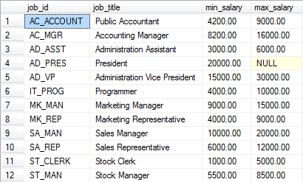
Selecting all columns
SELECT *
FROM job;
Grid format result:
Text format result:
job_id job_title min_salary max_salary
---------- ------------------------------ ------------ -----------
AC_ACCOUNT Public Accountant 4200.00 9000.00
AC_MGR Accounting Manager 8200.00 16000.00
AD_ASST Administration Assistant 3000.00 6000.00
AD_PRES President 20000.00 NULL
AD_VP Administration Vice President 15000.00 30000.00
IT_PROG Programmer 4000.00 10000.00
MK_MAN Marketing Manager 9000.00 15000.00
MK_REP Marketing Representative 4000.00 9000.00
SA_MAN Sales Manager 10000.00 20000.00
SA_REP Sales Representative 6000.00 12000.00
ST_CLERK Stock Clerk 1000.00 5000.00
ST_MAN Stock Manager 5500.00 8500.00
(12 row(s) affected)

Slide 16
Selecting Specific Columns
SELECT job_id, max_salary
FROM job;
job_id max_salary
---------- ----------
AC_ACCOUNT 9000.00
AC_MGR 16000.00
AD_ASST 6000.00
AD_PRES NULL
AD_VP 30000.00
IT_PROG 10000.00
MK_MAN 15000.00
MK_REP 9000.00
SA_MAN 20000.00
SA_REP 12000.00
ST_CLERK 5000.00
ST_MAN 8500.00
(12 row(s) affected)

Slide 17
Guideline for writing SQL statements
General Guidelines for Writing SQL
Goals: correct syntax, readability and easy to edit
SQL statements are not case sensitive
SQL statements can be on one or more lines
Keywords cannot be abbreviated or split across lines
Keywords are typically entered in UPPERCASE
New clauses are usually placed on separate lines
Indents are used to enhance readability

Slide 18
Arithmetic Expressions
Can create expressions with number and date data by using arithmetic operators.
Add (+), subtract (-), multiply (*) and divide (/)
Other operators exist, but these are the most common
Operator Precedence:
Multiplication and division take priority over addition and subtraction
Operators of the same priority are evaluated from left to right
Parentheses are used to prioritise evaluation and to clarify statements

Slide 19
Arithmetic Expressions
SELECT job_id, min_salary, max_salary, max_salary*1.05
FROM job;
No column name
for “max_salary*1.05”
job_id min_salary max_salary
---------- ----------- ----------- ------------
AC_ACCOUNT 4200.00 9000.00 9450.000000
AC_MGR 8200.00 16000.00 16800.000000
AD_ASST 3000.00 6000.00 6300.000000
AD_PRES 20000.00 NULL NULL
AD_VP 15000.00 30000.00 31500.000000
IT_PROG 4000.00 10000.00 10500.000000
MK_MAN 9000.00 15000.00 15750.000000
MK_REP 4000.00 9000.00 9450.000000
SA_MAN 10000.00 20000.00 21000.000000
SA_REP 6000.00 12000.00 12600.000000
ST_CLERK 1000.00 5000.00 5250.000000
ST_MAN 5500.00 8500.00 8925.000000
(12 row(s) affected)

Slide 20
Arithmetic Expressions
SELECT job_id, min_salary, max_salary, max_salary*1.05
FROM job;
A NULL is a value that is unavailable, unassigned, unknown, or inapplicable
A null is not the same as zero or a blank space
Arithmetic expressions containing a null value evaluate to null
job_id min_salary max_salary
---------- ----------- ----------- ------------
AC_ACCOUNT 4200.00 9000.00 9450.000000
AC_MGR 8200.00 16000.00 16800.000000
AD_ASST 3000.00 6000.00 6300.000000
AD_PRES 20000.00 NULL NULL
AD_VP 15000.00 30000.00 31500.000000
IT_PROG 4000.00 10000.00 10500.000000
MK_MAN 9000.00 15000.00 15750.000000
MK_REP 4000.00 9000.00 9450.000000
SA_MAN 10000.00 20000.00 21000.000000
SA_REP 6000.00 12000.00 12600.000000
ST_CLERK 1000.00 5000.00 5250.000000
ST_MAN 5500.00 8500.00 8925.000000
(12 row(s) affected)

Slide 21
Column Aliases
A column alias:
Renames a column heading for the results of that query
Is useful with calculations and other situations where column names may be missing, unhelpful or ambiguous
Usual form is AS 'aliasname' after the column name
The AS is optional, but recommended for clarity
If the alias contains spaces or special characters, you must enclose it in single quotation marks
If the alias is a single word with no special characters, the quote marks can be omitted
Notes:
Column Aliases
When displaying the result of a query, SQL Server normally uses the name of the selected column as the column heading. This heading may not be descriptive and hence may be difficult to understand. You can change a column heading by using a column alias.
Specify the alias after the column in the SELECT list using a space as a separator. By default, alias headings appear in uppercase. If the alias contains spaces or special characters (such as # or $), or is case sensitive, enclose the alias in single quotation marks (' ').

Slide 22
Column Aliases
SELECT job_title AS Job, max_salary AS 'Pre-raise Maximum',
max_salary*1.05 AS 'Post-raise Maximum'
FROM job;
Job Pre-raise Maximum Post-raise Maximum
------------------------------ ------------------ ------------------
Public Accountant 9000.00 9450.000000
Accounting Manager 16000.00 16800.000000
Administration Assistant 6000.00 6300.000000
President NULL NULL
Administration Vice President 30000.00 31500.000000
Programmer 10000.00 10500.000000
Marketing Manager 15000.00 15750.000000
Marketing Representative 9000.00 9450.000000
Sales Manager 20000.00 21000.000000
Sales Representative 12000.00 12600.000000
Stock Clerk 5000.00 5250.000000
Stock Manager 8500.00 8925.000000
(12 row(s) affected)

Slide 23
Concatenation Operator (+)
Using “+” between text-based columns (e.g. CHAR or VARCHAR) joins them together - concatenation
SELECT job_id + job_title AS 'Job ID & Title'
FROM job;
Job ID & Title
------------------------------------
AC_ACCOUNTPublic Accountant
AC_MGRAccounting Manager
AD_ASSTAdministration Assistant
AD_PRESPresident
AD_VPAdministration Vice President
IT_PROGProgrammer
MK_MANMarketing Manager
MK_REPMarketing Representative
SA_MANSales Manager
SA_REPSales Representative
ST_CLERKStock Clerk
ST_MANStock Manager
(12 row(s) affected)
Notes:
Note: Using a + for concatenation is quite unique to SQL Server’s implementation of SQL (i.e. “T-SQL”). Most other database servers use a function named “CONCAT”, e.g.
SELECT CONCAT(job_id, job_title) AS 'Job ID & Title'
FROM job;

Slide 24
Concatenation Operator (+)
You can add other text to this in single quotes as needed
SELECT job_id + ' (' + job_title + ')' AS 'Job ID & Title'
FROM job;
Job ID & Title
-------------------------------------
AC_ACCOUNT (Public Accountant)
AC_MGR (Accounting Manager)
AD_ASST (Administration Assistant)
AD_PRES (President)
AD_VP (Administration Vice President)
IT_PROG (Programmer)
MK_MAN (Marketing Manager)
MK_REP (Marketing Representative)
SA_MAN (Sales Manager)
SA_REP (Sales Representative)
ST_CLERK (Stock Clerk)
ST_MAN (Stock Manager)
(12 row(s) affected)
Notes:
One of the most common uses of this is to concatenated a first name, a space and a surname together to create a full name, e.g.
SELECT first_name + ' '+ last_name AS 'full_name'
FROM employee;

Slide 25
Duplicate Rows & the DISTINCT Keyword
By default, a query will display all rows, including rows which contain the same values (i.e. duplicates)
SELECT job_id
FROM employee;
job_id
----------
AD_PRES
AD_VP
AD_VP
IT_PROG
IT_PROG
IT_PROG
ST_MAN
ST_CLERK
ST_CLERK
...
Notes:
Since we have 20 employees and only 12 different jobs, obviously some employees have the same job.
Hence, if we select the job_id column from the employee table we are going to get 20 rows of results, some of which will be the same as others.

Slide 26
Duplicate Rows & the DISTINCT Keyword
You can eliminate duplicate rows by using the DISTINCT keyword in the SELECT clause.
SELECT DISTINCT job_id
FROM employee;
job_id
----------
AC_ACCOUNT
AC_MGR
AD_ASST
AD_PRES
AD_VP
IT_PROG
MK_MAN
MK_REP
SA_MAN
SA_REP
ST_CLERK
ST_MAN
(12 row(s) affected)
Notes:
By adding DISTINCT to the query, we can eliminate the duplicates – we now have 12 rows in the results – the same as our number of jobs!
This has a variety of uses, but it is common to use it to “clean up” a set of results which, due to what they select and the way it is manipulated, can validly return multiple rows of the same data.

Slide 27
Summary of SELECT Basics
That covers the basics of the SELECT statement
Selecting all columns with *
Specifying which columns to select by column name
Arithmetic operators
Column aliases
The concatenation operator
Using the DISTINCT keyword to eliminate duplicates
These can all be combined in order to select something very specific from a table
In coming weeks, we will learn to specify criteria with the WHERE clause, and connect columns from different tables using joins

Slide 28
MS SQL Server 2008 Overview
MS SQL Server 2008 includes multiple components and services that makes it a comprehensive enterprise platform
Key Components:
Database Engine
Analysis Services
Integration Services
Replication Services
Reporting Services
Newer versions of SQL Server exist, but the implementation of SQL in the newer versions are almost identical to 2008
This unit focuses on the SQL, not the other server features
Service Broker
Native HTTP Support
.NET Common Language Runtime (SQL CLR)
Notification Services
Full-Text Search, and more!
Notes:
We’ll pretty much be using the database engine itself, and not really going into the other parts.
It’s worth noting that we’re using the “R2” version of SQL Server 2008, which was released in 2010.

Slide 29
SQL Server Management Studio (SSMS)
SSMS is an integrated database management and development environment for SQL Server
Developers can use it to
Create databases, tables and other objects
Change table structures and constraints
Create, execute and save scripts/queries
Manage databases, services and other components
Create database diagrams
SSMS
SQL Server
Notes:
SSMS is not “part of” the server itself. It is an application that connects to the server and provides users with an administrative/design/testing interface.
This is achieved by sending SQL statements to the server and processing the response received. E.g. If you use SMSS to create a table using the application’s GUI, the application turns what you specify into a CREATE TABLE statement and sends it to the server. The server processes the command and sends back its usual response – either a success or failure message. SSMS then shows you feedback based on that response – i.e. the new table, or an error message.
There are similar applications for different database servers, e.g. phpMyAdmin for web-based administration of MySQL, MySQL Workbench and HeidiSQL are similar to SSMS in that they are desktop applications (for MySQL administration)…

Slide 30
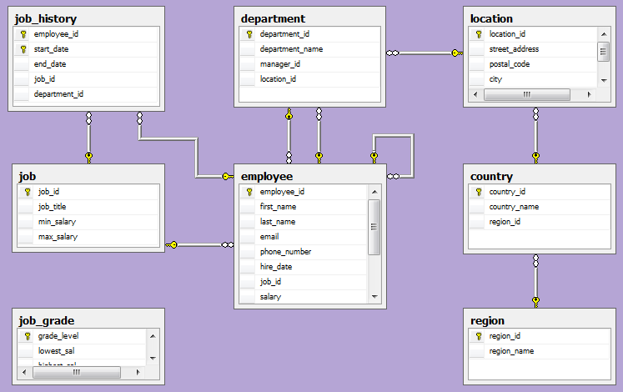
Company ER Diagram in SSMS
SSMS can generate database diagrams such as this...
Notes:
This diagram was generated after running the creation script for the Company database.
As you can see, the database which is implemented is the same as the one depicted in the ER diagram.
Generating an ER diagram in SSMS is a great way of confirming that what you’ve implemented in SQL Server is the same as what you designed.

Slide 31
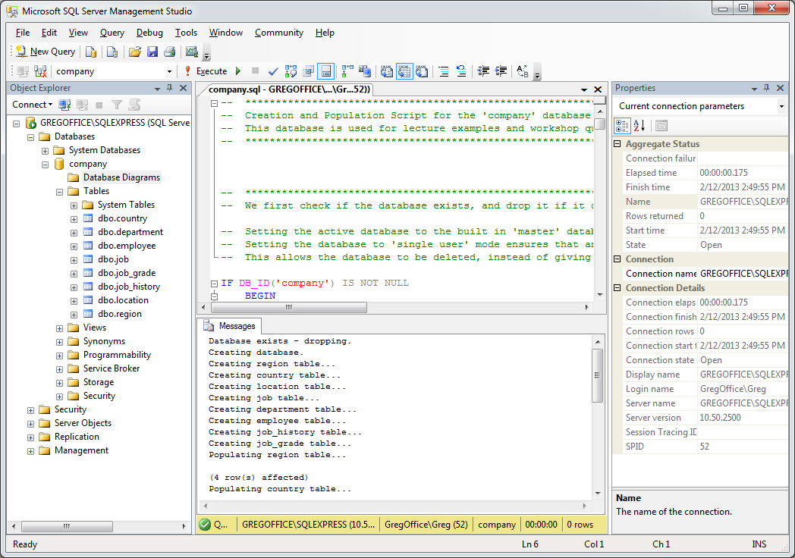
SQL Server Management Studio (SSMS)
Working Area
Query Results
Object
Explorer
Notes:
The first thing I normally do is close the Properties section on the right – it typically won’t contain anything useful to us at this level and hogs precious screen space. You can always bring it back if needed.

Slide 32
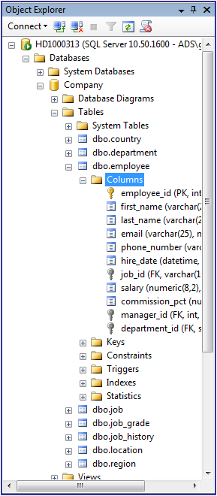
SSMS – Object Explorer
The left menu is the Object Explorer
Browse, access and manage all
objects (tables, databases, etc)
on the server
Refresh button may be needed
before new items show up
Right click on objects for menu
of useful/common commands
Right click on a table (or view)
to select or edit its contents
Right click on column to edit data
type, length, null, etc
Notes:
By expanding the relevant part of the Object Explorer, you can examine just about anything in the database structure and objects.
Right clicking on something will give you plenty of options such as selecting or editing the content of a table.
Always remember to Refresh.

Slide 33
SSMS – Useful Toolbar Items
Many of the toolbar buttons are very useful, but here are a few you will probably use the most frequently
Some toolbars will only appear while working on a query
Hover over other buttons to see tooltip about their purpose
Note: If you have some text selected in your query, only the selected text will be executed when you press the execute button
Open new query
window in work area
Save the active window
in the work area
Select active database
Run (selected part
of or whole) query
Show results as table or text

Slide 34
Starting SQL Server Management Studio
In ECU SCSS labs:
Find it by searching for it in the start menu and connect with the default settings (i.e. just press the connect button)
At home:
Follow the install/setup instructions in Blackboard
Download and install SQL Server 2008 R2 Express Edition
This is a free version of SQL Server 2008 R2
Make sure you install Management Studio Express
You may need to install other supporting software
Once installed, launch Management Studio and connect with the default settings
Once set up, you’re ready to play with some databases!

Slide 35
Summary
Introduction to SQL
Basics of the SELECT statement
Introduction to SQL Server and SQL Server Management Studio (SSMS)
From this week onwards the workshop sessions are labs, in which we work in SSMS

