Slide 1
CSP2108: Introduction to Mobile Applications Development
Module 11: Location

Slide 2
Topics this week
Location awareness
Location Handlers
Map Views
Networking

Slide 3
Location Awareness
Location awareness refers to devices that can passively or actively determine their location.
One of the special features of mobile devices is that they are, well, MOBILE!
That is, they can move from place to place
That wouldn’t be significant unless they were aware of their location and could make use of that information

Slide 4
Examples of mobile apps with location awareness
Pokemon GO!
more generally, virtual reality apps
Corona currently has no specific VR support
Apps that customise content etc. depending on location e.g. tourist guides
“who’s here” apps
Navigation apps
Corona has support for maps
Think of some more!

Slide 5
Location handlers
One way to make Corona apps location aware
Uses GPS /WiFi locations/ 3G/4G tower locations to estimate location

Slide 6
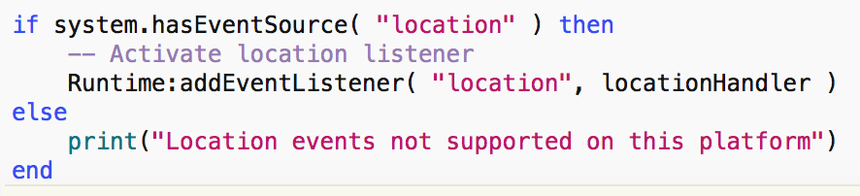
Adding a location handler
Notes:
https://docs.coronalabs.com/api/event/location/index.html

Slide 7
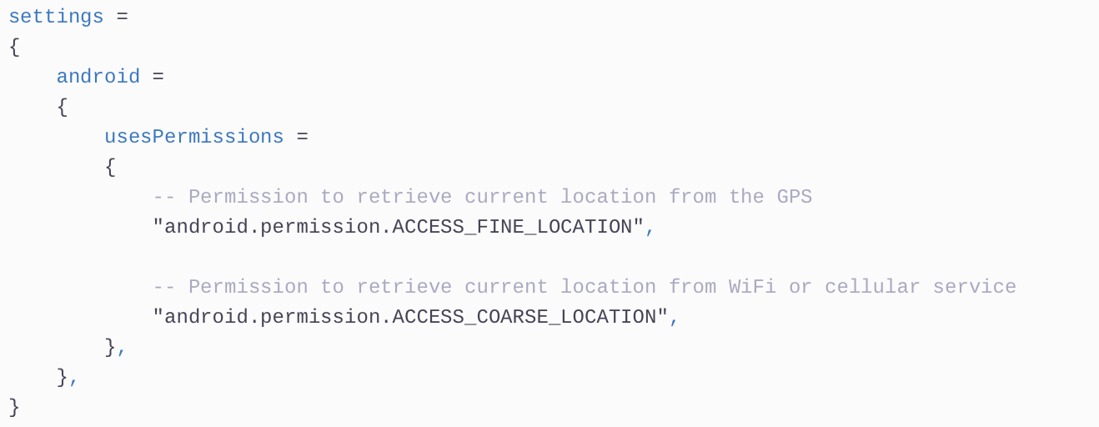
Android build settings for location events

Slide 8
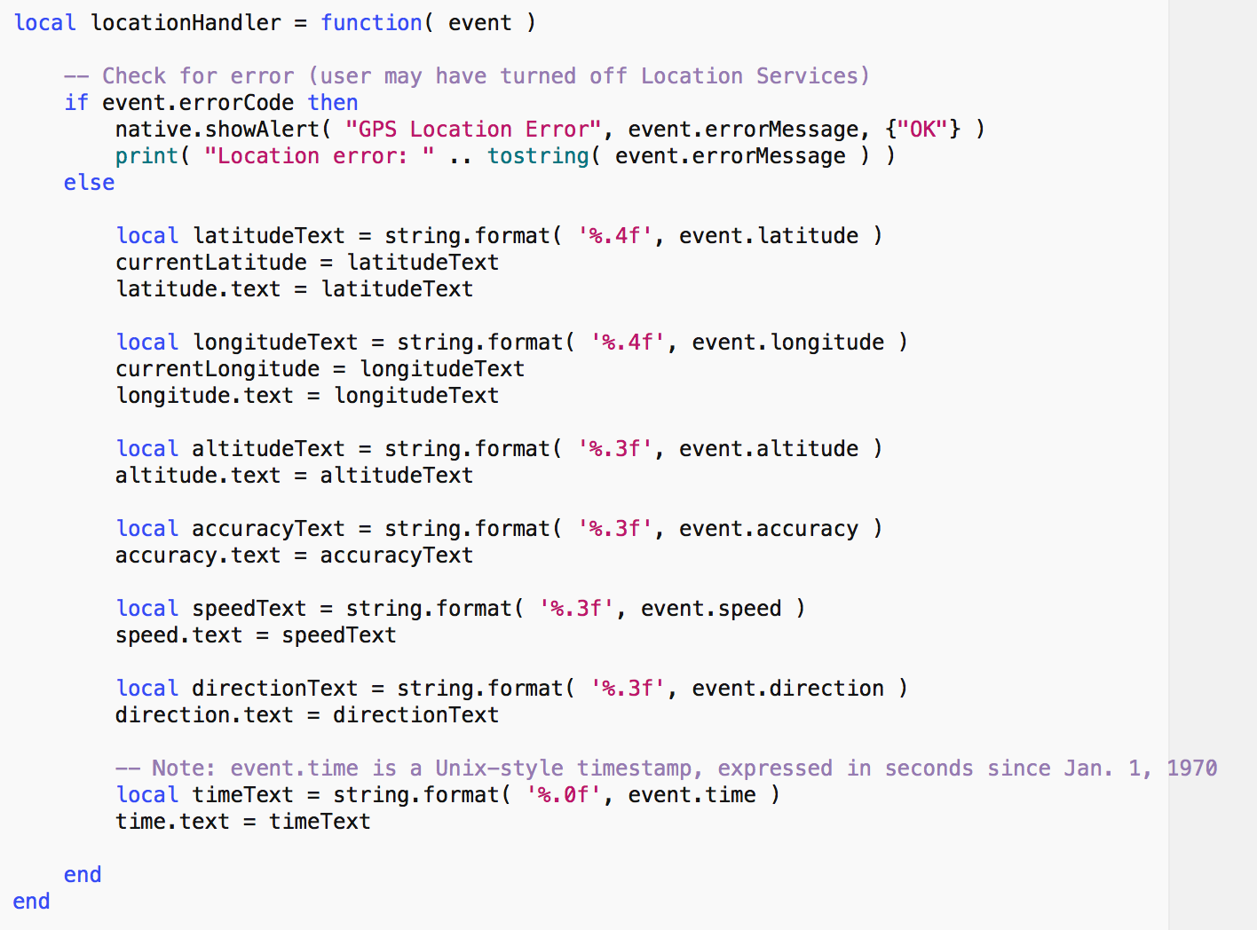
Example handler
latitude and longitude are in degrees.
1 degree is about 111 km
Notes:
Example from sample app Hardware/GPS

Slide 9
What about displaying?
For simple applications you can use a mapView
See https://docs.coronalabs.com/api/type/Map/index.html for details
Notes:
https://docs.coronalabs.com/api/type/Map/index.html

Slide 10
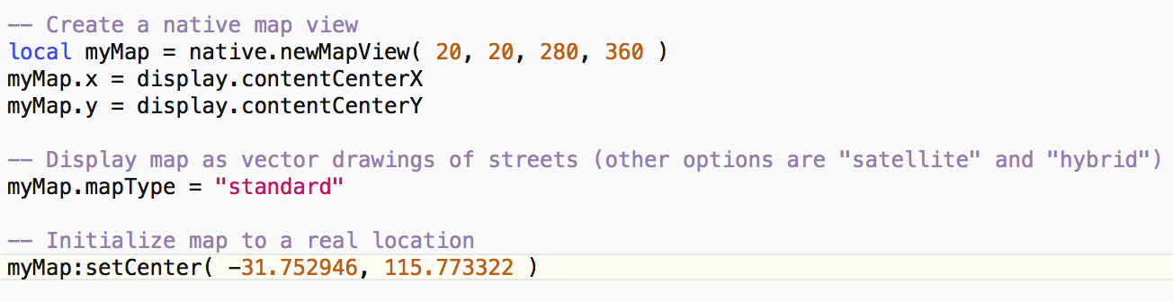
Corona’s mapView
Where is this???
Note: mapView doesn’t work in the simulator – test on a device
Notes:
https://docs.coronalabs.com/api/library/native/newMapView.html
https://docs.coronalabs.com/api/type/Map/index.html

Slide 11
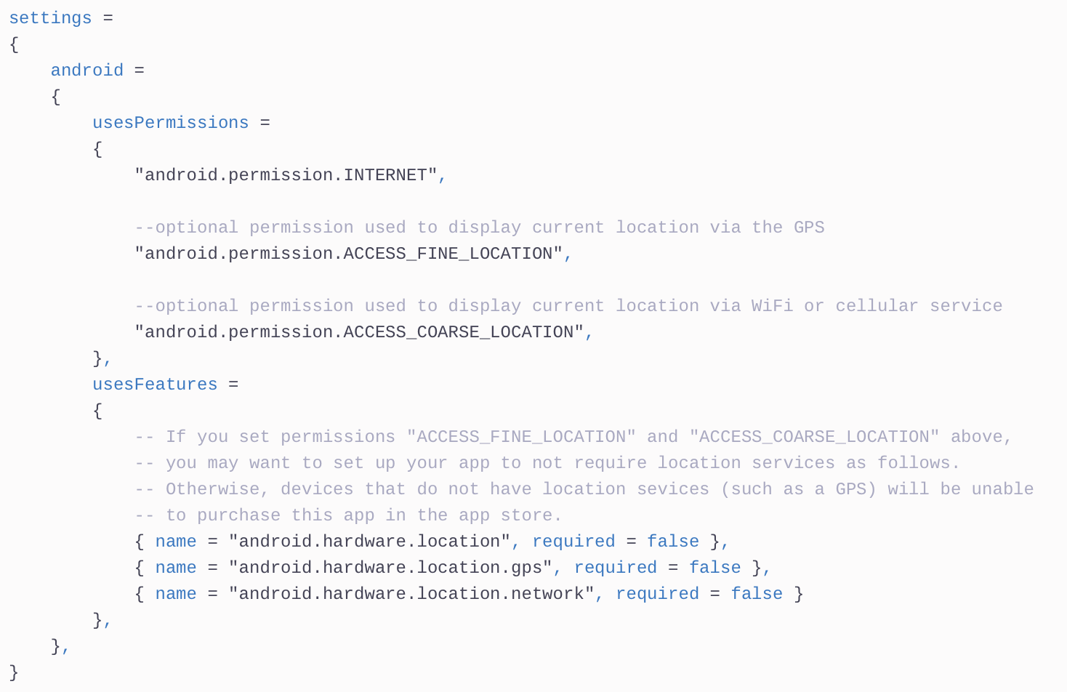
Android build.settings for mapView
See online docs for ioS settings

Slide 12
mapView events/listeners
marker listener – you can place markers and listen for the user tapping on them
map address listener can listen for
convert location description to latitude, longitude
convert latitude, longitude to description
map location listener can listen for user touches
can also get current (estimated) location

Slide 13
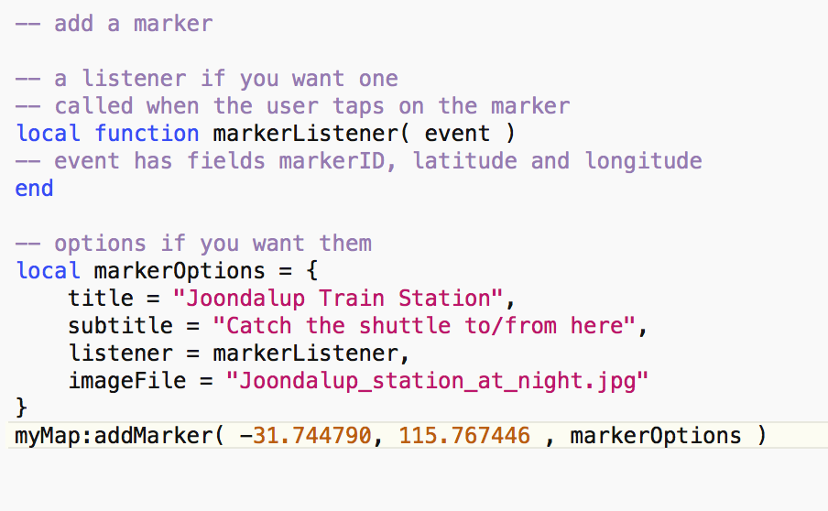
mapView : adding markers
Notes:
This doesn’t work on my Galaxy 5 (no marker shows)

Slide 14
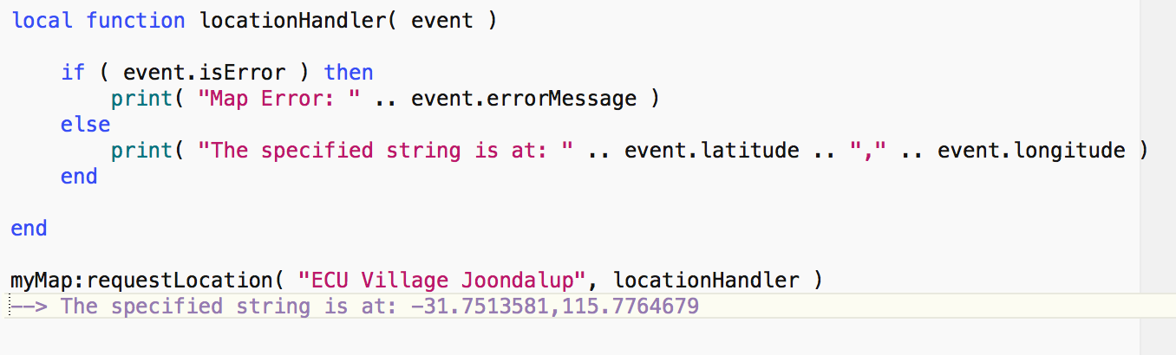
mapView : finding a location

Slide 15
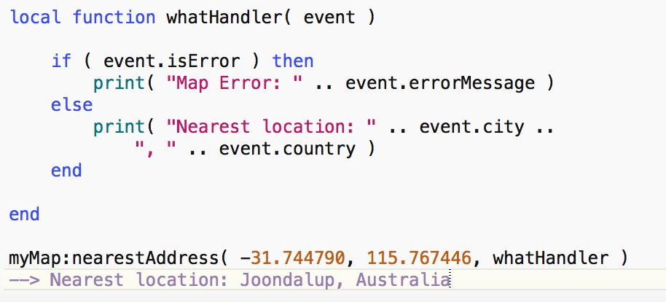
mapView: what’s here?

Slide 16
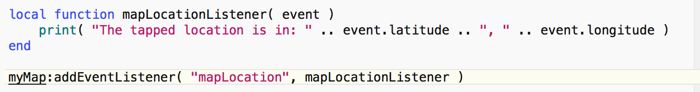
mapView : user touches

Slide 17
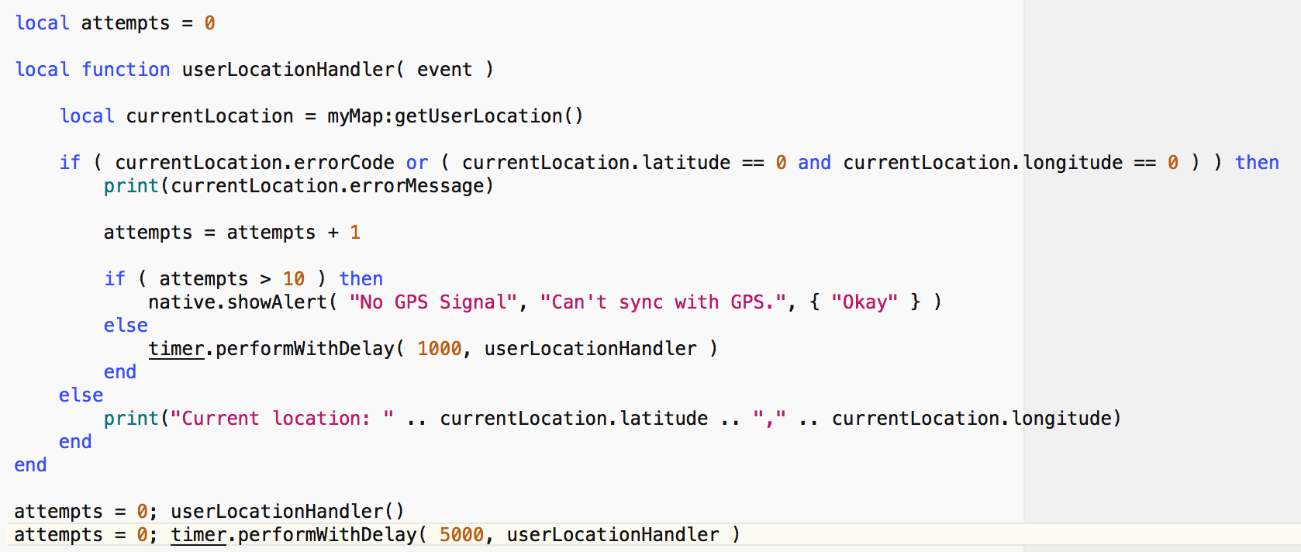
mapView : user’s location
Sample output:
Current location is unknown.
Current location is unknown.
Current location is unknown.
Current location is unknown.
Current location is unknown.
Current location is unknown.
Current location: -31.7096364,115.7912924
: Current location: -31.7096364,115.7912924

Slide 18
If you need more . . .
Another option: use a webView with
Google Maps APIs (https://developers.google.com/maps/documentation/), e.g.
Google Places API (https://developers.google.com/places/web-service/)
“The Google Places API Web Service is a service that returns information about places — defined within this API as establishments, geographic locations, or prominent points of interest — using HTTP requests.”
responds with JSON or XML
Google Map JavaScript API
use html files with JavaScript and a web listener
There are also
other web services that could be used
plug-ins
Notes:
http://www.w3schools.com/googleapi/google_maps_basic.asp
https://developers.google.com/places/web-service/
https://developers.google.com/maps/documentation/

