Slide 1
CSP2108: Introduction to Mobile Applications Development
Module 11: Networks

Slide 2
Topics this week
Location awareness
Location Handlers
Map Views
Networking
Notes:
https://docs.coronalabs.com/api/library/network/index.html
https://docs.coronalabs.com/api/library/socket/index.html#overview
https://rawgit.com/diegonehab/luasocket/master/doc/reference.html
https://coronalabs.com/blog/2015/11/17/tutorial-treasury-networking-with-corona-sdk/

Slide 3
Mobile apps and networks
Mobile apps very commonly use networking to
access remote information/content/data
store data remotely
create client/server apps
enable communication/sharing between users
do in-app purchases etc

Slide 4
Networking with Corona
There are at least three ways to carry out networking functions
system.openURL()
network library
sockets library
There are also specific libraries for using
Facebook
Apple Game Center / Google Play Game Services
Apple/Google/Amazon in-app-purchases
in-app advertising
We will cover these briefly – but network knowledge will not be expected or examined
We won’t cover these

Slide 5
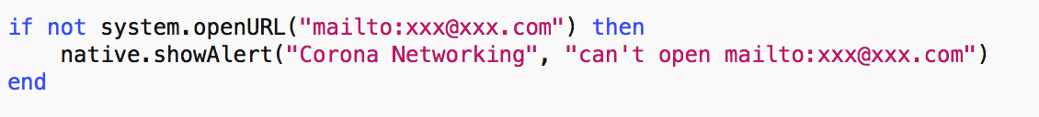
system.openURL()
This is one way to
open a page in a web browser:
send email:
dial a phone number:

Slide 6
network library
HTTP (Hypertext Transfer Protocol) is the main method of data communication on the World Wide Web (HTTPS is a more “secure”, encrypted variant)
Corona’s network library has functions to
network.request()
asychronous HTTP or HTTPS requests
network.download()
specialised version for downloads
network.upload()
specialised version for uploads

Slide 7
network.request()
network.request( url, method, listener [, params] )
url : e.g. http://www.coronalabs.com
method : http method – “GET”, “POST”, “HEAD”, “DELETE”, “PUT”
listener : function to call when done
params : various – see https://docs.coronalabs.com/api/library/network/request.html for details

Slide 8
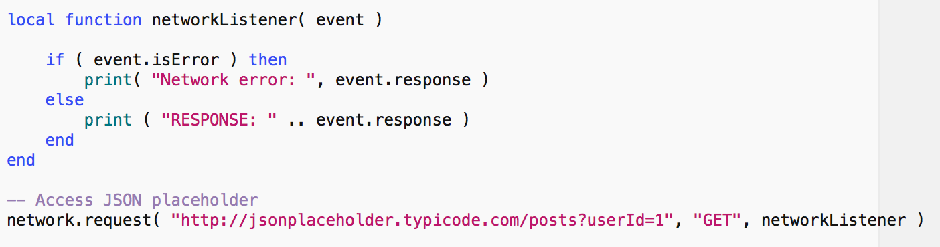
network.request() simple example
Asynchronous access: use a listener to wait for response
Simple “GET” – response will be in JSON format

Slide 9
JSON response
RESPONSE: [ { "userId": 1, "id": 1, "title": "sunt aut facere repellat provident occaecati excepturi optio reprehenderit", "body": "quia et suscipit\nsuscipit recusandae consequuntur expedita et cum\nreprehenderit molestiae ut ut quas totam\nnostrum rerum est autem sunt rem eveniet architecto" }, { "userId": 1, "id": 2, "title": "qui est esse", "body": "est rerum tempore vitae\nsequi sint nihil reprehenderit dolor beatae ea dolores neque\nfugiat blanditiis voluptate porro vel nihil molestiae ut reiciendis\nqui aperiam non debitis possimus qui neque nisi nulla" },
… there’s more!
]
Can then use json.decode() on response

Slide 10
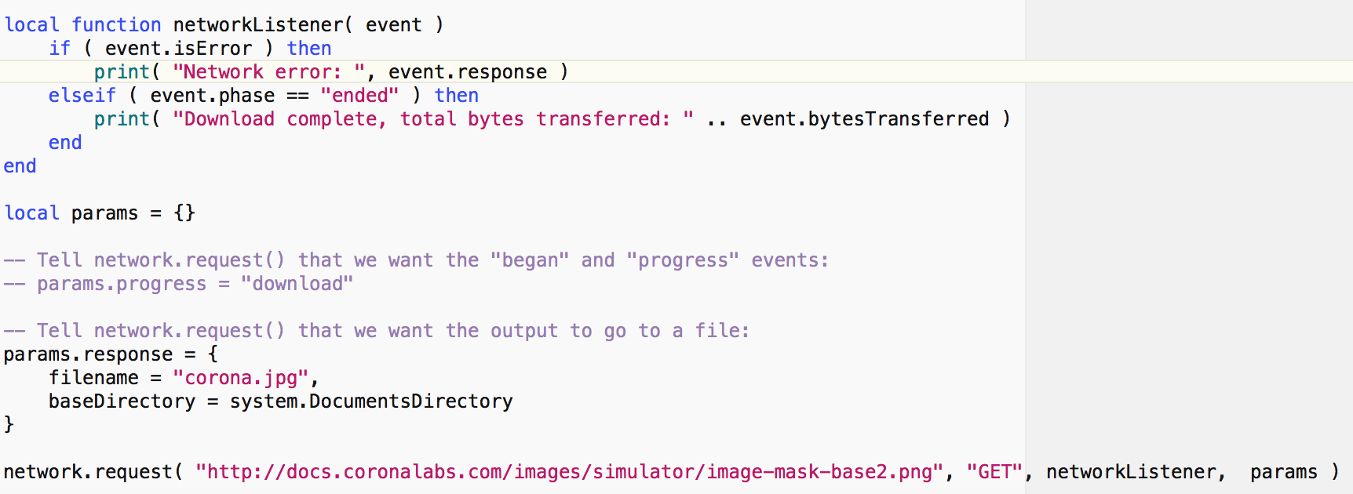
network.request() download
We have not done this, but you can get progress messages during download
Output: Download complete, total bytes transferred: 21530. The file will be found in the docs directory.

Slide 11
network.request()
Other examples on https://docs.coronalabs.com/api/library/network/request.html
http POST with custom headers
uploading a text file with POST
Upload and download examples also at
https://docs.coronalabs.com/api/library/network/upload.html
https://docs.coronalabs.com/api/library/network/download.html

Slide 12
Corona sockets
Finally, if you have some knowledge of networks/sockets, you could use the Corona sockets library, which is based on the LuaSocket libraries
Corona docs: https://docs.coronalabs.com/api/library/socket/index.html
LuaSocket docs: https://rawgit.com/diegonehab/luasocket/master/doc/reference.html

Slide 13
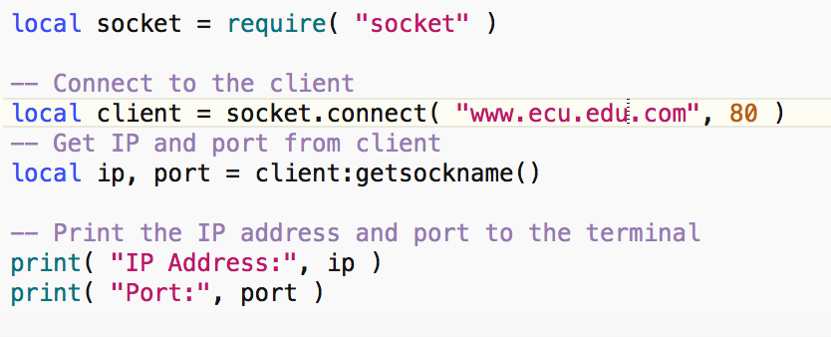
Corona sockets: just one example
Output:
IP Address: 10.1.1.234
Port: 50603

