Slide 1
Understanding Operating Systems Sixth Edition
Chapter 7
Device Management

Slide 2
Learning Objectives
After completing this chapter, you should be able to describe:
Features of dedicated, shared, and virtual devices
Differences between sequential and direct access media
Concepts of blocking and buffering and how they improve I/O performance
Roles of seek time, search time, and transfer time in calculating access time

Slide 3
Learning Objectives
Differences in access times in several types of devices
Critical components of the input/output subsystem, and how they interact
Strengths and weaknesses of common seek strategies, including FCFS, SSTF, SCAN/LOOK, C-SCAN/C-LOOK, and how they compare
Different levels of RAID and what sets each apart from the others

Slide 4
Types of Devices
Dedicated Devices
Device assigned to one job at a time
For entire time job is active (or until released)
Example: tape drives, printers, and plotters
Disadvantage
Inefficient if device is not used 100%
Allocated for duration of job’s execution
Shared Devices
Device assigned to several processes
Example: direct access storage device (DASD)
Processes share DASD simultaneously
Requests interleaved
Device manager supervision
Controls interleaving
Predetermined policies determine conflict resolution

Slide 5
Types of Devices
Virtual Devices
Dedicated and shared device combination
Dedicated devices transformed into shared devices
Example: printer
Converted by spooling program
Spooling
Speeds up slow dedicated I/O devices
Example: universal serial bus (USB) controller
Interface between operating system, device drivers, applications, and devices attached via USB host

Slide 6
Types of Devices
Storage media
Two groups
Sequential access media
Records stored sequentially
Direct access storage devices (DASD)
Records stored sequentially
Records stored using direct access files
Vast differences
Speed and sharability

Slide 7
Sequential Access Storage Media
Magnetic tape
Early computer systems: routine secondary storage
Today’s use: routine archiving and data backup
Records stored serially
Record length determined by application program
Record identified by position on tape
Record access
Tape mount
Fast-forwarded to record
Time-consuming process

Slide 8

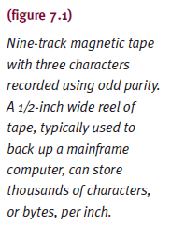
Sequential Access Storage Media
Tape density: characters recorded per inch
Depends upon storage method (individual or blocked)
Tape reading/writing mechanics
Tape moves under read/write head when needed

Slide 9
Sequential Access Storage Media
Interrecord gap (IRG)
½ inch gap inserted between each record
Same size regardless of records it separates
Blocking: group records into blocks
Transfer rate: (tape density) x (transport speed)
Interblock gap (IBG)
½ inch gap inserted between each block
More efficient than individual records and IRG

Slide 10
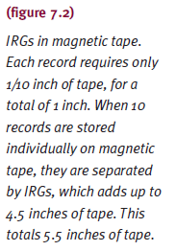

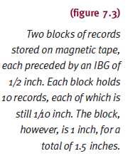

Sequential Access Storage Media

Slide 11
Sequential Access Storage Media
Blocking advantages
Fewer I/O operations needed
Less wasted tape
Blocking disadvantages
Overhead and software routines needed for blocking, deblocking, and record keeping
Buffer space wasted
When only one logical record needed

Slide 12
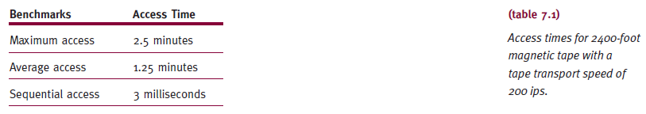
Sequential Access Storage Media
Advantages
Low cost, compact storage capabilities, good for magnetic disk backup and long-term archival
Disadvantages
Access time
Poor for routine secondary storage
Poor for interactive applications

Slide 13
Direct Access Storage Devices
Directly read or write to specific disk area
Random access storage devices
Four categories
Magnetic disks
Optical discs
Flash memory
Magneto-optical disks
Access time variance
Not as wide as magnetic tape
Record location directly affects access time

Slide 14
Fixed-Head Magnetic Disk Storage
Looks like a large CD or DVD
Covered with magnetic film
Formatted
Both sides (usually) in concentric circles called tracks
Data recorded serially on each track
Fixed read/write head positioned over data
Advantages
Fast (more so than movable head)
Disadvantages
High cost and reduced storage

Slide 15
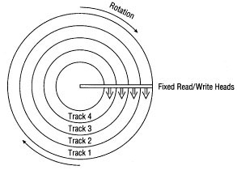
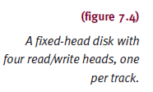
Fixed-Head Magnetic Disk Storage

Slide 16
Movable-Head Magnetic Disk Storage
One read/write head floats over disk surface
Example: computer hard drive
Disks
Single platter
Part of disk pack (stack of platters)
Disk pack platter
Two recording surfaces
Exception: top and bottom platters
Surface formatted with concentric tracks
Track number varies
1000+ (high-capacity disk)

Slide 17
Movable-Head Magnetic Disk Storage
Disk pack platter (cont'd.)
Track surface number
Track zero: outermost concentric circle on each surface
Center: contains highest-numbered track
Arm moves over all heads in unison
Slower: fill disk pack surface-by-surface
Faster: fill disk pack track-by-track
Virtual cylinder: fill track zero
Record access system requirements
Cylinder number, surface number, record number

Slide 18
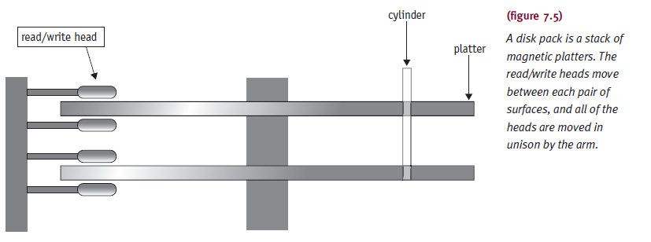
Movable-Head Magnetic Disk Storage

Slide 19
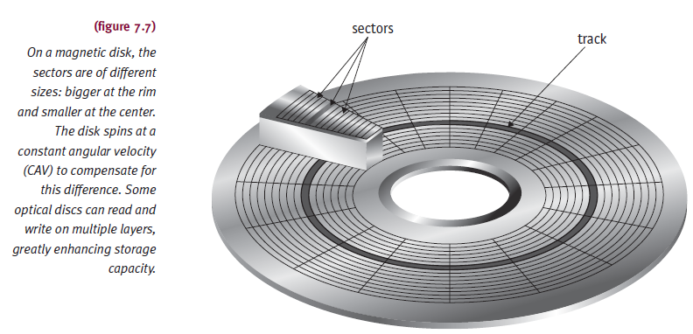
Optical Disc Storage
Design difference
Magnetic disk
Concentric tracks of sectors
Spins at constant angular velocity (CAV)
Wastes storage space but fast data retrieval

Slide 20
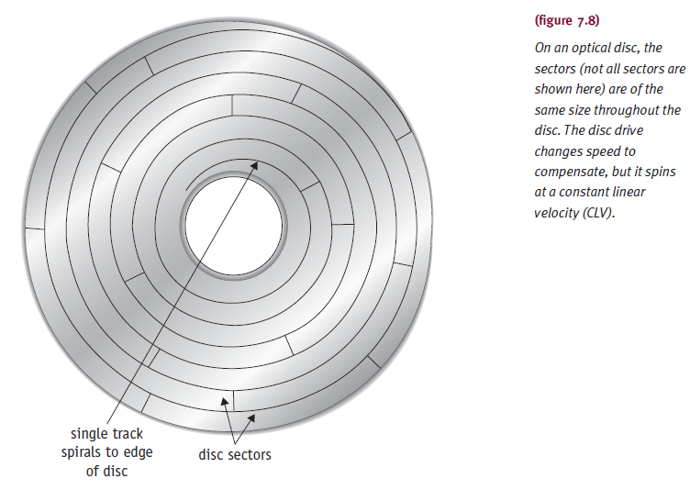
Optical Disc Storage
Design features
Optical disc
Single spiralling track of same-sized sectors running from center to disc rim
Spins at constant linear velocity (CLV)
More sectors and more disc data

Slide 21
Optical Disc Storage
Two important performance measures
Sustained data-transfer rate
Speed to read massive data amounts from disc
Measured in megabytes per second (Mbps)
Crucial for applications requiring sequential access
Average access time
Average time to move head to specific disc location
Expressed in milliseconds (ms)
Third feature
Cache size (hardware)
Buffer to transfer data blocks from disc

Slide 22
CD and DVD Technology
CD
Data recorded as zeros and ones
Pits: indentations
Lands: flat areas
Reads with low-power laser
Light strikes land and reflects to photodetector
Pit is scattered and absorbed
Photodetector converts light intensity into digital signal

Slide 23
CD and DVD Technology
CD-Recordable technology (CD-R)
Requires expensive disk controller
Records data using write-once technique
Data cannot be erased or modified
Disk
Contains several layers
Gold reflective layer and dye layer
Records with high-power laser
Permanent marks on dye layer
CD cannot be erased after data recorded
Data read on standard CD drive (low-power beam)

Slide 24
CD and DVD Technology
CD-Rewritable technology (CD-RW)
Data written, changed, erased
Uses phase change technology
Amorphous and crystalline phase states
Record data: beam heats up disc
State changes from crystalline to amorphous
Erase data: low-energy beam to heat up pits
Loosens alloy to return to original crystalline state
Drives read standard CD-ROM, CD-R, CD-RW discs
Drives store large quantities of data, sound, graphics, multimedia

Slide 25
CD and DVD Technology
DVD technology (Digital Versatile Disc)
CD-ROM comparison
Similar in design, shape, size
Differs in data capacity
Dual-layer, single-sided DVD holds 13 CDs
Single-layer, single-sided DVD holds 8.6 GB (MPEG video compression)
Differs in laser wavelength
Uses red laser (smaller pits, tighter spiral)
DVDs cannot be read by CD or CD-ROM drives
DVD-R and DVD-RW provide rewritable flexibility

Slide 26
Blu-Ray Disc Technology
Same physical size as DVD/CD
Smaller pits
More tightly wound tracks
Use of blue-violet laser allows multiple layers
50GB-500GB
432 Mbps
Formats: BD-ROM, BD-R, BD-RE

Slide 27
Flash Memory Storage
Electronically erasable programmable read-only memory (EEP)
Nonvolatile and removable
Emulates random access
Difference: data stored securely (even if removed)
Data stored on microchip card or “key”
Compact flash, smart cards, memory sticks
Often connected through USB port
Write data: electric charge sent through floating gate
Erase data: strong electrical field (flash) applied

Slide 28
Magnetic Disk Drive Access Times
File access time factors
Seek time (slowest)
Time to position read/write head on track
Does not apply to fixed read/write head devices
Search time
Rotational delay
Time to rotate DASD
Rotate until desired record under read/write head
Transfer time (fastest)
Time to transfer data
Secondary storage to main memory transfer

Slide 29
Fixed-Head Devices
Record access requires two items
Track number and record number
Access time = search time + transfer time
Total access time
Rotational speed dependent
DASDs rotate continuously
Three basic positions for requested record
In relation to read/write head position
DASD has little access variance
Good candidates: low activity files, random access
Blocking used to minimize access time

Slide 30
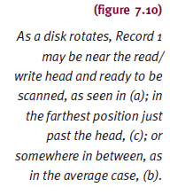
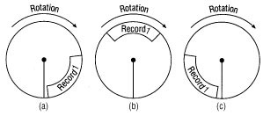
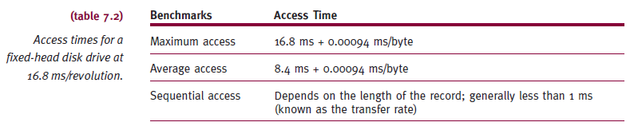
Fixed-Head Devices

Slide 31
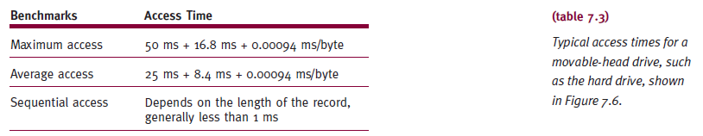
Movable-Head Devices
Record access requires three items
Seek time + search time + transfer time
Search time and transfer time calculation
Same as fixed-head DASD
Blocking is a good way to minimize access time

Slide 32
Components of the I/O Subsystem
I/O Channel
Programmable units
Positioned between CPU and control unit
Synchronizes device speeds
CPU (fast) with I/O device (slow)
Manages concurrent processing
CPU and I/O device requests
Allows overlap
CPU and I/O operations
Channels: expensive because so often shared

Slide 33
Components of the I/O Subsystem
I/O channel programs
Specifies action performed by devices
Controls data transmission
Between main memory and control units
I/O control unit: receives and interprets signal
Disk controller (disk drive interface)
Links disk drive and system bus
Entire path must be available when I/O command initiated
I/O subsystem configuration
Multiple paths increase flexibility and reliability

Slide 34
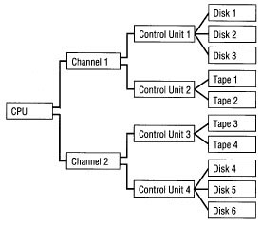

Components of the I/O Subsystem

Slide 35
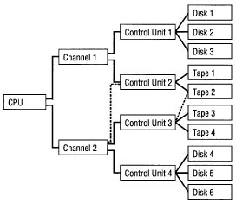
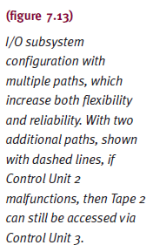
Components of the I/O Subsystem

Slide 36
Communication Among Devices
Problems to resolve
Know which components are busy/free
Solved by structuring interaction between units
Accommodate requests during heavy I/O traffic
Handled by buffering records and queuing requests
Accommodate speed disparity between CPU and I/O devices
Handled by buffering records and queuing requests

Slide 37
Communication Among Devices
I/O subsystem units finish independently of others
CPU processes data while I/O performed
Success requires device completion knowledge
Hardware flag tested by CPU
Channel status word (CSW) contains flag
Three bits in flag represent I/O system component (channel, control unit, device)
Changes zero to one (free to busy)
Flag tested using polling and interrupts
Interrupts are more efficient way to test flag

Slide 38
Communication Among Devices
Direct memory access (DMA)
Allows control unit main memory access directly
Transfers data without the intervention of CPU
Used for high-speed devices (disk)
Buffers
Temporary storage areas in main memory, channels, control units
Improves data movement synchronization
Between relatively slow I/O devices and very fast CPU
Double buffering: processing of record by CPU while another is read or written by channel

Slide 39
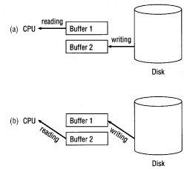
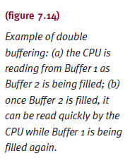
Communication Among Devices

Slide 40
Management of I/O Requests
I/O traffic controller
Watches status of devices, control units, channels
Three main tasks
Determine if path available
If more than one path available, determine which one to select
If paths all busy, determine when one is available
Maintain database containing unit status and connections

Slide 41
Management of I/O Requests
I/O scheduler
Same job as process scheduler (Chapter 4)
Allocates devices, control units, channels
If requests greater than available paths
Decides which request to satisfy first: based on different criteria
In many systems
I/O requests not preempted
For some systems
Allow preemption with I/O request subdivided
Allow preferential treatment for high-priority requests

Slide 42
Management of I/O Requests
I/O device handler
Performs actual data transfer
Processes device interrupts
Handles error conditions
Provides detailed scheduling algorithms
Device dependent
Each I/O device type has device handler algorithm

Slide 43
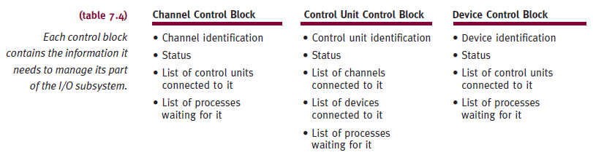
Management of I/O Requests

Slide 44
Device Handler Seek Strategies
Predetermined device handler
Determines device processing order
Goal: minimize seek time
Types
First-come, first-served (FCFS), shortest seek time first (SSTF), SCAN (including LOOK, N-Step SCAN, C-SCAN, and C-LOOK)
Scheduling algorithm goals
Minimize arm movement
Minimize mean response time
Minimize variance in response time

Slide 45
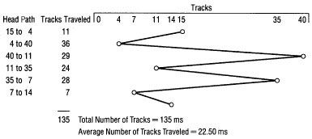
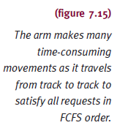
Device Handler Seek Strategies
FCFS
On average: does not meet three seek strategy goals
Disadvantage: extreme arm movement

Slide 46
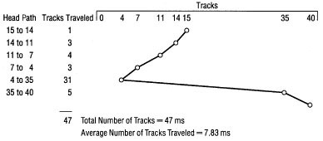
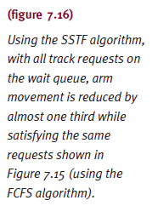
Device Handler Seek Strategies
Shortest Seek Time First (SSTF)
Request with track closest to one being served
Minimizes overall seek time
Postpones traveling to out of way tracks

Slide 47
Device Handler Seek Strategies
SCAN
Directional bit
Indicates if arm moving toward/away from disk center
Algorithm moves arm methodically
From outer to inner track, services every request in its path
If reaches innermost track, reverses direction and moves toward outer tracks
Services every request in its path

Slide 48
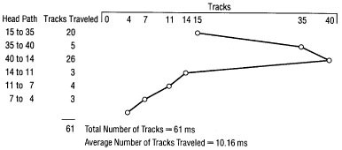
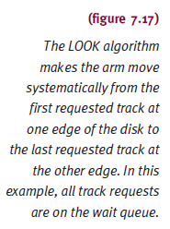
Device Handler Seek Strategies
LOOK
Arm does not go to either edge
Unless requests exist
Eliminates indefinite postponement

Slide 49
Device Handler Seek Strategies
N-Step SCAN
Holds all requests until arm starts on way back
New requests grouped together for next sweep
C-SCAN (Circular SCAN)
Arm picks up requests on path during inward sweep
Provides more uniform wait time
C-LOOK
Inward sweep stops at last high-numbered track request
No last track access unless required

Slide 50
Device Handler Seek Strategies
Best strategy
FCFS best with light loads
Service time unacceptably long under high loads
SSTF best with moderate loads
Localization problem under heavy loads
SCAN best with light to moderate loads
Eliminates indefinite postponement
Throughput and mean service times SSTF similarities
C-SCAN best with moderate to heavy loads
Very small service time variances

Slide 51
Search Strategies: Rotational Ordering
Rotational ordering
Optimizes search times
Orders requests once read/write heads positioned
Read/write head movement time
Hardware dependent
Reduces time wasted
Due to rotational delay
Request arrangement
First sector requested on second track is next number higher than one just served

Slide 52
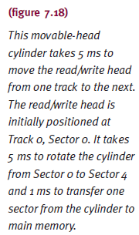
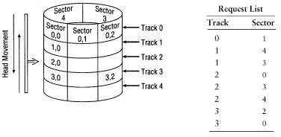
Search Strategies: Rotational Ordering

Slide 53
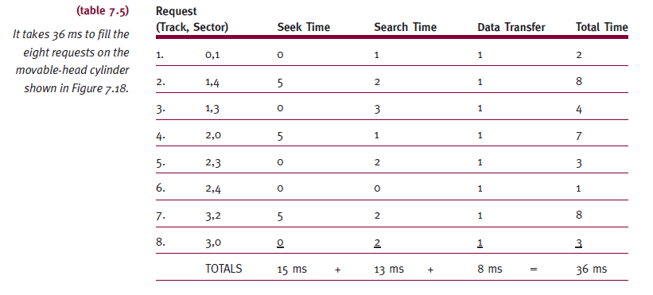
Search Strategies: Rotational Ordering

Slide 54
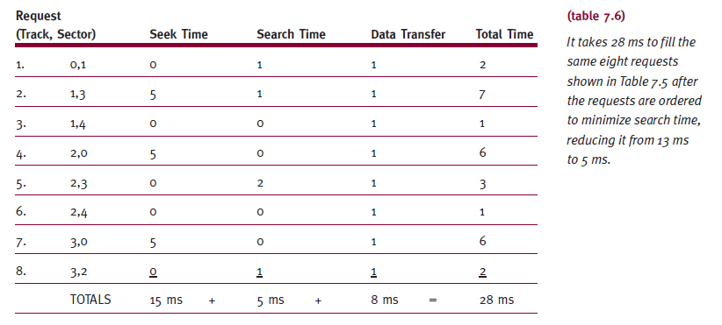
Search Strategies: Rotational Ordering

Slide 55
RAID
Physical disk drive set viewed as single logical unit
Preferable over few large-capacity disk drives
Improved I/O performance
Improved data recovery
Disk failure event
Introduces redundancy
Helps with hardware failure recovery
Significant factors in RAID level selection
Cost, speed, system’s applications
Increases hardware costs

Slide 56
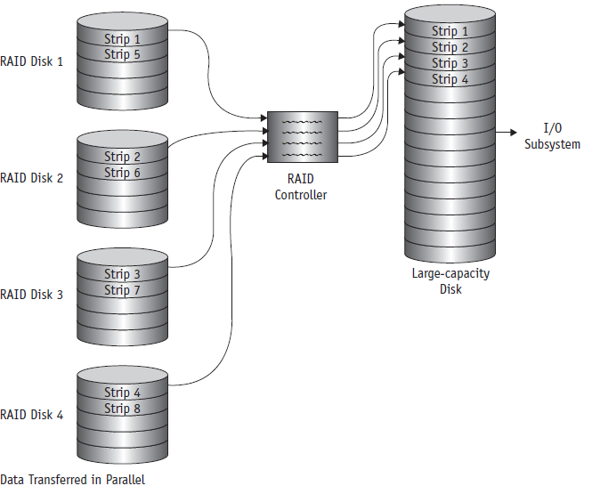
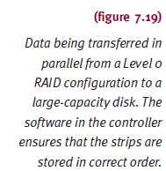
RAID

Slide 57
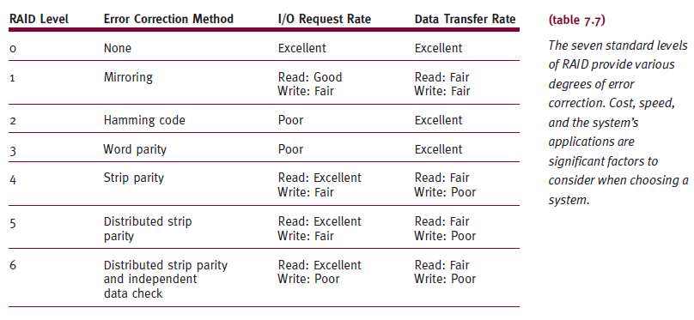
RAID

Slide 58
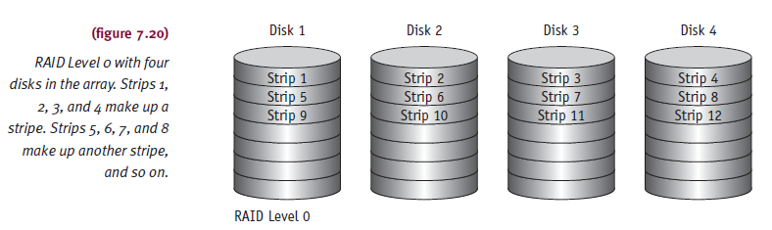
Level Zero
Uses data striping (not considered true RAID)
No parity and error corrections
No error correction/redundancy/recovery
Benefits
Devices appear as one logical unit
Best for large data quantity non-critical data

Slide 59
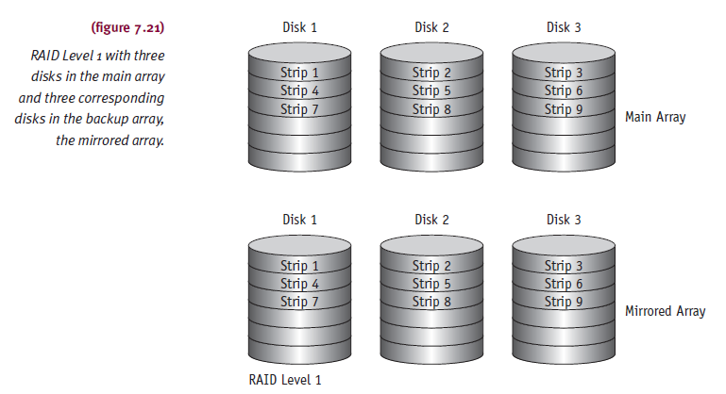
Level One
Uses data striping (considered true RAID)
Mirrored configuration (backup)
Duplicate set of all data (expensive)
Provides redundancy and improved reliability

Slide 60
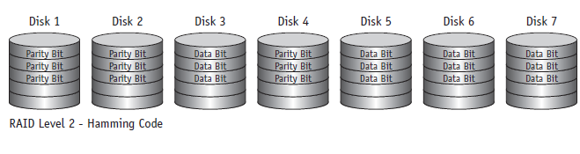
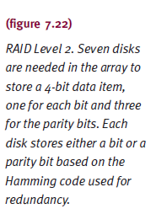
Level Two
Uses small stripes (considered true RAID)
Hamming code: error detection and correction
Expensive and complex
Size of strip determines number of array disks

Slide 61
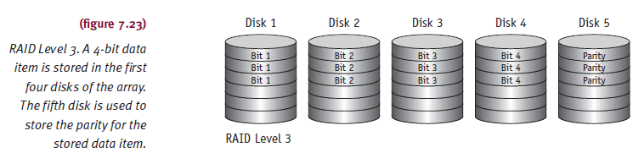
Level Three
Modification of Level 2
Requires one disk for redundancy
One parity bit for each strip

Slide 62
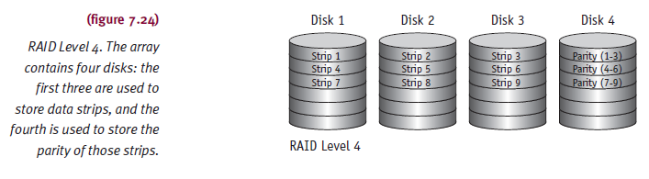
Level Four
Same strip scheme as Levels 0 and 1
Computes parity for each strip
Stores parities in corresponding strip
Has designated parity disk

Slide 63
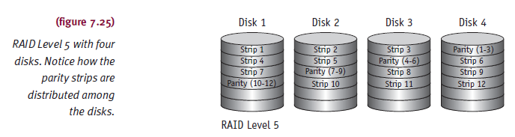
Level Five
Modification of Level 4
Distributes parity strips across disks
Avoids Level 4 bottleneck
Disadvantage
Complicated to regenerate data from failed device

Slide 64
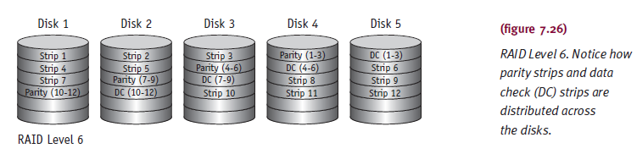
Level Six
Provides extra degree of error protection/correction
Two different parity calculations (double parity)
Same as level four/five and independent algorithm
Parities stored on separate disk across array
Stored in corresponding data strip
Advantage: data restoration even if two disks fail

Slide 65
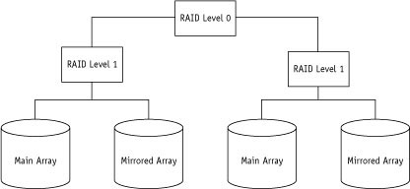

Nested RAID Levels
Combines multiple RAID levels (complex)

Slide 66
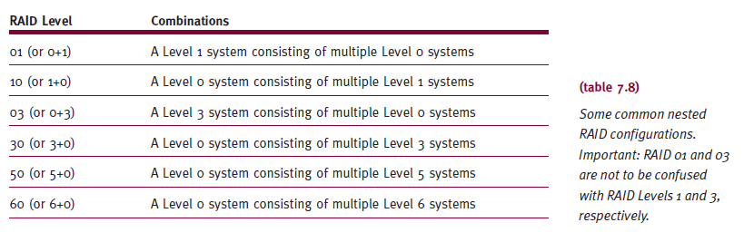
Nested RAID Levels

Slide 67
Summary
Device Manager
Manages every system device effectively as possible
Devices
Vary in speed and sharability degrees
Direct access and sequential access
Magnetic media: one or many read/write heads
Heads in a fixed position (optimum speed)
Move across surface (optimum storage space)
Optical media: disk speed adjusted
Data recorded/retrieved correctly

Slide 68
Summary
Flash memory: device manager tracks USB devices
Assures data sent/received correctly
I/O subsystem success dependence
Communication linking channels, control units, devices
SCAN: eliminates indefinite postponement problem
Best for light to moderate loads
C-SCAN: very small service time variance
Best for moderate to heavy loads
RAID: redundancy helps hardware failure recover
Consider cost, speed, applications

Slide 69
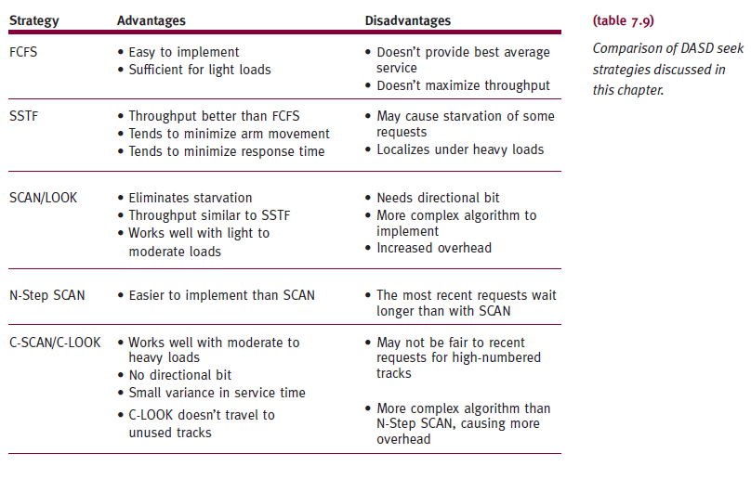
Summary

