Slide 1
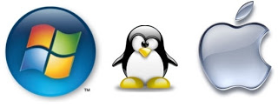
Operating System Security
Computer Security

Slide 2
What is an Operating System?
Provides the interface between the user and the computer hardware
Manages how applications access resources
Hard disks
CPU
RAM
Input devices
Output devices
Network interfaces

Slide 3
OS Security Concepts
Identification, Authentication, Authorisation
Separation and protection of objects
Auditing
Permissions and File System Security

Slide 4
Separation of Objects
An OS needs to stop objects from interfering with other objects
In particular it needs to prevent one process from interfering with other processes
Memory management is important
Many memory management techniques have been used by operating systems

Slide 5
Identification and Authentication
Passwords still heavily relied upon as a means of authentication
Smartcards, tokens making some progress
Consumer oriented biometric devices are becoming prominent for mobile computing devices

Slide 6
Authorisation
An operating system controls accesses to object within the system
Objects might include
Files
Network shares
External drives and peripherals
Resources (processor, memory etc)
Different Operating Systems have different capabilities in controlling access to these resources

Slide 7
Access Control Lists
For every user there is a list of objects
User A
Sales.doc
R
Expenses.xls
W
Contacts.mdb
R,W
For each object the OS maintains a list of users and permissions
Sales.doc
User 1
R
User 2
W
User 3
R,W

Slide 8
Access Control Matrices
The OS maintains a table of subjects, objects and permissions
 | Sales.doc | Expense.xls | Contact.mdb | Calc.exe
User 1 | R
User 2 |  | R,W |  | X
User 3
User 4 | R | W |  | X

Slide 9
Windows Security Architecture
Local Security Authority (LSA)
Security Reference Monitor (SRM)
Security Accounts Manager (SAM)
WinLogon and NetLogon
Access Control Lists (ACL)
User Account Controls (UAC)
Security Identifier (SID)

Slide 10
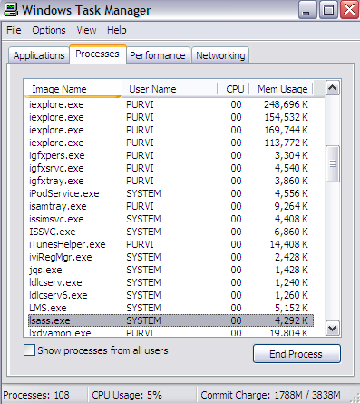
Local Security Authority (LSA)
A process responsible for enforcing a local security policy
Issues security tokens to accounts
Key component of the logon process
Notes:
During the local (interactive) logon to a machine, a person enters their username and password to the logon interface. This information is passed to the LSA, which then calls the appropriate authentication package. The password is sent through a one-way hash function. The LSA then queries the SAM database for the user's account information. If the password hash provided matches the one in the SAM, the SAM returns the users SID and the SIDs of any groups the user belongs to. The LSA then uses these SIDs to generate the security access token.

Slide 11
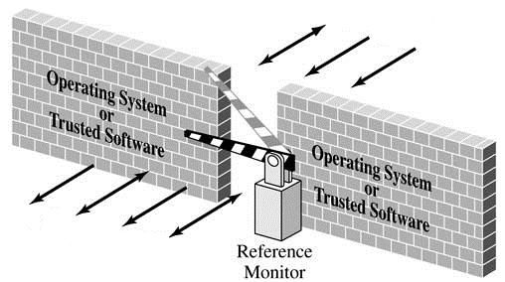
Security Reference Monitor
Determines if a process has the appropriate rights to perform an action

Slide 12
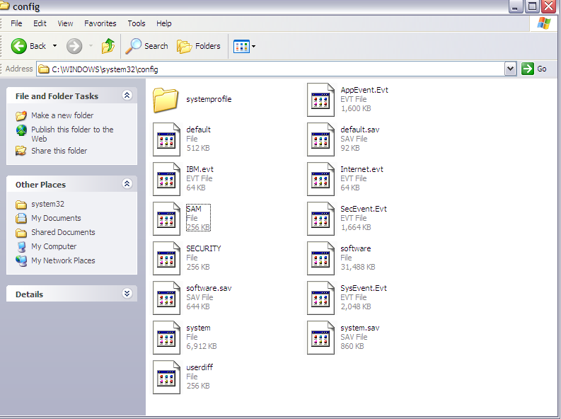
Security Accounts Manager
A database that stores user accounts and relevant security information about local users and groups
Stores users’ passwords in a hashed format
Notes:
When a user logs on to a computer using a local account, the SAM process (Samsrv) takes the logon information and performs a lookup against the SAM database, which resides in the windows system32/config directory(Something similar in UNIX, think etc/password). If credential match, then the user can log on to the system, assuming there are no other factors preventing logon, such as logon time restrictions or privilege issues.

Slide 13
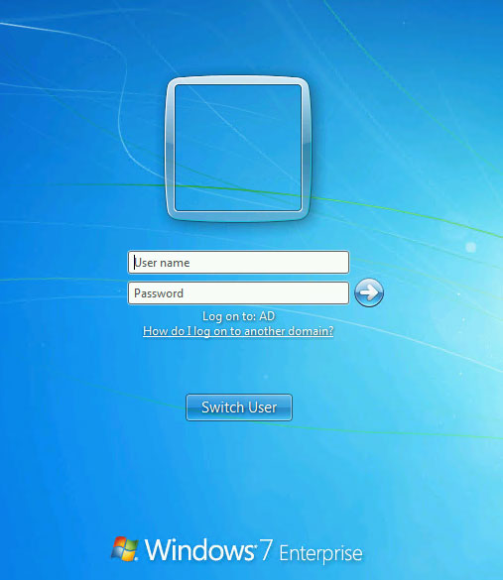
Winlogon and NetLogon
Winlogon.exe handles local logons
NetLogon handles logons across the network
Makes use of a Security
Attention Sequences (SAS)
The SAS is designed to make
login spoofing difficult
Notes:
Security Attention Sequences (SAS) in Windows is typically Ctrl + Alt + Del
This reduces the probability of a Login spoofing attack from occurring

Slide 14
Security Identifiers / Users and Groups
User accounts and groups are identified by a Security Identifier (SID)
Users have individual accounts
Users can be placed in groups
There is a many-to-many relationship between users and groups
A group can have many users
A user may be in many groups

Slide 15
Windows Login Process Example
Administrator creates a user account with;
Full name
Username
Password
Group
Privileges
Windows in-turn creates a Security Identifier (SID) in the form of S-1-5-21-AA-BB-CC-DD
Notes:
S-1-5-21-AA-BB-CC-DD
S : means SID
1: SID version number
5: identifier authority
21: means not unique , which just means there is no guarantee of uniqueness, a SID is unique within a domain
AA-BB-CC: unique number representing domain
DD: called relative ID (RID) ; its unique number that increments by 1 as each SID unique
For more information refer to..
http://www.techiesweb.com/sid-windows-security-identifier-working-method-overview-usage-and-its-deployment-methods/

Slide 16
Windows Login Process Example cont…
User initiates Security Attention Sequence
User types in username and password
LSA runs authentication package
User is authenticated locally or by a Domain Controller
Notes:
http://technet.microsoft.com/en-us/library/ff428139(v=ws.10).aspx

Slide 17
Windows Login Process Example cont…
SAM returns an SID to the LSA
LSA creates an access token containing
User’s individual SID
User’s group SID
Local system rights
Token is used to access objects via the Security Reference Monitor (SRM).

Slide 18
Windows NT Security Architecture
Logon Process
Security Policy Database
Security Accounts Manager
Local Security Authority
Directory Database
Security Reference Monitor (Kernel Mode)
Audit Log

Slide 19
Special accounts and groups
Administrator Account
Most powerful account
Often this account is not subject to account lock out if incorrect password is entered repeatedly
Guest account
These days this account is typically disabled by default. Admins should check this to make sure that it is disabled
Everyone group
Every user is automatically a member of this group
Newly created files may default to allowing access to the everyone group. Access to the everyone group should be removed if you want to limit access to a file

Slide 20
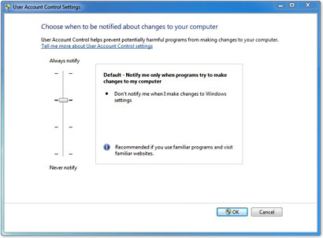
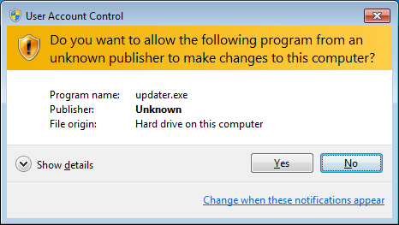
User Account Control (UAC)
Any task that has the potential to affect the integrity or security of the operating system will trigger the User Account Control
UAC is used in Unix Operating Systems

Slide 21
File Systems
Legacy Windows OS used the File Allocation Table (FAT, FAT32)
Contemporary Windows OS use the New Technology File System (NTFS)
From a security point of view NTFS is highly recommended
NTFS offers the following advantages
Can use file permissions
Increased stability, robustness and fault tolerance

Slide 22
NTFS Security Descriptors
Each NTFS file has a security descriptor
Contains the Security token of the owner
File also has an Access Control List
All file access must go through the Security Reference Monitor
The SRM compares tokens of users to the File’s ACL and determines if access is allowed
There are rules that determine how to handle ambiguous situations
E.g. if a user belongs to a group which has access to a file, but that particular user is specifically denied access to that file, the file access by that user should be denied

Slide 23
NTFS Stability
NTFS writes all file system interactions as transactions, which either fully complete or do not complete
NTFS keeps logs of transaction so that in the event of a crash, or power failure the OS can go through the logs and undo any transactions that failed to complete and redo any necessary transactions
This improves the fault tolerance of NTFS compared to FAT

Slide 24
NTFS Encryption
NTFS users can also benefit from transparent encryption of files
Encrypted Files System (EFS) exists as a layer on top of NTFS
Files are encrypted and decrypted ‘on-the-fly’
Doesn’t provide protection if an attacker gets access to a machine that is logged in
Does provide protection if a machine or disk is stolen after being logged out
Recovery agent allows administrators to recover files if user’s keys are lost
Possibilities of backdoors?
There were claims some time ago that someone had found some ‘NSA keys’ referred to in a Windows patch
Fears of that MS and US government had cooperated to leave backdoors
This was at the time, and remains, speculation

Slide 25
Auditing
Operating Systems have auditing capabilities
Administrators can audit and log many events
Successful and unsuccessful login attempts
Access to sensitive files
Modification of certain files, particularly executable files
Windows has an event viewer that can be used to monitor logs

Slide 26
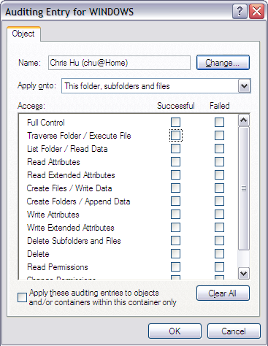
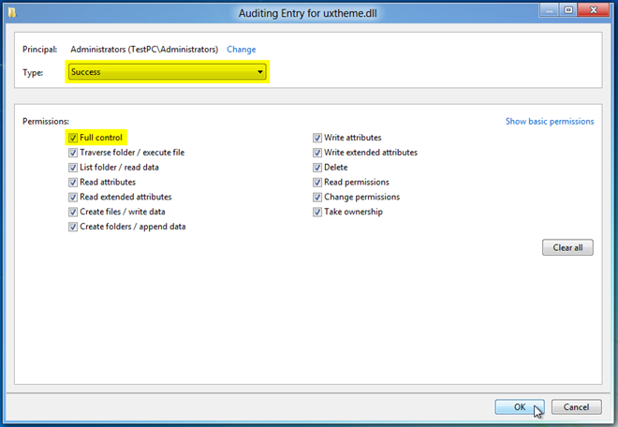
Windows Auditing cont…

Slide 27
Windows Event Logger
Keeps track of what processes are running, what other machines have interacted with the system via the Internet, and if the operating system has experienced any unexpected or suspicious behavior
Can leave important clues for troubleshooting, but also for determining the cause of a security breach

Slide 28
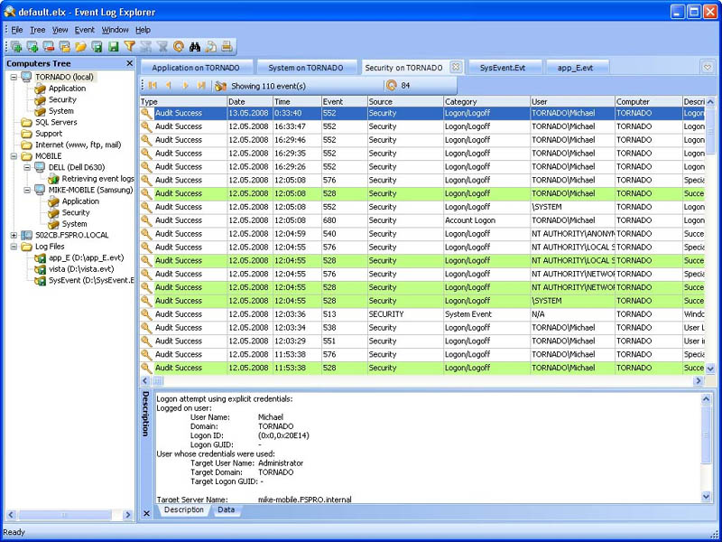
Windows Event Logger

Slide 29
Over auditing?
Deciding what to audit is a difficult task
Audit too little and you risk missing important events
Audit too much and performance suffers
You may also miss important event due to it being masked in too many irrelevant log entries
A balance is required
Determining a balance is not an easy task

Slide 30
OS Vulnerabilities
Operating Systems are complex pieces of software
How many millions of lines of code in a modern OS?
They WILL have
Design flaws
Implementation errors
Which lead to vulnerabilities
Sound software engineering practices can help to improve the overall quality of systems, but we have to assume that these problems are not going to go away

Slide 31
Comments on OS security
Sometimes an OS can be limited by its need for backwards compatibility
Eg when Windows NT was released, it had a better way of hashing passwords than earlier versions
However the old method was maintained in parallel with the new method so that the newer Windows NT could work with older versions of Windows
This lead to a vulnerability as the older passwords were generally easier to crack

Slide 32
Applying OS Security
However, none of these Operating Systems are secure ‘out of the box’
Whether you are using Windows, Linux, MacOS security features must be put to use
Configuration and maintenance are vital
Which is the most secure OS?
Which ever you can configure the best!!!
It may well be that a well configured windows system is more secure than a poorly configured Linux machine and vice versa

Slide 33
Open source vs Commercial OS
 | Windows | Linux
Maintenance and structure | Claims its platform is more secure because of a comprehensive approach to security using the Security Development Lifecycle However, because Windows is closed-source, only Microsoft-employed programmers can fix bugs | Claims its platform is more secure because all of its code is reviewed by so many people that bugs are detected Anyone with programming experience is free to fix bugs and submit them for inclusion in future releases and updates However such an approach has indeed produced several vulnerabilities, although this is a rare case

Slide 34
Open source vs Commercial OS cont…
User Accounts | In Windows, all logged-in sessions run with standard user permissions, preventing malicious programs from gaining total control of the system Processes that require administrator privileges can be run using the User Account Control framework. For standard users, this presents a credentials dialogue that requires the password of a member of the administrators group (who are listed) For users who are already logged in an administrator, only confirmation is necessary | Users typically run as limited accounts, having created both administrator (root) and at least one user account during installation In most Linux distributions, there are commands (su, sudo) that will temporarily grant elevated permissions to processes that need it In practice, this can be very dangerous, as any error can lead to severe damage to the system

Slide 35
Open source vs Commercial OS cont…
File Permissions | Old versions of non-NT Windows only operated on the FAT file system and did not support file system permissions Windows NT and subsequent NT-based versions of Windows use NTFS-based Access Control Lists to administer permissions, using tokens On Windows XP and prior versions, most home users still ran all of their software with Administrator accounts, as this is the default setup upon installation The existence of software that would not run under limited accounts and the cumbersome "Run As..." mechanism forced many users to use administrative accounts | Linux has a traditional Unix-like “user, group, other” approach to file system permissions at a minimum This approach is extended by Access Control Lists on some file systems There are some specific to Linux frameworks such as AppArmor and SELinux which add even finer-grained controls over which users and programs can access certain resources or perform certain operations

Slide 36
Virtual Machines (VM)
Virtual Machines allow an operating system to run without direct contact to the underlying hardware and operating system
A VM allows you to test software, examine malware in a sandbox and test the stability of a system
Any errors or identified threats can be rolled back through the VM hosting software

Slide 37
Security Standards for OS Evaluation
Numerous organisations create criteria for evaluating computer systems which are used to store and transfer sensitive information
Trusted Computer System Evaluation Criteria (TCSEC)
Common Criteria for Information Technology Security Evaluation Criteria

Slide 38
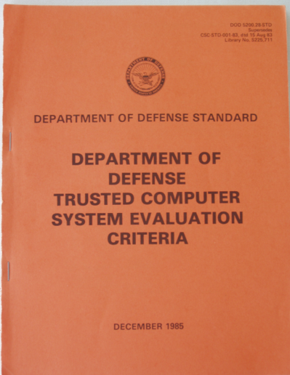
Trusted Computer System Evaluation Criteria
US DoD standard formalised in 1985
Orange Book
Used to determine how and
for what purpose a computer
system can be used in a
Government organisation
Focuses on the confidentiality
of information

Slide 39
TCSEC Security Criteria Divisions
D – Minimal protection
Has been certified/evaluated but does not meet any strict security requirements
C – Discretionary protection
A system utilising discretionary access control
B – Mandatory protection
A system utilising mandatory access control
A – Verified protection
A system utilising formal verification of security

Slide 40
Common Criteria
Common criteria is not a certification process but rather a framework for vendors to create security goals for their product and document how these goals have been met
In the US Common Criteria has replaced TCSEC as a measure of evaluating the security of a computer system

