Slide 1
Understanding Operating Systems Sixth Edition
Chapter 10
Management of Network Functions

Slide 2
Learning Objectives
The complexities introduced to operating systems by network capabilities
Network operating systems (NOS) compared to distributed operating systems (DO/S)
How a DO/S performs memory, process, device, and file management
How a NOS performs memory, process, device, and file management
Important features of DO/S and NOS

Slide 3
History of Networks
Initial network creation
Share expensive hardware resources
Provide centralized information resource access
Operating system development
Network operating system first
Distributed operating system followed
More powerful
Distributed processing
Even greater centralized information access
User collaboration
Complete common tasks

Slide 4
Comparison of Network and Distributed Operating Systems
Network operating systems (NOS)
Local operating systems extend powers
Handle interfacing details
Coordinate remote processing
Coordinate communications
Between local operating systems
Limitations
No global control of memory management, process management, device management, file management
Viewed as autonomous local functions
No true distributed computing

Slide 5
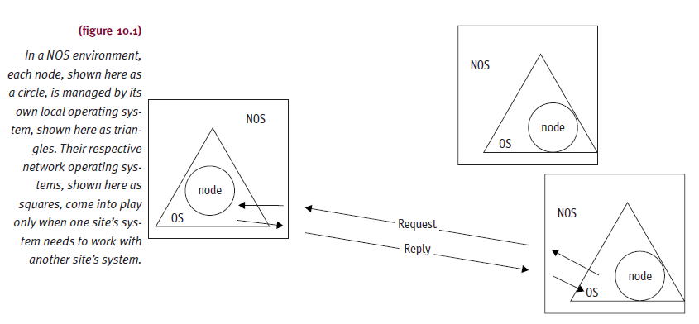
Comparison of Network and Distributed Operating Systems (cont'd.)

Slide 6
Comparison of Network and Distributed Operating Systems (cont'd.)
Distributed operating systems (DO/S)
Global assets controlled by operating system
Provide unified environment
Optimize whole network operations
Construction
Replicated kernel operating system
Network and intricacies hidden from users
Use network as single logical system

Slide 7
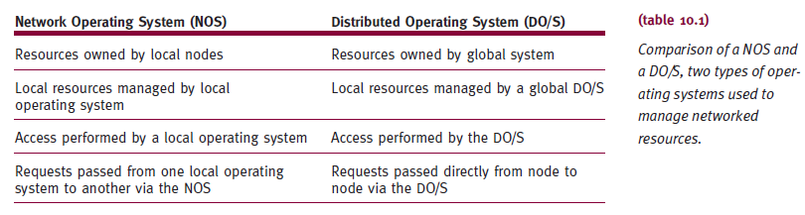
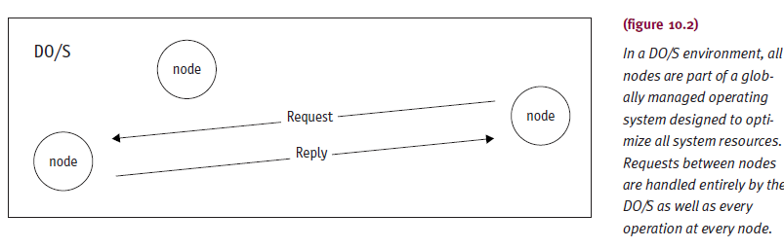
Comparison of Network and Distributed Operating Systems (cont'd.)

Slide 8
DO/S Development
Entire network resource groups managed globally
Negotiation- and compromise-based resource allocation
Occurs among equally important peer sites
Advantage
No special server software on local machines
Supports file copying, e-mail, remote printing

Slide 9
Memory Management
Uses kernel with paging algorithm
Tracks available memory amount
Based on goals of local system
Global system requirements drive local site policies and mechanisms
Memory allocation and deallocation dependencies
Scheduling and resource-sharing schemes that optimize network resources

Slide 10
Memory Management (cont'd.)
Extended role
Memory requests: local and global sources
Local level
Page allocation based on local policy
Global level
Receives process manager memory requests for new or expanding client or server processes
Uses local resources for memory garbage collection, compaction
Decides most and least active processes
Determines pre-emptive processes to provide space

Slide 11
Memory Management (cont'd.)
Functions
Control demand
Allocates and deallocates space requests based on network’s usage patterns
Page fault handling
Automatically brings requested page into memory
Examine total free memory table before allocating space

Slide 12
Memory Management (cont'd.)
Functions (cont'd.)
Virtual memory management
Allocates and deallocates virtual memory
Reads and writes to virtual memory
Swaps virtual pages to disk
Locks virtual pages in memory and protects pages as needed

Slide 13
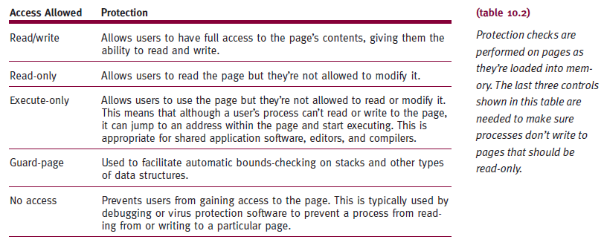
Memory Management (cont'd.)

Slide 14
Process Management
Provides policies and mechanisms
Create, delete, abort, name, rename, find, schedule, block, run, synchronize processes
Provide real-time priority execution if required
Manages execution states
READY, RUNNING, WAIT
Each CPU in network
Required to have own run-time kernel

Slide 15
Process Management (cont'd.)
Kernel
Role
Helps system reach operational goals
States
Dependent on global system’s process scheduler and dispatcher
System’s scheduling function (three parts)
Decision mode
Priority function
Arbitration rule

Slide 16
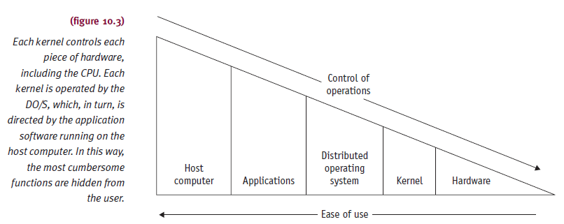
Process Management (cont'd.)

Slide 17
Process Management (cont'd.)
Decision mode
Determines policies when scheduling resource
Options: preemptive, nonpreemptive, round robin
Priority function
Scheduling algorithm policy assigning order given to processes in execution cycle
Examples: most time remaining (MTR), LTR
Arbitration rule
Resolves conflicts between equal priority jobs
Examples: last-in first-out (LIFO), FIFO

Slide 18
Process Management (cont'd.)
Job scheduling advances
Theories
Queuing theory
Statistical decision theory
Estimation theory
Maximize system throughput using durations to compute and schedule optimal way to interleave process chunks
Process functions
Specific procedures
Create, locate, synchronize, delete process

Slide 19
Process Management (cont'd.)
Process functions (cont'd.)
Create process
PCB with additional information identifying network location
Locate process
Uses system directory or process searching kernel queue spaces
Requires interprocess communications support
Synchronize processes
Uses message passing or remote procedure calls
Delete or terminate process
Finds PCB, accesses it, deletes it

Slide 20
Process Management (cont'd.)
DO/S design
Process-Based DO/S
Network resources managed as large heterogeneous collection
Object-Based DO/S
Clumps each hardware type with necessary operational software into discrete objects
Manipulated as a unit

Slide 21
Process Management (cont'd.)
Process-Based DO/S
Process management using client/server processes
Synchronized and linked together through messages and ports (channels or pipes)
Emphasizes processes and messages
Providing basic features essential to process management
Process management
Single OS copy
Multiple cooperating peers
Combination of two

Slide 22
Process Management (cont'd.)
Process-Based DO/S (cont'd.)
High-level cooperation and sharing
Actions and data
Synchronization is key issue in network process management
Interrupts represented as messages
Sent to proper process for service

Slide 23
Process Management (cont'd.)
Object-Based DO/S
System viewed as collection of objects
Examples: hardware (CPUs, memory), software (files, programs), or combination
Objects viewed as abstract entities
Objects have a set of unchanging properties
Process management becomes object management
Processes act as discrete objects
Two process management components
Kernel level and process manager

Slide 24
Process Management (cont'd.)
Kernel level
Provides basic mechanisms for building OS
Dynamically creating, managing, scheduling, synchronizing, deleting objects
Responsibilities
Maintains network’s capability lists
Responsible for process synchronization and communication support
Communication between distributed objects
Shared data objects, message objects, control interactions
Scheduler with consistent and robust mechanism

Slide 25
Process Management (cont'd.)
The Process Manager
Creates own primitives
If kernel does not have primitives
Examples: test and set, P and V
Responsibilities
Creating, dispatching, scheduling objects
Synchronizing object operations
Object communication and deleting objects
Kernel environment
To perform above tasks
Objects contain all their state information

Slide 26
Device Management
Devices
Opened, read from, written to, closed
Device parameters initialized and status bits set or cleared
Global, cluster, or localized basis
Allocates and deallocates devices to users
Only when process issues OPEN/CLOSE command
Keeps global accounting of each network device
Availability

Slide 27
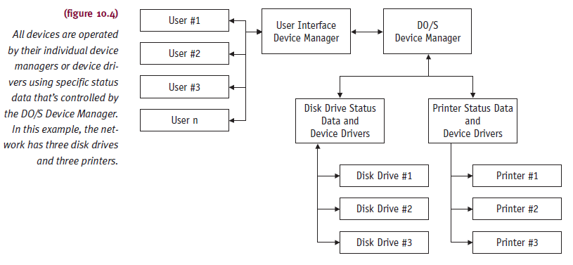
Device Management (cont'd.)

Slide 28
Device Management (cont'd.)
Process-Based DO/S
Resources controlled by servers
Called “guardians” or “administrators”
Responsibilities
Accepting requests for service on individual devices they control
Processing each request fairly
Providing service to requestor
Returning to serve others

Slide 29
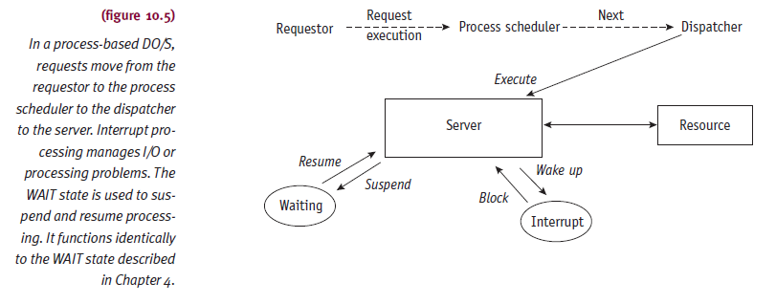
Device Management (cont'd.)

Slide 30
Device Management (cont'd.)
Process-Based DO/S (cont'd.)
Systems have clusters of resources
Group control
Configured around complex server processes
Administrator process configured as Device Manager
Includes software
Accepts local and remote service requests
Deciphers meaning, acts on them
Server process
One or more device drivers, Device Manager, network server component

Slide 31
Device Management (cont'd.)
Object-Based DO/S
Each device managed same way throughout network
Physical device considered an object
Surrounded by software layer
Physical device manipulated by set of operations, mobilizing device to perform designated functions
Objects assembled to communicate and synchronize
If local device manager cannot satisfy user request, request sent to another device manager

Slide 32
Device Management (cont'd.)
Object-Based DO/S (cont'd.)
Users
No need to know if centralized or distributed network resources
Device Manager object at each site
Maintains current directory of device objects at all sites

Slide 33
File Management
Provide transparent mechanisms
Find, open, read, write, close, create, delete files
Subset of database managers
Distributed database management implementation
Part of LAN
Tasks
Concurrency control
Data redundancy
Location transparency and distributed directory
Deadlock resolution or recovery
Query processing

Slide 34
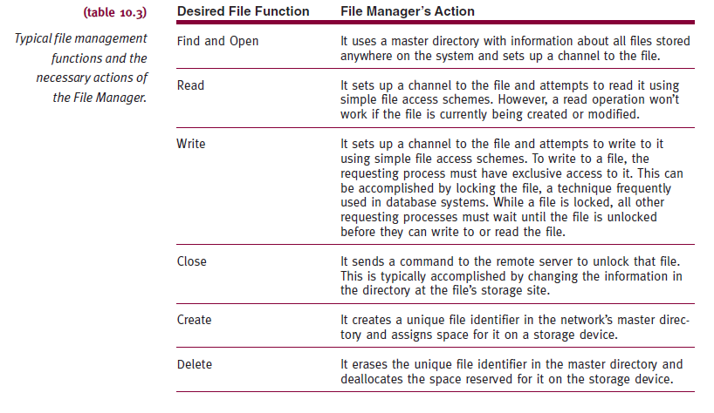
File Management (cont'd.)

Slide 35
File Management (cont'd.)
Concurrency control
System ability to perform concurrent reads and writes
Provided actions do not jeopardize database
Provides serial execution view on database
Data redundancy
Makes files faster and easier to read
Allows process to read copy closest or easiest to access
Read request split into several different requests for larger file

Slide 36
File Management (cont'd.)
Data redundancy (cont'd.)
Advantage: disaster recovery easy
Disadvantage: keeping multiple copies of same file up-to-date at all times
Updates performed at all sites
Location transparency and distributed directory
Users not concerned with physical location of files
Deal with network as a single system
Provided by mechanisms and directories
Map logical data items to physical locations

Slide 37
File Management (cont'd.)
Location transparency and distributed directory (cont'd.)
Distributed directory
Manages data locations transparency
Enhances data recovery for users
Contains
Definitions for stored physical data and logical structure
Policies and mechanisms mapping the two
System wide names of all resources and addressing mechanisms for locating and accessing them

Slide 38
File Management (cont'd.)
Deadlock resolution or recovery
Critical issues in distributed systems
Most important function
Detect and recover from a circular wait
Complex and difficult to detect because it involves multiple processes and multiple resources
Strategies used by distributed system
Detection, prevention, avoidance recovery

Slide 39
File Management (cont'd.)
Deadlock resolution or recovery (cont'd.)
Recognize circular waits
System uses directed resource graphs
Looks for cycles
Prevent circular waits
Delays transaction start until it has all resources
Avoid circular waits
Allows execution if transaction can run to completion
Recovery
System selects best victim, kills victim, reallocates its resources to the waiting processes

Slide 40
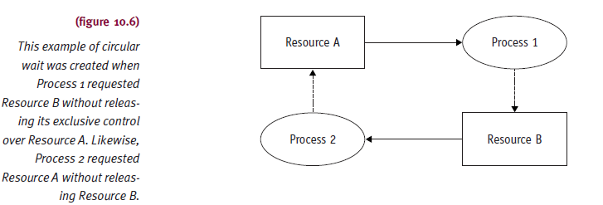
File Management (cont'd.)

Slide 41
File Management (cont'd.)
Query processing
Function of processing requests for information
Increases effectiveness
Global query execution sequences
Local site processing sequences
Device processing sequences
Ensures consistency of entire system’s scheduling scheme
Query processing strategy
Integral processing scheduling strategy part

Slide 42
Network Management
Provides concurrent processes policies
Intrasite and intersite communication
Responsibilities
Locate processes in network
Send messages throughout network
Track media use
Reliably transfer data
Code and decode messages, retransmit errors
Perform parity checking, do cyclic redundancy checks, establish redundant links
Acknowledge messages and replies if necessary

Slide 43
Network Management (cont'd.)
Links processes (objects) together through port
When communication needed
Provides routing functions
Keeps network use statistics
Message scheduling, fault localizations, and rerouting
Aids process time synchronization
Systemwide clock

Slide 44
Network Management (cont'd.)
Process-Based DO/S
Inter process communication transparent to users
Responsibilities
Allocating ports to processes
Identifying every process in network
Controlling message flow
Guaranteeing transmission and acceptance of messages without errors
Interfacing mechanism for every process
Traffic operator: accepts and interprets send and receive commands

Slide 45
Network Management (cont'd.)
Object-Based DO/S
Easy intermode and intramode communications among cooperative objects
No need to know receiver location
Only receiver’s name
Provides message’s proper routing to receiver
Process invokes operation part of its local object environment
Services usually provided at kernel level

Slide 46
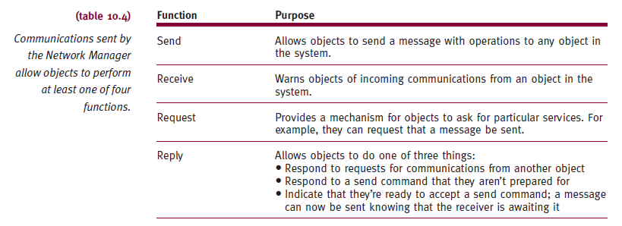
Network Management (cont'd.)

Slide 47
NOS Development
NOS runs on server
Performs network services
Workstations called clients
Network management functions
Only when system needs to use network
Focus on sharing resources
Not running programs
Factors for best NOS choice
Applications to run on server
Technical support required
User’s training level

Slide 48
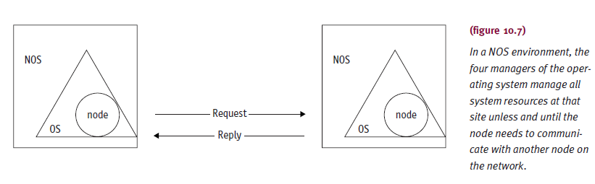
NOS Development (cont'd.)

Slide 49
Important NOS Features
Support
Standard local area network technologies
Client desktop operating systems
Robust architecture adapting easily to new technologies
Support every operating system in corporate information network
Operate wide range of third-party software applications and hardware devices
Support multiuser network applications software
Blend efficiency with security

Slide 50
Major NOS Functions
Function
Transfer files between computers
Example: FTP command
Not true file sharing
Must copy file to local disk
Duplicates and wastes space
Needs version control
Anonymous FTP
Files available to general public
Advantage: Web for FTP
Users know how to use browser

Slide 51
Summary
NOS
No full utilization of global resources available to all connected sites
DO/S specifically addressed NOS failure
Specific requirements
Secure from unauthorized access
Accessible to authorized users
Monitor available system resources
Communications links
Perform required networking tasks

