Slide 1

Threats and Threat Agents
Computer Security

Slide 2
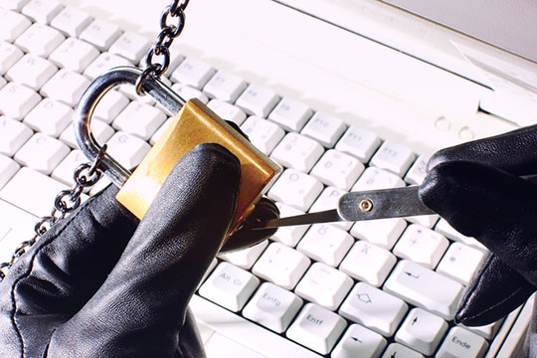
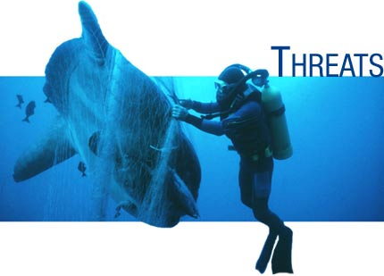
What is a Threat?
A possible danger
Any possibility which if to eventuate would cause some degree of harm
An act designed to obtain a negative response

Slide 3
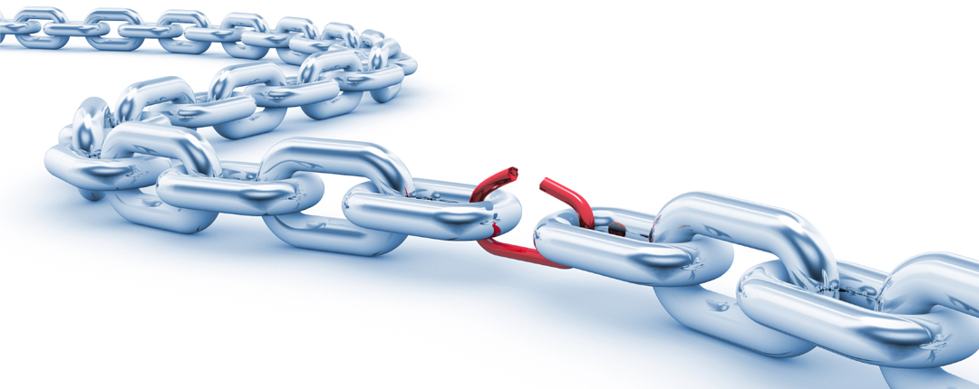
What is a Vulnerability?
A flaw or weakness in the design, implementation, or operation of a system
How open something is to an attack
Threats act on or exploit vulnerabilities
The possibility of being attacked or harmed

Slide 4
What is Risk?
Risk is the potential harm that may arise from some current process of from some future event
Risk management is the process of understanding and responding to factors that may lead to a beach of confidentiality, integrity or availability

Slide 5
Risk Assessment
Risk is
the likelihood of the occurrence of a vulnerability
multiplied by
The value of the asset
minus
the percentage of risk mitigated by current controls
plus
the uncertainty of current knowledge of the vulnerability

Slide 6

Risk control strategies
Defence – apply safeguard to eliminate/reduce risk
Mitigation – plan / prepare thus control the risk
Acceptance – accept outcome of an exploitation
Transferal – shift risk to other assets, processes or organisations (insurance)
Termination – remove an asset from the environment thus removing the risk

Slide 7
Instinctive Risk Assessment
Everyday we perform a basic form of risk analysis instinctively
We automatically attempt to assess the risk involved with the things that we do
When we cross a busy road we automatically perform an instinctive risk assessment

Slide 8
Real Vs Perceived Risk
During the period of the Washington Sniper many parents elected to drive their children to school believing this to be the safest course of action
Bruce Schneier argued that the probability of everyone in the car dying in a traffic accident was greater than any one of them being killed by the Washington Sniper

Slide 9
Real Vs Perceived Risk
Shoppers will worry about E. coli bacteria on spinach leaves but fill their shopping cart with fatty foods
People worry about the plane they are in crashing, yet on a global level more people die in car accidents
http://www.time.com/time/magazine/article/0,9171,1562978-1,00.html

Slide 10
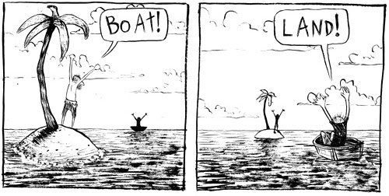
Risk Perception
“I don’t earn over $40,000 a year
so I will not be a victim to internet crime
so I do not need to use security software”
“You have to use the Internet everyday to be attacked online”

Slide 11
Generic Threats
In terms of computer security, there are generally considered to be four generic threats
Interception
Modification
Fabrication
Interruption

Slide 12
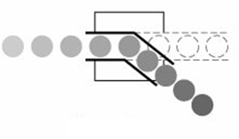
Interception
An unauthorised entity gains access to an asset
Could be a person, a program or a computer system resulting in a breach of confidentiality
Copying of data/files, wiretapping etc.

Slide 13
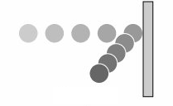
Interruption
An asset is lost, unavailable or unusable
A breach of availability
Physically destroying hardware
Erasing a programs or files
Disconnecting a power or network cable

Slide 14
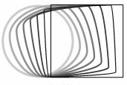
Modification
An unauthorised party alters an asset
A breach of integrity
Changing values in a database
Modify data transmitted electronically
Modify programs so they perform additional tasks

Slide 15
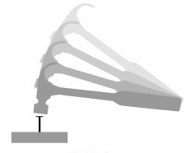
Fabrication
Falsely creating objects on a system
A breach of integrity
Creation of false records in a database
Creation of additional processes to consume system resources

Slide 16
Specific Threats
The previous slides indicated four generic types of threats
Lets move on an discuss some more specific examples
You should be able to relate these specific threats back to the generic threats already covered

Slide 17
Examples of specific threats
Intrusion
Hacking
Espionage
Destruction of hardware
Destruction of software
Destruction of data
Hardware theft
Software theft
Data theft
Injection of traffic/data
Corruption of data
Eavesdropping
Surveillance
Social engineering
Malware
Information Warfare
This is by no means an exhaustive list!

Slide 18
Hacking
Hacking is one of the most abused terms in the computer security field
A catchy term often (ab)used by the media
(1) An individual who maliciously breaks into a computer system
(2) An individual with advanced skills who tests and identifies system vulnerabilities

Slide 19
Information Warfare
The utilisation of information to gain an advantage
Information Warfare can be used to describe a wide variety of activities
Cyber-war
Net-war
Psychological operations
Information operations
Information could be the target, the weapon, an enabler or a force multiplier
IW may entail information denial, disinformation, deception (in many forms)

Slide 20
Malware
A catch-all, umbrella term to describe a range of MALicious softWARE
The term virus is also often abused, particularly by the mainstream media
We will discuss malware in a later module

Slide 21
Espionage
Obtaining information in a secretive manner
Could occur between nations, corporations or any non-state actors
Could involve theft of information
Via network or system intrusions
Dumpster diving
Social engineering

Slide 22
Eavesdropping/surveillance
Monitoring/listening to an entity without consent
Could be done for any number of reasons or in any number of ways
Electronic
Optical
Profiling of web browsing habits, credit card purchases etc (data mining)

Slide 23
Social Engineering
Manipulating people through social interaction
Over the telephone
‘Hi…its Fred from IT. We’re having some problems with your account…if you could just give me your username and password…’
In person
Via email
You’d be surprised how much information
you can get out of someone just by asking for it

Slide 24
Threat Agents/Attackers
The source of these threats
Human, natural, animal
Examples might include
Malware writers
Hackers
Fraudsters
White collar criminals
Organised criminals
Disgruntled employees
An opposing team
Governments

Slide 25
Motivations of Attackers
Financial
Emotional – revenge etc
Ideological – activists, hacktivists etc
Opportunity
Compulsion/addiction
Social acceptance
Challenge
Again this is by no means an exhaustive list

Slide 26
Capabilities of Attackers
Is your attacker an individual? A group? An organisation?
What are the capabilities of the threat agents?
How well resourced are they?
The NSA might have the resources to brute force an encryption algorithm
The average individual probably would not

Slide 27
Risk Aversion
How risk averse is the attacker?
Does the attacker fear repercussions of being caught?
A white collar criminal committing fraud might be highly risk averse
Someone with nothing to lose might not be so risk averse
What risks will the attacker be prepared to take?

Slide 28
Threat Modelling
How do we identify and analyse threats?

Slide 29
Modelling Threats
We often tend to identify threats in an ad hoc manner
We address threats in the order that we think of them
What about the threats that we don’t think of?
Is there a more structured way?
A methodology?
Schneier advocates a technique known as attack trees or threat trees

Slide 30
Attack Trees
A more formalised way of identifying threats
We put ourselves in the position of the attacker
We first decide on our overall goal
We then decide on a number of ways to achieve this
Then each of these becomes a goal…
…and we think of how to achieve these

Slide 31
Attack Tree Example
Suppose that our ultimate aim is to steal a diamond from a store that is kept in a safe
We could represent many different approaches in the form of an attack tree
Sometimes these diagrams are referred to as ‘Threat Trees’

Slide 32
Attack Tree Example
The person looking at the diagram could be management who may not always want to read a detailed (lengthy) report
The first node is our main goal
It should be specific, i.e. a goal of just ‘diamond’ does not tell the reader anything
So lets start with the first node…”Steal Diamond”
Steal Diamond

Slide 33
Attack Tree Example Cont…
Next we need to consider perhaps through ‘research’ the ways in which the diamond could be stolen from the safe…
In this scenario 4 ways have been identified
However, we could have identified 2 or even 20 ways…
The 4 identified ways on row 2 now become our new goals
Steal Diamond
Determine combination of safe
Force Safe Open
Steal entire safe
Intercept Diamond to/from safe

Slide 34
Attack Tree Example Cont…
Again we have researched and identified 4 ways as to how we could determine the combination of the safe
Steal Diamond
Determine combination of safe
Bribe authorised user
Blackmail authorised user
Trick user into revealing combination
Search offices for combination (written down)

Slide 35
Attack Tree Example Cont…
Next we look at the ways that we could force the safe open
Steal Diamond
Force Safe Open
By using crowbar
Placing explosives near safe
Drilling into the safe

Slide 36
Attack Tree Example Cont…
The process continues until sufficient information is provided on the diagram so that an individual who has little expertise in the area could understand and interpret the attack approach that is being described

Slide 37
Attack Tree Example Cont…
Steal Diamond
Determine combination of safe
Intercept Diamond to/from safe
Steal entire safe
Force Safe Open
Bribe authorised user
Blackmail authorised user
Trick user into revealing combination
Search offices for combination
By using crowbar
Placing explosives near safe
Drilling into safe
Sending employee trick email
Phoning employee pretending to be manager

Slide 38
Determining possible attack avenues?
Journal papers, conference papers...
Blackhat conferences, Defcon, Kiwicon,
News media, magazines?
What attacks have occurred in the past?
Variations of old attacks?
Common Vulnerabilities and Exposures (cve.mitre.org)

Slide 39
Controls, Safeguards and Countermeasures
How do we determine appropriate controls to reduce risks?

Slide 40
Controls and Safeguards
Controls can be;
e.g.
Firewalls
Security guards
Passwords
Cryptography
Preventative and/or Delaying
e.g.
Security guards
Log file analysis
Intrusion Detection Systems
Detective
Responsive
e.g.
Security guards
Law Enforcement
Forensic analysis

Slide 41
Determining Effective Controls
What controls are available?
Need to identify possible controls
How effective will the control be in mitigating threats and reducing risk?
This is often difficult to estimate
How feasible are these controls?
In terms of economic, technical and practical feasibility
What tradeoffs are involved?
Controls almost always involve some trade-off
Money, privacy, convenience, others?

Slide 42
Trade-offs
Security controls almost always involve trade-offs
Money
Purchase price
Training
Maintenance
Privacy/Liberty
Eg CCTV cameras, passenger screening lists
Convenience
If controls are overly restrictive, users may try to circumvent them

Slide 43
Evaluating Trade-offs
How much security do we gain from the trade-off?
What does it cost us?
Is it worth the cost?
Sometimes security measures are simply meant to re-assure people and make them feel better
Eg does providing a plastic knife with an airline meal instead of a metal knife make us any more secure?

Slide 44
Determining Appropriate Controls
Appropriateness of controls might also depend on your point of view
Eg If you are a home owner you might install an alarm system
This might cause a burglar to bypass your house and rob your neighbours house instead
This measure might be appropriate for you as a home owner
By the same countermeasure might not be appropriate for the local police, who want to reduce burglaries in general

Slide 45
Defence in Depth
Defence in Depth (DiD) is an important concept when considering countermeasures
Layering security measures
It is much more difficult to defeat several countermeasures than just one
Of course it is important that these countermeasures are independent and the breaching one does not automatically breach them all
The principle applies in both physical and a logical sense

Slide 46
