Slide 1
Chapter 2
Memory Management:
Early Systems

Slide 2
Learning Objectives
After completing this chapter, you should be able to describe:
The basic functionality of the three memory allocation schemes presented in this chapter: fixed partitions, dynamic partitions, relocatable dynamic partitions
Best-fit memory allocation as well as first-fit memory allocation schemes
How a memory list keeps track of available memory
2

Slide 3
Learning Objectives (cont'd.)
The importance of deallocation of memory in a dynamic partition system
The importance of the bounds register in memory allocation schemes
The role of compaction and how it improves memory allocation efficiency
3

Slide 4
Introduction
Management of main memory is critical
Entire system performance dependent on two items
How much memory is available
Optimization of memory during job processing
This chapter introduces:
Memory manager
Four types of memory allocation schemes
Single-user systems
Fixed partitions
Dynamic partitions
Relocatable dynamic partitions
4

Slide 5
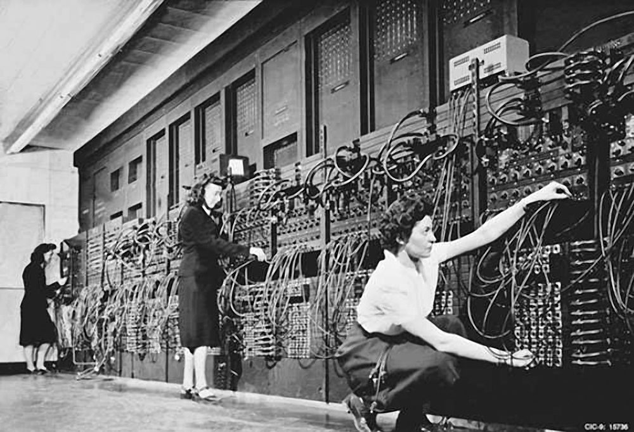
Notes:
ENIAC1

Slide 6
Single-User Contiguous Scheme
Commercially available in 1940s and 1950s
Entire program loaded into memory
Contiguous memory space allocated as needed
Jobs processed sequentially
Memory manager performs minimal work
Register to store the base address
Accumulator to track program size
Disadvantages
No support for multiprogramming or networking
Not cost effective
Program size must be less than memory size to execute

Slide 7
Fixed Partitions
Commercially available in 1950s and 1960s
Main memory is partitioned
At system startup
One contiguous partition per job
Permits multiprogramming
Partition sizes remain static
Must shut down computer system to reconfigure
Requires:
Protection of the job’s memory space
Matching job size with partition size

Slide 8
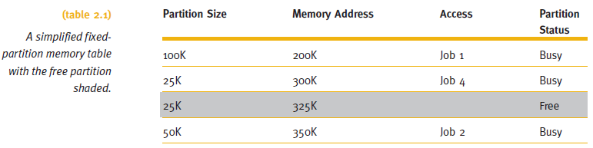
Fixed Partitions
Memory manager allocates memory space to jobs
Uses a table

Slide 9
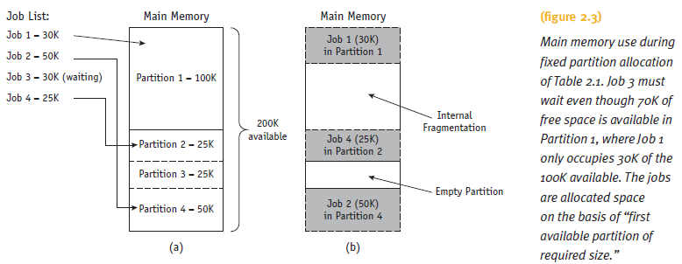
Fixed Partitions

Slide 10
Fixed Partitions
Disadvantages
Requires contiguous loading of entire program
Job allocation method
First available partition with required size
To work well:
All jobs must be same size and memory size known ahead of time
Arbitrary partition size leads to undesired results
Partition too small
Large jobs have longer turnaround time
Partition too large
Memory waste: internal fragmentation

Slide 11
Dynamic Partitions
Main memory is partitioned
Jobs given memory requested when loaded
One contiguous partition per job
Job allocation method
First come, first serve allocation method
Memory waste: comparatively small
Disadvantages
Full memory utilization only during loading of first jobs
Subsequent allocation: memory waste
External fragmentation: fragments between blocks

Slide 12
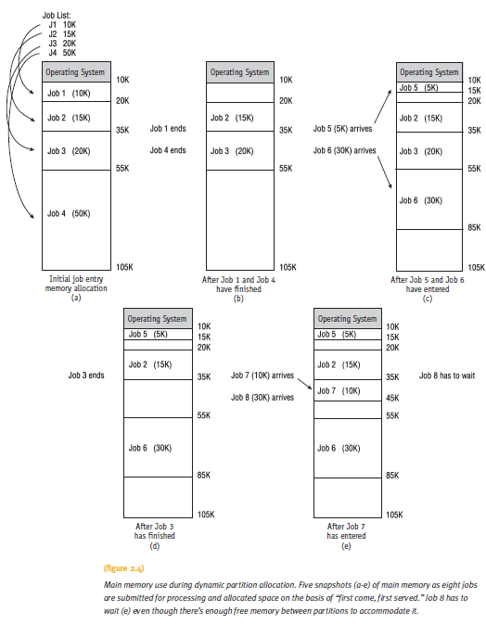
Dynamic Partitions (cont'd.)
Dynamic Partitions

Slide 13
Best-Fit Versus First-Fit Allocation
Two methods for free space allocation
First-fit memory allocation: first partition fitting the requirements
Leads to fast allocation of memory space
Best-fit memory allocation: smallest partition fitting the requirements
Results in least wasted space
Internal fragmentation reduced, but not eliminated
Fixed and dynamic memory allocation schemes use both methods

Slide 14
Best-Fit Versus First-Fit Allocation
First-fit memory allocation
Advantage: faster in making allocation
Disadvantage: leads to memory waste
Best-fit memory allocation
Advantage: makes the best use of memory space
Disadvantage: slower in making allocation

Slide 15
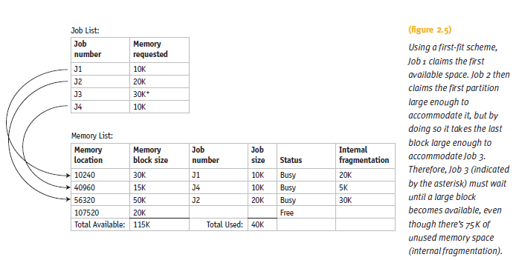
Best-Fit Versus First-Fit Allocation

Slide 16
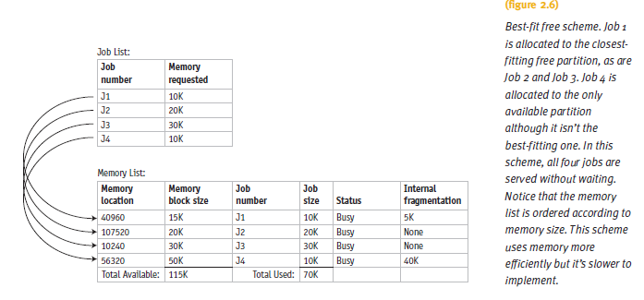
Best-Fit Versus First-Fit Allocation

Slide 17
Best-Fit Versus First-Fit Allocation
Algorithm for first-fit
Assumes memory manager keeps two lists
One for free memory
One for busy memory blocks
Loop compares the size of each job to the size of each memory block
Until a block is found that is large enough to fit the job
Job stored into that block of memory
Memory Manager moves out of the loop
Fetches next job from the entry queue

Slide 18
Best-Fit Versus First-Fit Allocation
Algorithm for first-fit (cont'd.):
If entire list searched in vain
Then job is placed into waiting queue
Otherwise, Memory Manager fetches next job
Process repeats

Slide 19
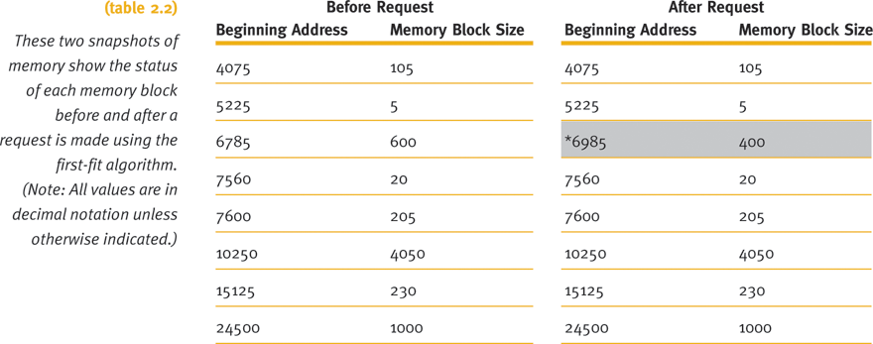
Best-Fit Versus First-Fit Allocation

Slide 20
Best-Fit Versus First-Fit Allocation (cont'd.)
Algorithm for best-fit
Goal
Find the smallest memory block into which the job will fit
Entire table searched before allocation

Slide 21
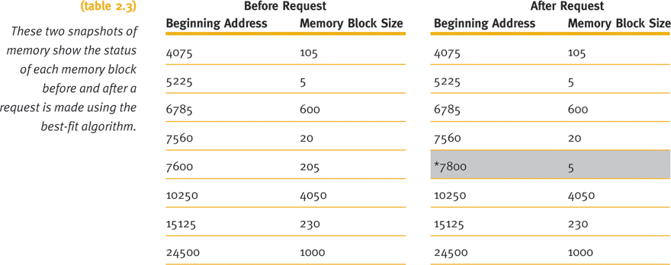
Best-Fit Versus First-Fit Allocation

Slide 22
Best-Fit Versus First-Fit Allocation
Hypothetical allocation schemes
Next-fit: starts searching from last allocated block, for next available block when a new job arrives
Worst-fit: allocates largest free available block to new job
Opposite of best-fit
Good way to explore theory of memory allocation
Not best choice for an actual system

Slide 23
Deallocation
Deallocation: freeing allocated memory space
For fixed-partition system:
Straightforward process
Memory Manager resets the status of job’s memory block to “free” upon job completion
Any code may be used
Example code: binary values with zero indicating free and one indicating busy

Slide 24
Deallocation
For dynamic-partition system:
Algorithm tries to combine free areas of memory
More complex
Three dynamic partition system cases
Case 1: When the block to be deallocated is adjacent to another free block
Case 2: When the block to be deallocated is between two free blocks
Case 3: When the block to be deallocated is isolated from other free blocks

Slide 25
Case 1: Joining Two Free Blocks
Blocks are adjacent
List changes to reflect starting address of the new free block
Example: 7600 - the address of the first instruction of the job that just released this block
Memory block size changes to show its new size for the new free space
Combined total of the two free partitions
Example: (200 + 5)

Slide 26
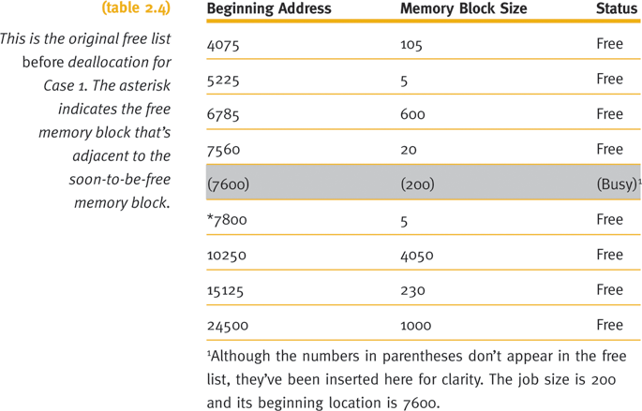
Case 1: Joining Two Free Blocks

Slide 27
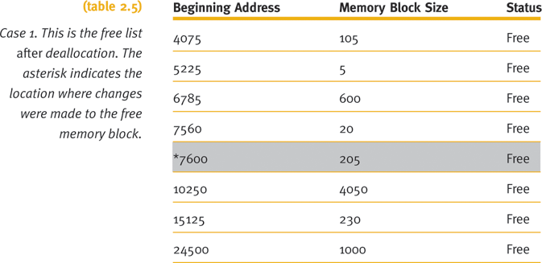
Case 1: Joining Two Free Blocks

Slide 28
Case 2: Joining Three Free Blocks
Deallocated memory space
Between two free memory blocks
List changes to reflect starting address of new free block
Example: 7560 was smallest beginning address
Sizes of the three free partitions must be combined
Example: (20 + 20 + 205)
Combined entry (last of the three) given status of “null”
Example: 7600

Slide 29
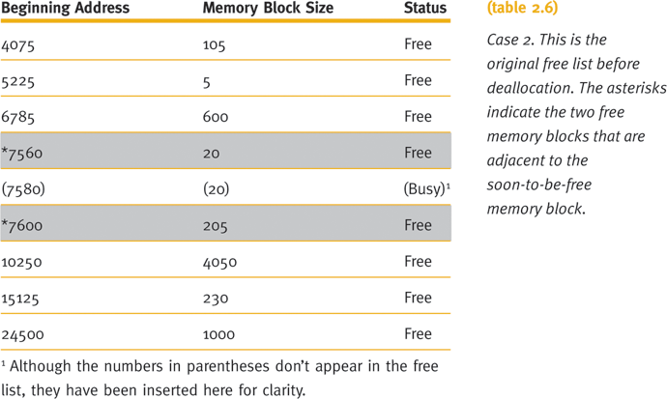
Case 2: Joining Three Free Blocks

Slide 30
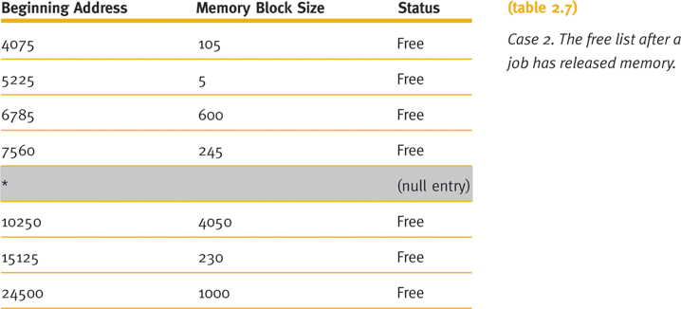
Case 2: Joining Three Free Blocks

Slide 31
Case 3: Deallocating an Isolated Block
Deallocated memory space
Isolated from other free areas
System determines released memory block status
Not adjacent to any free blocks of memory
Between two other busy areas
System searches table for a null entry
Occurs when memory block between two other busy memory blocks is returned to the free list

Slide 32
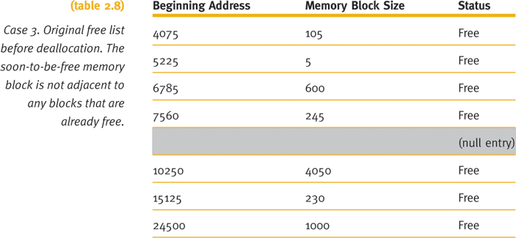
Case 3: Deallocating an Isolated Block

Slide 33
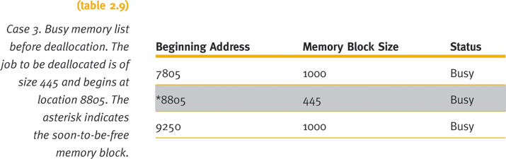
Case 3: Deallocating an Isolated Block

Slide 34
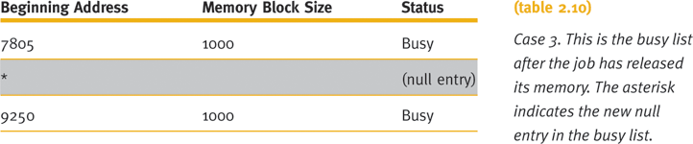
Case 3: Deallocating an Isolated Block

Slide 35
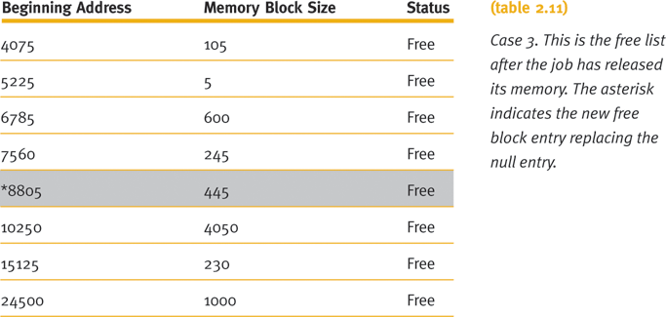
Case 3: Deallocating an Isolated Block

Slide 36
Relocatable Dynamic Partitions
Memory Manager relocates programs
Gathers together all empty blocks
Compact the empty blocks
Make one block of memory large enough to accommodate some or all of the jobs waiting to get in

Slide 37
Relocatable Dynamic Partitions
Compaction: reclaiming fragmented sections of memory space
Every program in memory must be relocated
Programs become contiguous
Operating system must distinguish between addresses and data values
Every address adjusted to account for the program’s new location in memory
Data values left alone

Slide 38
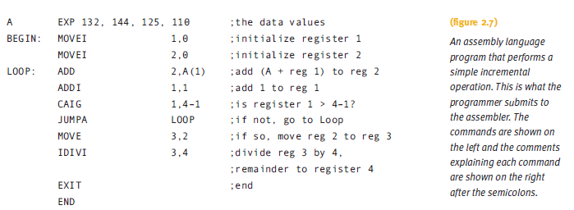
Relocatable Dynamic Partitions

Slide 39
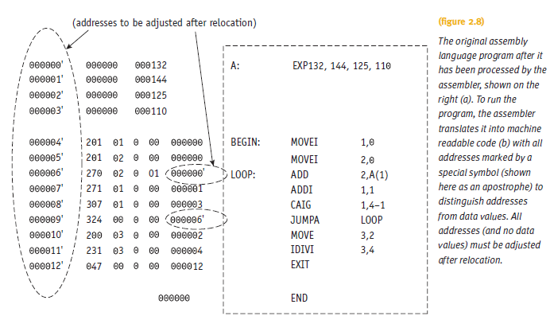
Relocatable Dynamic Partitions

Slide 40
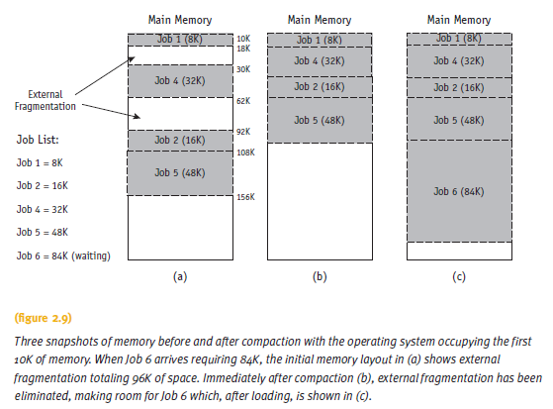
Relocatable Dynamic Partitions

Slide 41
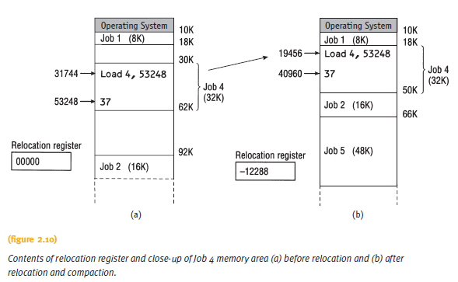
Relocatable Dynamic Partitions

Slide 42
Relocatable Dynamic Partitions
Compaction issues:
What goes on behind the scenes when relocation and compaction take place?
What keeps track of how far each job has moved from its original storage area?
What lists have to be updated?

Slide 43
Relocatable Dynamic Partitions
What lists have to be updated?
Free list
Must show the partition for the new block of free memory
Busy list
Must show the new locations for all of the jobs already in process that were relocated
Each job will have a new address
Exception: those already at the lowest memory locations

Slide 44
Relocatable Dynamic Partitions
Special-purpose registers used for relocation:
Bounds register
Stores highest location accessible by each program
Relocation register
Contains the value that must be added to each address referenced in the program
Must be able to access the correct memory addresses after relocation
If the program is not relocated, “zero” value stored in the program’s relocation register

Slide 45
Relocatable Dynamic Partitions
Compacting and relocating optimizes use of memory
Improves throughput
Options for timing of compaction:
When a certain percentage of memory is busy
When there are jobs waiting to get in
After a prescribed amount of time has elapsed
Compaction entails more overhead
Goal: optimize processing time and memory use while keeping overhead as low as possible

Slide 46
Summary
Four memory management techniques
Single-user systems, fixed partitions, dynamic partitions, and relocatable dynamic partitions
Common requirements of four memory management techniques
Entire program loaded into memory
Contiguous storage
Memory residency until job completed
Each places severe restrictions on job size
Sufficient for first three generations of computers

Slide 47
Summary
New modern memory management trends in late 1960s and early 1970s
Discussed in next chapter
Common characteristics of memory schemes
Programs are not stored in contiguous memory
Not all segments reside in memory during job execution

