Slide 1
CSG1102 – Unit Information

Slide 2
Staff Details
Peter Hannay
Roles: Lecturer and unit coordinator
Office: JO 2.341
Email: p.hannay@ecu.edu.au
Phone: 08 6304 2849
Don Griffiths
Roles: Tutor
Email: d.griffiths@ecu.edu.au

Slide 3
Staff Details
Contact us with any queries, issues, feedback, requests for feedback on assignment work, etc
Email is preferred contact method – use your student email account only
Include unit code in subject line of email
Notes:
Don’t be afraid to contact us. If you are struggling or unsure about what is expected, etc, contact us BEFORE it becomes a big problem.
Remember to include your unit code in your email subject and send it from your student email account only. Failure to do this may result in your emails being spam-filtered, ending up in the wrong folder, or replies not being delivered correctly.

Slide 4
Unit Timetable
This unit consists of a lecture and workshop
If studying online, I recommend completing weekly content by the first half of the week, to maximise your time to ask questions

Slide 5
Assessments
Annotated Bibliography – 20%
A list of citations with summary information
Essay – 30%
A discussion of Ext3 file system journaling
Exam – 50%
It is required you pass the exam in order to pass the unit

Slide 6
Academic Misconduct
The point of the unit is for you to learn something
The assessments are there to allow you to demonstrate what you have learned
If you do something that stops this process from working properly, it is academic misconduct
You are expected to understand and avoid doing anything which is academic misconduct

Slide 7
Academic Misconduct
Plagiarism
If you quote, paraphrase, use (etc) something that someone else said or wrote and don’t properly acknowledge them, how do I determine if you have learned anything?
If you copy someone else’s work and submit it as your own, how do I determine if you have learned anything?
Collusion
Helping your classmates is fine. Help them with their work – do not let them use your work or do it for them
If your work ends up almost identical to someone else’s, how do I determine if you have learned anything?
Notes:
Collusion is often a bigger problem than plagiarism, as some students will do it without realising. I understand the desire to help your friends/classmates and work with them. That is fine. It’s how people learn, and it is generally encouraged.
You just need to know where to draw the line. Don’t work on an assignment together if it is an individual assignment. If your friend is stuck on something, don’t share your work or do it for them. Explain how to solve the problem, point them towards the appropriate resources, and let them work it out themselves. Never, ever, give someone a copy of your work or code. Ever.

Slide 8
You are expected to…
Attend lectures and workshops / labs / tutorials
Be an active learner – ask questions, discuss issues, participate in unit forums, etc
Complete workshop / lab / tutorial exercises
They are a significant portion of the assessments
Read lecture notes, textbook, additional information as indicated in weekly content
Notes:
You will get as much out of this unit as you put in.

Slide 9
OSH Induction - Emergency Evacuations
Take notice of fire alarms, TV messages, audio messages or instruction from a Security Officer / Building / Area Warden (they may be wearing bright fluorescent jackets)
Be aware of the evacuation procedure - vacate the room in an orderly fashion through the specified emergency exit doors taking belongings with you. These doors should automatically open when the door bar is pushed
Go directly to the Emergency Assembly Area for that building. All rooms should have a map displaying this information (indicate Assembly Area from map to students)

Slide 10
OSH Induction - Emergency Evacuations
See Emergency Procedures multi-coloured flip chart and "Instruction to Lecturers" located in each room
Assist wheel chair bound / disabled / injured persons to a safe location inside the room while able bodies persons evacuate, then assist them in evacuation
Obey instructions
Do not leave the premises or go to café etc. – go to Emergency Assembly Area (refer to chart)
Do not use lifts
Wait to be told to return to building or to disperse by a FESA Officer in Charge or a Security Officer / Building / Area Warden

Slide 11
OSH Induction - Emergency Assistance
Note the location and use of the Security phones on campus. These are radiophones and there will be a pause before an officer responds
Security Officers will escort them to vehicles
Security Officers are trained in First Aid
It is safer to walk around on campus and to transport after hours in pairs or more
There are designated well-lit walkways for movement around campus after dark
Note the location and availability of the campus Medical Suite

Slide 12
OSH Induction - Responsibilities of Students
If lecturer does not show inform school secretary / clerical as soon as possible
ECU supports a NON-SMOKING environment
Hazards need to be reported to a university staff member
Accidents and injuries need to be reported to a university staff member as soon as possible

Slide 13
A few final things…
Arrive to lectures and workshops / labs / tutorials on time
Turn off your mobile phones or set them to silent
Give staff your attention during class – your email and private conversations can wait for an hour or two
Do not be afraid to contact us – We are here to answer queries, clarify things, provide feedback on work, etc
Do not be afraid to speak up in class – got an answer? A question? A suggestion? A pulse? Please, let us know!
Notes:
The first few of these are common courtesy and respect…
Contact us BEFORE something becomes a problem. There’s nothing worse than receiving an assignment that doesn’t answer the question, because the brief was misinterpreted and the student never contacted us for feedback or clarifications…

Slide 14
Chapter 1
Introducing Operating Systems

Slide 15
Learning Objectives
After completing this chapter, you should be able to describe:
Innovations in operating systems development
The basic role of an operating system
The major operating system software subsystem managers and their functions
The types of machine hardware on which operating systems run

Slide 16
Learning Objectives
The differences among batch, interactive, real-time, hybrid, and embedded operating systems
Multiprocessing and its impact on the evolution of operating system software
Virtualization and core architecture trends in new operating systems

Slide 17
Introduction
Operating systems
Manage computer system hardware and software
This text explores:
What they are
How they work
What they do
Why they do it
This chapter describes:
How operating systems work
The evolution of operation systems

Slide 18
What is an Operating System?
Computer System
Software (programs)
Hardware (physical machine and electronic components)
Operating System
Part of computer system (software)
Manages all hardware and software
Controls every file, device, section of main memory and nanosecond of processing time
Controls who can use the system
Controls how system is used

Slide 19
Operating System Software
Includes four essential subsystem managers
Memory Manager
Processor Manager
Device Manager
File Manager
Network Manager (fifth subsystem manager)
In all modern operating systems
Assumes responsibility for networking tasks
Discussed further in Chapters 9 & 10

Slide 20
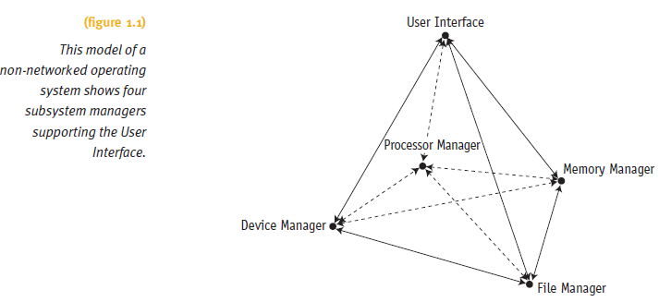
Operating System Software

Slide 21
Operating System Software
Each manager:
Works closely with other managers
Performs a unique role
Manager tasks
Monitor its resources continuously
Enforce policies determining:
Who gets what, when, and how much
Allocate the resource (when appropriate)
Deallocate the resource (when appropriate)

Slide 22
Operating System Software (cont'd.)
Network Manager
Operating systems with networking capability
Fifth essential manager
Convenient way for users to share resources
Retains user access control
Resources include:
Hardware (CPUs, memory areas, printers, tape drives, modems, and disk drives)
Software (compilers, application programs, and data files)

Slide 23
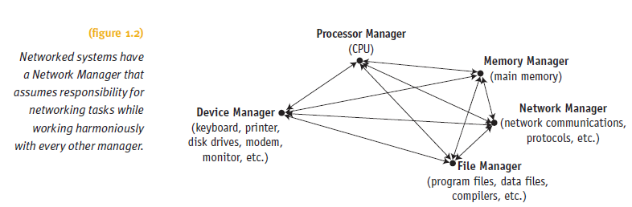
Operating System Software (cont'd.)

Slide 24
Main Memory Management
In charge of main memory
Random Access Memory (RAM)
Responsibilities include:
Preserving space in main memory occupied by operating system
Checking validity and legality of memory space request
Setting up memory tracking table
Tracks usage of memory by sections
Needed in multiuser environment
Deallocating memory to reclaim it

Slide 25
Processor Management
In charge of allocating Central Processing Unit (CPU)
Tracks process status
An instance of program execution
Two levels of responsibility:
Handle jobs as they enter the system
Handled by Job Scheduler
Manage each process within those jobs
Handled by Process Scheduler

Slide 26
Device Management
In charge of monitoring all resources
Devices, channels, and control units
Responsibilities include:
Choosing most efficient resource allocation method
Printers, ports, disk drives, etc.
Based on scheduling policy
Allocating the device
Starting device operation
Deallocating the device

Slide 27
File Management
In charge of tracking every file in the system
Data files, program files, compilers, application programs
Responsibilities include:
Enforcing user/program resource access restrictions
Uses predetermined access policies
Controlling user/program modification restrictions
Read-only, read-write, create, delete
Allocating resource
Opening the file
Deallocating file (by closing it)

Slide 28
Cooperation Issues
Essential manager
Perform individual tasks and
Harmoniously interact with other managers
Requires incredible precision
No single manager performs tasks in isolation
Network manager
Convenient way to share resources
Controls user access

Slide 29
A Brief History of Machine Hardware
Hardware: physical machine and electronic components
Main memory (RAM)
Data/Instruction storage and execution
Input / Output devices (I/O devices)
All peripheral devices in system
Printers, disk drives, CD/DVD drives, flash memory, and keyboards
Central processing unit (CPU)
Controls interpretation and execution of instructions
Controls operation of computer system

Slide 30
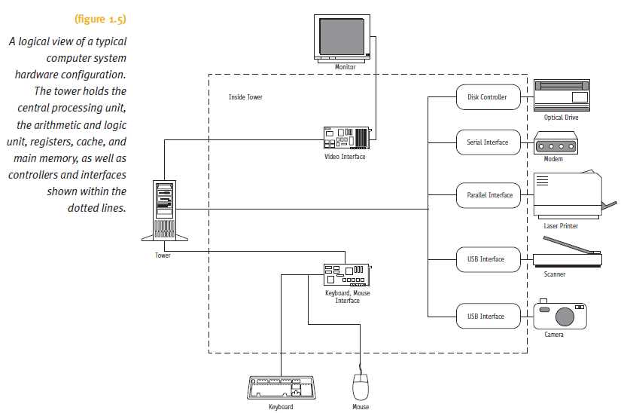
A Brief History of Machine Hardware

Slide 31
A Brief History of Machine Hardware
Computer classification
By capacity and price (until mid-1970s)
Mainframe
Large machine
Physical size and internal memory capacity
Classic Example: 1964 IBM 360 model 30
CPU required 18-square-foot air-conditioned room
CPU size: 5 feet high x 6 feet wide
Internal memory: 64K
Price: $200,000 (1964 dollars)
Applications limited to large computer centers

Slide 32
A Brief History of Machine Hardware
Minicomputer
Developed for smaller institutions
Compared to mainframe
Smaller in size and memory capacity
Cheaper
Example: Digital Equipment Corp. minicomputer
Price: less than $18,000
Today
Known as midrange computers
Capacity between microcomputers and mainframes

Slide 33
A Brief History of Machine Hardware
Supercomputer
Massive machine
Developed for military operations and weather forecasting
Example: Cray supercomputer
6 to 1000 processors
Performs up to 2.4 trillion floating-point operations per second (teraflops)
Uses:
Scientific research
Customer support/product development

Slide 34
A Brief History of Machine Hardware
Microcomputer
Developed for single users in the late 1970s
Example: microcomputers by Tandy Corporation and Apple Computer, Inc.
Very little memory (by today’s standards)
64K maximum capacity
Microcomputer’s distinguishing characteristic
Single-user status

Slide 35
A Brief History of Machine Hardware
Workstations
Most powerful microcomputers
Developed for commercial, educational, and government enterprises
Networked together
Support engineering and technical users
Massive mathematical computations
Computer-aided design (CAD)
Applications
Requiring powerful CPUs, large main memory, and extremely high-resolution graphic displays

Slide 36
A Brief History of Machine Hardware
Servers
Provide specialized services
To other computers or client/server networks
Perform critical network task
Examples:
Print servers
Internet servers
Mail servers

Slide 37
A Brief History of Machine Hardware
Advances in computer technology
Dramatic changes
Physical size, cost, and memory capacity
Networking
Integral part of modern computer systems
Mobile society information delivery
Creating strong market for handheld devices
New classification
By processor capacity, not memory capacity
Moore’s Law
Computing power rises exponentially

Slide 38
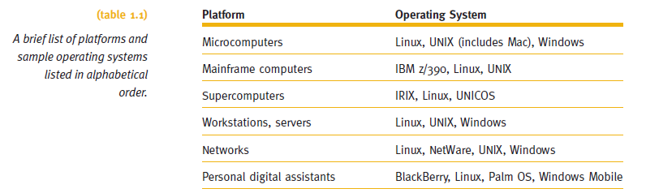
A Brief History of Machine Hardware

Slide 39
Types of Operating Systems
Five categories
Batch
Interactive
Real-time
Hybrid
Embedded
Two distinguishing features
Response time
How data enters into the system

Slide 40
Types of Operating Systems
Batch Systems
Input relied on punched cards or tape
Efficiency measured in throughput
Interactive Systems
Faster turnaround than batch systems
Slower than real-time systems
Introduced to provide fast turnaround when debugging programs
Time-sharing software developed for operating system

Slide 41
Types of Operating Systems
Real-time systems
Reliability is key
Fast and time limit sensitive
Used in time-critical environments
Space flights, airport traffic control, high-speed aircraft
Industrial processes
Sophisticated medical equipment
Distribution of electricity
Telephone switching
Must be 100% responsive, 100% of the time

Slide 42
Types of Operating Systems
Hybrid systems
Combination of batch and interactive
Accept and run batch programs in the background
Interactive load is light
Embedded systems
Computers placed inside other products
Adds features and capabilities
Operating system requirements
Perform specific set of programs
Not interchangeable among systems
Small kernel and flexible function capabilities

Slide 43
Brief History of Operating Systems Development
1940s: first generation
Computers based on vacuum tube technology
No standard operating system software
Typical program included every instruction needed by the computer to perform the tasks requested
Poor machine utilization
CPU processed data and performed calculations for fraction of available time
Early programs
Designed to use the resources conservatively
Understandability is not a priority

Slide 44
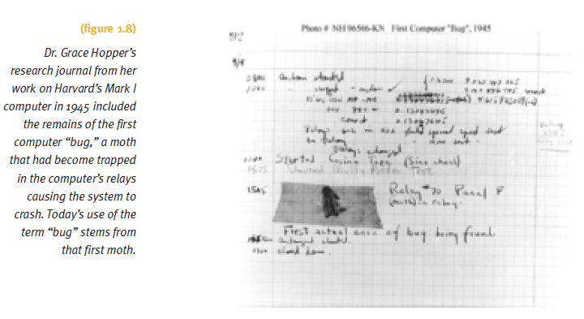
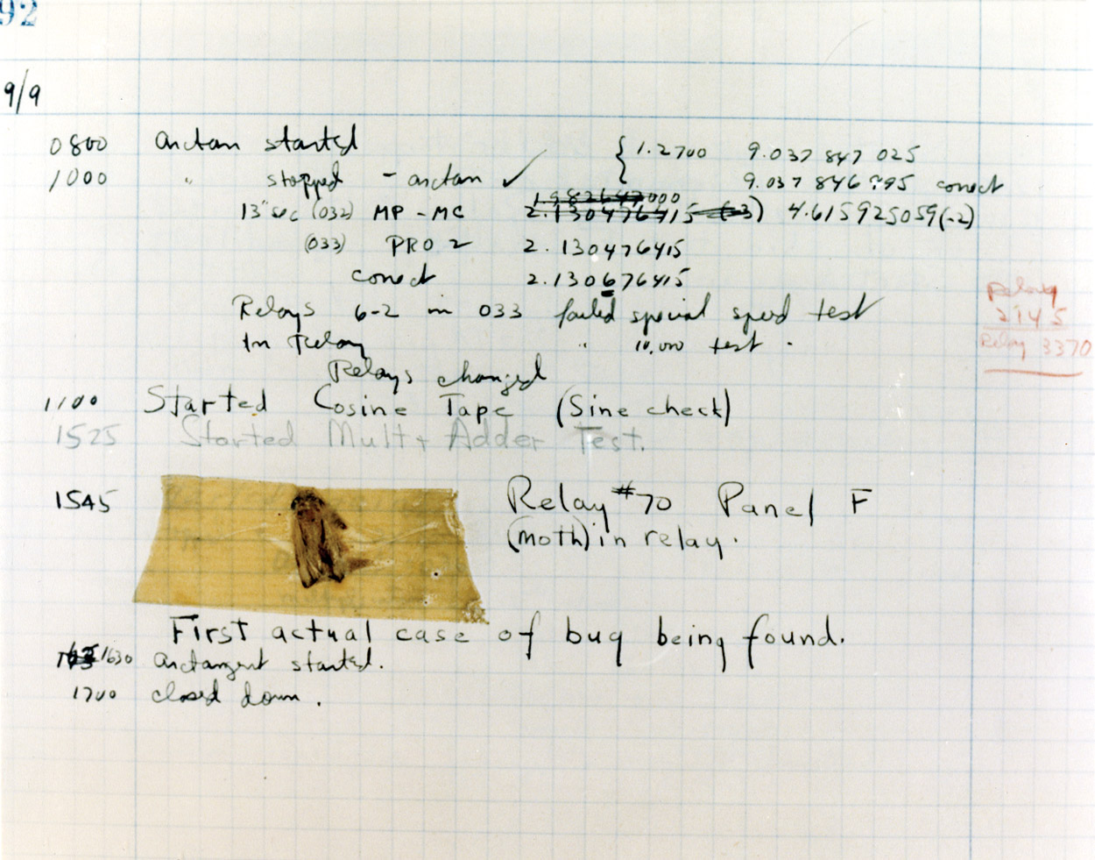
Brief History of Operating Systems Development

Slide 45
Brief History of Operating Systems Development
1950s: second generation
Focused on cost effectiveness
Computers were expensive
IBM 7094: $200,000
Two widely adopted improvements
Computer operators: humans hired to facilitate machine operation
Concept of job scheduling: group together programs with similar requirements
Expensive time lags between CPU and I/O devices

Slide 46
Brief History of Operating Systems Development
1950s: second generation (cont'd.)
I/O device speed gradually became faster
Tape drives, disks, and drums
Records blocked before retrieval or storage
Access methods developed
Added to object code by linkage editor
Buffer between I/O and CPU introduced
Reduced speed discrepancy
Timer interrupts developed
Allowed job-sharing

Slide 47
Brief History of Operating Systems Development
1960s: third generation
Faster CPUs
Speed caused problems with slower I/O devices
Multiprogramming
Allowed loading many programs at one time
Program scheduling
Initiated with second-generation systems
Continues today
Few advances in data management
Total operating system customization
Suit user’s needs

Slide 48
Brief History of Operating Systems Development
1970s
Faster CPUs
Speed caused problems with slower I/O devices
Main memory physical capacity limitations
Multiprogramming schemes used to increase CPU
Virtual memory developed to solve physical limitation
Database management software
Became a popular tool
A number of query systems introduced
Programs started using English-like words, modular structures, and standard operations

Slide 49
Brief History of Operating Systems Development
1980s
Cost/performance ratio improvement of computer components
More flexible hardware (firmware)
Multiprocessing
Allowed parallel program execution
Evolution of personal computers
Evolution of high-speed communications
Distributed processing and networked systems introduced

Slide 50
Brief History of Operating Systems Development
1990s
Demand for Internet capability
Sparked proliferation of networking capability
Increased networking
Increased tighter security demands to protect hardware and software
Multimedia applications
Demanding additional power, flexibility, and device compatibility for most operating systems

Slide 51
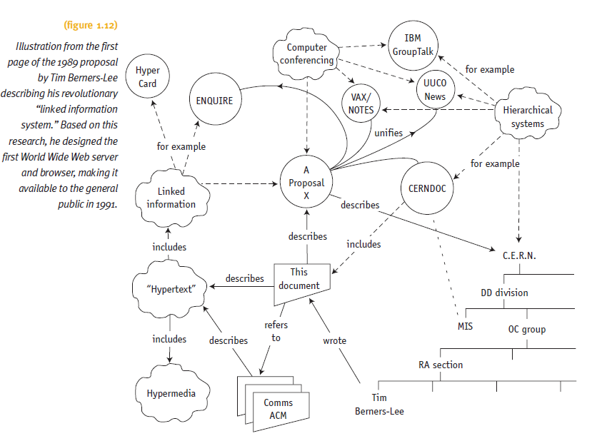
Brief History of Operating Systems Development

Slide 52
Brief History of Operating Systems Development
2000s
Primary design features support:
Multimedia applications
Internet and Web access
Client/server computing
Computer systems requirements
Increased CPU speed
High-speed network attachments
Increased number and variety of storage devices
Virtualization
Single server supports different operating systems

Slide 53
Threads
Multiple actions executing simultaneously
Heavyweight process (conventional process)
Owns the resources
Passive element
Lightweight process (thread)
Uses CPU and scheduled for execution
Active element
Multithreaded applications programs
Contain several threads running at one time
Same or different priorities
Examples: Web browsers and time-sharing systems

Slide 54
Object-Oriented Design
Driving force in system architecture improvements
Kernel (operating system nucleus)
Resides in memory at all times, performs essential tasks, and protected by hardware
Kernel reorganization
Memory resident: process scheduling and memory allocation
Modules: all other functions
Advantages
Modification and customization without disrupting integrity of the remainder of the system
Software development more productive

Slide 55
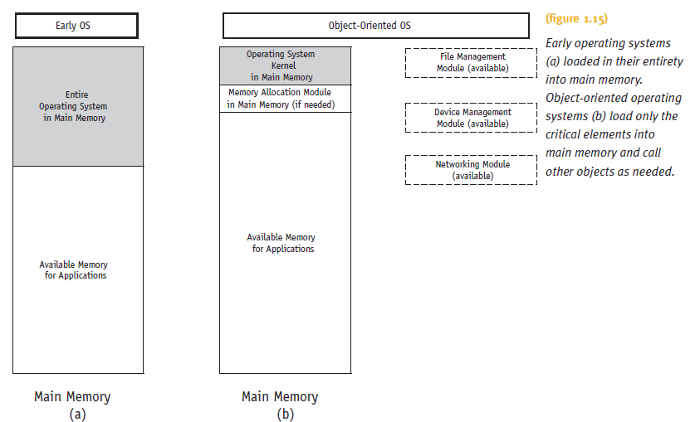
Object-Oriented Design

Slide 56
Summary
Operating system overview
Functions of OS
Manages computer system
Hardware and software
Four essential managers
Work closely with the other managers and perform unique role
Network Manager
Operating systems with networking capability
Essential hardware components
Memory chips, I/O, storage devices, and CPU

Slide 57
Summary
Evolution of OSs
Run increasingly complex computers
Run increasingly complex computer systems
Prior to mid-1970s
Computers classified by capacity and price
Dramatic changes over time
Moore’s Law: computing power rises exponentially
Physical size, cost, and memory capacity
Mobile society information delivery
Creates strong market for handheld devices
Integral in modern computer systems

Slide 58
Summary
Five categories of operating systems
Batch, interactive, real-time, hybrid, and embedded
Use of object-oriented design improves the system architecture
Several ways to perform OS tasks
Designer determines policies to match system’s environment
Next:
Explore details of operating system components

