Slide 1
Communicating in an IT Environment Lecture 9 – Inferential Statistics (M.Brogan & B.Combes)

Slide 2
<< Review Exercise
Explain the following measures of central tendency:
Mean
Median
Standard Deviation
z-score
Calculate the Mean, Median and Standard Sample Deviation for this data set of exam scores for 2 classes in CSG1132. Using the formula for calculating a z-score, decide in which class student 3 is performing best. Explain your result.
ID | Class 1 | Class 2
1 | 50 | 55
2 | 75 | 65
3 | 80 | 70
Notes:
-The mean is the average score, obtained adding all of the values in a data set and dividing by the number of items.
-The median is the middle score. Median plays an important role in the world of statistics. By definition, it is a value which divides an array into two equal parts. In this problem you are to determine the current median of some long integers.
Suppose, we have five numbers {1,3,6,2,7}. In this case, 3 is the median as it has exactly two numbers on its each side. {1,2} and {6,7}.
If there are even number of values like {1,3,6,2,7,8}, only one value cannot split this array into equal two parts, so we consider the average of the middle values {3,6}. Thus, the median will be (3+6)/2 = 4.5. In this problem, you have to print only the integer part, not the fractional. As a result, according to this problem, the median will be 4!
The Standard Deviation The standard deviation is a measure of how widely values are dispersed from the average value (the mean).
The z-score

Slide 3
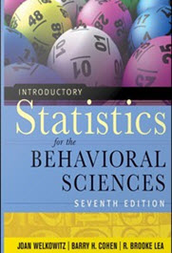
Inferential statistics
The CO₂ and sea level rise table from last week suggested an inference – namely that rising CO₂ levels are associated with sea level rise
This is typical of inferential statistics, where we are trying to reach conclusions that extend beyond the immediate data alone.
For instance, we use inferential statistics to try to infer from the sample data what the population might think. Or, we use inferential statistics to make judgments of the probability that an observed difference between groups is a dependable one or, alternately, one that might have happened by chance.
Thus, we use inferential statistics to make inferences from our data to more general conditions; we use descriptive statistics simply to describe what's going on in our data.
Welkowitz, J., Cohen, B. and Lea, R. (2011). Introductory Statistics for the Behavioural Sciences. Hoboken: New Jersey. Wiley. –Chapter 5

Slide 4

Correlation testing
The CO₂ problem involved a test of whether two variables were co-related. This is a common problem in statistics e.g.
H₁ – The number of close friends a person has is positively associated with FB friends;
In a test of correlation, if data is normally distributed a Pearson’s Product Moment Correlation test is used;
If data is not normally distributed, a Spearman’s rank order correlation coefficient non-parametric test is used
This test requires conversion of interval and ratio data to ordinal data.
Notes:
The Pearson correlation is described by the product of the sum of the z-scores for each variable divided by the number of observations. Do recall the definition of a z-score:
A z-score is a (Jackson, 2006, p.109) measure of how many standard deviation units an individual’s raw score falls from the mean of the distribution. A z score is calculated using the following formula:
Where :
X= the individual score
X= sample mean
S= standard deviation

Slide 5
Linear association
Weight (Pounds) | Height (Inches)
100 | 60
120 | 61
105 | 63
115 | 63
119 | 65
134 | 65
129 | 66
143 | 67
151 | 65
163 | 67
160 | 68
176 | 69
165 | 70
181 | 72
192 | 76
208 | 75
200 | 77
152 | 68
134 | 66
138 | 65
The simplest kind of relationship between two variables is a linear relationship.
For this data set (Jackson, 2006, p.135) r=0.94
Interpretation= ‘There is a strong positive relationship between weight and height’
r is the correlation coefficient
Can range from +1 to -1
Strength is usually described as ‘weak’, ‘moderate’ or ‘strong’ (+-.70-.99) depending on the value of r

Slide 6
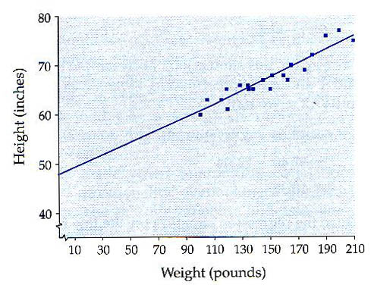
Scatter plot view
The strong positive relationship between height and weight seen in the data set can be represented on a scatter plot with a regression line. The regression line (Jackson, 2006, p.137) is the best fitting straight line drawn through the center of a scatter plot that indicates the relationship between the variables.
The slope of the line is given by the formula
<< Class Problem:
Explain the formula in your own words;
What is the predictive power of the line?
Notes:
For a linear regression Y= bX + a ; b the slope of the line equals the correlation coefficient * the SD for Y/SD x;
Given any particular value for X , Y can be calculated using the formula.
Note also that this is the simplest form of regression, where more that two variables are involved, a situation of multiple linear regression is described.

Slide 7
Multiple Linear Regression
Simple linear regression involving bivariate analysis is widely used but involves significant simplification:
In the real world many predictor variables can be at work determining the dependent measure;
What other predictor variables exist for weight besides height?
Multiple linear regression is an analysis method based on multiple variables.
Predictive power is often increased by the use of more sophisticated models based on numerous predictive variables.
Where strong or moderate correlation exists between two variables, conclusions about causality need to be treated with caution
For example, the relationship that we now accept between smoking and lung cancer has emerged from many empirical studies that have enabled us to be confident about the relationship

Slide 8
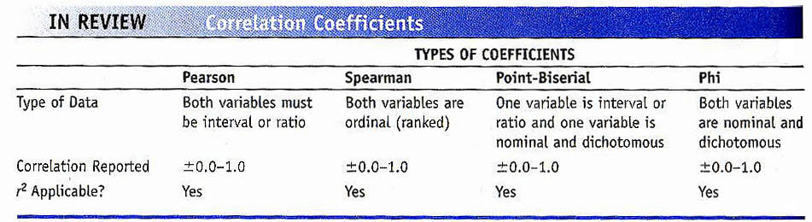
Interpreting correlation
Care must be exercised in the interpretation of the results of correlation testing:
Where strong correlation is observed between variables this should not be interpreted as causality:
The observed effect may be attributable to a third variable or some combination of predictor variables. In other words the observed effect is co-incident rather than causal;
A claim of association is no more nor no less..
There are many types of correlation coefficients that are paired with data types (Jackson, 2006, p.137):
Notes:
Pefrect direct relationship o inverse relatiosnhip.

Slide 9
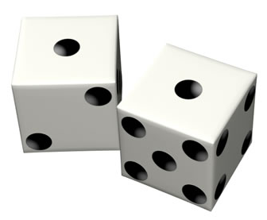
Confidence levels Rolling the dice
Inferential statistics are used to accept or reject hypotheses on the basis of probability that an observed effect can be attributed to a relationship between variables.
There are two widely used ‘gold standards’ :
α= 0.05 meaning that the probability of the outcome being observed by chance distribution of values is <1/20
α=0.01 meaning that the probability of the outcome being observed by chance distribution of values is <1/100

Slide 10
H₁ – FB Friends and close friends
H₁ – The number of close friends a person has is positively associated with FB friends;
This hypothesis was aimed at exploring whether individuals in FB displaying good sociability as measured by FB friends, would display similar sociability in the real world, as measured by close friends.
If the thesis is to be accepted or rejected then it must be test against the data with a test of association

Slide 11
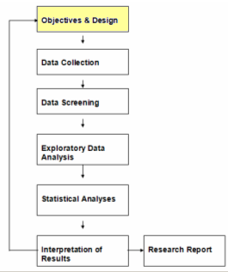
Hypothesis testing
The null hypothesis
describes the situation where no positive correlation is observed between close friends and FB friends.
The hypothesis is rejected.
The hypothesis is accepted:
if correlation is found at the required confidence level (0.01, 0.05 etc.)
Confidence levels ask the question what is the probability that the observed correlation might have happened by chance?
The tested P-value is compared with the confidence level to determine acceptance or rejection.
Notes:
In the null hypothesis the distribution of scores relative to the mean shows no significant difference between the two groups.

Slide 12
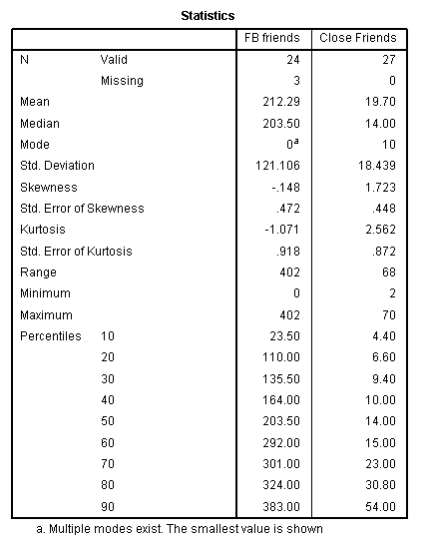
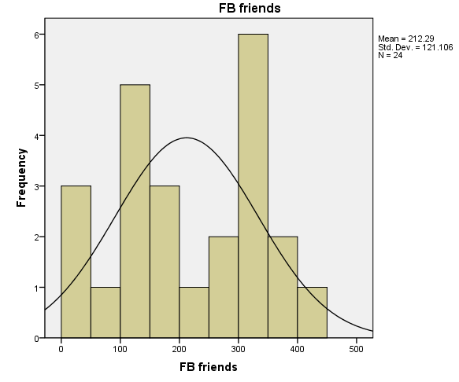
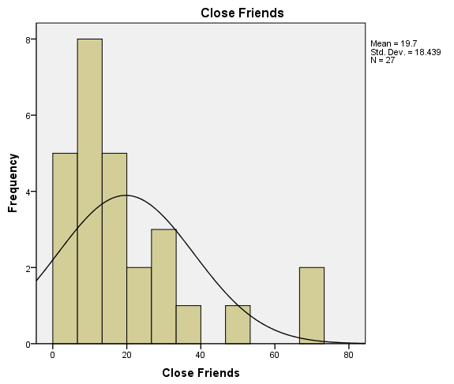
H₁ – FB Friends and close friends
Data screening
The data were found to be normally distributed with FB friends but CF display + skew (with many small values)
A non-parametric test is required

Slide 13
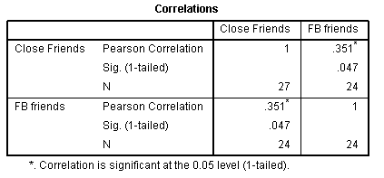
H₁ – FB Friends and close friends
Correlation testing – Spearman’s Rho
Below is the SPSS dialog for results of the test of correlation
The result shows weak + association that is significant at the α = 0.05 confidence level.
The result is sufficient to reject the null hypothesis, but what interpretation would you put on it?

Slide 14

Statistical Literacy
“Statistical literacy is critical thinking about statistics in arguments.
Critical thinking focuses on identifying and evaluating arguments supporting the truth of disputable claims. Critical thinking focuses on both deductive and inductive arguments. Statistical literacy is critical thinking about statistics as evidence for inferences.”
Milo Scheild. Director of the W. M. Keck Statistical Literacy Project

Slide 15
Using and abusing numbers
Over the past two weeks, we have explored the foundations of statistical literacy:
Measures of central tendency (mean, median)
Normality
Measures of dispersion (standard deviation)
How to interpret and misinterpret statistical findings
Lies, damned lies and statistics OR
Abuse of numbers?
The wilful misuse of statistics is rampant..

Slide 16
Using and abusing numbers
“There are three kinds of lies: lies, damned lies and statistics" (Disraeli, British Prime Minister, 1804 - 1881)
“The only statistics you can trust are those you falsified yourself" (Winston Churchill, British wartime Prime Minister, 1874-1965)
“A little inaccuracy saves a world of explanation" (Clarence Edwin Ayres, economist and philosopher, 1891-1972)
“Statistics rarely lie, but people can and do misuse and misunderstand statistics. Statistical literacy can help the public know when statistics are being presented in a bogus manner and to understand what the statistics really mean” (Kenneth Prewitt, Director, Bureau of Census USA)

Slide 17
Statistical literacy: Using and abusing numbers
Common statistical fallacies and mistakes
Differences in means between populations or samples are ‘significant’
Inferential tests are required to establish significant differences
The presence of outliers can distort the mean
Std. Dev. is essential to understanding what interpretation can be attributed to the mean
Means shed light on the behavior of cases
E.g. JO students are more social as measured by mean FB friends than ML students
Imputing a property of a cohort to particular case is dangerous (similar to z-score scenario)
Where two means are different, there may be many values common to both distributions

Slide 18
Statistical literacy: Using and abusing numbers
Review of the data on hours spent on Facebook shows that JO students spend around half as much time online as ML students as measured by the mean :
Claim : ML students are more addicted to FB than JO students
This claim may be wrong because:
The claim aims to shed light on behavior at case level
Std Dev. shows considerable variability in the ML scores
Outliers could be affecting the mean (e.g. 0)
An independent samples t-test is a more reliable way to resolve this claim
Are the distributions of the scores in the two samples significantly different at a confidence level of 0.05 or 0.01?

Slide 19
Statistical literacy: Using and abusing numbers
Confusing causation with association
Consider three claims about the results of an observational study
1. People who weigh more tend to be taller [than people who weight less].
2.Weight is positively associated with height
3. If you gain weight, you can expect to get taller.
Spurious association is where an effect is caused by one or more other variables, rather than the ones being tested
An association is observed between ice cream sales and drownings (Moore, 1993)
An association is observed between doctors in a region and people dying of disease
Explanations?

Slide 20
Statistical literacy: Using and abusing numbers
Simpson’s Paradox:
A reversal of an association between two variables after a third variable is taken into account.
Correlation is not necessarily a sign of direct causation. An observed correlation may be spurious due entirely to a confounding factor – a common cause.

Slide 21
Statistical Literacy: Simpson’s Paradox
At Berkeley, rejection for admission was more likely for women than for men at the college level.
However, rejection was also found more likely for men than for women at the department level.
The confounding factor was the department.
Thus, the association between sex and rejection was reversed after taking into account the department rejecting the admission.
The department was a more important explanatory factor than the sex of the applicant. And the choice of department was significantly associated with sex: 90% of women chose departments with high rejection rates while only 50%of men chose such departments. (Freedman et al)

Slide 22
Statistical Literacy: Using and abusing numbers
Distinguishing observational studies from experiment.
In an experiment the researcher has effective physical control.
In an observational study, the researcher has no physical control.
Surveys are observational studies that take place outside the context of a lab where experimental conditions can be controlled
Wherever subjects know that they are involved in a study, this can influence behavior (Hawthorne Effect)

Slide 23
Statistical Literacy Using and abusing numbers
Reliability problems with surveys
Error
Random error
Often due to large number of small determinate causes. Minimize by getting a larger sample
Systematic error
Due to bias. Unrepresentative subset of the target population.
Bad measuring instruments (eg. Bad questions in a survey)
Response bias. (choosing not to respond, untruthful responses). (Schield, 1999)

Slide 24
Statistical Literacy: Using and abusing numbers
Overreach
Trying to reach conclusions that extend beyond the immediate data alone.
Generalizing findings from samples to populations when there are too few measurements or where the sample is not genuinely representative of the population
With the Facebook problem, the data could not be used for inference about Facebook user behavior beyond the immediate context of the CSG1132 population

Slide 25
Statistical Literacy: Using and abusing numbers
Methodological errors in statistical analysis
Described by applying tests wrongly and relying upon simple approaches to understanding data (e.g. Bivariate analysis) when more sophisticated methods should have been used
We used the concept of ‘goodness of fit’ to describe match between parameters of a data set and appropriate methods
Should not use parametric methods on non-parametric data and vice versa
Always check for normality.

Slide 26
Exam time..
Textual and numerical interpretation
Question: Have the students followed the instructions?

Slide 27
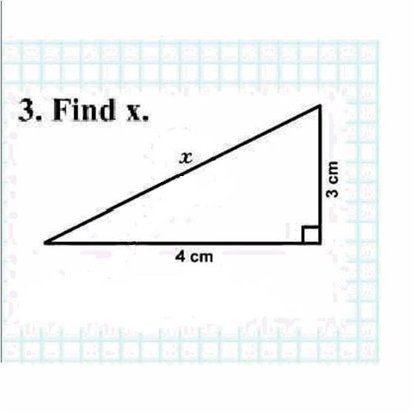

Slide 28
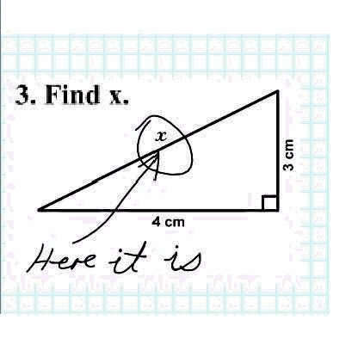

Slide 29
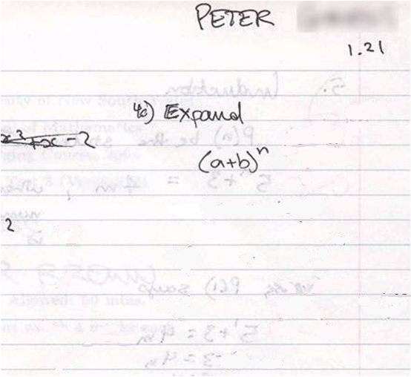

Slide 30
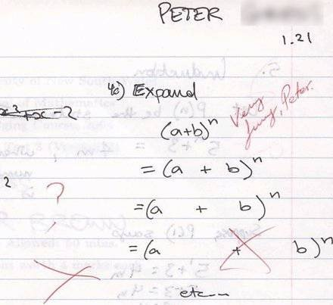

Slide 31
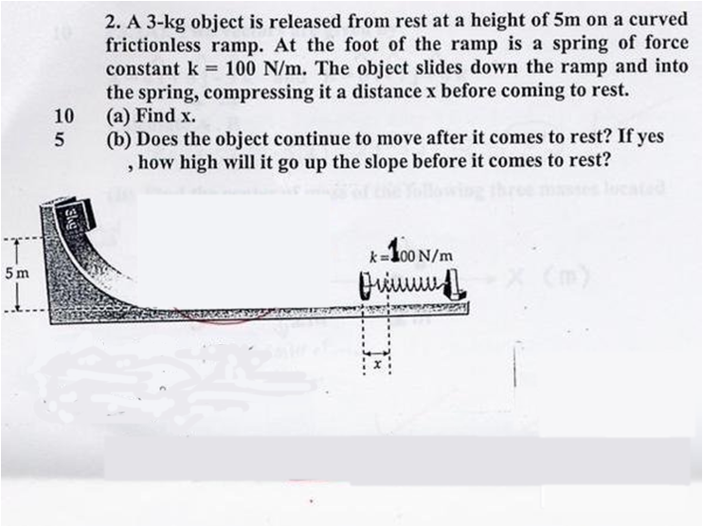

Slide 32
