Slide 1
Understanding Operating Systems Sixth Edition
Chapter 8
File Management

Slide 2
Learning Objectives
After completing this chapter, you should be able to describe:
The fundamentals of file management and the structure of the file management system
File-naming conventions, including the role of extensions
The difference between fixed-length and variable-length record format
The advantages and disadvantages of contiguous, noncontiguous, and indexed file storage techniques
Comparisons of sequential and direct file access
Access control techniques and how they compare
The role of data compression in file storage
Notes:
<number>

Slide 3
The File Manager
File management system
Software
File access responsibilities
Creating, deleting, modifying, controlling
Support for libraries of programs
Online users
Spooling operations
Interactive computing
Collaborates with device manager

Slide 4
Responsibilities of the File Manager
Four tasks
File storage tracking
Policy implementation
Determine where and how files are stored
Efficiently use available storage space
Provide efficient file access
File allocation if user access cleared
Record file use
File deallocation
File returned to storage
Communicate file availability

Slide 5
Responsibilities of the File Manager
Policy determines:
File storage location
System and user access
Uses device-independent commands
Access to material
Two factors
Flexibility of access to information (Factor 1)
Shared files
Providing distributed access
Allowing users to browse public directories

Slide 6
Responsibilities of the File Manager
Subsequent protection (Factor 2)
Prevent system malfunctions
Security checks
Account numbers and passwords
File allocation
Activate secondary storage device, load file into memory, update records
File deallocation
Update file tables, rewrite file (if revised), notify waiting processes of file availability

Slide 7
Definitions
Field
Group of related bytes
Identified by user (name, type, size)
Record
Group of related fields
File
Group of related records
Information used by specific application programs
Report generation
Flat file
No connections to other files, no dimensionality

Slide 8
Definitions (cont'd.)
Databases
Groups of related files
Interconnected at various levels
Give users flexibility of access to stored data
Program files
Contain instructions
Directories
Listings of filenames and their attributes

Slide 9
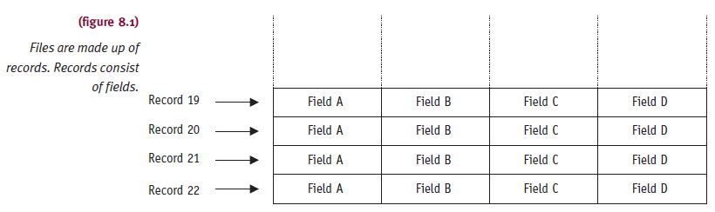
Definitions (cont'd.)

Slide 10
Interacting with the File Manager
User Commands
OPEN, DELETE, RENAME, COPY
Device independent
Physical location knowledge not needed
Cylinder, surface, sector
Device medium knowledge not needed
Tape, magnetic disk, optical disc, flash storage
Network knowledge not needed

Slide 11
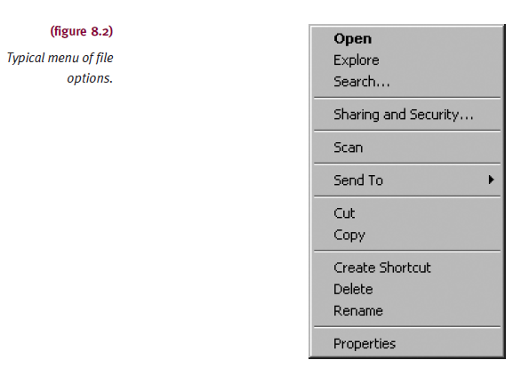
Interacting with the File Manager (cont'd.)

Slide 12
Interacting with the File Manager (cont'd.)
Logical commands
Broken into lower-level signals
Example: READ
Move read/write heads to record cylinder
Wait for rotational delay (sector containing record passes under read/write head)
Activate appropriate read/write head and read record
Transfer record to main memory
Send flag indicating free device for another request
Performs error checking and correction
No need for error-checking code in programs

Slide 13
Typical Volume Configuration
Volume
Secondary storage unit (removable, nonremovable)
Multifile volume
Contains many files
Multivolume files
Extremely large files spread across several volumes
Volume name
File manager manages
Easily accessible
Innermost part of CD, beginning of tape, first sector of outermost track

Slide 14
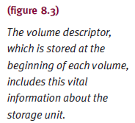

Typical Volume Configuration (cont'd.)

Slide 15
Typical Volume Configuration (cont'd.)
Master file directory (MFD)
Stored immediately after volume descriptor
Lists
Names and characteristics of every file in volume
File names (program files, data files, system files)
Subdirectories
If supported by file manager
Remainder of volume
Used for file storage

Slide 16
Typical Volume Configuration (cont'd.)
Single directory per volume
Supported by early operating systems
Disadvantages
Long search time for individual file
Directory space filled before disk storage space filled
Users cannot create subdirectories
Users cannot safeguard their files
Each program needs unique name
Even those serving many users

Slide 17
Introducing Subdirectories
File managers
Create MFD for each volume
Contains file and subdirectory entries
Improvement over single directory scheme
Problems remain: unable to logically group files
Subdirectory
Created upon account opening
Treated as file
Flagged in MFD as subdirectory
Unique properties

Slide 18
Introducing Subdirectories (cont'd.)
File managers today
Users create own subdirectories (folders)
Related files grouped together
Implemented as upside-down tree
Efficient system searching of individual directories
May require several directories to reach file

Slide 19
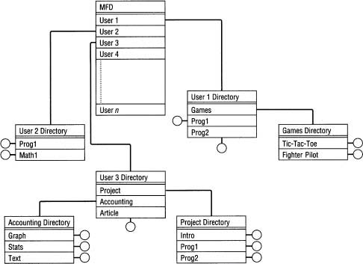
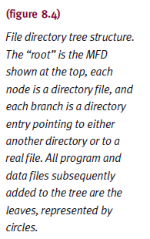
Introducing Subdirectories (cont'd.)

Slide 20
Introducing Subdirectories (cont'd.)
File descriptor
Filename: ASCII code
File type: organization and usage
System dependent
File size: for convenience
File location
First physical block identification
Date and time of creation
Owner
Protection information: access restrictions
Record size: fixed size, maximum size

Slide 21
File-Naming Conventions
Filename components
Relative filename and extension
Complete filename (absolute filename)
Includes all path information
Relative filename
Name without path information
Appears in directory listings, folders
Provides filename differentiation within directory
Varies in length
One to many characters
Operating system specific

Slide 22
File-Naming Conventions (cont'd.)
Extensions
Appended to relative filename
Two to three characters
Separated by period
Identifies file type or contents
Example
BASIA_TUNE.MP3
Unknown extension
Requires user intervention

Slide 23
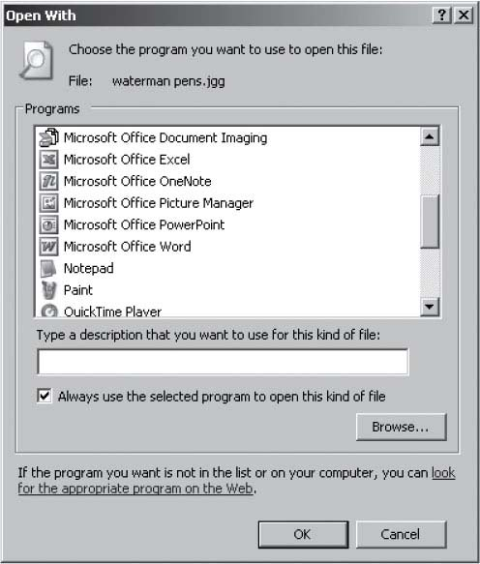
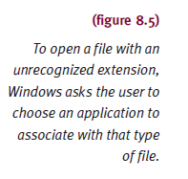
File-Naming Conventions (cont'd.)
Understanding Operating Systems, Sixth Edition
<number>

Slide 24
File-Naming Conventions (cont'd.)
Operating system specifics
Windows
Drive label and directory name, relative name, and extension
UNIX/Linux
Forward slash (root), first subdirectory, sub-subdirectory, file’s relative name
Understanding Operating Systems, Sixth Edition
<number>

Slide 25
File Organization
Arrangement of records within files
All files composed of records
Modify command
Request to access record within a file
Understanding Operating Systems, Sixth Edition
<number>

Slide 26
Record Format
Fixed-length records
Direct access: easy
Record size critical
Ideal for data files
Variable-length records
Direct access: difficult
No empty storage space and no character truncation
File descriptor stores record format
Used with files accessed sequentially
Text files, program files
Used with files using index to access records

Slide 27
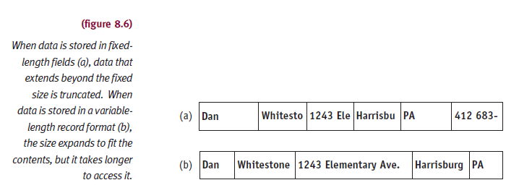
Record Format (cont'd.)

Slide 28
Physical File Organization
Describes:
Record arrangement
Medium characteristics
Magnetic disks file organization
Sequential, direct, indexed sequential
File organization scheme selection considerations
Volatility of data
Activity of file
Size of file
Response time

Slide 29
Physical File Organization (cont'd.)
Sequential record organization
Records stored and retrieved serially
One after the other
Easiest to implement
File search: beginning until record found
Optimization features may be built into system
Select key field from record and sort before storage
Complicates maintenance algorithms
Preserve original order when records added, deleted

Slide 30
Physical File Organization (cont'd.)
Direct record organization
Uses direct access files
Direct access storage device implementation
Random organization
Random access files
Relative address record identification
Known as logical addresses
Computed when records stored, retrieved
Uses hashing algorithms to transform a key field

Slide 31
Physical File Organization (cont'd.)
Direct record organization (cont'd.)
Advantages
Fast record access
Sequential access if starting at first relative address and incrementing to next record
Updated more quickly than sequential files
No preservation of records order
Adding, deleting records is quick
Disadvantages
Hashing algorithm collision
Similar keys

Slide 32
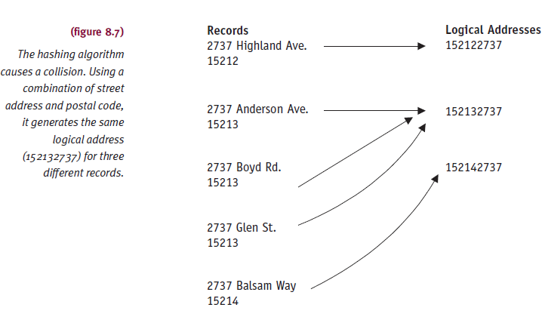
Physical File Organization (cont'd.)

Slide 33
Physical File Organization (cont'd.)
Indexed sequential record organization
Best of sequential and direct access
ISAM software: creates, maintains
Advantage: no collisions (no hashing algorithm)
Generates index file for record retrieval
Divides ordered sequential file into equal sized blocks
Each entry in index file contains the highest record key and physical data block location
Search index file
Overflow areas

Slide 34
Physical Storage Allocation
File manager works with files
As whole units
As logical units or records
Within file
Records must have same format
Record length may vary
Records subdivided into fields
Application programs manage record structure
File storage
Refers to record storage

Slide 35
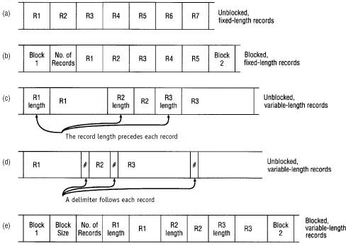
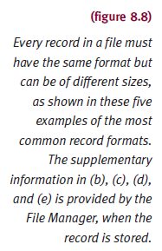
Physical Storage Allocation (cont'd.)
<number>

Slide 36
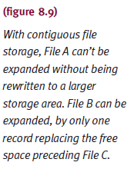
Contiguous Storage
Records stored one after another
Advantages
Any record found once starting address, size known
Easy direct access
Disadvantages
Difficult file expansion, fragmentation
<number>

Slide 37
Noncontiguous Storage
Files use any available disk storage space
File records stored in contiguous manner
If enough empty space
Remaining file records and additions
Stored in other disk sections (extents)
Extents
Linked together with pointers
Physical size determined by operating system
Usually 256 bytes

Slide 38
Noncontiguous Storage (cont'd.)
File extents linked in two ways
Storage level
Each extent points to next one in sequence
Directory entry
Filename, storage location of first extent, location of last extent, total number of extents (not counting first)
Directory level
Each extent listed with physical address, size, pointer to next extent
Null pointer indicates last one

Slide 39
Noncontiguous Storage (cont'd.)
Advantage
Eliminates external storage fragmentation
Eliminates need for compaction
Disadvantage
No direct access support
Cannot determine specific record’s exact location

Slide 40
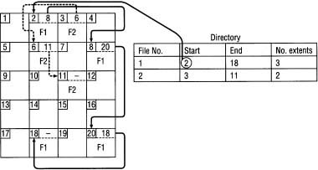
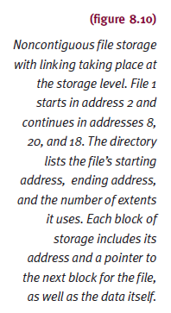
Noncontiguous Storage (cont'd.)

Slide 41
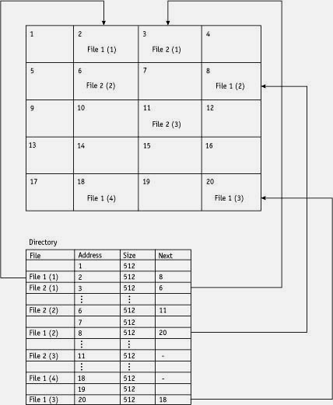
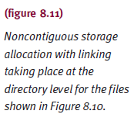
Noncontiguous Storage (cont'd.)
<number>

Slide 42
Indexed Storage
Allows direct record access
Brings pointers together
Links every extent file into index block
Every file has own index block
Disk sector addresses for file
Lists entry in order sectors linked
Supports sequential and direct access
Does not necessarily improve storage space use
Larger files experience several index levels

Slide 43
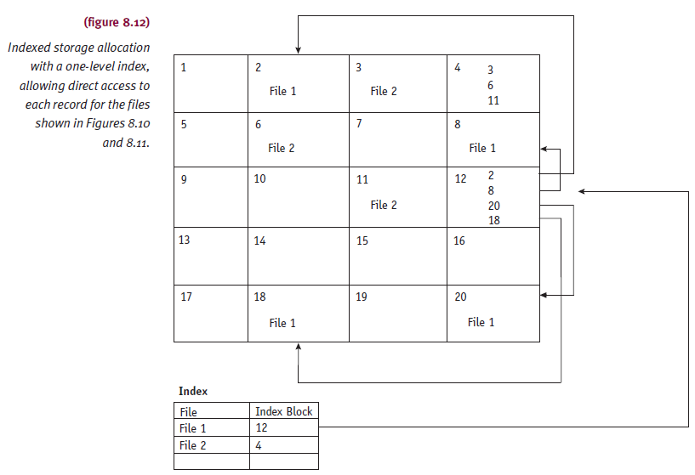
Indexed Storage (cont'd.)

Slide 44
Access Methods
Dictated by a file organization
Most flexibility: indexed sequential files
Least flexible: sequential files
Sequential file organization
Supports only sequential access
Records: fixed or variable length
Access next sequential record
Use address of last byte read
Current byte address (CBA)
Updated every time record accessed

Slide 45
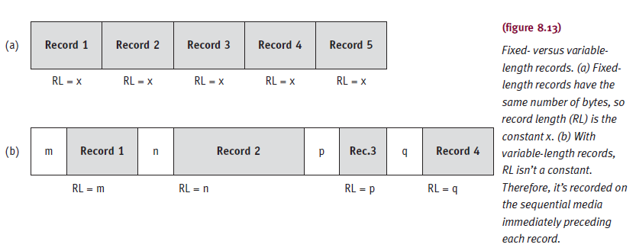
Access Methods (cont'd.)

Slide 46
Sequential Access
Update CBA
Fixed-length records
Increment CB
CBA = CBA + RL
Variable-length records
Add length of record (RL) plus numbers of bytes used to hold record to CBA
CBA = CBA + N + RL

Slide 47
Direct Access
Fixed-length records (RN: desired record number)
CBA = (RN – 1) * RL
Variable-length records
Virtually impossible
Address of desired record cannot be easily computed
Requires sequential search through records
Keep table of record numbers and CBAs
Indexed sequential file
Accessed sequentially or directly
Index file searched for pointer to data block

Slide 48
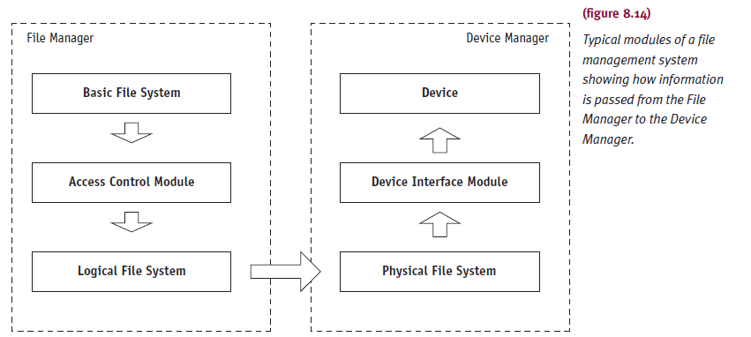
Levels in a File Management System

Slide 49
Levels in a File Management System
Level implementation
Structured and modular programming techniques
Hierarchical
Highest module passes information to lower module
Modules further subdivided
More specific tasks
Uses information of basic file system
Logical file system transforms record number to byte address

Slide 50
Levels in a File Management System
Verification at every level
Directory level
File system checks if requested file exists
Access control verification module
Determines whether access allowed
Logical file system
Checks if requested byte address within file limits
Device interface module
Checks if storage device exists

Slide 51
Access Control Verification Module
File sharing
Data files, user-owned program files, system files
Advantages
Save space, synchronized updates, resource efficiency
Disadvantage
Need to protect file integrity
Five possible file actions
READ only, WRITE only, EXECUTE only, DELETE only, combination
Four methods

Slide 52
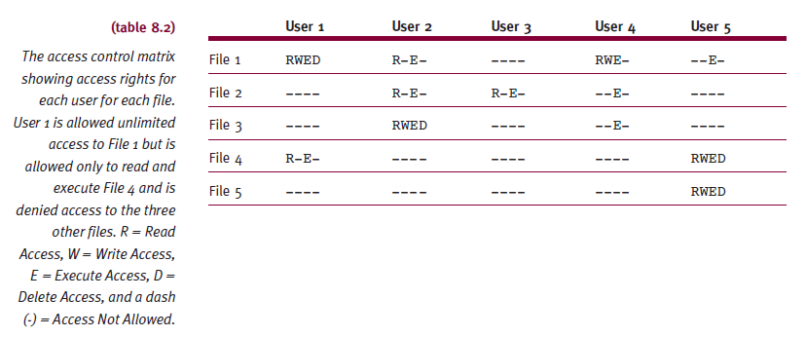
Access Control Matrix
Advantages
Easy to implement
Works well in system with few files, users

Slide 53
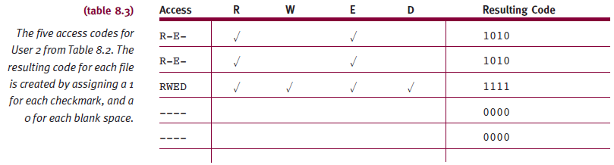
Access Control Matrix (cont'd.)
Disadvantages
As files and user increase, matrix increases
Possibly beyond main memory capacity
Wasted space: due to null entries

Slide 54
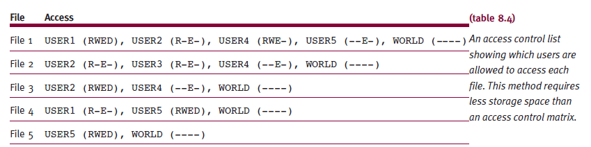
Access Control Lists
Modification of access control matrix technique

Slide 55
Access Control Lists (cont'd.)
Contains user names granted file access
User denied access grouped under “WORLD”
Shorten list by categorizing users
SYSTEM
Personnel with unlimited access to all files
OWNER
Absolute control over all files created in own account
GROUP
All users belonging to appropriate group have access
WORLD
All other users in system

Slide 56
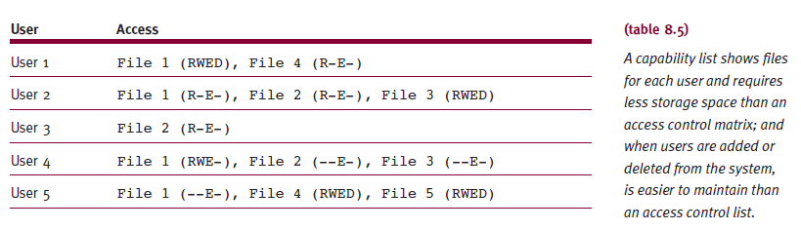
Capability Lists
Lists every user and files each has access to
Can control access to devices as well as to files
Most common

Slide 57
Data Compression
A technique used to save space in files
Text decompression
Other decompression schemes
<number>

Slide 58
Text Compression
Records with repeated characters
Repeated characters are replaced with a code
Repeated terms
Compressed using symbols to represent most commonly used words
University student database common words
Student, course, grade, department each be represented with single character
Front-end compression
Entry takes given number of characters from previous entry that they have in common

Slide 59
Other Compression Schemes
Large files
Video and music
ISO MPEG standards
Photographs
ISO
International Organization for Standardization

Slide 60
Summary
File manager
Controls every file and processes user commands
Manages access control procedures
Maintain file integrity and security
File organizations
Sequential, direct, indexed sequential
Physical storage allocation schemes
Contiguous, noncontiguous, indexed
Record types
Fixed-length versus variable-length records
Four access methods

