Slide 1
Understanding Operating Systems Sixth Edition
Chapter 9
Network Organization Concepts

Slide 2
Learning Objectives
After completing this chapter, you should be able to describe:
Several different network topologies—including the star, ring, bus, tree, and hybrid—and how they connect numerous hosts to the network
Several types of networks: LAN, MAN, WAN, and wireless LAN
The difference between circuit switching and packet switching, and examples of everyday use that favor each
Conflict resolution procedures that allow a network to share common transmission hardware and software effectively
The two transport protocol models (OSI and TCP/IP) and how the layers of each one compare

Slide 3
Basic Terminology
Network
Collection of loosely coupled processors
Interconnected by communication links
Using cables, wireless technology, both
Common goal
Provide convenient resource sharing
Control access
General network configurations
Network operating system (NOS)
Distributed operating system (D/OS)

Slide 4
Basic Terminology (cont'd.)
Network operating system (NOS)
Networking capability
Added to single-user operating system
Users aware of specific computers and resources in network
Access resources
Log on to remote host
Data transfer from remote host

Slide 5
Basic Terminology (cont'd.)
Distributed operating system (D/OS)
Users not aware of specific computers and resources in network
Access remote resources as if local
Good control: distributed computing systems
Allows unified resource access
Total view across multiple computer systems
No local dependencies for controlling and managing resources
Cooperative management

Slide 6
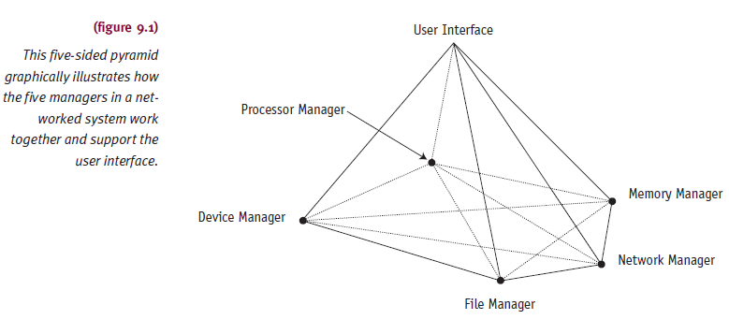
Basic Terminology (cont'd.)
Distributed operating system (D/OS) (cont'd.)
Comprised of four managers with a wider scope

Slide 7
Basic Terminology (cont'd.)
Distributed operating system (D/OS) (cont'd.)
Advantages over traditional systems
Easy and reliable resource sharing
Faster computation
Adequate load balancing
Good reliability
Dependable communications among network users

Slide 8
Basic Terminology (cont'd.)
Remote
Other processors and resources
Local
Processor’s own resources
Site
Specific location in network
One or more computers
Host
Specific computer system at site
Services and resources used from remote locations

Slide 9
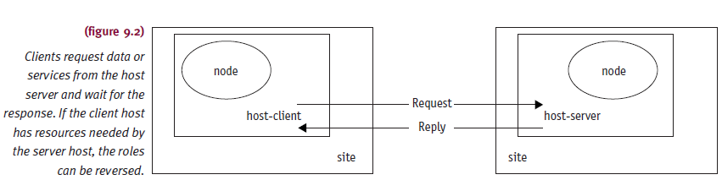
Basic Terminology (cont'd.)
Node
Name assigned to computer system
Provides identification

Slide 10
Network Topologies
Physically or logically connected sites
Star, ring, bus, tree, hybrid
Topology tradeoffs
Need for fast communication among all sites
Tolerance of failure at a site or communication link
Cost of long communication lines
Difficulty connecting one site to large number of other sites

Slide 11
Network Topologies (cont'd.)
Four basic criteria
Basic cost
Expense required to link various sites in system
Communications cost
Time required to send message from one site to another
Reliability
Assurance of site communication if link or site fails
User environment
Critical parameters for successful business investment

Slide 12
Star Topology
Transmitted data from sender to receiver
Passes through central controller
Hub or centralized topology
Advantages
Permits easy routing
Easy access control to network
Disadvantages
Requires extremely reliable central site
Requires ability to handle all network traffic
No matter how heavy

Slide 13
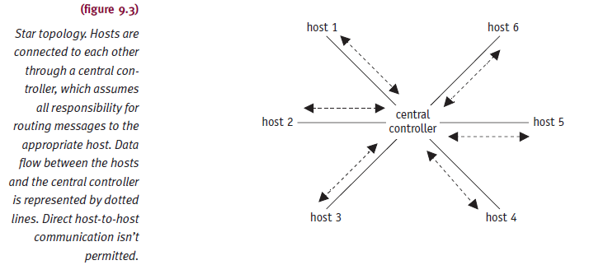
Star Topology (cont'd.)

Slide 14
Ring Topology
Sites connected in closed loop
May connect to other networks
Using bridge (same protocols)
Using gateway (different protocols)
Data transmitted in packets
Source and destination address fields
Packet passed from node to node
One direction only
Every node must be functional
Bypass failed node needed for proper operation

Slide 15
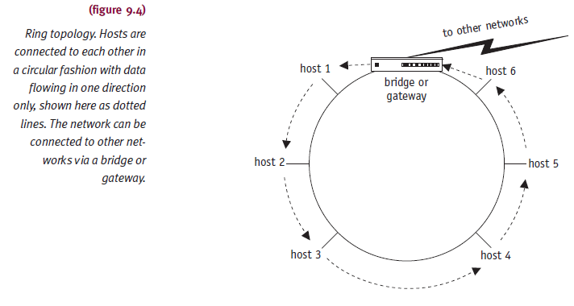
Ring Topology (cont'd.)

Slide 16
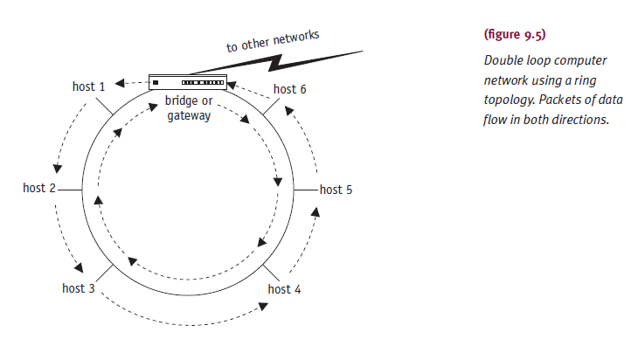
Ring Topology (cont'd.)

Slide 17
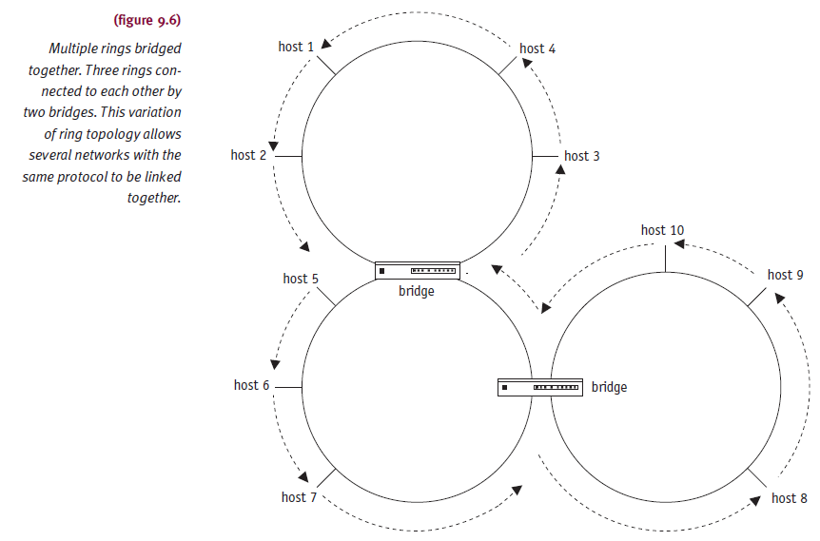
Ring Topology (cont'd.)

Slide 18
Bus Topology
Sites connect to single communication line
Messages circulate in both directions
One site sends messages at a time successfully
Need control mechanism
Prevent collision
Data passes directly from one device to another
Data may be routed to end point controller at end of the line

Slide 19
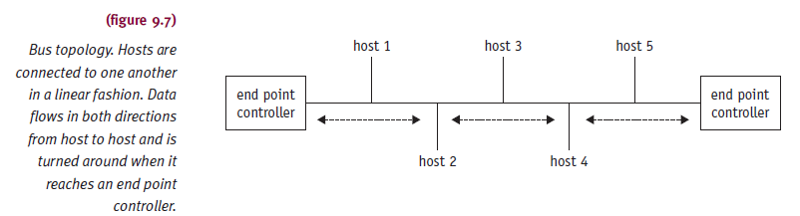
Bus Topology (cont'd.)

Slide 20
Tree Topology
Collection of buses connected by branching cable
No closed loops
Designers create networks using bridges
Message from any site
Received by all other sites until reaching end point
Reaches end point controller without acceptance
Host absorbs message
Advantage
Message traffic still flows even if single node fails

Slide 21
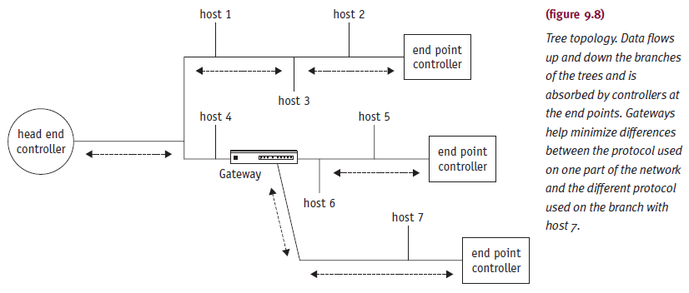
Tree Topology (cont'd.)

Slide 22
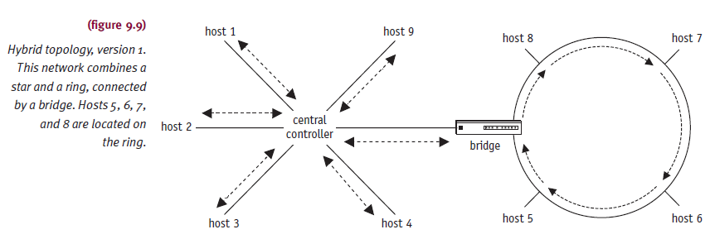
Hybrid Topology
Strong points of each topology in combination
Effectively meet system communications requirements

Slide 23
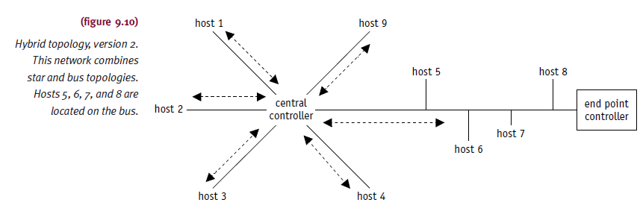
Hybrid Topology (cont'd.)

Slide 24
Network Types
Grouping
According to physical distances covered
Characteristics blurring
Network types
Local area networks (LAN)
Metropolitan area networks (MAN)
Wide area networks (WAN)

Slide 25
Local Area Network
Single office building, campus, similarly enclosed environment
Single organization owns/operates
Communicate through common communication line
Communications not limited to local area only
Component of larger communication network
Easy access to outside
Through bridge or gateway

Slide 26
Local Area Network (cont'd.)
Bridge
Connects two or more geographically distant LANs
Same protocols
Bridge connecting two LANs using Ethernet
Gateway
Connects two or more LANs or systems
Different protocols
Translates one network protocol into another
Resolves hardware and software incompatibilities
SNA gateway connecting microcomputer network to mainframe host

Slide 27
Local Area Network (cont'd.)
Data rates: 100 Mbps to more than 40 Gbps
Close physical proximity
Very high-speed transmission
Star, ring, bus, tree, and hybrid
Normally used
Transmission medium: varies
Factors determining transmission medium
Cost, data rate, reliability, number of devices supported, distance between units

Slide 28
Metropolitan Area Network
Configuration spanning area larger than LAN
Several blocks of buildings to entire city
Not exceeding 100 km circumference
Owned and operated by a single organization
Used by many individuals and organizations
May be owned and operated as public utilities
Means for internetworking several LANs
High-speed network often configured as a logical ring

Slide 29
Wide Area Network
Interconnects communication facilities in different parts of a country or world
Operated as part of public utility
Uses common carriers’ communications lines
Telephone companies
Uses broad range of communication media
Satellite, microwaves
WANs generally slower than LANs
Examples: ARPAnet (first WAN), Internet (most widely recognized WAN)

Slide 30
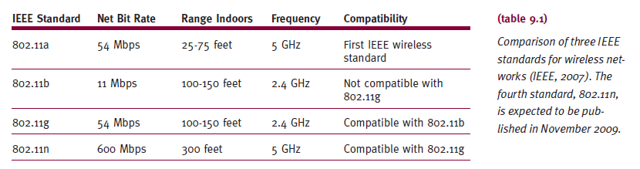
Wireless Local Area Network
LAN using wireless technology to connect computers or workstations
Located within range of network
Security vulnerabilities
Open architecture; difficulty keeping intruders out

Slide 31
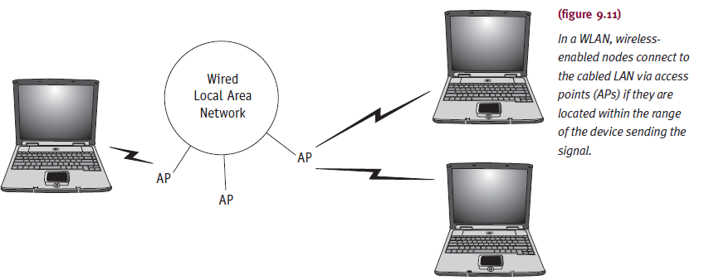
Wireless Local Area Network (cont'd.)
WiMAX standard 802.16
High bandwidth, long distances

Slide 32
Software Design Issues
How do sites use addresses to locate other sites?
How are messages routed and how are they sent?
How do processes communicate with each other?
How are conflicting demands for resources resolved?

Slide 33
Addressing Conventions
Addressing protocols
Fulfill need to uniquely identify users
Closely related to site network topology and geographic location
Distinction between local and global name
Local name within its own system
Global name outside its own system
Must follow standard name conventions (length, formats)

Slide 34
Addressing Conventions (cont'd.)
Example: Internet address
someone@icarus.lis.pitt.edu
Uses Domain Name Service (DNS) protocol
General-purpose data query service
Hierarchical
Domain names read left to right
Logical user to host machine
Host machine to net machine
Net machine to cluster
Cluster to network
Periods separate components

Slide 35
Routing Strategies
Router
Internetworking device (primarily software driven)
Directs traffic
Between two different types of LANs
Between two network segments (different protocol addresses)
Network layer operation
Role changes (network designs changes)
Connects sites
To other sites and Internet

Slide 36
Routing Strategies (cont'd.)
Router functions
Securing information
Generated in predefined areas
Choosing fastest route
From one point to another
Providing redundant network connections
Routing protocol considerations
Addressing, address resolution, message format, error reporting
Address resolution
Maps hardware address

Slide 37
Routing Strategies (cont'd.)
Message formats
Allow performance of protocol functions
Finding new network nodes
Determine whether they work (testing)
Reporting error conditions
Exchanging routing information
Establishing connections (transmit data)
Most widely used Internet routing protocols
Routing information protocol (RIP)
Open shortest path first (OSPF)

Slide 38
Routing Strategies (cont'd.)
Routing information protocol (RIP)
Path selection based on node and hop number
Between source and destination
Path with smallest number of hops chosen (always)
Advantage
Easy to implement
Disadvantages
No consideration: bandwidth, data priority, network type
Update and reissue routing table: changes or not
Tables propagate (router to router)

Slide 39
Routing Strategies (cont'd.)
Open shortest path first (OSPF)
Network state determined first
Transmission path selected
Update messages sent when changes in routing environment occur
Reduces number of messages in internetwork
Reduces message size: not sending entire table
Disadvantages
Increased memory usage
Bandwidth savings offset by higher CPU usage
Shortest path calculation

Slide 40
Connection Models
Communication network concern
Moving data from one point to another
Minimizing transmission costs
Providing full connectivity
Circuit switching
Dedicated communication path
Established between two hosts before transmission begins
Example: telephone system
Disadvantage
Delay before signal transfer begins

Slide 41
Connection Models (cont'd.)
Packet switching
Store-and-forward technique
Before sending message
Divide into multiple equal-sized units (packets)
At destination
Packets reassembled into original long format
Header contains pertinent packet information
Advantages
More flexible, reliable
Greater line efficiency
Users allocate message priority

Slide 42
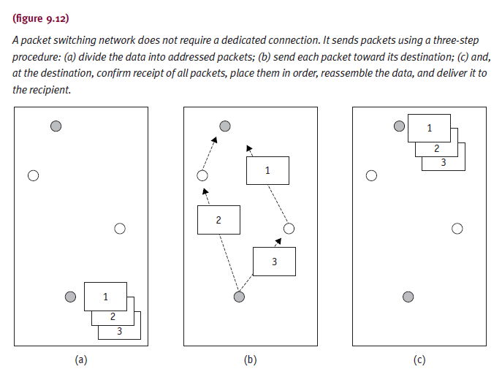
Connection Models (cont'd.)

Slide 43
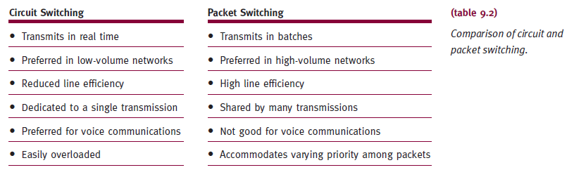
Connection Models (cont'd.)

Slide 44
Connection Models (cont'd.)
Datagrams
Packet destination and sequence number added to information
Uniquely identifying message to owning packet
Each packet handled independently
Route selected as each packet accepted
At destination
All packets of same message reassembled
Advantages
Diminishes congestion and provides reliability

Slide 45
Connection Models (cont'd.)
Datagrams (cont'd.)
Message not delivered until all packets accounted for
Receiving node requests retransmission
Lost or damaged packets
Advantages
Diminishes congestion
Sends incoming packets through less heavily used paths
More reliability
Alternate paths set up upon node failure

Slide 46
Connection Models (cont'd.)
Virtual circuit
Complete path sender to receiver
Established before transmission starts
All message packets use same route
Several virtual circuits to any other node
Advantages
Routing decision made once
Speeds up transmission
Disadvantages
All virtual circuits fail upon one failure
Difficult to resolve congestion (in heavy traffic)

Slide 47
Conflict Resolution
Device sharing requires access control methods
Facilitates equal and fair network access
Access control techniques
Round robin
Reservation
Contention
Medium access control protocols
Carrier sense multiple access (CSMA)
Token passing
Distributed-queue, dual bus

Slide 48
Conflict Resolution (cont'd.)
Round robin
Node given certain time to complete transmission
Efficient
If many nodes transmitting over long time periods
Substantial overhead
If few nodes transmit over long time periods
Reservation
Good if lengthy and continuous traffic
Access time on medium divided into slots
Node reserves future time slots

Slide 49
Conflict Resolution (cont'd.)
Reservation (cont'd.)
Good configuration
Several terminals connected to host through single I/O port
Contention
No attempt to determine transmission turn
Nodes compete for medium access
Advantages and disadvantages
Easy implementation; works well under light to moderate traffic; better for short and intermittent traffic
Performance breaks down under heavy loads

Slide 50
Conflict Resolution (cont'd.)
Carrier sense multiple access (CSMA)
Contention-based protocol
Easy implementation (Ethernet)
Carrier sense
Node listens to/tests communication medium before transmitting messages
Prevents collision with node currently transmitting
Multiple access
Several nodes connected to same communication line as peers
Same level and equal privileges

Slide 51
Conflict Resolution (cont'd.)
CSMA Disadvantages
Collision
Two or more nodes transmit at same instant
Probability of collision increases
As nodes get further apart
Large or complex networks
Less appealing access protocol

Slide 52
Conflict Resolution (cont'd.)
CSMA/CD
Modification of CSMA
Includes collision detection (Ethernet)
Reduces wasted transmission capacity
Prevents multiple nodes from colliding
Collisions not completely eliminated (reduced)
Implemented in Apple’s cabling system: LocalTalk
Collision occurrence involves small packet
Not actual data (in case of Apple CSMA/CA)
No guarantee data will reach destination
Ensures error free data delivery

Slide 53
Conflict Resolution (cont'd.)
Token Passing
Special electronic message (token)
Generated and passed node to node
Only node with token allowed to transmit
Then passes token
Fast access
Collisions nonexistent
Typical topologies
Bus
Ring

Slide 54
Conflict Resolution (cont'd.)
Token-bus
Token passed to node in turn
Data attached; sent to destination
Receiving node
Copies data; adds acknowledgment; returns packet to sending node
Sending node passes token to next node in sequence
Initial node order determination
Cooperative decentralized algorithm
Then determined by priority based on node activity

Slide 55
Conflict Resolution (cont'd.)
Token-bus (cont'd.)
Higher overhead at each node (than CSMA/CD)
Nodes have long waits before receiving token
Token-ring
Token moves between nodes in turn
One direction only
To send message
Node must wait for free token
Receiving node copies packet message
Sets copied bit indicating successful receipt

Slide 56
Conflict Resolution (cont'd.)
Distributed-queue, dual bus (DQDB)
Dual-bus configuration
Each bus transports data one direction only
Steady stream of fixed-size slots
Slots generated at end of each bus
Marked as free and sent downstream
Marked busy and written to
Written by nodes ready to transmit
Nodes read and copy data from slots
Continue travel toward end of bus: dissipate

Slide 57
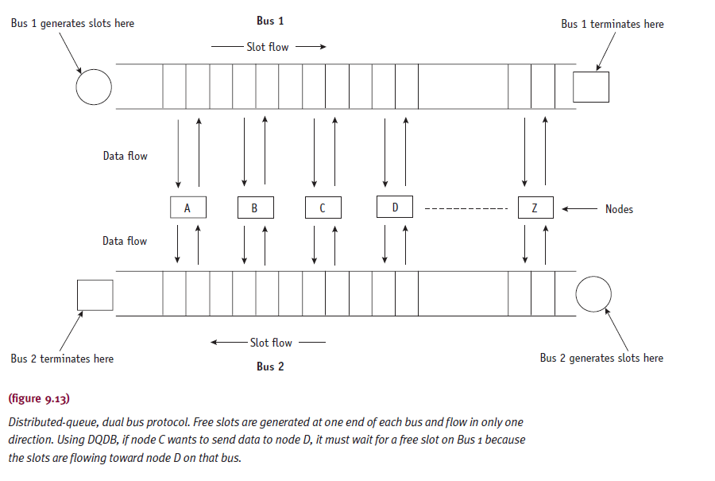
Conflict Resolution (cont'd.)

Slide 58
Conflict Resolution (cont'd.)
DQDB advantages
Negligible delays under light loads
Predictable queuing under heavy loads
Suitable for MANs managing large file transfers
Satisfy interactive users’ needs

Slide 59
Transport Protocol Standards
Network usage grew quickly (1980s)
Need to integrate dissimilar network devices
Different vendors
Creation of single universally adopted architecture
OSI reference model
TCP/IP

Slide 60
OSI Reference Model
Basis for connecting open systems
Distributed applications processing
“Open”
Connect any two systems conforming to reference model and related standards
Vendor independent
Similar functions collected together
Seven logical clusters (layers)

Slide 61

The OSI Reference Model

Slide 62
OSI Reference Model (cont'd.)
Layer 1: The Physical Layer
Describes mechanical, electrical, functional specifications
Transmits bits over communication line
Examples: 100Base-T, RS449, CCITT V.35
Layer 2: The Data Link Layer
Establishes and controls physical communications path before data sent
Transmission error checking
Problem resolution (on other side) E.g. HDLC and SDLC
Layer 3: The Network Layer
Addressing and routing services moving data through network to destination
Layer 4: The Transport Layer
Maintains reliable data transmission between end users
Example: Transmission Control Protocol (TCP)

Slide 63
OSI Reference Model (cont'd.)
Layer 5: The Session Layer
Provides user-oriented connection service
Transfers data over communication lines
Example: TCP/IP
Layer 6: The Presentation Layer
Data manipulation functions common to many applications
Formatting, compression, encryption
Layer 7: The Application Layer
Application programs, terminals, computers
Access network
Provides user interface
Formats user data before passing to lower layers

Slide 64
TCP/IP Model
Transmission Control Protocol/Internet Protocol (TCP/IP)
Oldest transport protocol standard
Internet communications basis
File-transfer protocol: send large files error free
TCP/IP
Emphasizes internetworking
Provides connectionless services
Organizes communication system
Three components: processes, hosts, networks
Four layers

Slide 65
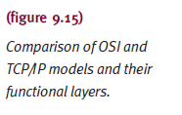
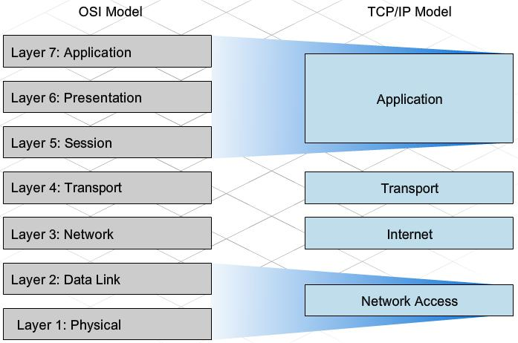
TCP/IP Model v/s The OSI Reference Model

Slide 66
TCP/IP Model Explained

Slide 67
TCP/IP Model (cont'd.)
Network Access Layer
Protocols provide access to communication network
Flow control, error control between hosts, security, and priority implementation performed
Internet Layer
Equivalent to OSI model network layer performing routing functions
Implemented within gateways and hosts
Example: Internet Protocol (IP)

Slide 68
TCP/IP Model (cont'd.)
Host-Host Layer
Transfer data between two processes
Different host computers
Error checking, flow control, manipulate connection control signals
Example: Transmission Control Protocol (TCP)
Process/Application Layer
Protocols for computer-to-computer resource sharing and terminal-to-computer remote access
Examples: FTP, SMTP, Telnet

Slide 69
Summary
Network operating systems: coordinate functions
Memory Manager, Processor Manager, Device Manager, File Manager
Must meet owner reliability requirements
Detect node failures; change routing instructions to bypass; retransmit lost messages successfully
Basic network organization concepts
Terminology
Network topologies and types
Software design issues
Transport protocol standards

